Slide 1
Colorado Sales Territory Analysis
West Region | In-store sales, 2022-2025
Mohammed Sohaib Lalmi
DATA BOOTCAMP, YearUp United | Instructor: Nigel Caldon
Notes:
Introduce yourself. I analyzed the Colorado in-store territory of the West region for EmporiUm, using SQL for the numbers and Excel for the chart. In five minutes: the company, my territory, how they compare, the trends, and one recommendation.

Slide 2
Agenda
1
Scenario What EmporiUm asked
2
Summary stats The West region, then Colorado
3
Comparative analysis Colorado against the West region
4
Trends West region, then Colorado, then what they mean
5
Relationship analysis What drives store revenue
6
Findings and recommendation One thing to do next quarter
Notes:
Six parts. Scenario, summary stats, comparison, trends, relationship, and the recommendation. The first four numbers are the whole company; then I zoom in on Colorado.

Slide 3
Scenario
The company
EmporiUm is a student-focused retail chain. It sells textbooks, technology, art supplies and more, in stores and online.
The data
Every sale from January 2022 to December 2025 in the sample_sales database.
My job
Analyze the Colorado territory (18 stores). It is in the West region, together with the Online Sales territory.
The sales manager wants
Revenue, trends, how Colorado compares with the West, and one recommendation.
Notes:
EmporiUm sells to students in stores and online. I was given four years of sales. My territory is Colorado, in-store. In the Management table the West region is two territories: Colorado and Online Sales. So I compare Colorado with the West region as a whole.

Slide 4
Summary stats: the West region
$74.4M
total West revenue
2022-2025, 172,063 transactions
$6.4M Colorado stores
46,498 transactions
$68.0M Online Sales
125,565 transactions
$433
average sale across the West
Notes:
The West region has two territories: Colorado (in-store) and Online Sales. Together: $74.4M and 172,063 transactions from January 2022 to December 2025. Colorado is $6.4M and 46,498 transactions. Online is $68.0M and 125,565 transactions. Average sale across the West is about $433. Q3 gives the West total, and the online numbers come from a very small query on the Online_Sales table.

Slide 5
Summary stats: Colorado
$6.4M
total in-store revenue
Q1: $6,412,632.22
18 stores
Jan 2022 - Dec 2025
46,498
transactions
$138
average sale
71%
of revenue is Technology ($4.55M)
Notes:
Q1 and Q4. Colorado: $6,412,632.22 from 18 stores and 46,498 transactions, January 2022 to December 2025. Average sale about $138. Technology and Accessories is $4.55M, which is 71 percent of Colorado revenue, and it has the highest average sale, about $464.

Slide 6
Colorado vs. the West region
8.6%
of West revenue
$6.4M of $74.4M
27.0%
of West transactions
46,498 of 172,063
$138 vs $542
average sale
Colorado stores vs. online
Colorado is small in dollars, not in customers. Online orders are much bigger.
Notes:
Q3. Colorado is 8.6 percent of West revenue but 27 percent of West transactions. The reason is the average sale: about $138 in a Colorado store against about $542 online. So Colorado is small in dollars because online orders are much bigger, not because Colorado has few customers. This is a benchmark for size, not a performance problem.

Slide 7
Trend: the West region
Year | Colorado | Online Sales | West region
2022 | $1.01M | $17.74M | $18.75M
2023 | $1.49M | $16.18M | $17.67M
2024 | $1.49M | $16.39M | $17.88M
2025 | $2.42M | $17.70M | $20.12M
Total | $6.41M | $68.00M | $74.42M
The West grew only 7%. Online is flat, so the growth is in Colorado.
Notes:
West revenue by year is Colorado plus Online Sales: $18.75M, $17.67M, $17.88M, $20.12M. That is only 7 percent growth over four years. Online, which is most of the West, stayed near $17M a year. So the growth in the West comes from Colorado. Colorado by year comes from my Q2 pivot; online by year comes from a small query on Online_Sales.

Slide 8
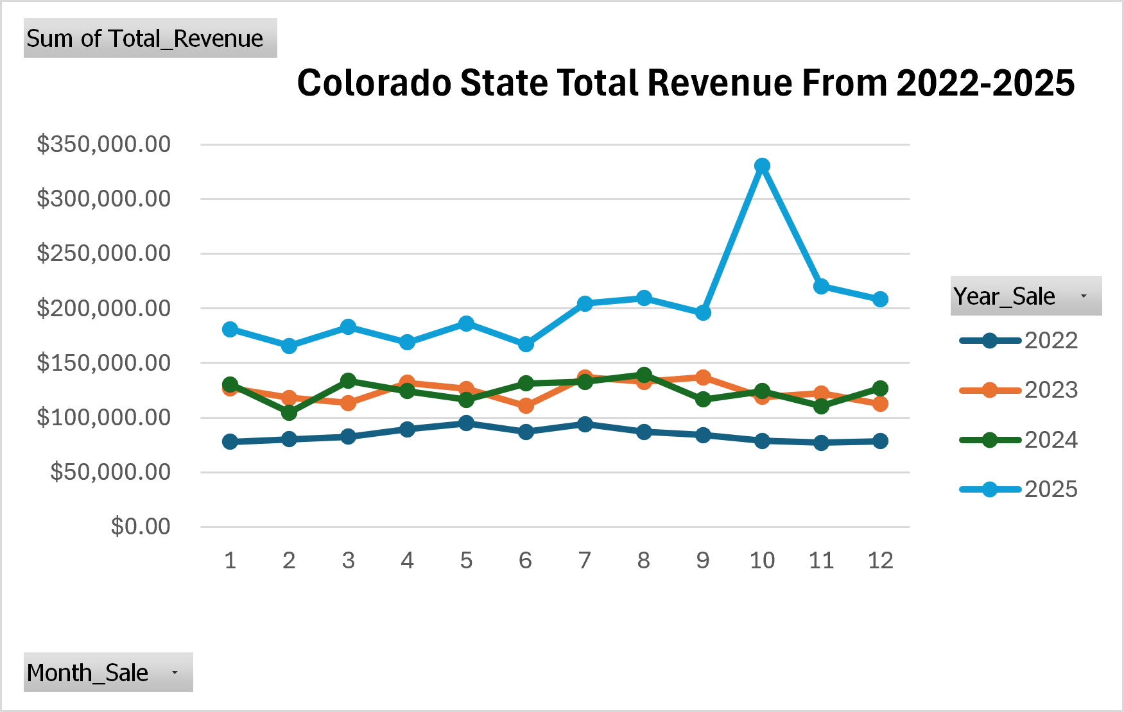
Trend: Colorado
$1.0M to $2.4M
from 2022 to 2025
+139%
in four years
Oct 2025
peak month, about $331K
Notes:
Q2. This is my Excel PivotChart from the monthly query: one line per year. Yearly totals are $1.01M, $1.49M, $1.49M and $2.42M. 2023 and 2024 are almost the same, then 2025 jumps. October 2025 is the highest month at about $331K. July and August are above June in all four years.

Slide 9
Trend analysis: Colorado is the growth
+139%
Colorado revenue, 2022 to 2025
about 2.4 times
+7%
West region revenue
online was flat
5.4% to 12.0%
Colorado share of the West
2022 compared with 2025
July and August are strong every summer in Colorado. October 2025 was the peak.
Notes:
What the trends mean. Colorado revenue grew 139 percent from 2022 to 2025, which is about 2.4 times. The West region grew only 7 percent and online was flat, so Colorado is where the growth is. Colorado went from 5.4 percent of West revenue in 2022 to 12.0 percent in 2025. July and August are strong in Colorado every summer; back-to-school is a possible reason, but that is a guess. I do not know why October 2025 spiked; I would ask the managers.

Slide 10
More sales, more revenue
Store | Number of sales | Revenue | Average sale
Denver | 6,591 | $917K | $139
Greeley | 4,405 | $640K | $145
Other 16 stores (each, on average) | 2,219 | $303K | $137
Every store earns about the same on each sale ($137 to $145). Denver earns more because it makes more sales, not because it charges more.
Notes:
This comes from my Q5 result. Denver makes 6,591 sales and earns $917K. Greeley makes 4,405 sales and earns $640K. The other 16 stores make about 2,200 sales each and earn about $303K each. The average sale is about the same everywhere, $137 to $145. So the stores that earn more are the stores that make more sales. I can see that, but I do not know why Denver gets more customers; I would ask the store managers.

Slide 11
Findings and recommendation
Small but growing
Colorado is 8.6% of the West ($6.4M) but grew 139% since 2022.
Technology carries it
71% of Colorado revenue, with the highest average sale ($464).
Volume is the gap
Denver and Greeley lead; the other 16 stores earn $279K to $345K each.
Recommendation
Focus next quarter on technology sales in the smaller Colorado stores.
Notes:
Findings: Colorado is small in the West region but it is the part that is growing. Technology is 71 percent of Colorado revenue. The gap between stores is transaction volume. Recommendation: focus next quarter on technology sales in the smaller Colorado stores, because that is where the most revenue is and where the 16 smaller stores have the most room to grow. The data shows the opportunity; how to capture it, with promotions, stock or marketing, is something to test with the store managers, starting by asking what Denver and Greeley do differently. Measure it with revenue per store next quarter compared with the same quarter last year.

