Slide 1
Colorado Sales Territory Analysis
West Region | In-store sales, 2022-2025
Mohammed Sohaib Lalmi
DATA BOOTCAMP, YearUp United | Instructor: Nigel Caldon
Notes:
Introduce yourself and the project: you analyzed the Colorado in-store territory of the West region for EmporiUm using SQL and Excel. Five minutes: KPI, growth, benchmark, drivers, recommendation.

Slide 2
The main KPI
$6.4M
total in-store revenue
Q1: $6,412,632.22
Jan 2022 - Dec 2025
period covered by the data
18 stores
Colorado, in-store sales
46,498
transactions in four years
Notes:
Q1: Colorado earned about $6.4 million, from January 2022 to December 2025, across 18 stores and 46,498 transactions. I joined store sales to store locations to keep only Colorado, then used SUM, MIN and MAX.

Slide 3
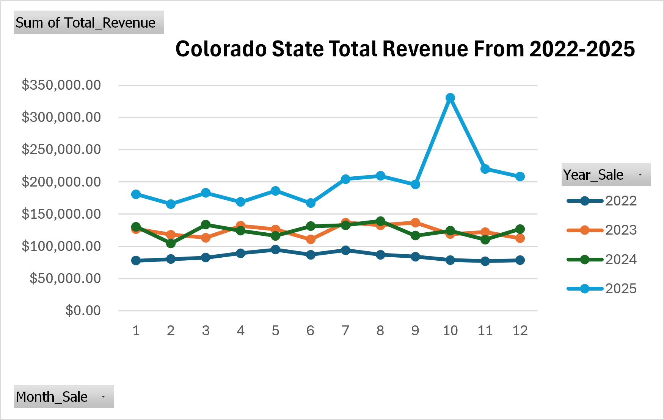
Revenue is growing
$1.0M to $2.4M
from 2022 to 2025
Oct 2025
peak month, about $331K
July + August
above June in all four years
Notes:
Q2: Each line is a year. Revenue rises from about $1.0M in 2022 to $2.4M in 2025, 2024 was flat, October 2025 is the highest month. July and August are strong every summer. Check: the 48 months add up to the Q1 total.

Slide 4
Revenue by month and year
Month | 2022 | 2023 | 2024 | 2025 | Total
Jan | $77,950.98 | $127,097.69 | $130,507.83 | $181,006.05 | $516,562.55
Feb | $80,315.69 | $118,165.45 | $104,570.81 | $165,726.20 | $468,778.15
Mar | $82,516.36 | $113,336.10 | $133,808.20 | $183,144.31 | $512,804.97
Apr | $89,350.31 | $131,835.33 | $124,228.43 | $168,853.86 | $514,267.93
May | $94,892.89 | $126,201.30 | $116,437.33 | $186,318.66 | $523,850.18
Jun | $86,847.70 | $110,745.70 | $131,379.21 | $167,246.64 | $496,219.25
Jul | $94,048.49 | $137,070.84 | $132,936.24 | $204,640.58 | $568,696.15
Aug | $87,058.36 | $132,936.24 | $139,385.22 | $209,591.63 | $568,971.45
Sep | $84,206.09 | $137,022.60 | $116,550.68 | $196,114.94 | $533,894.31
Oct | $78,706.96 | $118,913.30 | $124,204.24 | $330,762.82 | $652,587.32
Nov | $76,920.06 | $122,127.52 | $110,361.93 | $220,240.73 | $529,650.24
Dec | $78,541.63 | $112,438.65 | $127,097.69 | $208,271.75 | $526,349.72
Total | $1,011,355.52 | $1,487,890.72 | $1,491,467.81 | $2,421,918.17 | $6,412,632.22
Source: Q2 results (Colorado stores) in Excel. The bottom-right cell is the main KPI: $6,412,632.22.
Notes:
This is the PivotTable from my Excel file. Rows are months, columns are years, values are revenue. Yearly totals: $1.01M in 2022, $1.49M in 2023, $1.49M in 2024, $2.42M in 2025. Look at October 2025: $330,762.82, the highest cell.

Slide 5
Benchmark: the West region
8.6%
of the $74.4M West region is Colorado stores
91.4%
is the Online Sales territory
Online sells to 29 states, so this is not a like-for-like comparison.
Notes:
Q3: West region = Colorado stores plus the Online Sales territory: $74.4M. Colorado is about 8.6%. Be careful with wording: online covers many states and is managed separately, so this is not a performance problem for Colorado.

Slide 6
Technology drives revenue
71%
of revenue is Technology & Accessories
$464
highest average sale per transaction
Notes:
Q4 and Q4b: Technology & Accessories brings in about $4.55M of $6.41M, 71%, and has the highest average sale, about $464. To get there I chained store sales, store locations, products and categories.

Slide 7
Two stores lead
3x
Denver vs. the average of the other 16 stores
2x
Greeley vs. the same average
Average sale is similar in every store, so the gap is transaction volume, not price.
Notes:
Q5: Denver earns about $917K and Greeley about $640K, together about 24% of revenue. The other 16 stores earn $279K to $345K each. Denver has roughly three times the transactions of a typical store, so the difference is volume.

Slide 8
Recommendation
Focus next quarter on technology sales in the smaller Colorado stores.
1
2
3
Technology is 71% of revenue
Q4b
Revenue is growing: $1.0M to $2.4M
Q1, Q2
The 16 smaller stores earn far less than Denver and Greeley
Q5
Notes:
Q6: One recommendation: focus on technology in the smaller stores. Technology is 71% of revenue and has the highest average sale; revenue is growing; Denver and Greeley already lead, so the 16 smaller stores have the most room to grow. The data shows where the opportunity is; the how (promotions, stock, marketing) is something to test with store managers.

