Slide 1

BOOK PROJECT
Sprint 1
Monica Lalor, Mikayla Kantorski,
Kaleigh Andrzejewski, Angela Gardner

Slide 2

PROJECT FOCUS
Create an web interface that manages a personal book library
Tracks loans made to students
Sends reminder emails

Slide 3

Design a functional website interface (add homepage and dashboard functionality
01
02
Research the tools to be used in this project and choose a database
SPRINT GOALS
03
Figure out how user states correlate to database
04
Connect the database to our website to begin designing tables

Slide 4
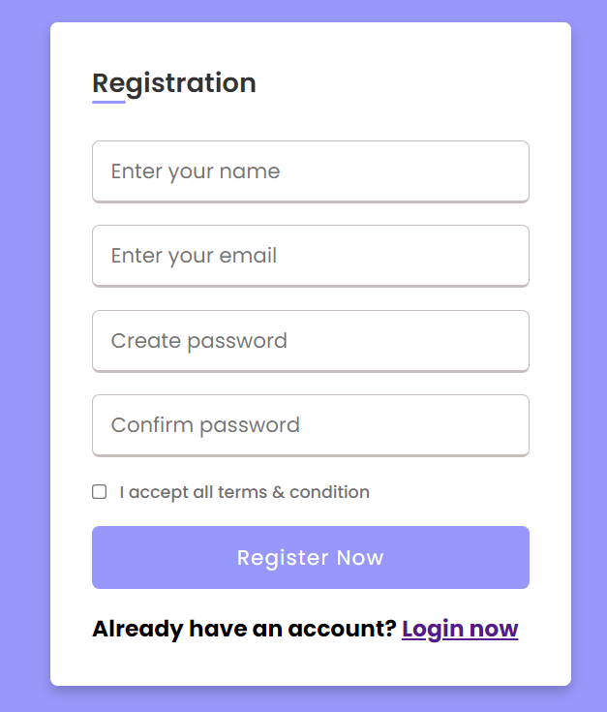
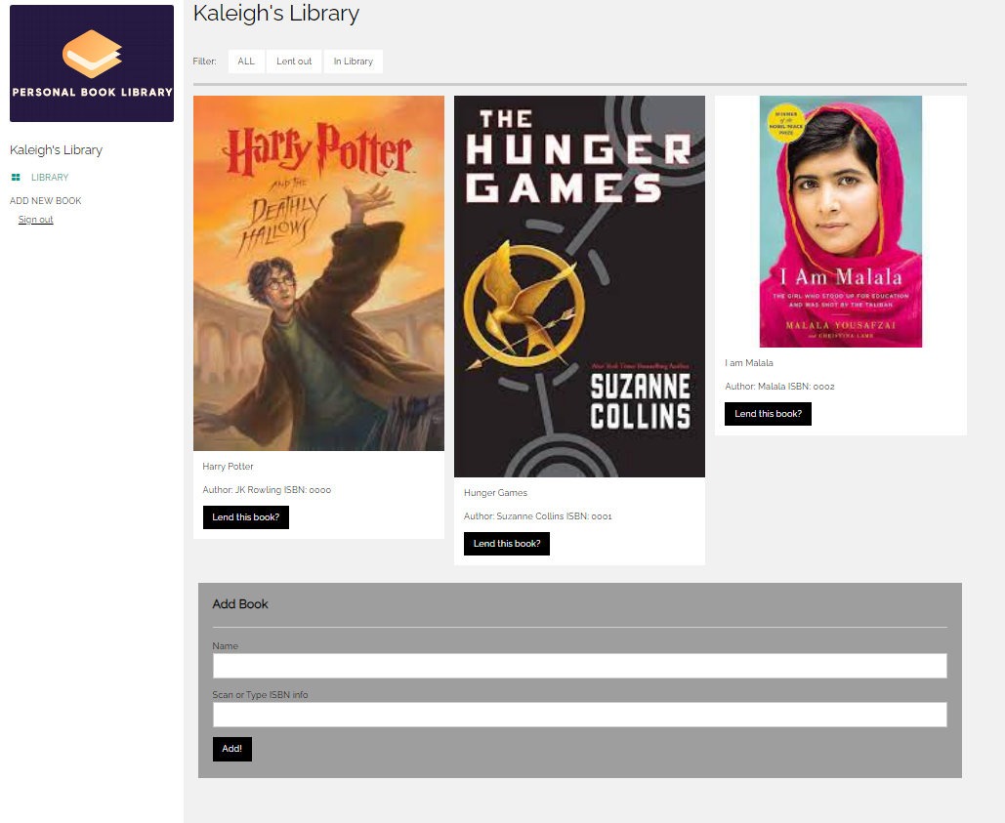
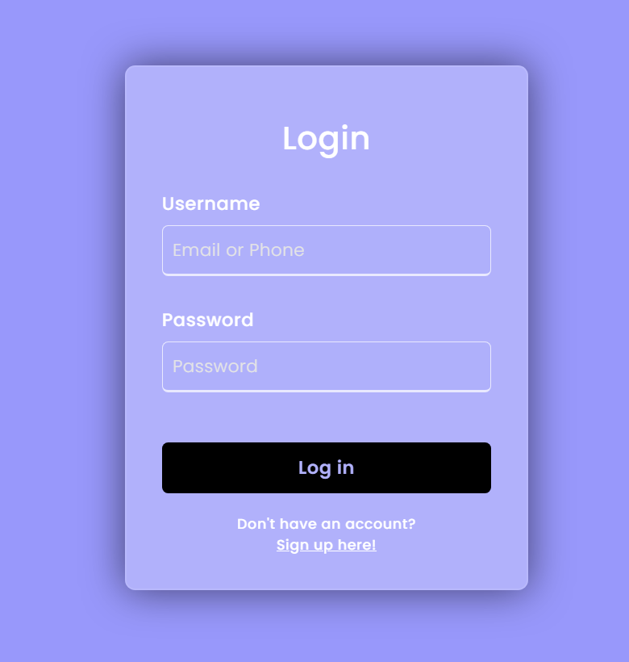

SPRINT ACHIEVEMENTS
Login
Registration
Library/Home
Database

Slide 5
PROJECT BACKLOG
TO DO
IN PROGRESS
COMPLETED
Email functionality
Connect Accounts
Create & host website
Login/registration functionality
Update PWEB
Login page design
Add/edit books
Store book info in database
Registration page design
Storing books in user’s library
Home/book page design
Book scanner
Create database
Welcome/About page

Slide 6
SPRINT BACKLOG
RESEARCH TIME ~ 12 HRS
Design Development Time ~6.5 HRS
Find ISBN Database
[ Done, ~2 hours ]
Design pages of the website
[ Done, ~ 1.5 hours]
Research and decide on database
[ Done, ~4 hours ]
Basic login functionality
(can access the dashboard) [ Done, ~ 1 hour]
Research and troubleshoot database tools
[ Done, ~5 hours ]
Basic dashboard functionality
(basic appearance) [ Done, ~4 hours]
Decide user interaction with the website
[ Done, ~1 hour]
Design tables for the Database
[ Not completed]

Slide 7

LESSONS LEARNED
There are lots of books
To store all of the book data in our database, we need 250 GB of storage
Free databases have limited storage
Our biggest initial barrier was trying to find a database service

Slide 8


Click here
DEMO

