Slide 1
IT 4773 – Final Project
Michael Lees, Olivia Venuti, Daniel Botti
000855667, 000359137, 001010341

Slide 2
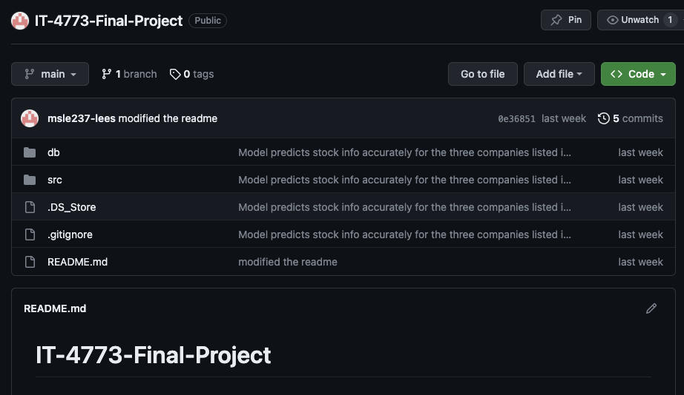
Introduction to the Codebase
Objective: Forecasting closing prices of stocks using machine learning.
Overview of dataset: US-based companies and ETFs stock price data from prior to 2017.
Key stocks analyzed: Broadwind Inc (BWEN), CSI Compressco LP (CCLP), IAC Inc (IAC).
Code for this project can be found in this GitHub repository:
https://github.com/msle237-lees/IT-4773-Final-Project
The dataset can be found here:
https://www.kaggle.com/datasets/borismarjanovic/price-volume-data-for-all-us-stocks-etfs

Slide 3
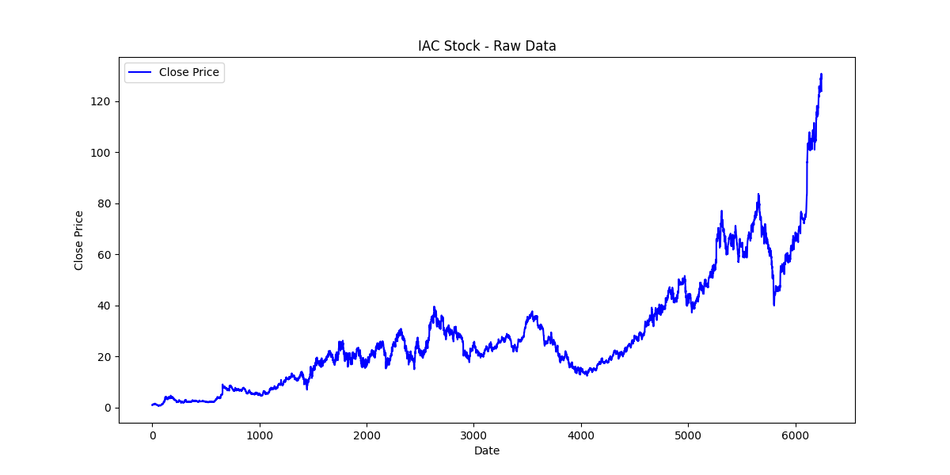
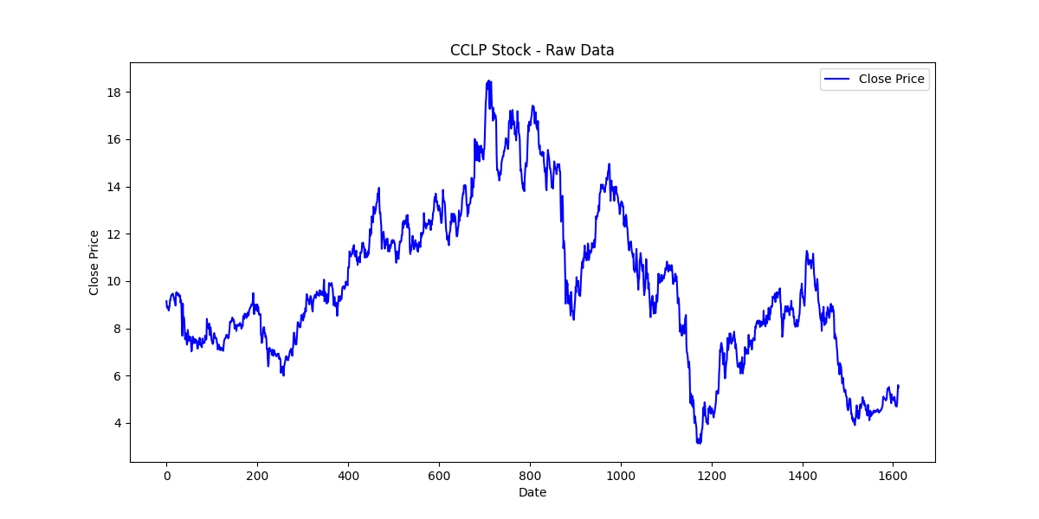
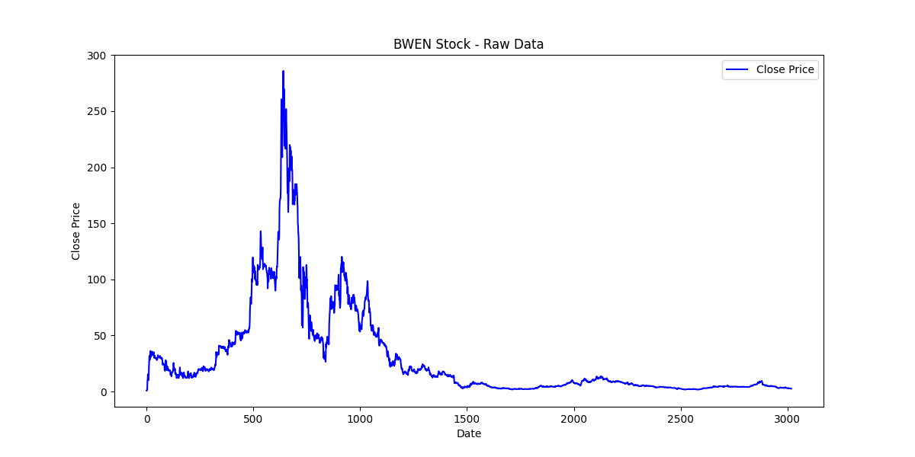
Data Reading and Initial Processing
Description of read_custom_csv function: reads CSV files and formats data into pandas dataframes
Dataset source: Historical stock data from the csv files provided by the dataset creator.
Initial data visualization: Using plot_raw_data to visualize raw stock prices (visible on right).

Slide 4
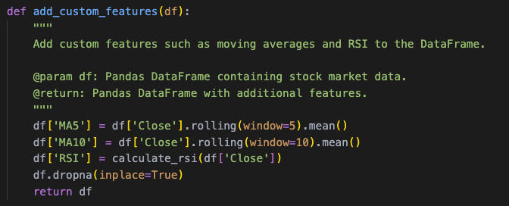
Enhancing Data with Custom Features
Explanation of add_custom_features function: adds MA5, MA10, and RSI.
Importance of these features in predicting stock prices.
Visualization of enhanced data: Demonstrating added features on stock trends.
Place holder for custom dataset

Slide 5
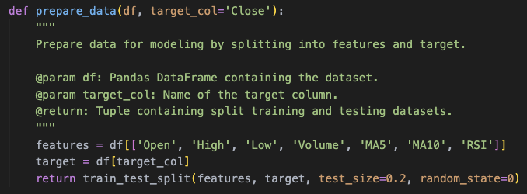
Preparing Data for Model Training
Details on prepare_data function: splits data into features and target, training and testing sets.
Emphasis on the 'Close' price as the target variable for prediction.
Significance of data splitting in training robust models.

Slide 6
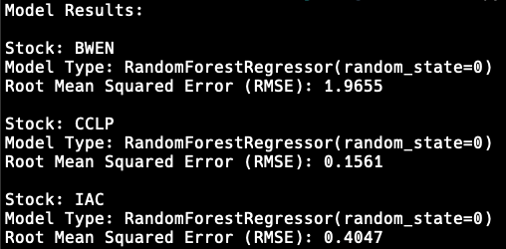
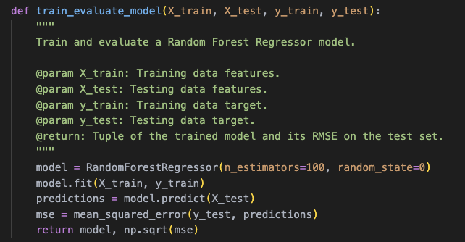
Model Training and Performance Evaluation
Overview of train_evaluate_model function: trains RandomForestRegressor.
Use of RMSE for evaluating model performance.
Discussion on the effectiveness and reliability of the Random Forest model in stock price prediction.

Slide 7
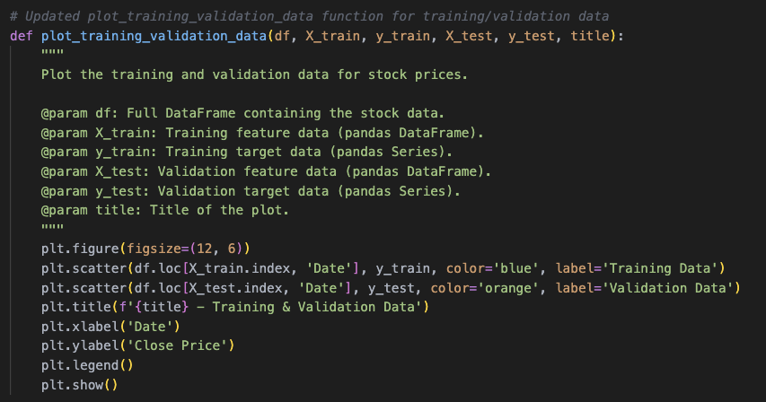
Visualization of Training and Validation Data
Utilization of plot_training_validation_data for visual analysis.
Comparative visualization of training and testing datasets.
Insights gained from visual analysis in model training and evaluation.

Slide 8
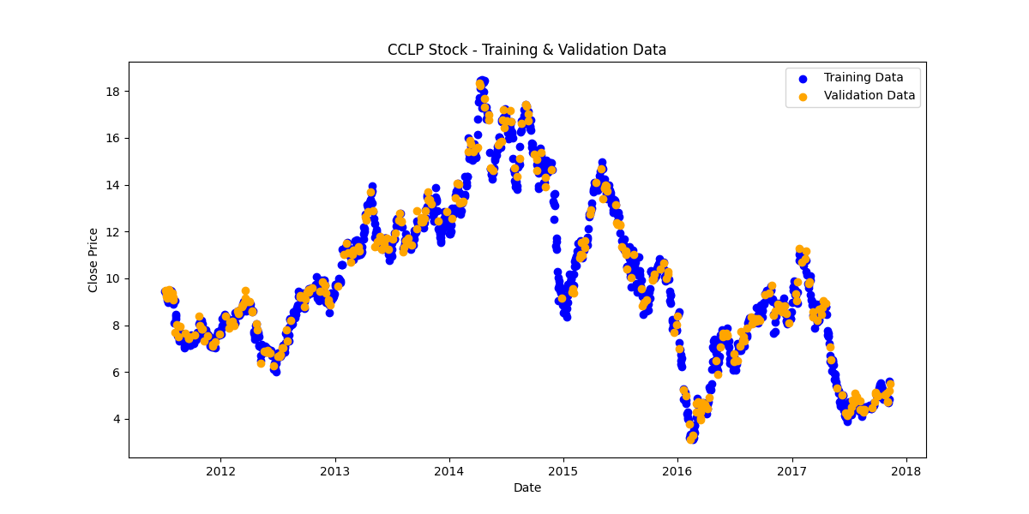
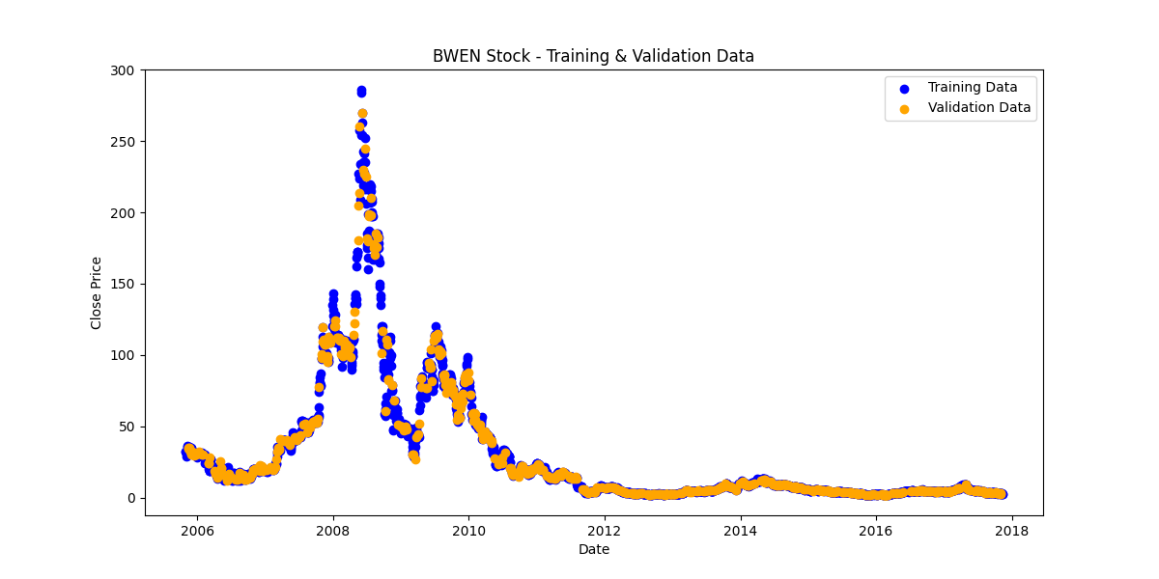
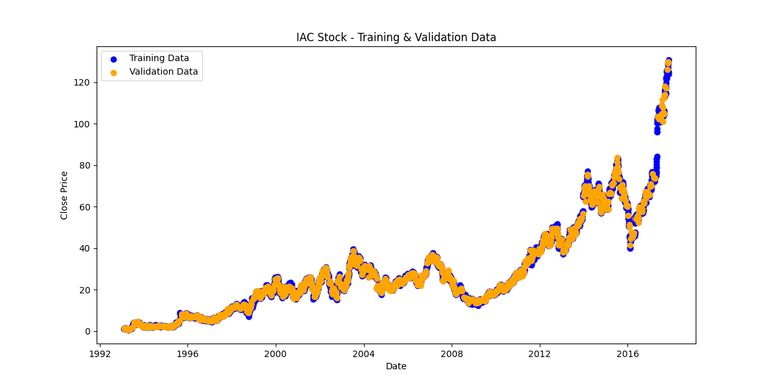
Concluding Remarks and Key Insights
Summary of findings: How well did the models perform?
The model performed exactly as intended, accurately predicting stock market closing prices up to December of 2017.
Since the dataset only went to December of 2017, we can imply that if the dataset is applied to current stock market trends, we could predict certain outcomes relevant to the stock’s closing price.
Of course, getting involved in the stock market requires more than only looking at the closing price of a stock, however our model only looks at this certain data type.

