Slide 1
CUS1166 – Software Engineering Technology Presentation
Flask-CORS
Maureen Sledge
April 10, 2019

Slide 2
Overview
FLASK-CORS
What is it?
Flask-CORS is a flask extension that is used to handle Cross Origin Resource Sharing (CORS), which makes AJAX (which allows web based applications to send and retrieve data from a server asynchronously without interfering with the display and behavior of the existing page) possible
What is CORS?
Cross Origin Resource Sharing is when a server requests a resource (such as an image or font for example) outside of its origin.
Imagine the idea of resource sharing as a building with a security entrance. For example, if you need to borrow equipment, you could ask a neighbor in the building who has one. The building’s security would likely not have a problem with this request (i.e., same-origin). If you needed a particular tool, however, and you ordered it from an outside source like an online marketplace (i.e., cross-origin), the security at the entrance may request that the delivery person provide identification when your tool arrives.
Notes:
Provide any information need to orient the audience what topic you are about to present.

Slide 3
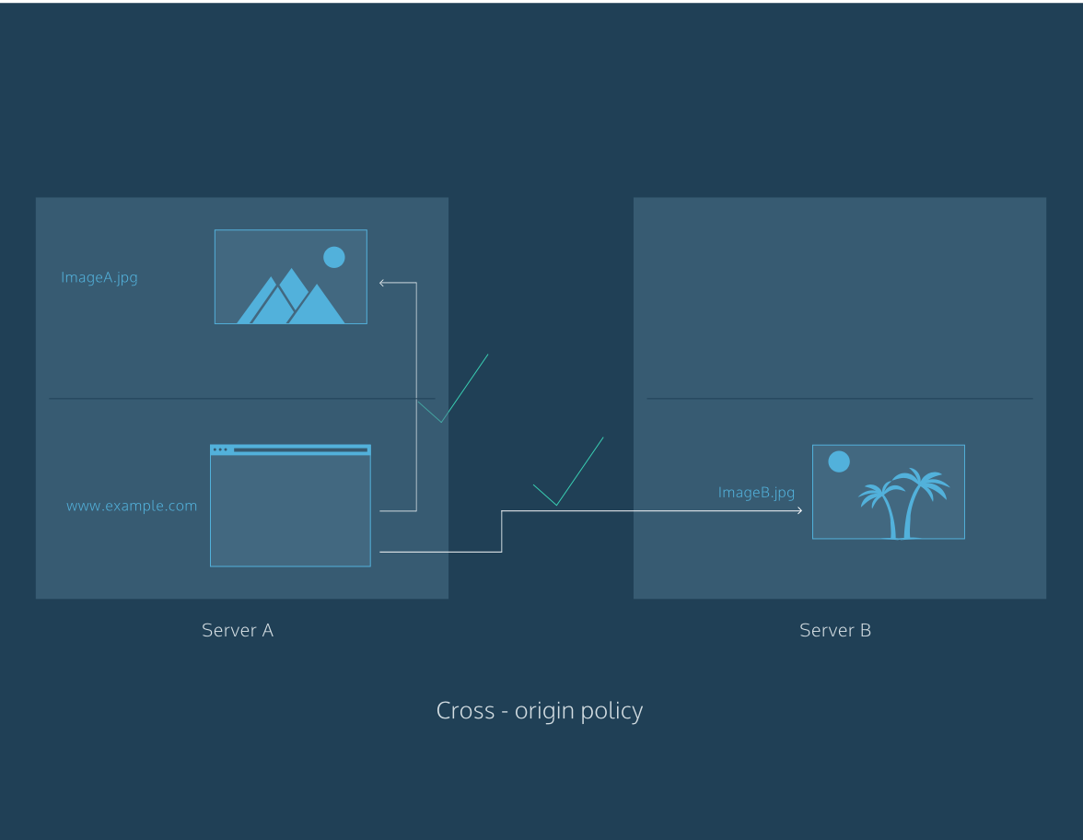

Overview
FLASK-CORS
Flask-CORS basically enables cross origin resource sharing, which is very important when dealing with web based applications in python.
However, it also allows servers to specify not just who can access its assets, but also how the assets can be accessed.
This is done using standard HTTP request methods such as GET, POST, etc. CORS allows a server the ability to specify who can access its assets and which HTTP request methods are allowed from external resources
Notes:
Provide any information need to orient the audience what topic you are about to present.

Slide 4
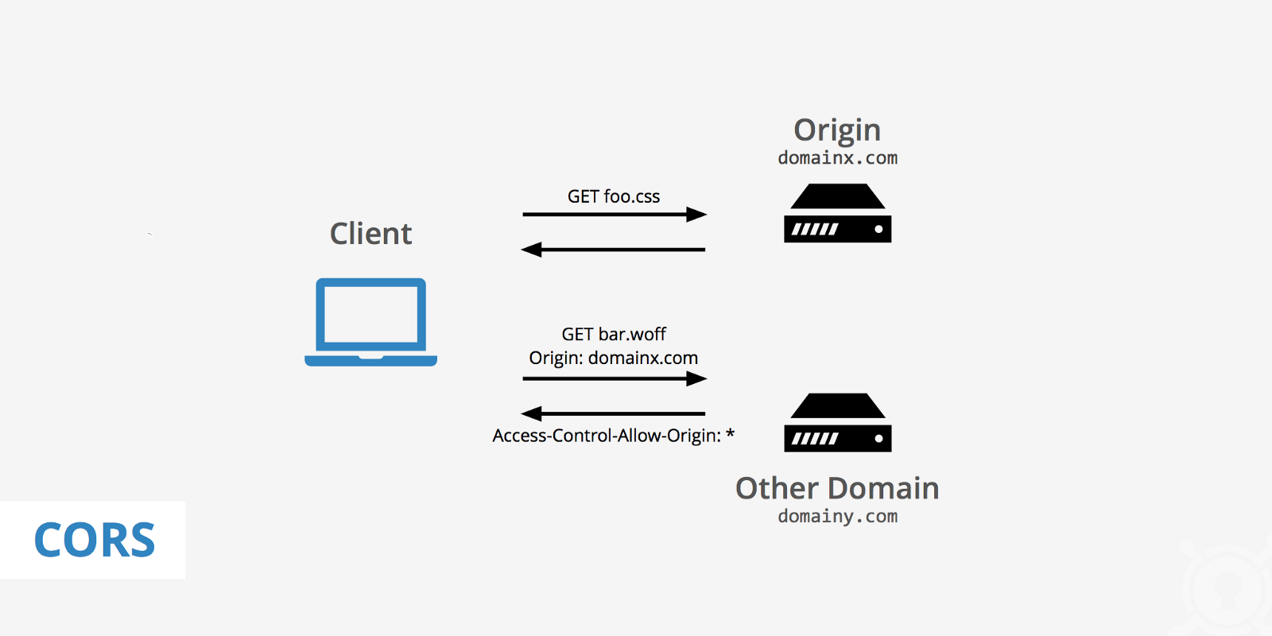
Purpose/Goal of Technology
FLASK-CORS: Purpose
The purpose of Flask-CORS is to handle Cross Origin Resource Sharing, making AJAX possible
It solves CORS restrictions when you try to get information from different domains.
Notes:
Motivate. what problem does this technology tries to solve; What is its purpose

Slide 5
Use Cases/Examples/ Applications
FLASK-CORS: Uses
What would you even use Flask-CORS for?
Flask-CORS is used for when you need to access information from third party servers.
Due to different domains access might not be given so you need to use Flask-CORS in order to access the information
Flask-CORS can be used in web applications when you are pulling information from other websites/using APIs (which is how I used it in my implementation)
It is important to use it in the case of security, to avoid any ajax request to domain other than the one open by the user (specified in the url)
Notes:
Identify possible use cases, examples, problems someone could consider using this technology.

Slide 6
Background – Key Concepts
FLASK-CORS: Key Concepts
AJAX:
web based applications to send and retrieve data from a server asynchronously without interfering with the display and behavior of the existing page
Flask-CORS works with blueprints and cookies as well.
Blueprints are concepts implemented in flask for making application components and supporting common patterns within an application or across applications
Cookies in flask are gathered from request objects is a dictionary with all the cookies the client transmits
Notes:
Introduce any background, key concepts and terminology needed for the audience to understand the technology your are presenting.

Slide 7
Background – Key Concepts
FLASK-CORS: Key Concepts
Cross Origin parameters (these are used in the decorator)
origins (list or string) –The origin, or list of origins to allow requests from. The origin(s) may be regular expressions, exact origins, or else an asterisk.
Default : ‘*’
methods (list or string) –The method or list of methods which the allowed origins are allowed to access for non-simple requests.
Default : [GET, HEAD, POST, OPTIONS, PUT, PATCH, DELETE]
expose_headers (list or string) –The header or list which are safe to expose to the API of a CORS API specification
Default : None
allow_headers (list or string) –The header or list of header field names which can be used when this resource is accessed by allowed origins
Default : None
supports_credentials (bool) –Allows users to make authenticated requests. If true, injects the Access-Control-Allow-Credentials header in responses.
note:This option cannot be used in conjuction with a ‘*’ originDefault : False
max_age (timedelta, integer, string or None) –The maximum time for which this CORS request maybe cached. This value is set as the Access-Control-Max-Age header.
Default : None
send_wildcard (bool) –If True, and the origins parameter is *, a wildcard Access-Control-Allow-Origin header is sent, rather than the request’s Origin header.
Default : True
always_send (bool) –If True, CORS headers are sent even if there is no Origin in the request’s headers.
Default : True
automatic_options (bool) –If True, CORS headers will be returned for OPTIONS requests. For use with cross domain POST requests which preflight OPTIONS requests, you will need to specifically allow the Content-Type header.
Default : True
vary_header (bool) –If True, the header Vary: Origin will be returned as per suggestion by the W3 implementation guidelines.
Setting this header when the Access-Control-Allow-Origin is dynamically generated (e.g. when there is more than one allowed origin, and an Origin than ‘*’ is returned) informs CDNs and other caches that the CORS headers are dynamic, and cannot be re-used.
If False, the Vary header will never be injected or altered.
Default : True
Notes:
Introduce any background, key concepts and terminology needed for the audience to understand the technology your are presenting.

Slide 8
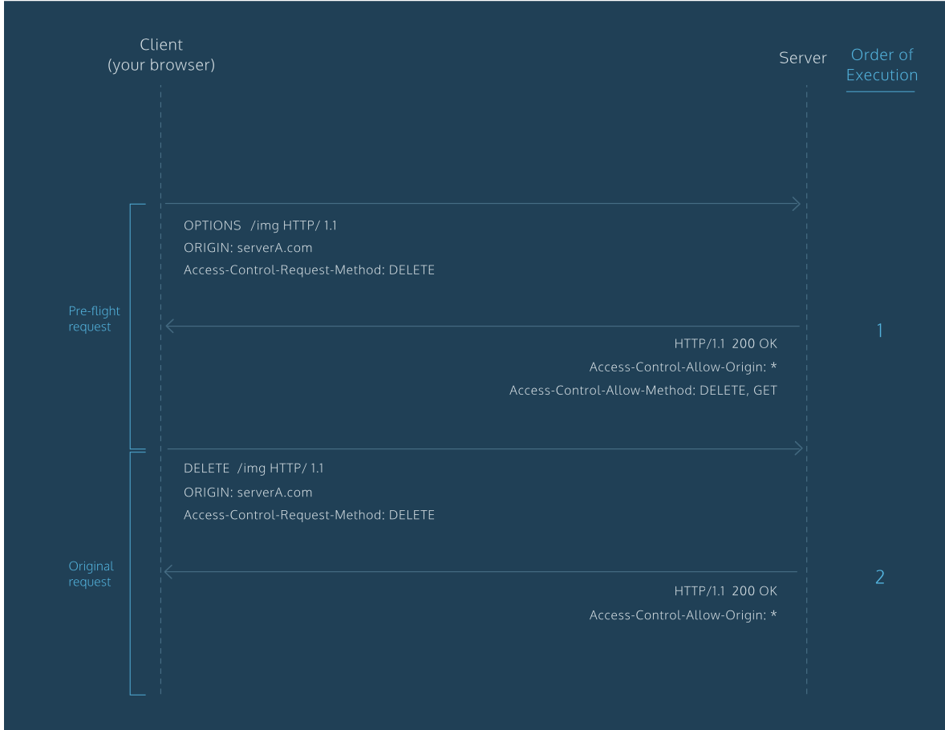
Background – Key Concepts
FLASK-CORS: Key Concepts
Pre-Flight (this checks to see if your request is feasible)
When a request is made using any of the following HTTP request methods, a standard preflight request will be made before the original request.
PUT
DELETE
CONNECT
OPTIONS
TRACE
PATCH
The purpose of the preflight request is to determine whether or not the original request is safe (for example, a DELETE request). The server will respond to the preflight request and indicate whether or not the original request is safe. If the server specifies that the original request is safe, it will allow the original request. Otherwise, it will block the original request.
Pre-Flights can be triggered using request methods.
Notes:
Introduce any background, key concepts and terminology needed for the audience to understand the technology your are presenting.

Slide 9
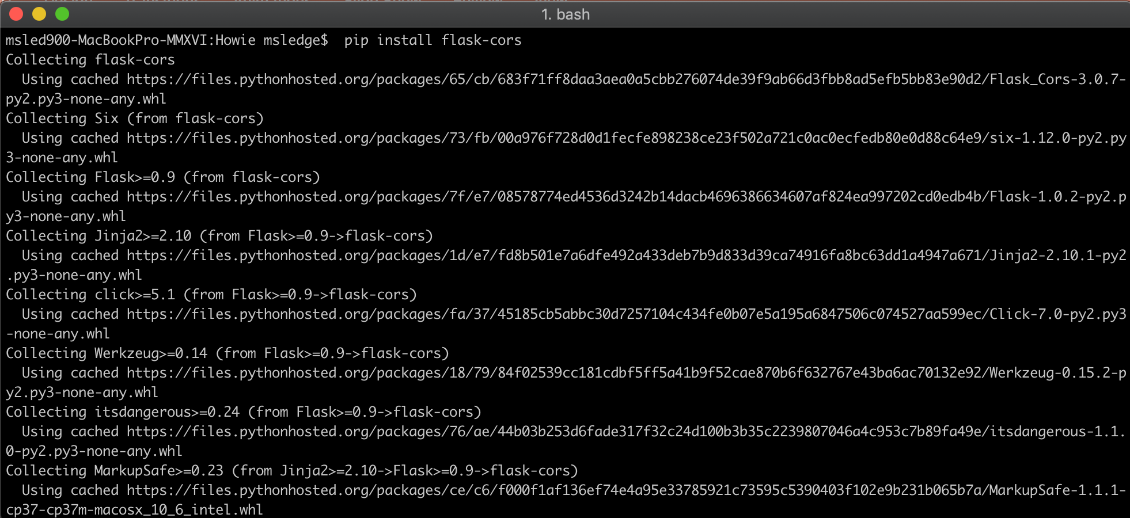
Getting Started Tutorial
FLASK-CORS: How to implement
1. Enter terminal
2. Type: $ pip install -U flask-cors
*In Pycharm depending on what you are trying to do you might also have to import some things such as:
from flask_cors import CORS
Notes:
Present a getting tutorial; this should cover the basic activities for someone to start using the technology and solving a basic problem using this technology (This might need more that one slides)

Slide 10
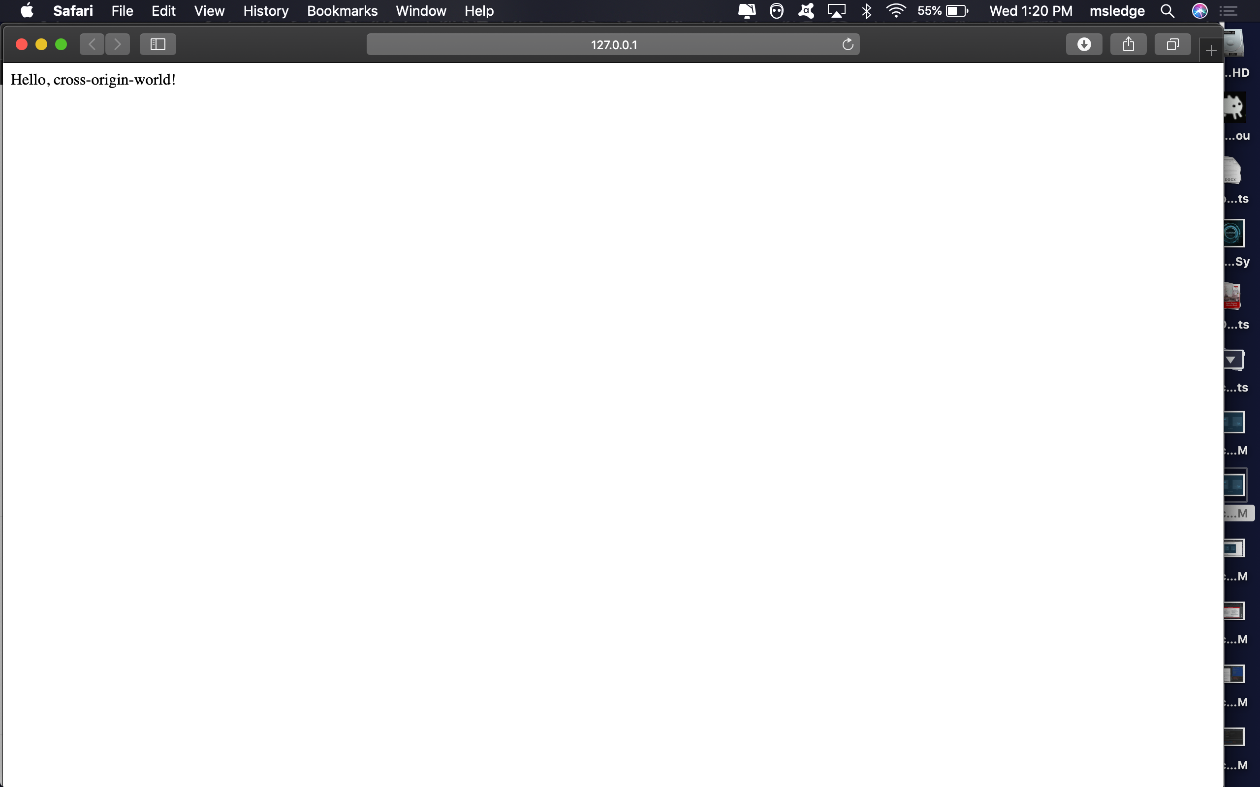
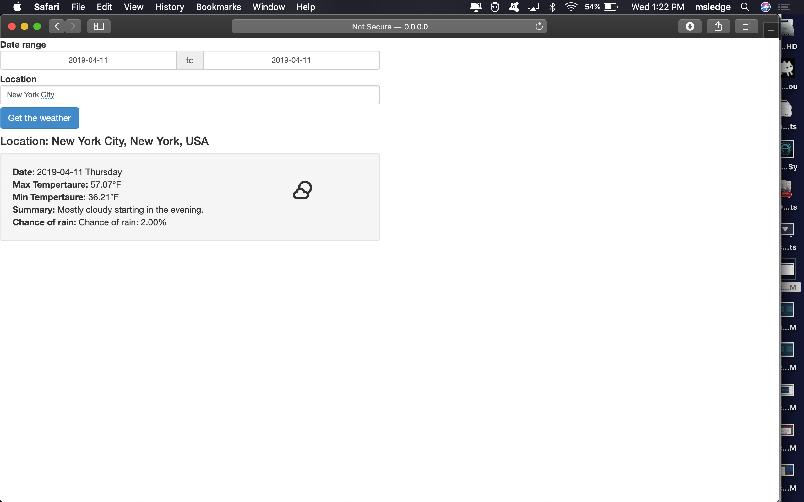
Non-Trivial Application
FLASK-CORS: Demonstration
I will be showing you two different examples of Flask-CORS being used in Pycharm. One is just a simple usage that sets up and shows you how you would use Flask-CORS in its simplest case. The other Flask_CORS is utilized in a web application that tells you the weather by using the Dark Sky API.
< Case 1
Case 2 >
Notes:
Demonstrate a non-trivial use case/application of the technology that you coded/prepared. This should be a custom example you coded yourself. Possibly this can be an example demonstrating how you could use this technology in your team’s project. You might need more that one slide for this section.

Slide 11
Resources
FLASK-CORS: Resources
https://flask-cors.readthedocs.io/en/1.10.2/
https://flask-cors.readthedocs.io/en/v1.6.1/#
https://github.com/corydolphin/flask-cors
https://flask-cors.readthedocs.io/en/latest/api.html#using-the-cors-extension
https://pypi.org/project/Flask-Cors/
Notes:
Resources for further reading. Provide a list of resources to help your classmates to learn more about this technology.

Slide 12
Q&A
FLASK-CORS: Review and Questions
So, what is Flask-CORS?
Simply put it is a way that allows python users to access cross origin resources within their web applications without either messing up the frontend or breaking the code. Through CORS, you can understand how risky behavior — like downloading assets from external origins — are mitigated.
Any Questions?
Notes:
Open the floor for your classmates and the instructor to ask question about your presentation.

Slide 13
Thank you!!!

