Slide 1
Liberty Rail Systems Penetration Test
By Ben Harlan, Louis Jackson, Arwin Johnson, Madison Sleppy, and Brianna Timmons
Gladfelter Hall, Room 553
April 22, 2025

Slide 2
Executive Summary
Methods and Dates of Engagement
OSINT = February 6, 11 flags attempted
Web-Based = February 25, 1 flag attempted
Phishing = April 1st and 3rd, 1 flag attempted
Vishing = April 15, 5 flags attempted
LRS Overall Performance
Letter Grade of D
Recommendations
Social Media Policies
Training
Notes:
Over the past three months, we have attempted to gather information from Liberty Rail Systems through various methods.
We attempted to find 11 flags on February 6 using open-source intelligence, including the public LRS website and the Recruit & Network platform.
We attempted one flag on February 25 by applying to LRS.
On April 1 and 3, we attempted one flag via phishing by sending LRS an email about our application.
On April 15, we attempted 5 flags by "voice phishing" or vishing in a phone call with LRS employees.
Overall, on a letter-grade scale, we have decided to give LRS a "D" grade. Most of the information was easily available online and by communicating with LRS staff. During our vishing attempt, the staff gave us some pushback, but overall the information was easy to obtain.
We would recommend for LRS to implement social media policies where employees are prohibited from sharing sensitive information online. We would also recommend training employees on phishing and vishing techniques to prevent them from accidentally giving out sensitive information.

Slide 3
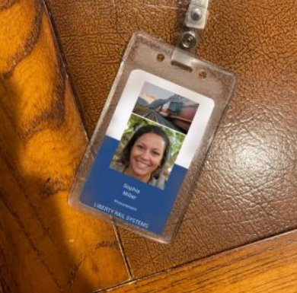
OSINT Findings || 11/11 Flags Found
Employee ID Badge
Posting this information allows an attacker to create their own employee badge and impersonate a Liberty Rail Systems employee, granting them access to restricted areas.
Notes:
One thing we found using open-source intelligence was the employee ID badge.
Sophie Miller, a receptionist for Liberty Rail Systems, posted a picture of her employee identification badge on the Recruit & Network website that anyone is able to view.
Posting this information is harmful because it shows a potential attacker the layout of the employee badge.
This can lead the attacker to creating their own badge to impersonate a Liberty Rail Systems employee, giving them access to the company's premises.
This can then allow the attacker to install malware on company devices.

Slide 4
Vish Finding || 2/5 Flags Found
Confirmation of Specific Email Client
> Outlook <
Harm
This information can enable targeted attacks by creating fake alerts and login prompts.
Attackers can use scripts tailored to how the client processes emails.
Further, the attacker can refine social engineering methods to easily bypass pushbacks.
Excerpt From Conversation:
Visher : “… yeah …. I always have trouble with these clients and such. What do you all use at Liberty?”
Contact: “I’m always struggling as well. We use Outlook…”

Slide 5
Career Application Findings
Application Submission: Created an application that appealed to the position of Administrative Assistant. Chose previous work history, organizations, professional affiliations, that applied and were similar to those of current LRS employees.
Phish: Made a general script of what to say during vish call.
Vish: Tried to make conversation with employee. Related difficulties in work environment to personal life to hopefully get the flags.

Slide 6

Dangers
Allowing so much information to be public makes it easier for vishers to pretend to be someone that is trusted.
Impersonate company staff.
We were able to make very convincing emails to HR, because of all the flags we were able to find.

Slide 7
Career Application Report
AS-9876 : Administrative Staff
Resume & Cover Letter
Combination of AI & Human
Phish
Prime contact for vish call
Vish
Establish relationship with company as well as physical access to building
POTENTIAL HARM
Vulnerabilities with Admin Staff Position
Sensitive information
Company recourses
Other Employees
Company-wide Impacts
Public Relations
Financial Security
Employee Trust

Slide 8

The Importance of AI
Write or edit phish scripts
Write or edit resumes
Voice changer

Slide 9
Recommendations
Organization
Employee
Update policies
What's safe to post
Vish
Phish
Train employees
Be careful with posts
Report posts that violate policy
AI Specific
AI Detection Tools
- GPTZero
Notes:
We were able to complete all of our OSINT findings from information on the LRS website and employee's Network and Recruit posts. As a result, we recommend updating and training employees on what is and is not safe to post online.

Slide 10

Thank you for your time!
Any Questions?

Slide 11
Division of Labor
Ben - Vish Information, Career App Report
Louis – importance of AI, recommendations
Arwin – Harm Section in Vish findings.
Madison – OSINT Findings, Exec. Summary
Brianna – Career Application Findings, Dangers

