Slide 1
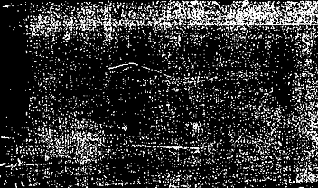
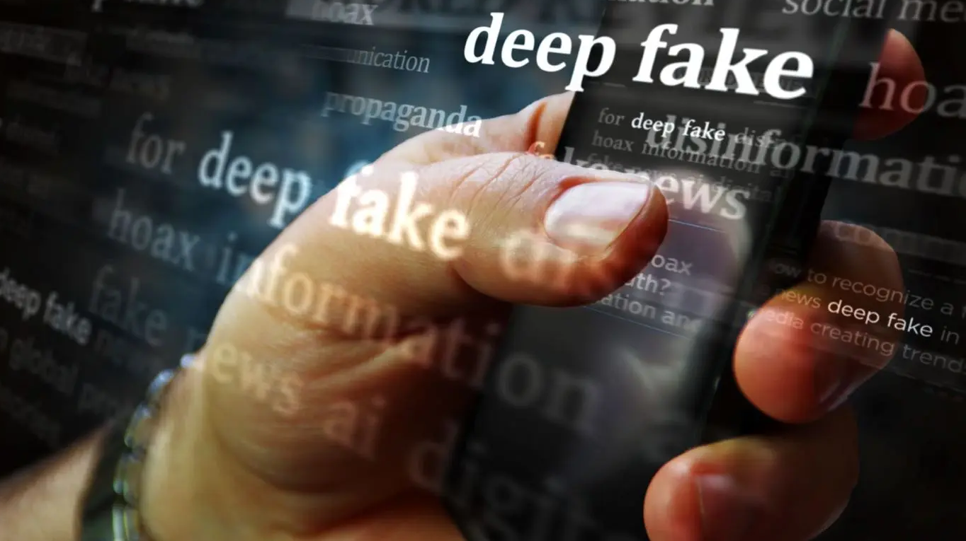
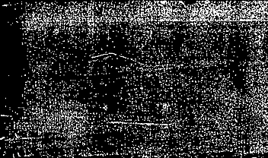

AI, Deep Fakes, and Disinformation
By: Arwin, Ben, Brianna, Louis, Madison, and Marino

Slide 2
What is disinformation?
Disinformation is information that is misleading or untrue
It is created with the intention to manipulate or mislead others
The main goal of disinformation is to sway public opinions, undermine trust in institutions, or push for specific economic, political, or social outcomes.
As artificial intelligence programs become widely available, disinformation is becoming a larger issue
AI programs are being used to create disinformation in audio, visual and textual forms
With the help of social media, disinformation is being spread to the public

Slide 3


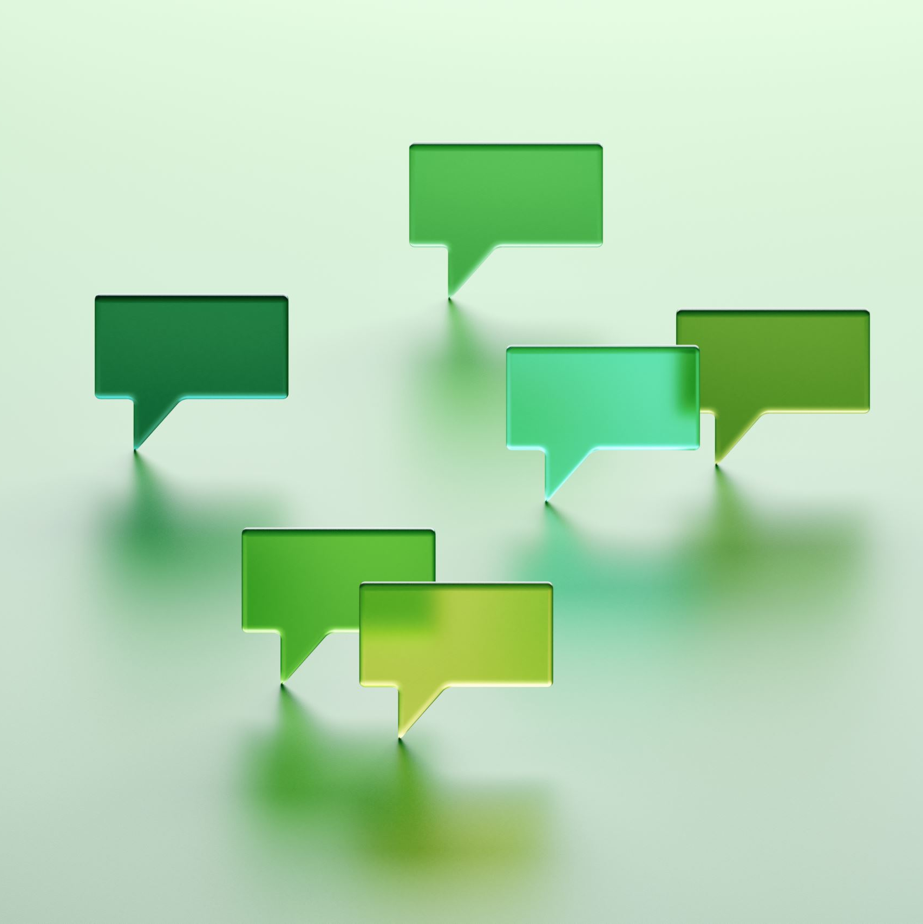



How Disinformation Spreads - The Rise of Social Media
Commonality of Social Media
Tik Tok - Twitter/X - Facebook - Instagram - Youtube
Ease of Generative Media
Chat GPT - DeepL - Gemini | Text - Audio - Video
The Evolution of AI Generation
Lack of Detection

Slide 4
How Disinformation Spreads - The Purpose Behind It
Social Bonding & Self Expression
It feels good to share!
Entertainment
Humor & Malevolence
The Onion VS Fear Mongering

Slide 5
How to Spot Disinformation
Disinformation can come in many formats: audio, image, text, and video.
If you think you have come across disinformation, it is important to verify its legitimacy:
Check the source of the information
Determine the “5 W’s and the H” of the story
Look for signs of emotional manipulation (sense of urgency, etc.)
Take your own personal biases into account
Be suspicious!
If you are still unsure, you can do your own research to check if what you have seen is true
Notes:
Expand on the information on the slides.
Is the source of the information a legitimate news source? Is it based on gossip or random social media posts? If it came from a questionable source, don’t be afraid to look up the source to verify its integrity
Every story should answer these questions: “What, where, who, why, when, and how.” If any of these questions are not answered by the media, then the story is most likely false. If any of these answers seem flimsy or suspicious, the story is likely false.
Many sources of disinformation or “fake news” try to push a sense of urgency so that the reader acts fast or is inspired to feel a certain way.
Everyone has their own biases. We are all more likely to believe that certain stories are true based on our own outlooks. It is important to recognize your own biases and see how they can affect your personal judgement. Seek diverse sources of information
Do not assume everything you see online is true!

Slide 6
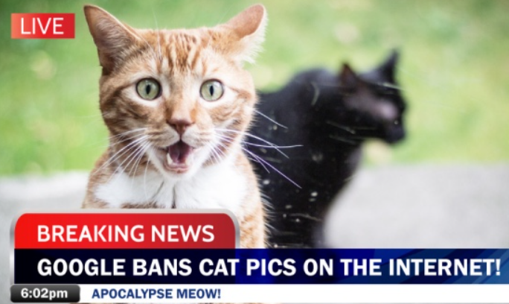
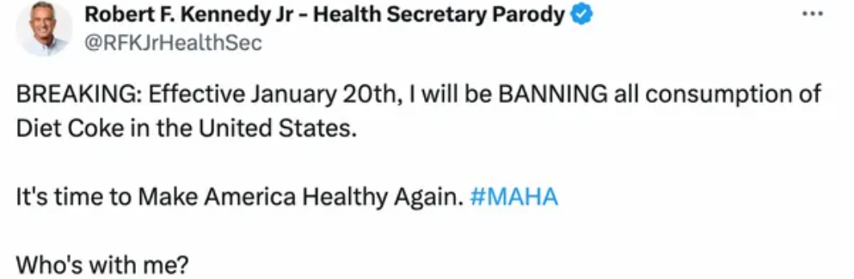
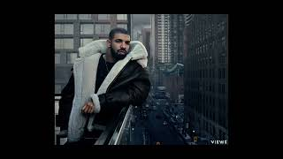
Examples of Disinformation
Textual
Image
Audio
Notes:
See if the audience can guess why each example is considered disinformation.
Then, expand on why each example is considered disinformation.
Image - Not from a reliable source, outrageous headline added to unrelated image for engagement/”clickbait”
Audio/Video - Unnatural vocal inflections, no emotion in the song. Feels “soulless;” picture is not real (looks too edited, body does not blend with background, etc)
Textual - Nonsensical, from a parody account. Emphasize that it is a parody account attempting to trick people into believing inaccurate information

Slide 7

What is AI and why is it important? - Louis
Many types
Generative AI (ChatGPT, Dall-E, Mid Journey, etc.)
Break training image/text down and use math to find most likely output
AI can be used to make disinformation on purpose
Also can generate wrong answer
Notes:
https://aws.amazon.com/what-is/large-language-model/
https://www.pbs.org/newshour/science/how-ai-makes-images-based-on-a-few-words
https://mitsloanedtech.mit.edu/ai/basics/addressing-ai-hallucinations-and-bias/

Slide 8
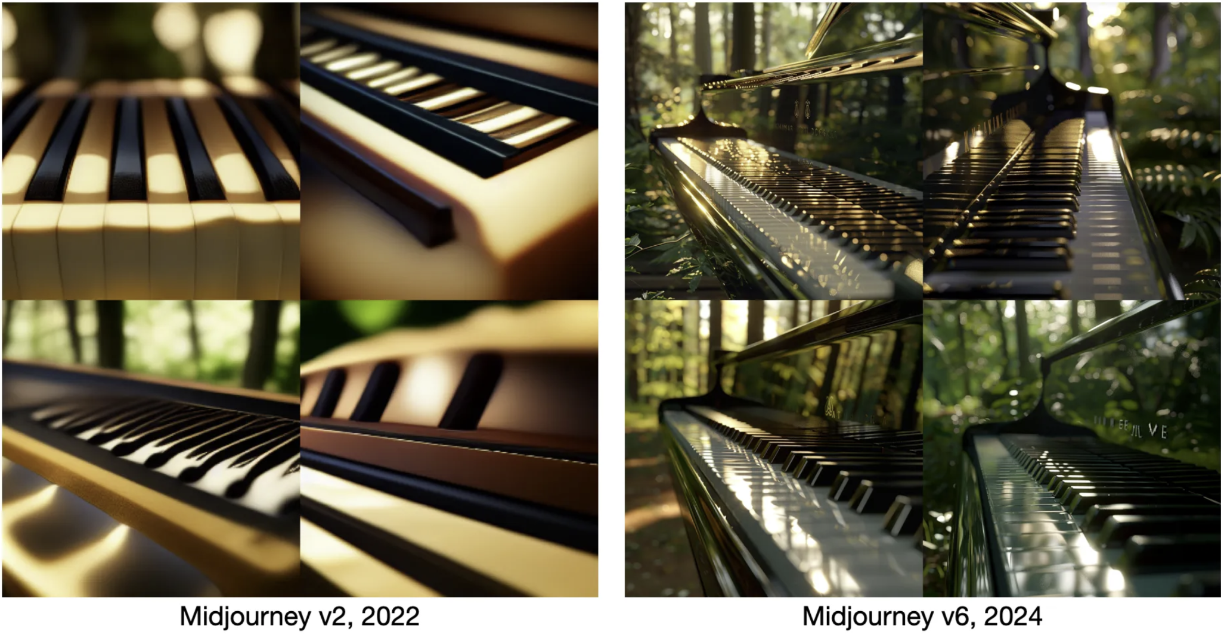
How AI makes disinformation worse - Louis
Number of posts
Updated to be more believable
Notes:
ask audience how they think AI can be used in disinformation
try to find examples of older AI generated images vs current version
https://medium.com/@junehao/comparing-ai-generated-images-two-years-apart-2022-vs-2024-6c3c4670b905

Slide 9
How to spot AI
AI-generated text is grammatically flawless but often repetitive and generic.
AI images frequently display unnatural patterns and distorted textures.
Tools like GPTZero, Copyleaks, Hugging Face and sight engine can detect AI content.

Slide 10
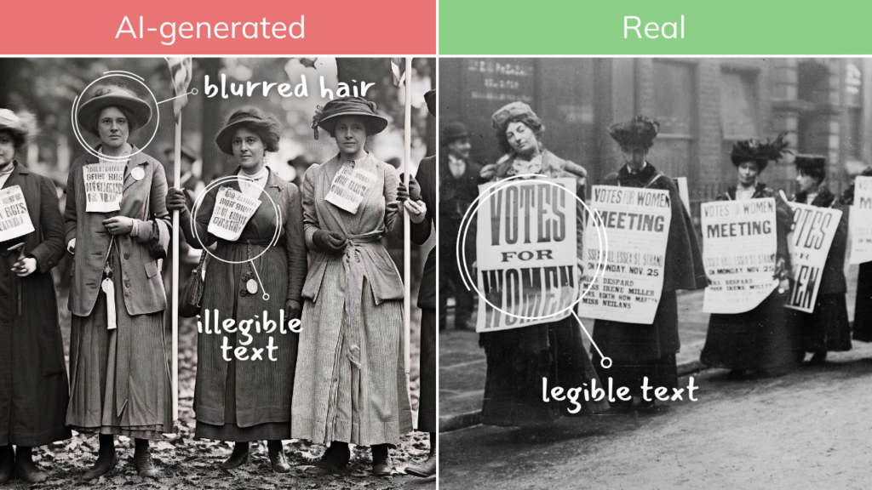
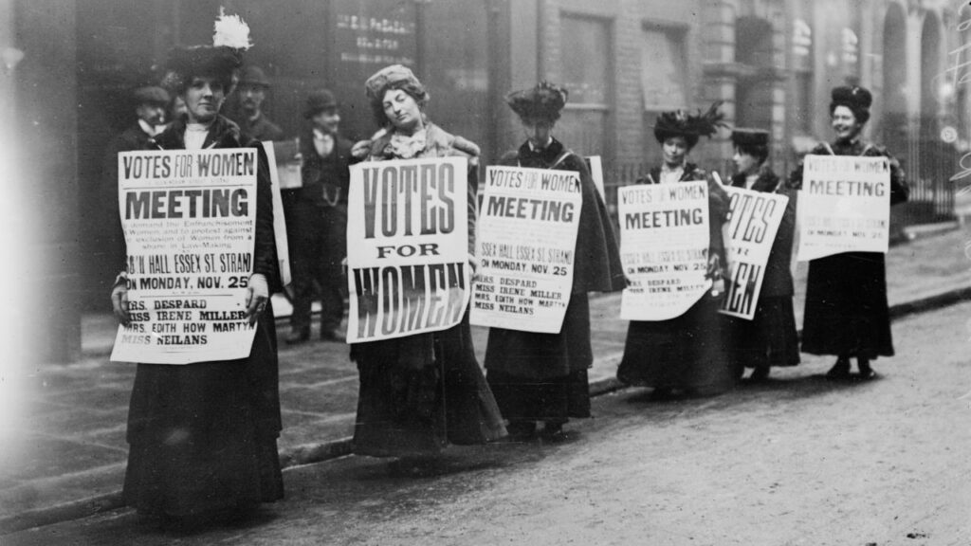
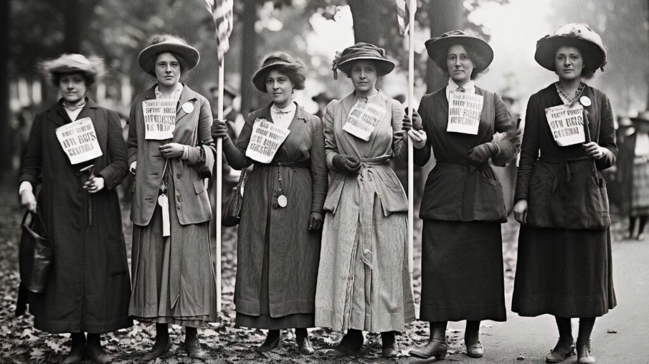
Examples

Slide 11
What are Deep Fakes ?
Deep Fakes are audio, images, or videos of people generated through AI technology.
Deep Fakes are usually highly realistic and capture people doing or saying things that they never actually did.
Deepfake images are made through the use of Generative Adversarial Networks.
Images from all over the web are gathered and then processed, and fine-tuning is done to these images through a generator.
Deepfake audios are made by detecting one's voice to convert text into spoken audio through AI.

Slide 12
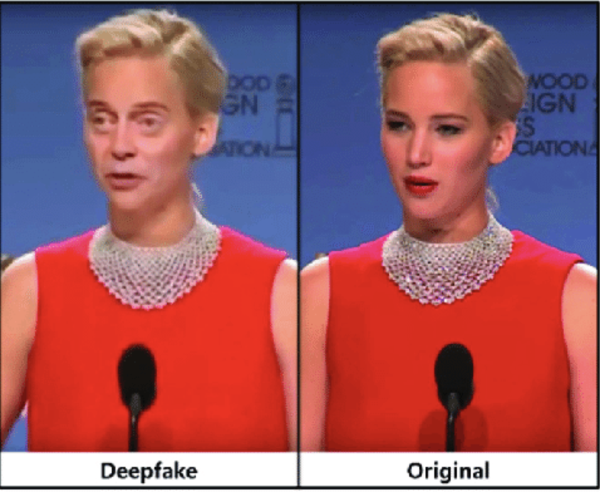
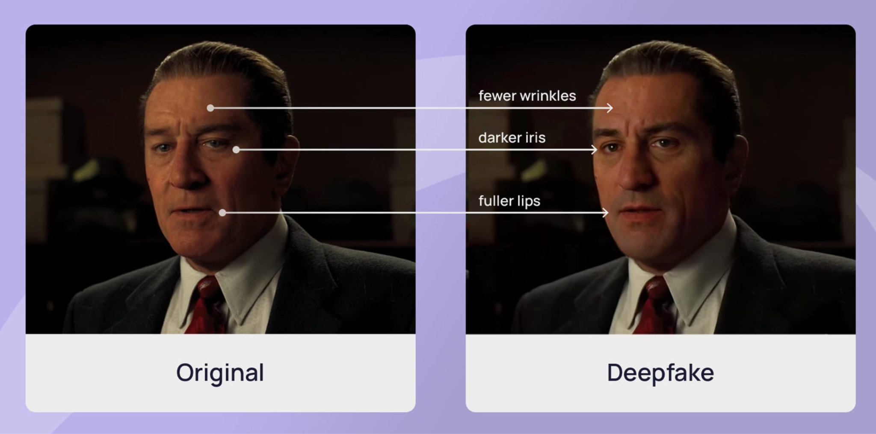
Deep Fakes vs Real Images
Deep Fake images may have inconsistent lighting qualities
Adjusted skin tones and textures,
Changes in eye placement (may be off centered), or the image may look to “perfect.”
Real images will have natural lighting, consistency in shadows, realism in textures and facial features will be aligned.
Notes:
Have the audience choose between a deep fake and a Real Image based on the criteria listed above.

Slide 13
Mitigation/prevention measures
Educate yourself, family and friends on how to spot deep fakes and AI
Add watermarks on photos, such as your name.
Think of it like a stamp: it indicates ownership or authenticity
Avoid sharing too many personal details on social media
Use strong passwords and use two-step authentication to prevent hacking.
Know of other scams, such as the grandparent scam.
Sign up for scam alerts via the (FTC) below:
ftc.gov/scams
Use a reverse image search to make sure the image is authentic
Notes:
For point 4, Scammers rely on personal information to create deepfakes. The less you put out there the less there is to create.
Watermarkly an online tool to put watermarks on images. Makes it challenging for ai to manipulate your image.
-show example of strong vs not strong password.
-Grandparent scam uses a family members voice and asks for money
-Ask what personal information you should NOT share online
-Ask what what you would do verify a video or pic is real

Slide 14

Is this safe to Post online?
Full name & Address
No, used for identity theft or scams
Phone Number
No-can lead to spam or scams
Vacation Plans
Makes you a target to burglary. Post after vacation
Favorite song
Yes
Photo of your pets
Yes-just be careful if collar is showing
Photo of driver's license
No-Contains critical information
Posting a photo of work badge
No-contains information about where you work
Post about baking
Yes
Notes:
Ask audience

Slide 15

Questions?

Slide 16
Works cited
“Extra! Extra! Avoid Fake News!” National Cybersecurity Alliance, 1 Nov. 2023, www.staysafeonline.org/articles/extra-extra-avoid-fake-news.
“How to Protect Yourself against Deepfakes .” National Cybersecurity Alliance, 22 Dec. 2023, www.staysafeonline.org/articles/how-to-protect-yourself-against-deepfakes.
“Science & Tech Spotlight: Combating Deepfakes.” Science & Tech Spotlight: Combating Deepfakes | U.S. GAO, 11 Mar. 2024, www.gao.gov/products/gao-24-107292.
“When Scammers Call Grandma.” National Cybersecurity Alliance, 22 July 2024, www.staysafeonline.org/articles/when-scammers-call-grandma.

Slide 17
Division of labor
Louis: AI introduction slide, AI making disinfo worse slide
Madison: What is disinformation, how to spot disinformation, examples of disinformation
Marino: Mitigation/prevention measures ,Is this safe to share online?
Ben: How Disinformation Spreads
Brianna: Deep fakes vs real images, and What are Deep fakes? Power point theme
Arwin: How to spot AI?

