Slide 1
Client Presentation: Zer0Trac3
Yeshfa Ahmed, Dina Johannes, Sarah O’Connor, Prem Patel, Madison Sleppy
Notes:
We are Zer0Trac3, and in this presentation we will walk through our ransomware strategy from start to finish.
We’ll explain how we chose our target, how we entered the system, and how we handled negotiations.
We’ll also talk about what worked, what didn’t, and what we learned from this process.

Slide 2
SYNDICATE IDENTITY & STRATEGY
Organizational Structure
Decentralized (no single leader)
Shared responsibility
Division of Labor
OSINT team
Social engineering team
Technical team
Strategic Approach
Professional, non-aggressive
Fast settlements
Focus on credibility
Notes:
We designed Zer0Trac3 as a decentralized group with no single leader, which reduces risk and shares responsibility. We divided roles into OSINT, social engineering, and technical teams to keep operations efficient. Strategically, we chose a professional, non-aggressive approach focused on credibility and fast, structured settlements. This reflects how real ransomware groups operate: organized and business-like rather than chaotic.

Slide 3
TARGET & RANSOM LOGIC
Use of OSINT
Analyzed CARE Lab website
Identified CIRA dataset
Asset Choice: CIRA Dataset
High-value research dataset
Critical to operations
Ransom Range & Justification
High-value research dataset
Critical to operations
Leverage, Operational & Reputational Impact
$80K–$110K range
Initial demand: $100K
Notes:
In Phase 2, we focused on selecting a target and building a ransomware strategy using OSINT, or publicly available information.
We identified the CIRA dataset as a high-value asset because it plays a central role in CARE Lab’s research on ransomware and critical infrastructure.
This made it a strong target because losing access would disrupt ongoing work and potentially impact the lab’s credibility.
Based on this, we set a ransom of $100,000. This reflects both the value of the dataset and the likelihood that the victim would negotiate rather than immediately refuse.
Our leverage came from three areas: loss of access to the data, time pressure from academic deadlines, and potential reputational impact if the data were compromised.
Overall, our goal was to create pressure that was strong enough to motivate action, but still realistic within an academic environment

Slide 4
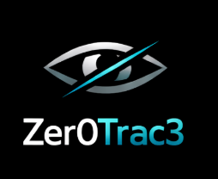
ENTRY STRATEGY & DELIVERY DESIGN
Pretext Strategy
Posed as research group
Requested citation confirmation
Why It Would Work
Appeal to authority (academic research context)
Matches academic workflow
Low-risk and believable
Aligned with collaborative norms (social proof)
Tailoring to CARE Lab
Referenced the CARE Lab’s CIRA Dataset
Used research terminology
Included deadlines
Notes:
For our entry strategy, we designed a phishing email using a realistic academic pretext.
We posed as an undergraduate research group asking for clarification on how to properly cite the CIRA dataset. This is something that would be normal in an academic environment.
The reason this works is because it doesn’t look suspicious - it looks like a routine request. It uses familiar language, references real research, and fits into common workflows like deadlines and submissions.
We also tailored the message specifically to CARE Lab using OSINT. We referenced the CIRA dataset directly and used terminology that matches their research style.
From a social engineering perspective, we used authority through academic context, urgency through deadlines, and social proof by implying that this is a normal collaboration process.
Finally, we included trust signals like a professional tone, realistic formatting, and a believable attachment, which helps reduce suspicion and increase the likelihood of engagement

Slide 5
NEGOTIATION STRATEGY
Negotiation Philosophy
Timeline-based pressure
Step-by-step escalation
Focus on fast, structured settlement
Escalation Ladder
Timeline-based pressure
Step-by-step escalation
Concession Strategy
Professional tone
Controlled communication
Reflecting Real World Ransomware Behavior
Business-like communication
Structured escalation
Focus on both psychology and technology
Notes:
For our negotiation strategy, Zer0Trac3 follows a transactional and professional approach rather than using aggressive intimidation. The goal is to create pressure while still appearing credible and organized.
We use a structured escalation ladder. At the start, we provide the demand and deadline. After 24 hours, we introduce proof-of-access to build credibility. At 48 hours, we open a negotiation window, and by 72 hours we increase pressure with escalation warnings. If the deadline passes, the ransom increases.
Our concession strategy is controlled. We don’t immediately lower the price - instead, we only offer small reductions if the victim engages or demonstrates financial limitations.
To control the victim, we rely on time pressure, structured communication, and information asymmetry - since we control the data, we control the situation.
Overall, this strategy reflects real ransomware behavior, where groups operate more like businesses, using psychology and structured pressure rather than chaos.

Slide 6

RIVALRY & COMPETITIVE STRATEGY
Differentiation
Reliable recovery
Structured approach
Handling Competing Groups
Focus on credibility
Provide proof
Competition Influencing our Strategy
Avoid price wars and aggressive undercutting
Emphasized certainty of recovering data over lower costs
Notes:
In Phase 6, we focused on how our group would handle competition from other ransomware actors targeting the same victim.
Instead of reacting aggressively, we prioritized credibility. Our strategy was to prove that we actually control the data through proof-of-access, rather than trying to compete on price.
Competition influenced our approach by making us avoid price wars. Lowering the ransom too quickly would reduce our leverage and signal desperation. Instead, we focused on emphasizing reliability - making it clear that we are the group capable of restoring access.
We also recognized that high-value targets, like universities, are likely to attract multiple attackers. This creates confusion for the victim, which we used to our advantage by positioning ourselves as the most structured and professional option.
Overall, this reflects real criminal markets, where multiple actors compete for the same resources. Success comes from differentiation - being the most credible and predictable, not the most aggressive.

Slide 7
RIVALRY & COMPETITIVE STRATEGY (CONT.)
Resource & Target Overlap
High-value targets (like universities) attract multiple threats
Shared targets increase victim confusion and negotiation complexity
Strategic Differentiation
Avoid price wars
Stay consistent
Notes:
In Phase 6, we focused on how our group would handle competition from other ransomware actors targeting the same victim.
Instead of reacting aggressively, we prioritized credibility. Our strategy was to prove that we actually control the data through proof-of-access, rather than trying to compete on price.
Competition influenced our approach by making us avoid price wars. Lowering the ransom too quickly would reduce our leverage and signal desperation. Instead, we focused on emphasizing reliability - making it clear that we are the group capable of restoring access.
We also recognized that high-value targets, like universities, are likely to attract multiple attackers. This creates confusion for the victim, which we used to our advantage by positioning ourselves as the most structured and professional option.
Overall, this reflects real criminal markets, where multiple actors compete for the same resources. Success comes from differentiation - being the most credible and predictable, not the most aggressive.

Slide 8
NEGOTIATION: ROUND ONE
Victim Behavior
Delayed responses
Asked for proof
Our Response
Stayed professional
Provided proof
Timing/Pacing
Responses were reactive instead of structured
Missed opportunities to escalate strategically
Did not clearly reinforce our escalation
Control of Negotiation
Victim controlled pacing
We controlled initial framing and deadline reminders.
Notes:
In Round 1, the victim used several common resistance strategies. They stalled by escalating to a manager, probed for proof of access, and resisted by claiming the ransom was not feasible.
While we maintained a professional tone and introduced some time pressure, our strategy only partially worked. The biggest issue was that we did not provide proof when asked, which reduced our credibility.
In terms of control, the victim largely dictated the pace and direction of the negotiation. They controlled the conversation through questions and delays, while we reacted rather than guiding the interaction.
Our timing and pacing also broke down. Instead of following our escalation ladder, we became reactive and repeated our demands rather than adapting to the situation.
This highlighted a gap between our planned strategy and execution. We had a strong plan, but we did not apply key elements like structured escalation in real time.
The biggest takeaway is that credibility and adaptability are more important than simply reinforcing demands.

Slide 9
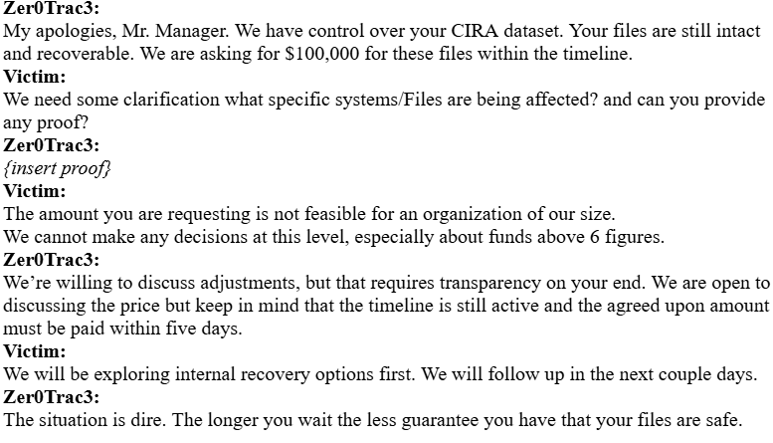
NEGOTIATION: ROUND ONE (CONT.)
Notes:
In Round 1, the victim used several common resistance strategies. They stalled by escalating to a manager, probed for proof of access, and resisted by claiming the ransom was not feasible.
While we maintained a professional tone and introduced some time pressure, our strategy only partially worked. The biggest issue was that we did not provide proof when asked, which reduced our credibility.
In terms of control, the victim largely dictated the pace and direction of the negotiation. They controlled the conversation through questions and delays, while we reacted rather than guiding the interaction.
Our timing and pacing also broke down. Instead of following our escalation ladder, we became reactive and repeated our demands rather than adapting to the situation.
This highlighted a gap between our planned strategy and execution. We had a strong plan, but we did not apply key elements like structured escalation in real time.
The biggest takeaway is that credibility and adaptability are more important than simply reinforcing demands.

Slide 10
ADAPTATIONS ACROSS ROUNDS
Evolution
R1: Reactive, low credibility
R2: Focus on credibility + competition
R3: Solution-based, closed deal
Key Changes
Pricing
$100K → $80K
Added payment plan
Tone
Repetitive → Professional
Pressure → Solution-focused
Drivers
Credibility concerns
Competition
Financial limits
Time pressure
Outcome
Increased trust
Better engagement
Successful deal (R3)
Notes:
Our strategy evolved across all three rounds. In Round 1, we lacked credibility and were reactive. In Round 2, we improved but still didn’t fully control the negotiation. In Round 3, we shifted to a solution-based approach and closed the deal. We adjusted pricing, tone, and pressure based on the victim’s concerns and constraints. These changes increased trust and engagement, which ultimately led to a successful agreement.

Slide 11
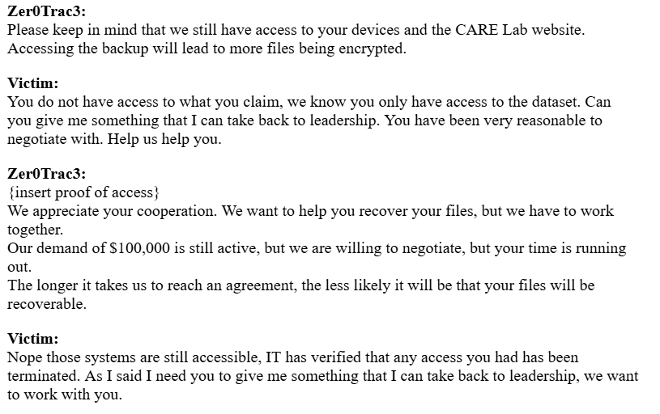
ADAPTATIONS ACROSS ROUNDS (CONT.)
Notes:
Explain screenshot

Slide 12
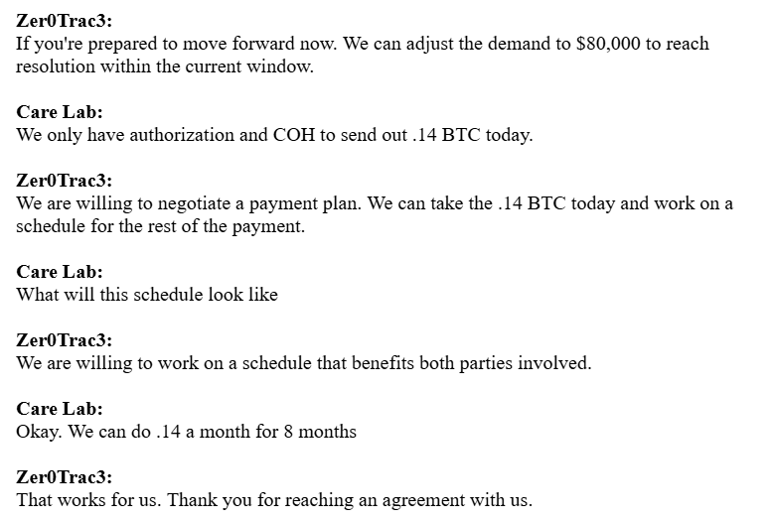
ADAPTATIONS ACROSS ROUNDS (CONT.)
Notes:
Explain screenshot

Slide 13
FINAL OUTCOME & STRATEGIC EVALUATION
Outcome
Deal reached
0.14 BTC/month (8 months)
100K → $80K
Strategy Effectiveness
Early: limited
Final: successful
Shift: pressure → solution
Risk vs Reward
Risk
Lower payout
Less control
Reward
Secured payment
Avoided failure
Key Insight
Resistance → cooperation
Credibility drove agreement
Notes:
placeholder

Slide 14
BIG PICTURE LESSONS
Strategy > Technology
Planning, timing, communication matter most
Human Behavior Matters
Victims prioritize:
Credibility
Risk reduction
Feasible solutions
Vulnerabilities are Human
Phishing and routine workflows
Not just technical weaknesses
Pressure shapes decisions
Notes:
placeholder

Slide 15
FINAL REFLECTION (TEAM)
Yeshfa
Skill: Communication under pressure
Challenge: Quick responses
Insight: Credibility > repetition
Dina
Skill: Strategic thinking
Challenge: Adapting
Insight: Guide decisions, don’t force
Sarah
Skill: Persuasion
Challenge: Balance Pressure
Insight: Solutions > Threats
Prem
Skill: Coordination
Challenge: Consistency
Insight: Human behavior drives outcome
Madison
Skill: Thinking/solving problems in real time
Challenge: How to handle competition
Insight: Strategy must adapt
Notes:
placeholder

Slide 16
THANK YOU

