Slide 1
DATA ANALYSIS AND DATA SCIENCE
LA GUARDIA COMMUNITY COLLEGE
NEW YORK
Online Retail - Data Analysis
OCTOBER / 2026
Presented by
MICHAEL LINARES
Company Name
Quarter Month
Year

Slide 2
Online Retail - Data Analysis
Data Analysis
APA REF; Chen, D. (2015). Online Retail [Dataset]. UCI Machine Learning Repository. https://doi.org/10.24432/C5BW33.
Data from = Online Retail Donated on 11/5/2015
INFO:
This is a transactional data set which contains all the transactions occurring between 01/12/2010 and 09/12/2011 for a UK-based and registered non-store online retail.
Dataset Characteristics Multivariate, Sequential, Time-Series
Subject Area Business
Company Name
Quarter Month
Year

Slide 3
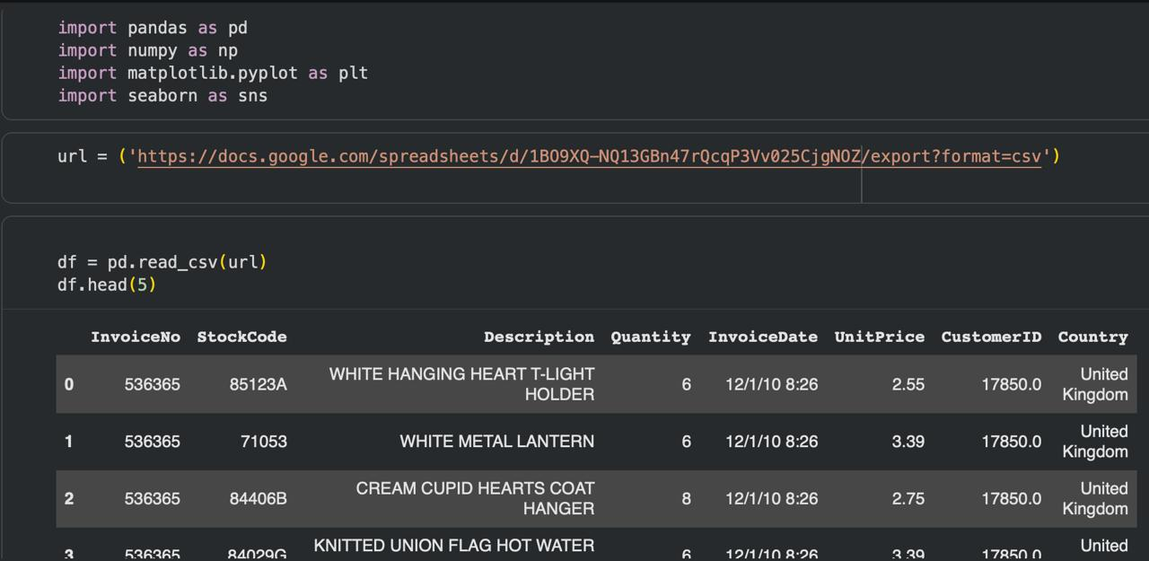
Online Retail - Data Analysis
Company Name
Quarter Month
Year

Slide 4
Online Retail - Data Analysis
df.columns
Index(['InvoiceNo', 'StockCode', 'Description', 'Quantity', 'InvoiceDate',
'UnitPrice', 'CustomerID', 'Country'],
dtype='object')
Company Name
Quarter Month
Year

Slide 5
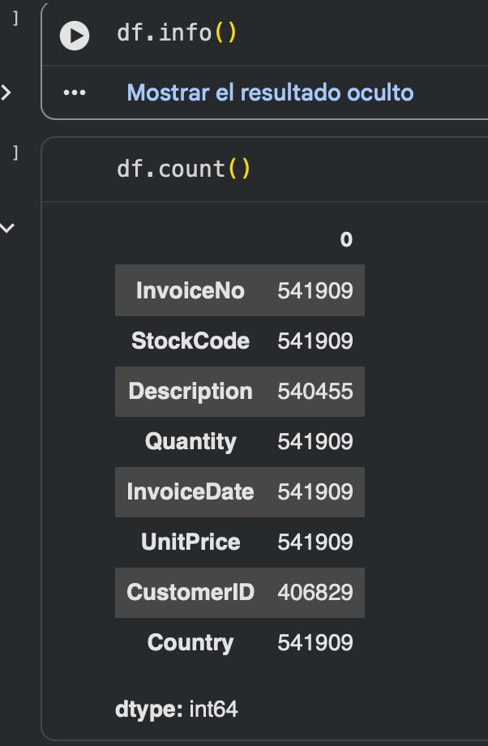
Online Retail - Data Analysis
Company Name
Quarter Month
Year

Slide 6
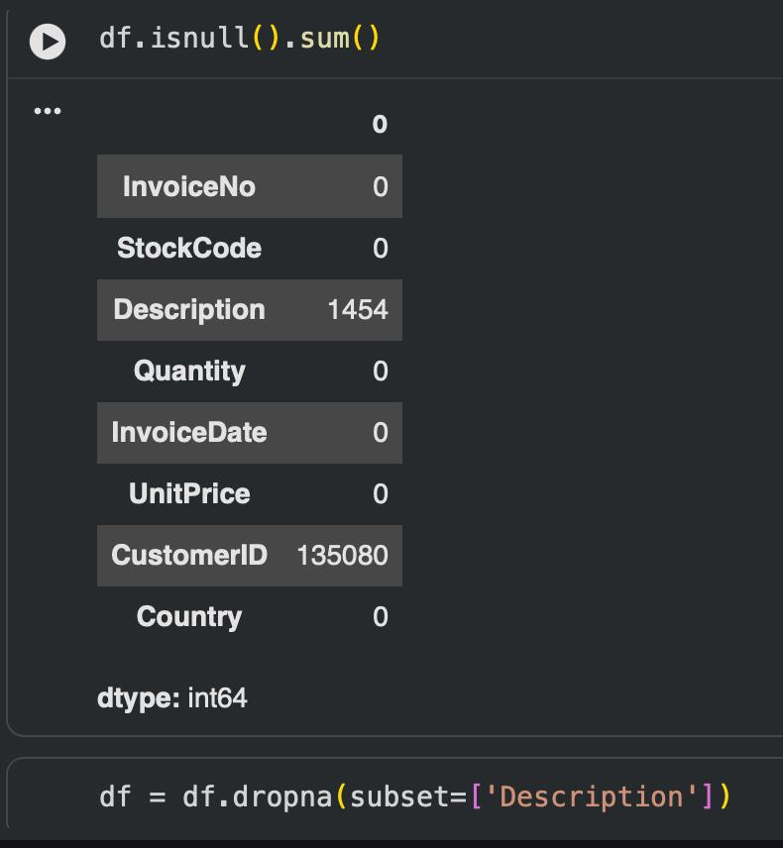
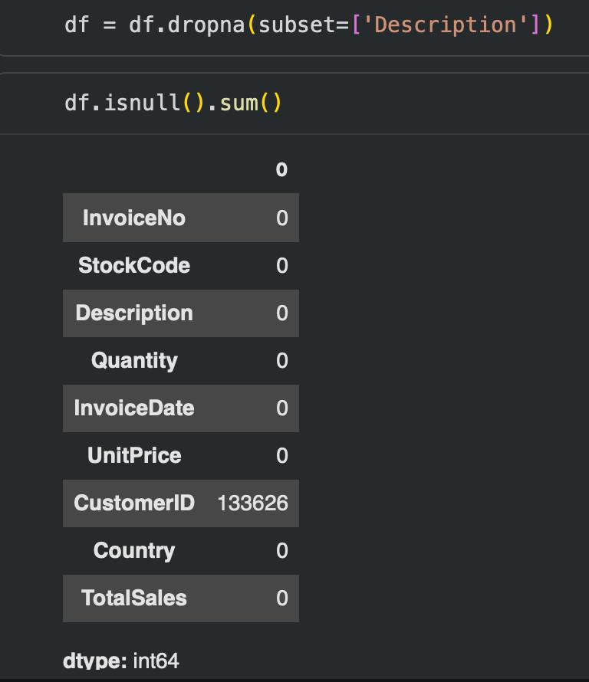
Online Retail - Data Analysis
Company Name
Quarter Month
Year

Slide 7
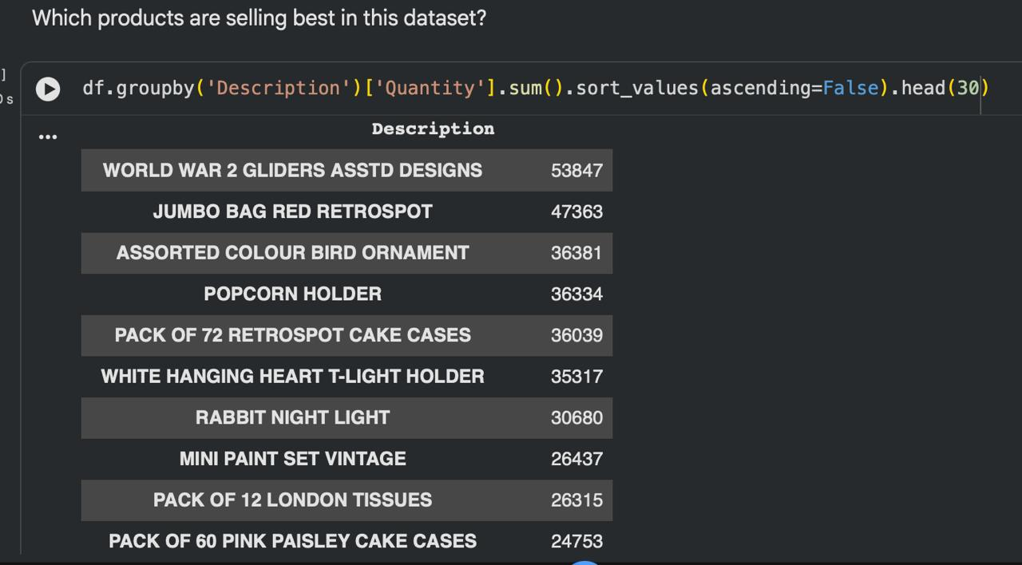
Online Retail - Data Analysis
Company Name
Quarter Month
Year

Slide 8
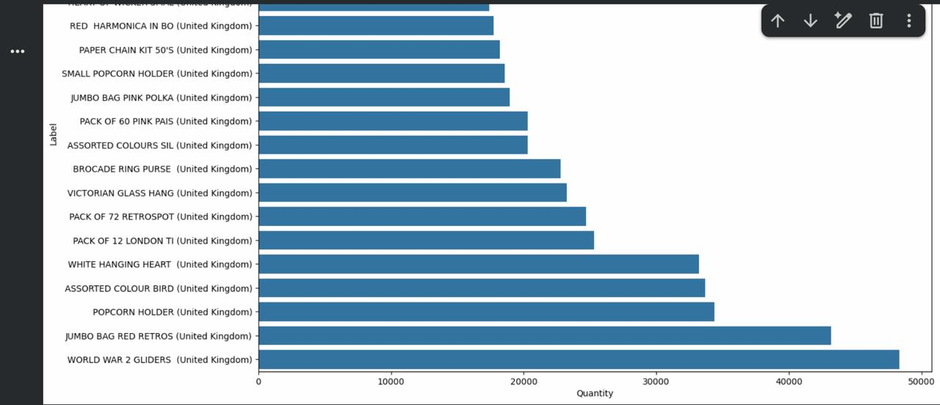
Online Retail - Data Analysis
Company Name
Quarter Month
Year

Slide 9
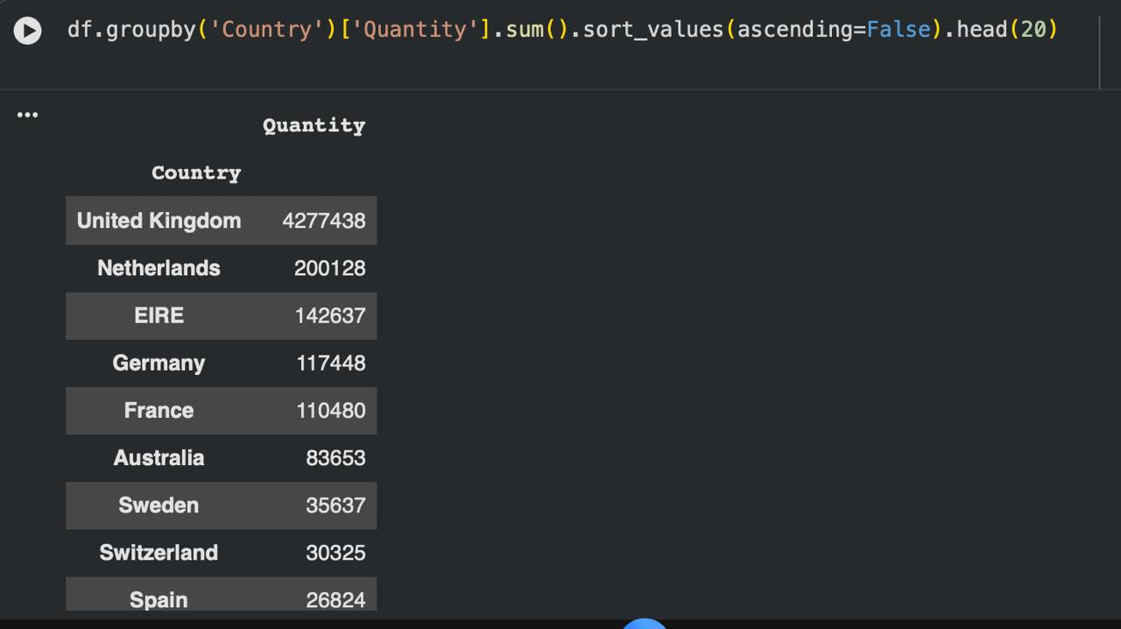
Online Retail - Data Analysis
Company Name
Quarter Month
Year

Slide 10
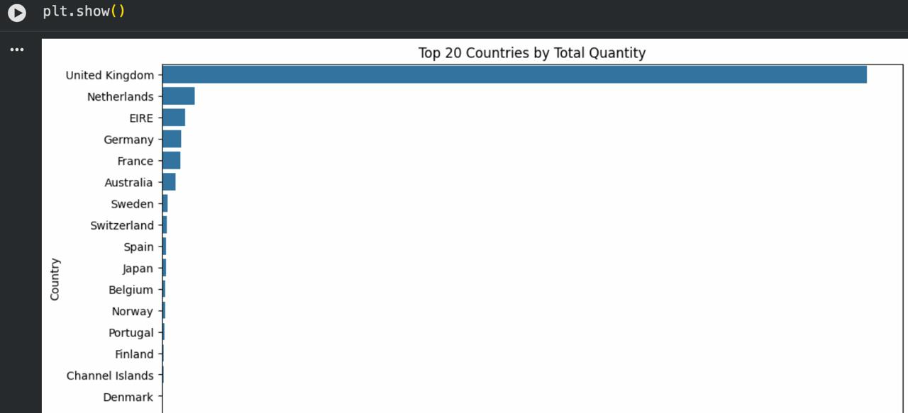
Online Retail - Data Analysis
Company Name
Quarter Month
Year

Slide 11
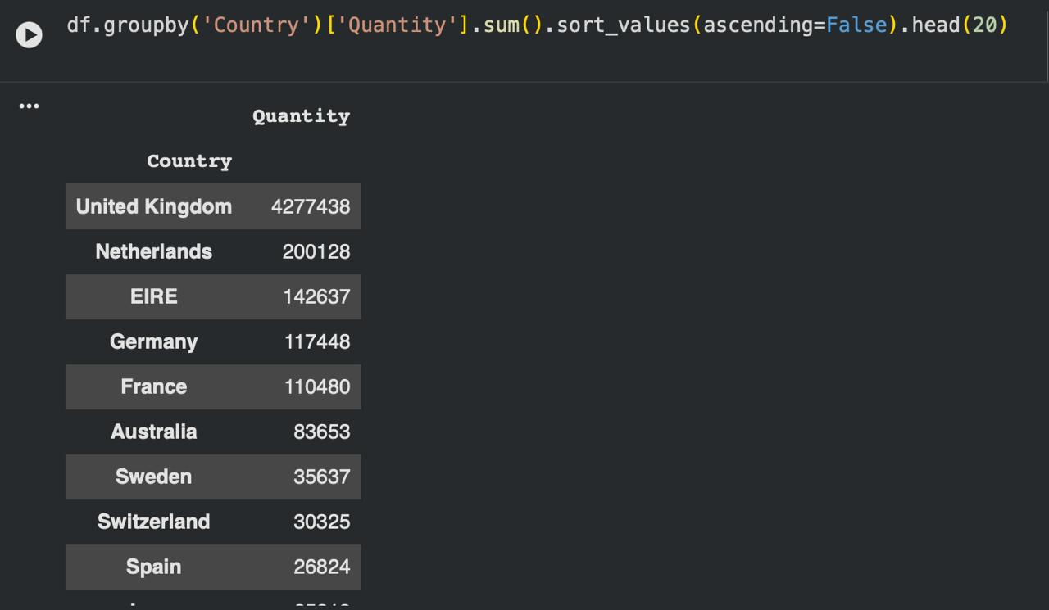
Online Retail - Data Analysis
Company Name
Quarter Month
Year

Slide 12
Online Retail - Data Analysis:
# Creating data
df['TotalSales'] = df['Quantity'] * df['UnitPrice']
top10 = (
df.groupby('Country').agg({
'Quantity' : 'sum',
'UnitPrice' : 'mean',
'TotalSales': 'sum'
})
.sort_values('TotalSales', ascending=False)
.head(10)
)
Company Name
Quarter Month
Year

Slide 13
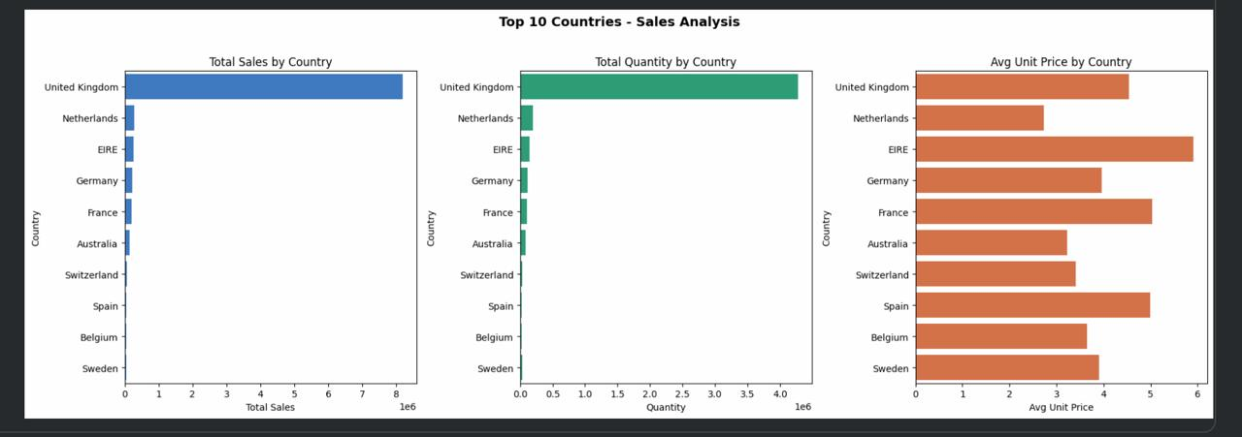
Online Retail - Data Analysis
Company Name
Quarter Month
Year

Slide 14
RECOMMENDATIONS FOR SALES STRATEGY
Maintain UK Focus while optimizing high-margin products
Expand European Market — Netherlands, Germany, France show growing demand
Develop Product Bundles tailored to regional preferences
Track Product Seasonality — gift items may spike at specific times of year
Company Name
Quarter Month
Year

Slide 15
REFERENCES
DATA ANALYSIS AND DATA SCIENCE LA GUARDIA COMMUNITY COLLEGUE NEW YORK
Online Retail - Data Analysis
APA REF; Chen, D. (2015). Online Retail [Dataset]. UCI Machine Learning Repository. https://doi.org/10.24432/C5BW33.
Data from = https://archive.ics.uci.edu/dataset/352/online+retail$0
Online Retail Donated on 11/5/2015
Company Name
Quarter Month
Year

