Slide 1
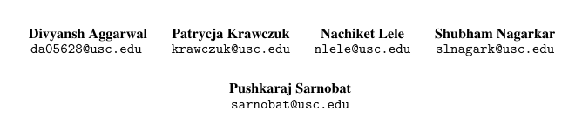
Crisis Computing: Multimodal Social Media Content for Improved Emergency Response
Visionaries

Slide 2
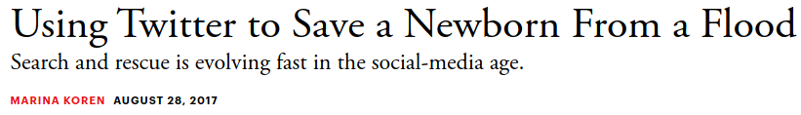
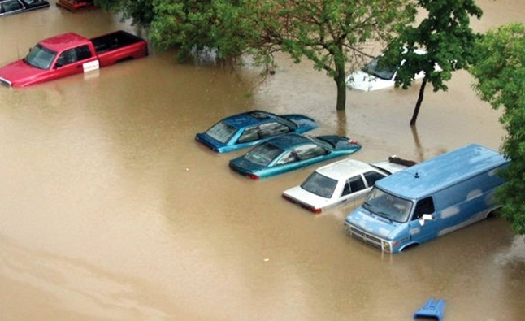
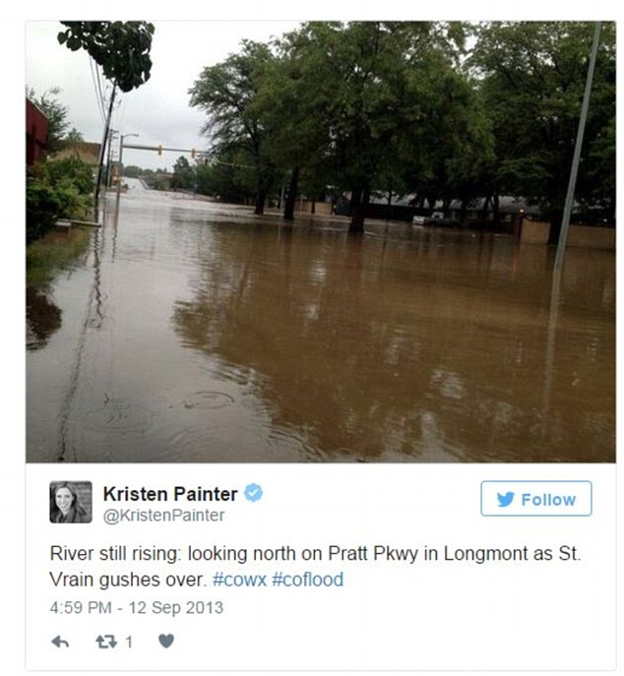
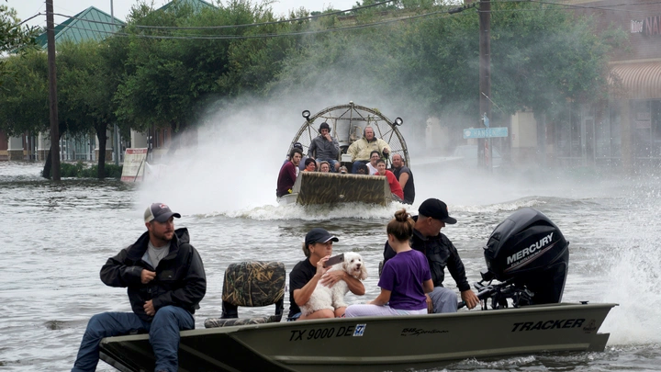

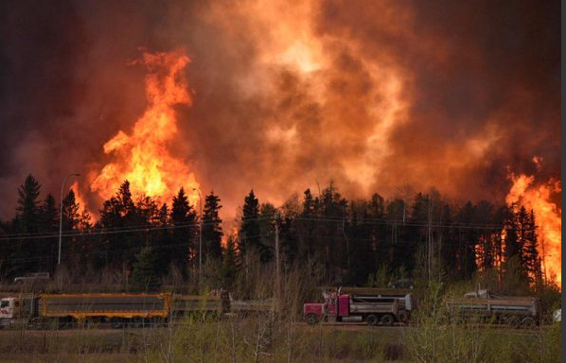
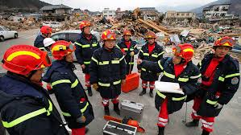


Motivation
California wildfires hit home for Bills rookie Tanner Vallejo #Bills https://t.co/GV4GooaAp6

Slide 3
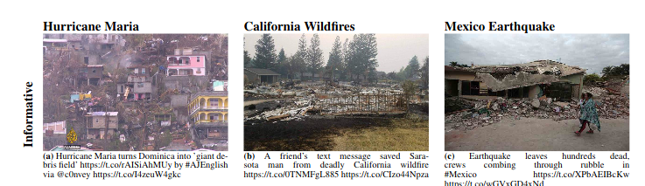
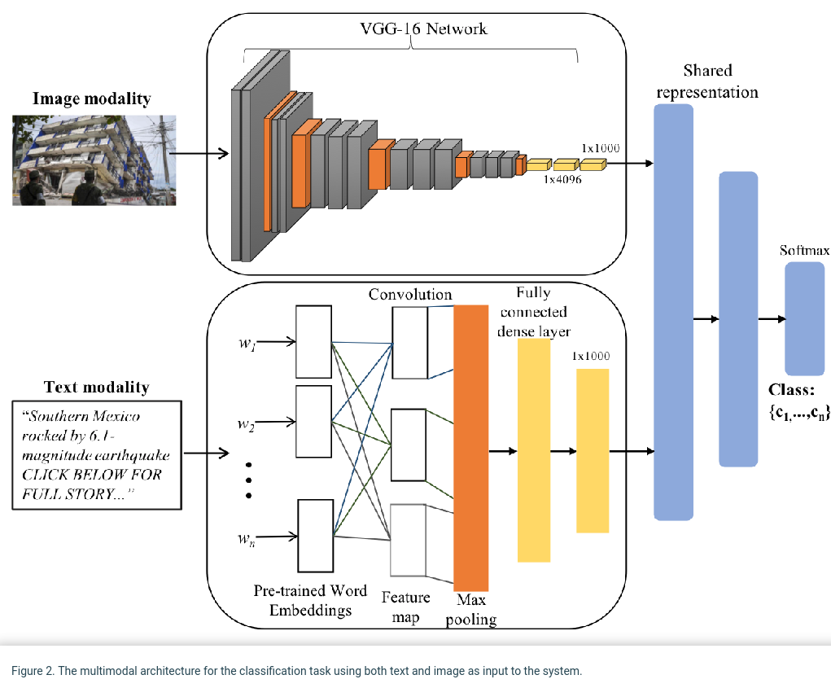
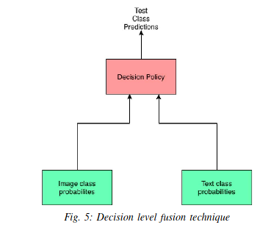
Current Challenges and Limitations
CrisisMMD: Multimodal Twitter Datasets from Natural Disasters
Most research on textual data only,
Labeled data scarcity,
CrisisMMD - first multimodal dataset (late 2018),
Only a couple of papers use multimodal data (all of them recently published), models that use multimodal data outperform unimodal models
LABELS: Disaster Type, Informative vs Not Informative,
Humanitarian Categories, Damage Severity Assessment
Both use only “clean” subset of CrisisMMD
VGG 19 Bidirectional
LSTM
Analysis of Social Media Data using Multimodal
Deep Learning for Disaster Response (April 2020)
Multimodal Analysis of Disaster Tweets (Sept 2019)
Notes:
During natural and man-made disasters, people use social me-dia platforms such as Twitter to post textual and multime-dia content to report updates about injured or dead people,infrastructure damage, and missing or found people amongother information types. Studies have revealed that this on-line information, if processed timely and effectively, is ex-tremely useful for humanitarian organizations to gain situ-ational awareness and plan relief operations.

Slide 4
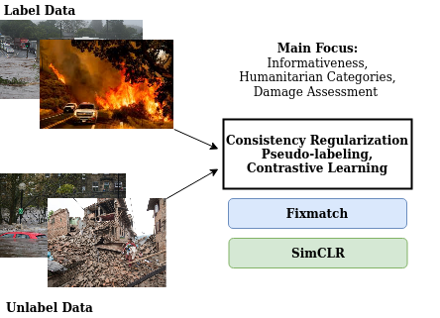
Methods and Experiments I
Step 1: Labels Propagation Images
Employ machine learning methodologies like transfer, contrastive and semi-supervised learning to propagate labels to unimodal datasets
FixMatch: Simplifying Semi-Supervised Learning with Consistency and Confidence
A Simple Framework for Contrastive Learning of Visual Representations
Notes:
During natural and man-made disasters, people use social me-dia platforms such as Twitter to post textual and multime-dia content to report updates about injured or dead people,infrastructure damage, and missing or found people amongother information types. Studies have revealed that this on-line information, if processed timely and effectively, is ex-tremely useful for humanitarian organizations to gain situ-ational awareness and plan relief operations.

Slide 5
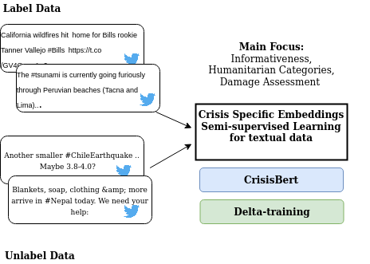
Methods and Experiments II
Step 1: Labels Propagation Text
Employ machine learning methodologies like transfer, contrastive and semi-supervised learning to propagate labels to unimodal datasets
CrisisBert: A Robust Transformer for Crisis Classification and Contextual Crisis Embeddings
Delta-training: Simple Semi-Supervised Text Classificationusing Pretrained Word Embeddings
Notes:
During natural and man-made disasters, people use social me-dia platforms such as Twitter to post textual and multime-dia content to report updates about injured or dead people,infrastructure damage, and missing or found people amongother information types. Studies have revealed that this on-line information, if processed timely and effectively, is ex-tremely useful for humanitarian organizations to gain situ-ational awareness and plan relief operations.

Slide 6
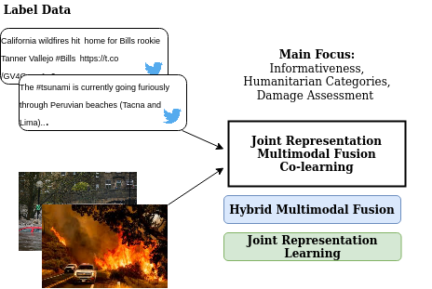
Methods and Experiments III
Step 2: Multimodal Learning
Use the enriched dataset to train multimodal model. Explore techniques like joint representation learning, fusion and co-learning.
Multimodal fusion for multimedia analysis: A survey
Learning Joint Multimodal Representation with Adversarial Attention Networks
Notes:
During natural and man-made disasters, people use social me-dia platforms such as Twitter to post textual and multime-dia content to report updates about injured or dead people,infrastructure damage, and missing or found people amongother information types. Studies have revealed that this on-line information, if processed timely and effectively, is ex-tremely useful for humanitarian organizations to gain situ-ational awareness and plan relief operations.

Slide 7
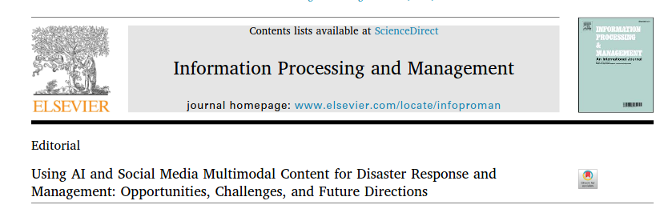
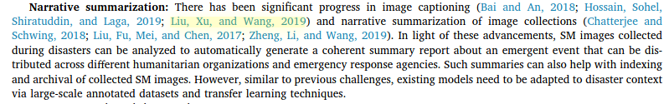

Slide 8
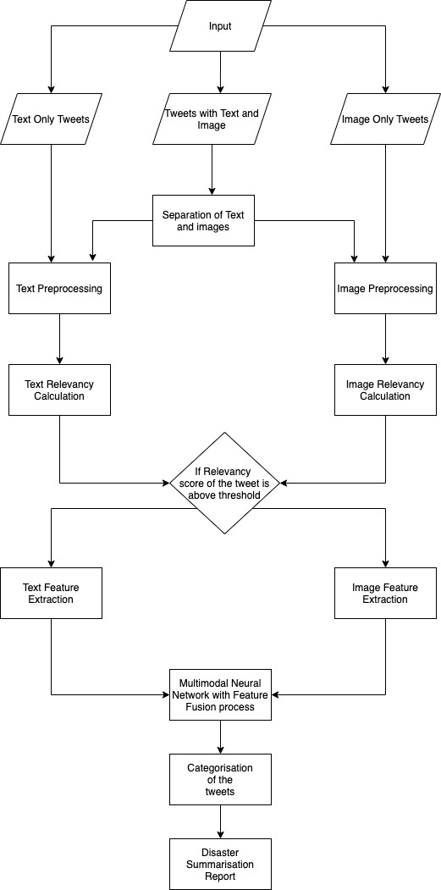
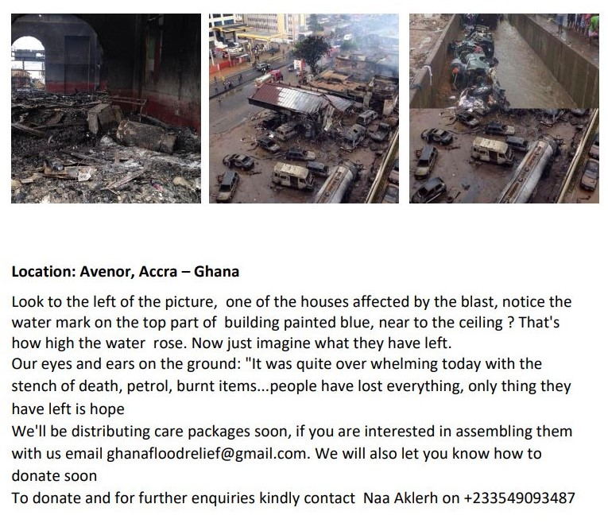
Automatically generating summaries of a developing crisis from online postings.
Notes:
During natural and man-made disasters, people use social me-dia platforms such as Twitter to post textual and multime-dia content to report updates about injured or dead people,infrastructure damage, and missing or found people amongother information types. Studies have revealed that this on-line information, if processed timely and effectively, is ex-tremely useful for humanitarian organizations to gain situ-ational awareness and plan relief operations.

