Slide 1
WORKFLOW FOR LUNG IMAGE SEGMENTATION USING U-NET
A workflow to implement U-Net architecture, for segmenting lung Images, using Pegasus API
https://pegasus.isi.edu

Slide 2
Dataset and Algorithm
Dataset is lung Image segmentation data from NCBI (National Center for Biotechnology Information) - https://www.ncbi.nlm.nih.gov/pmc/articles/PMC4256233/
Images - 662 Images and Masks (~ 4GB)
Using 100 images for the workflow
Model - Keras implementation of U-Net architecture (https://arxiv.org/abs/1505.04597 ). The architecture consists of
Contraction - Increase the “What” and reduces the “Where” (localization)
Expansion - Create high-resolution segmentation map (up-convolutions and concatenation with high-resolution features from contracting path)
Output segmentation map - number of classes
It outperforms a sliding-window convolutional network as it can be trained end-to-end from very few images unlike traditional CNNs.
https://pegasus.isi.edu

Slide 3
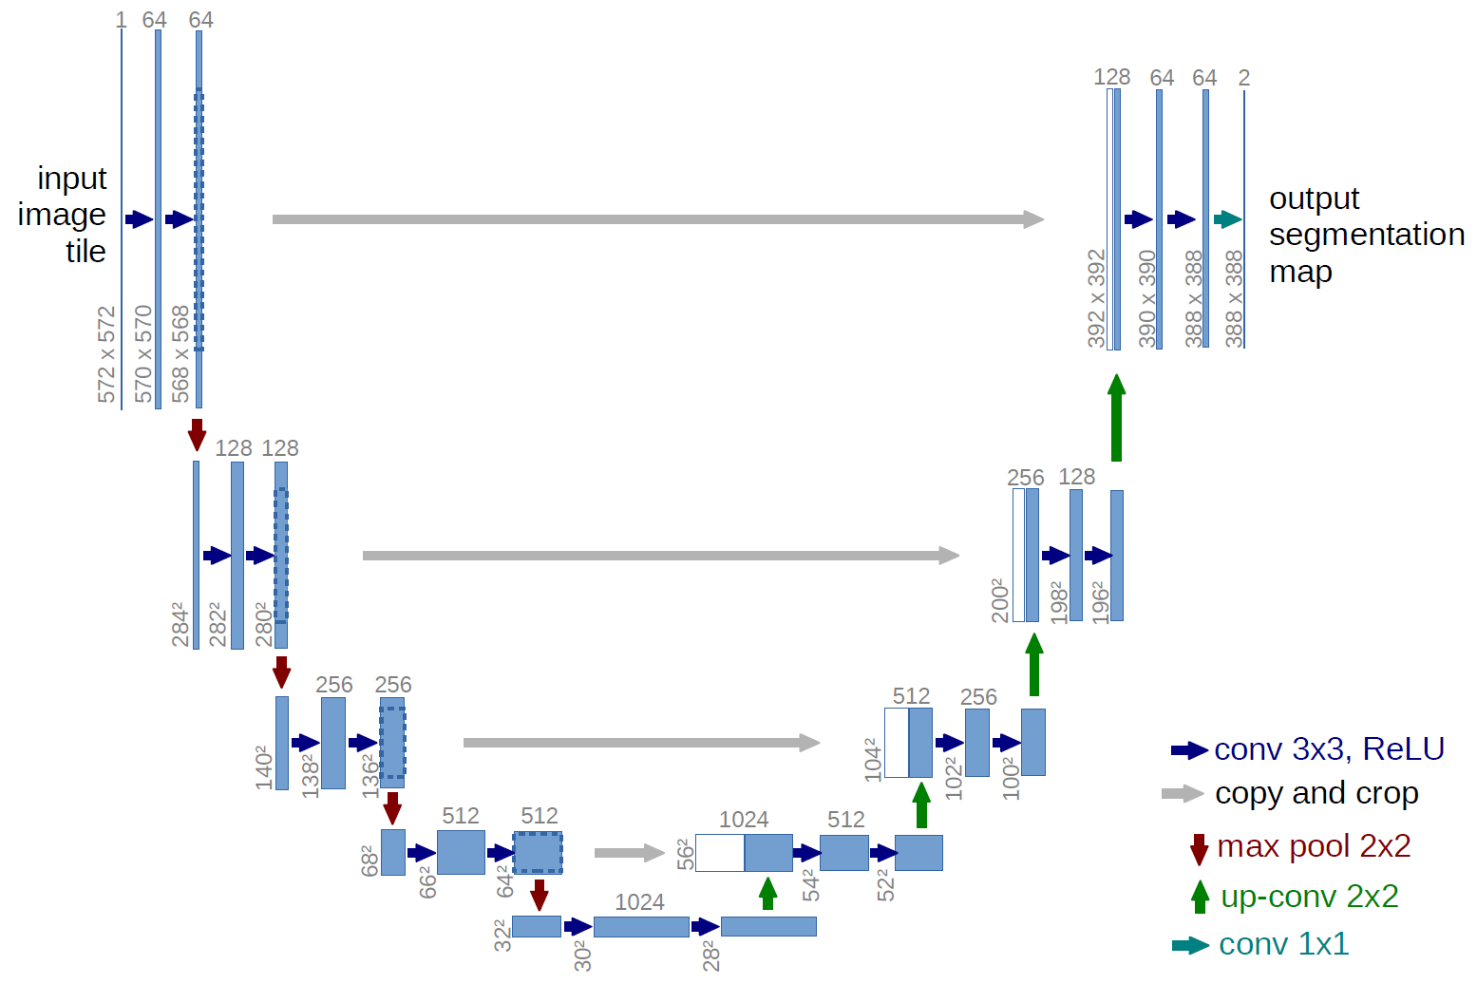

Slide 4
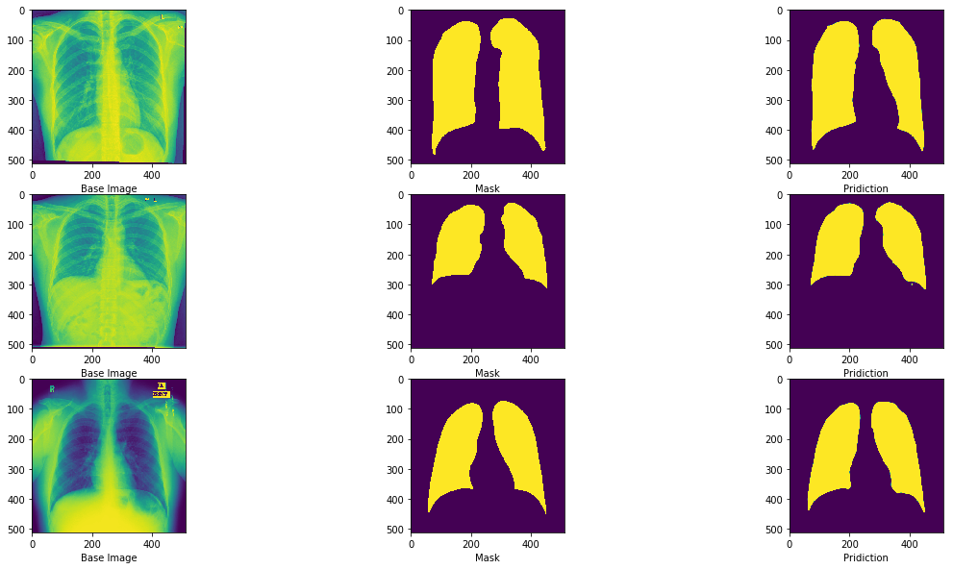
Lung Image Segmentation

Slide 5
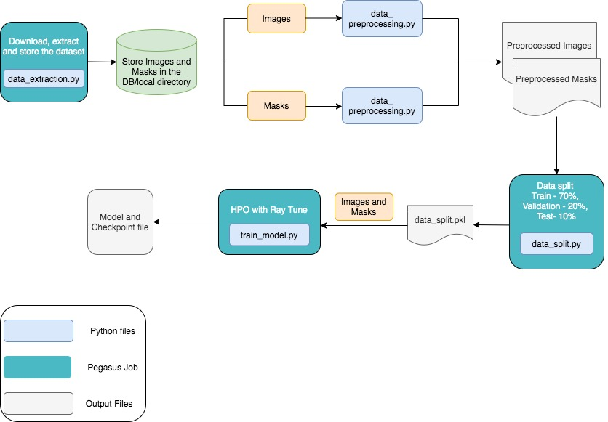
Workflow
https://pegasus.isi.edu

Slide 6
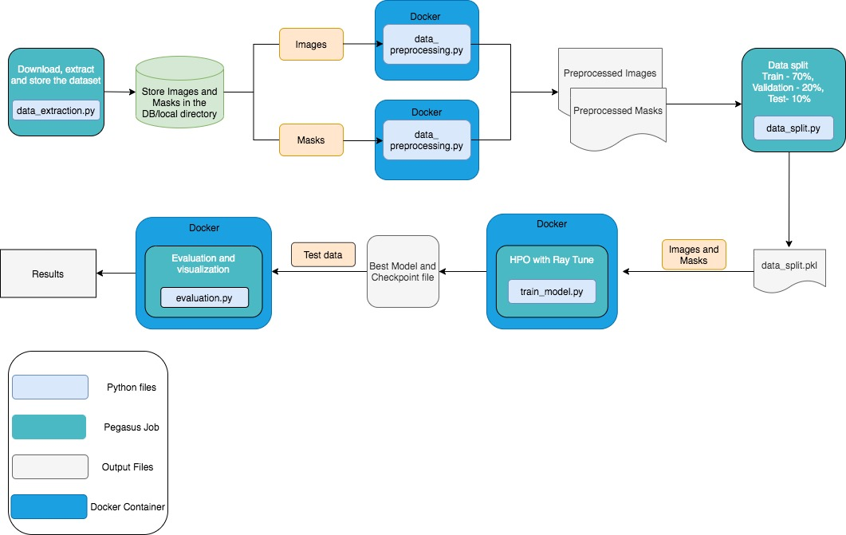
Docker Workflow

Slide 7
Next Steps
Scaling up the dataset and run the workflow on OSG

