Slide 1
NPSA CONGRESS 2026 — BARCELONA
Between Molecules and Mind
The Architecture of Affect
Threat, Opportunity, and Repair Regulated by Three Neuropeptides of POMC
ACTH · Mobilization
β-endorphin · Conservation
α-MSH · Recalibration
Introduction to Meta-strophe Theory · Part One
Mitchell Slutzky, PhD NPSA Barcelona · June 2026
Meta-strophe Theory · Part One
NPSA Congress 2026 · Barcelona
1

Slide 2
CONGRESS FRAMING
If affect is central, what architecture regulates it?
The congress claim becomes a substrate-free functional-architecture question: how affect coordinates regulation across brain and body.
Functional
architecture
Brain–body
communication
Coordinated
response
Clinical
implications
What structure makes affect regulatory across substrates?
How is organismic state broadcast, compared, and updated?
How are regulatory actions selected, fueled, and revised?
How does this change diagnosis, treatment, and prognosis?
Solms and Friston place affect at the foundation of consciousness and press the question of functional organization. This talk proposes one biological candidate: POMC-derived regulatory address space.
Meta-strophe Theory · Part One
NPSA Congress 2026 · Barcelona
2

Slide 3
THE MISSING PIECES
Affect is the felt face of regulation
Not just a feeling added to physiology — a readout of regulatory action.
The organism has to register:
Regulation loop
1
What state it is in
STATE
ACTION
2
What response that state can support
READOUT
3
Whether it has enough supply to meet the demand
Affect is the readout that closes the loop.
Meta-strophe Theory · Part One
NPSA Congress 2026 · Barcelona
3

Slide 4
THE BIOLOGICAL CANDIDATE
POMC is ancient, not cortical
A precursor molecule cleaved into regulatory peptides that coordinate brain and body.
POMC
proopiomelanocortin
ONE PRECURSOR
Conserved across vertebrate evolution
Cleaved on demand
Coordinates state across body and brain
A candidate molecular-affective grammar
ACTH
β-endorphin
α-MSH
Three regulatory economies. One condensed communication: affect state.
Meta-strophe Theory · Part One
NPSA Congress 2026 · Barcelona
4

Slide 5
POMC AND REGULATORY FUELS
One precursor, three regulatory economies
The peptide triplet becomes the first visual grammar of the talk.
ACTH
β-endorphin
α-MSH
Mobilization
• cortisol / glucose
• cardiovascular activation
• readiness for action
Conservation
• analgesia / endurance
• protective withdrawal
• shielding when action is too costly
Recalibration / repair
• energy balance
• immune / inflammatory tuning
• safe strategy update
Meta-strophe Theory · Part One
NPSA Congress 2026 · Barcelona
5

Slide 6
THE PROBLEM AS OLD AS LIFE
Maintain viability under constraint, at minimum cost
Before psychology or cognition, living systems face a thermoeconomic problem.
Regulatory problem
Changing world
expand viability under constraint at minimum cost
Viable action
MOBILIZE
CONSERVE
RECALIBRATE
spend energy · act
reduce expenditure · endure
update strategy · repair
Meta-strophe Theory · Part One
NPSA Congress 2026 · Barcelona
6

Slide 7
AFFECTIVE STATE AS ADDRESS
Three coordinates define a regulatory address
Affective state becomes legible as a point in structured regulatory space.
V
Valence
D
Demand
S
Supply
Threat or opportunity?
The frame in which regulatory fuels are used.
Mobilize, conserve, or recalibrate?
The strategy being implemented.
Peptide-specific fuel relative to demand.
Mismatch generates affective state.
Notation: V±[D_X relation S_Y] example: V−[D_M > S_ACTH]
Meta-strophe Theory · Part One
NPSA Congress 2026 · Barcelona
7

Slide 8
FROM ADDRESS TO MAP
A regulatory address becomes a point in space
The same grammar can be read clinically, biologically, and geometrically.
Regulatory address
Point in regulatory space
V−[D_M > S_ACTH]
Demand
Threat frame
Mobilization demand
ACTH undersupply
ANXIETY
Supply relation
Valence
Each named affect is a location, not merely a label.
Meta-strophe Theory · Part One
NPSA Congress 2026 · Barcelona
8

Slide 9
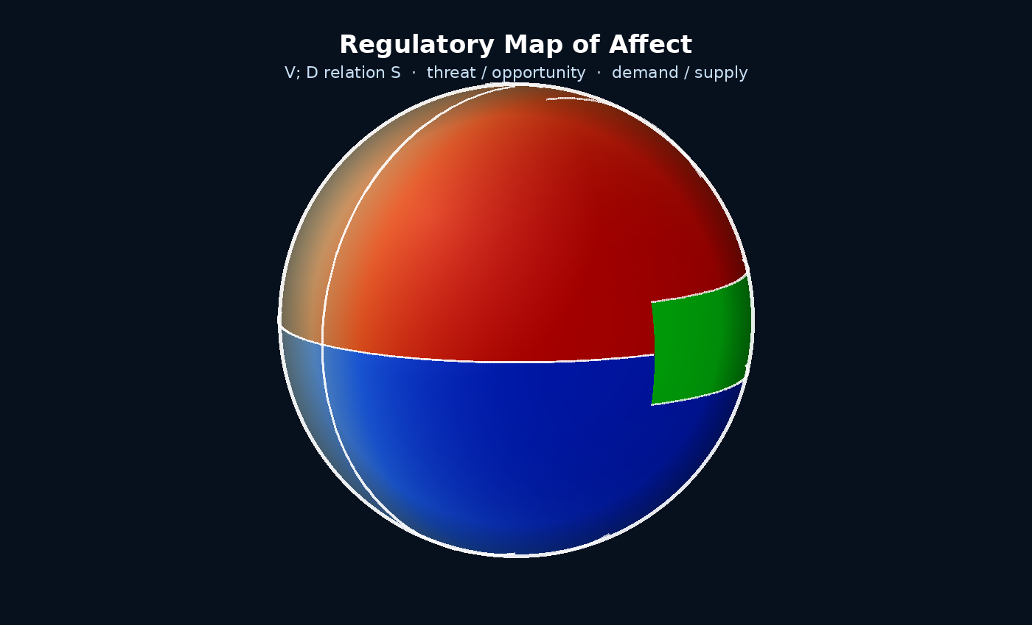
META-STROPHE THEORY
The geometry that falls out is a sphere
Catastrophe is the turn downward; Meta-strophe is the turn beyond.
Opportunity face
Threat face
mobilize / conserve + recalibrate accuracy > speed
mobilize / conserve speed > accuracy
Part One: the structure of affect. The larger theory asks how organisms turn beyond failed regulation.
Meta-strophe Theory · Part One
NPSA Congress 2026 · Barcelona
9

Slide 10
BUILDING THE MAP
First: a single axis — demand
Before affect labels, the system must choose a regulatory strategy.
MOBILIZE
do more · spend energy · act
This choice applies whether the situation is later read as threat or opportunity.
Valence comes next.
do less · reduce expenditure · shield
CONSERVE
Meta-strophe Theory · Part One
NPSA Congress 2026 · Barcelona
10

Slide 11
THREAT FACE
Threat compresses regulation into a 2×2 map
Left is undersupply; right is oversupply. Peptide supply is always relative to regulatory demand.
D > S undersupply
D < S oversupply
Anxiety
Anger
Mobilize / ACTH
V−[D_M > S_ACTH]
ACTH under-supplied
activation without capacity
V−[D_M < S_ACTH]
ACTH over-supplied
surplus force for boundary defense
Depression
Dissociation
Conserve / β-endorphin
V−[D_C > S_β-End]
β-endorphin under-supplied
shutdown without adequate protection
V−[D_C < S_β-End]
β-endorphin over-supplied
protective shielding / analgesia
Threat = act now or shield now. No true recalibrative middle is foregrounded.
Meta-strophe Theory · Part One
NPSA Congress 2026 · Barcelona
11

Slide 12
FOUR THREAT-AFFECT CONFIGURATIONS
Threat × demand × supply produces clinical states
Same coordinate grammar; four familiar clinical configurations.
Anxiety
Anger
Depression
Dissociation
V−[D_M > S_ACTH]
ACTH under-supplied
V−[D_M < S_ACTH]
ACTH over-supplied
V−[D_C > S_β-End]
β-endorphin under-supplied
V−[D_C < S_β-End]
β-endorphin over-supplied
The map distinguishes activation without capacity, forceful defense, unprotected shutdown, and protective shielding.
Meta-strophe Theory · Part One
NPSA Congress 2026 · Barcelona
12

Slide 13
OPPORTUNITY FACE
α-MSH adds the third regime: recalibration
Opportunity does not mean “pleasant”; it means enough room to update rather than merely react.
Opportunity
Threat
Mobilize
Recalibrate
Conserve
Mobilize
three demands × three supply relations = nine regions
Conserve
α-MSH coordinates the conditions under which old regulation can be revised safely.
speed > accuracy
Meta-strophe Theory · Part One
NPSA Congress 2026 · Barcelona
13

Slide 14
OPPORTUNITY MAP
The opportunity face opens nine regions
Opportunity adds matched supply states; recalibration creates the middle band.
D > S undersupply
D = S
matched
D < S oversupply
Anticipation
Engagement
Exhilaration
Mobilize / ACTH
V+[D_M > S_ACTH]
ACTH under-supplied
V+[D_M = S_ACTH]
ACTH matched to demand
V+[D_M < S_ACTH]
ACTH over-supplied
Too Cautious
Comfort Zone
Overconfident
Recalibrate / α-MSH
V+[D_R > S_α-MSH]
α-MSH under-supplied
V+[D_R = S_α-MSH]
α-MSH matched to demand
V+[D_R < S_α-MSH]
α-MSH over-supplied
Complacency
Contentment
Bliss
Conserve / β-endorphin
V+[D_C > S_β-End]
β-endorphin under-supplied
V+[D_C = S_β-End]
β-endorphin matched to demand
V+[D_C < S_β-End]
β-endorphin over-supplied
Comfort Zone = maximum regulatory freedom: the system can mobilize, conserve, and update without collapsing back into threat.
Meta-strophe Theory · Part One
NPSA Congress 2026 · Barcelona
14

Slide 15
LIVE DEMONSTRATION
Entering the regulatory map
If the live/local sphere works, this is where the deck gives way to the model.
Sphere sequence
1. Threat face: demand + supply
2. Four threat affects
3. Opportunity face: α-MSH adds recalibration
4. Clinical trajectories
Backup slides follow if AV fails.
Meta-strophe Theory · Part One
NPSA Congress 2026 · Barcelona
15

Slide 16
CLINICAL RAMIFICATIONS
Diagnosis is a trajectory, not a box
Repeated mismatches move the system through regulatory space.
Bipolar disorder
PTSD
Borderline organization
diagonal traversal: over-supplied mobilization → depleted conservation
threat-lock: cycling within the threat face, recalibration unavailable
rapid cross-valence instability, difficulty stabilizing in matched zone
Meta-strophe Theory · Part One
NPSA Congress 2026 · Barcelona
16

Slide 17
EXTENSIONS AND CONVERGENCES
Three convergences, one proposed architecture
Each mapping is a bridge, not the full paper.
Freud
Panksepp
Polyvagal Theory
• Pleasure principle: biphasic discharge
• Reality principle: triphasic recalibration
• Nirvana principle: zero-demand origin
• Primary emotional systems
• Motivational vectors
• Direction + intensity + resource signature
• Mobilization and shutdown as threat strategies
• Social engagement as regulated access to safety
• Meta-strophe adds peptide-specific supply and recalibration
The claim is structural convergence: prior models describe parts of a larger regulatory architecture.
Meta-strophe Theory · Part One
NPSA Congress 2026 · Barcelona
17

Slide 18
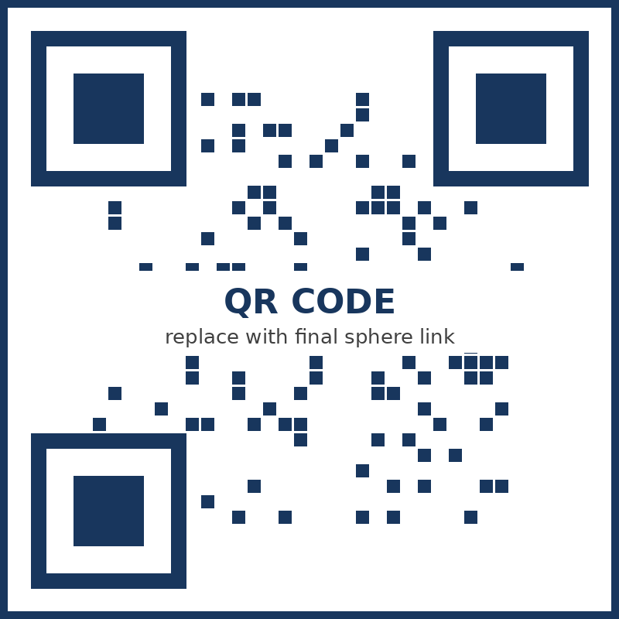
PROGRAM AND FALSIFICATION
Three claims to test under pressure
If the trajectories do not fit the cases, the model should change.
1
Affective states are regulatory addresses: valence, demand, and peptide-specific supply.
2
Clinical categories are trajectories through the sphere, not flat symptom clusters.
3
Treatment alters trajectories by restoring recalibration and reducing threat-lock.
Enter the sphere
[final URL / QR]
Rotatable map · clickable regions · clinical trajectory overlays
Further developments and resource pages will be posted as completed.
Meta-strophe Theory · Part One
NPSA Congress 2026 · Barcelona
18

