Slide 1
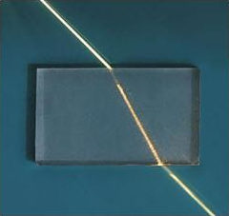
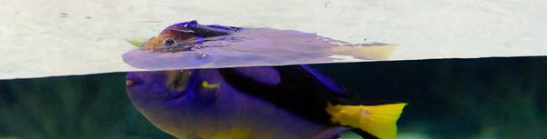
4.04 Wave Speed and Density: Refraction
Why does light bend when it enters a new medium?
Notes:
Unit 4a Waves, lesson 4.04 (Mon, Nov 16). Classkick: Flip the Sign + Case #1 warm-up, Part 1 Refraction (Q1-Q4), the Refraction Lab (Q5-Q7), and the Refraction Lab Map. The graded 4.04 Refraction Lab is assigned today. Lab Map repeats the lab slide: you can hand out answers.

Slide 2
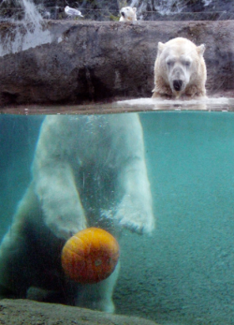
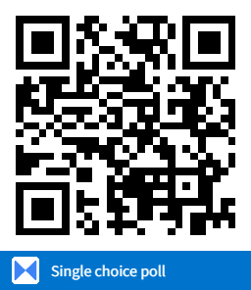
Think About It
Why does this polar bear look like its head is chopped off?
Make your best guess. We will find out today!
A. It is really two different bears.
B. Light bends when it goes between water and air.
C. The water acts like a mirror.
D. The bear is actually shaped like that.
Notes:
Hook. Answer: B. Light from the bear changes speed as it crosses between the water and the air, so it bends (refraction). The light from the bear's body reaches your eyes from a different direction than the light from its head, so the two parts do not line up. Come back to this picture after the refraction video.

Slide 3





Today's Goals
I can define refraction: a wave bends when it enters a new medium.
I can explain that the wave's speed changes, so it bends.
I can tell when light bends toward or away from the normal.
I can use PhET data to show light slows down in glass and water.
Rate each goal:
1
Not yet
2
Getting there
3
I can teach it
Notes:
Objective from the 4.04 page: Students will learn how a wave's speed changes when it enters a new medium, and how that change makes light bend (refraction).

Slide 4

Ohio Science Standards
7.PS.4 Energy can be transferred through a variety of ways.
In this lesson
Integer warm-up
Vocab check-in
What is refraction?
Toward or away from the normal
The marching band model
Refraction Lab (graded)
Lenses and our eyes
A wave travels at a constant speed through a material as long as the material is uniform.
The speed of a wave depends on the material (sound travels faster through most solids than gases).
When a wave enters a new medium, its speed changes, which can make it bend (refraction).
Inquiry skills (Grades 5–8): "Use appropriate mathematics, tools and techniques to gather data" and "Think critically and logically to connect evidence and explanations" (today's Refraction Lab).
Source: Ohio's Learning Standards for Science (2018), Grade 7 Physical Science; content statement paraphrased.

Slide 5
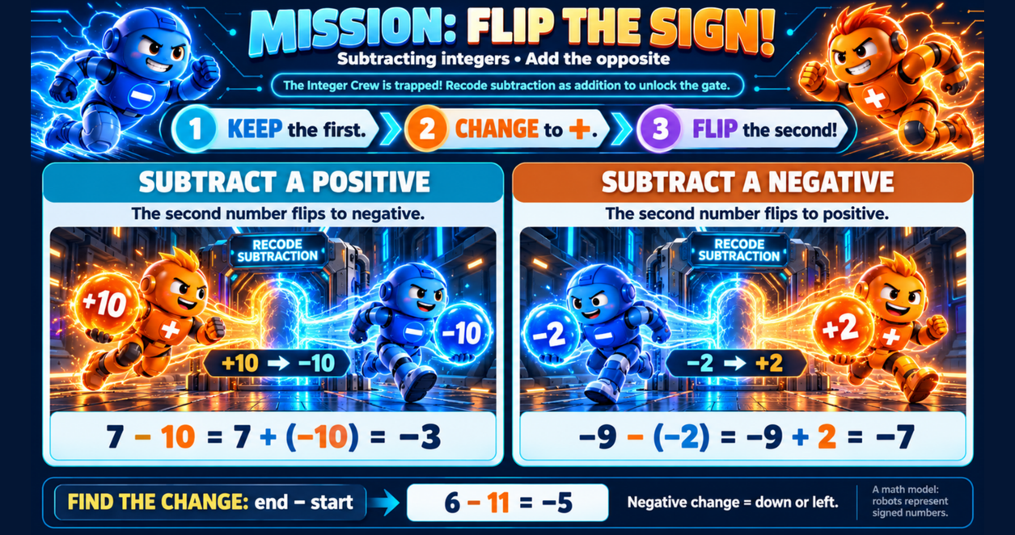
Classkick: 4.04 Math · Flip the Sign
Notes:
Math poster: subtracting integers. Keep the first, change subtraction to addition, flip the sign of the second number. 7 − 10 = 7 + (−10) = −3. −9 − (−2) = −9 + 2 = −7.

Slide 6
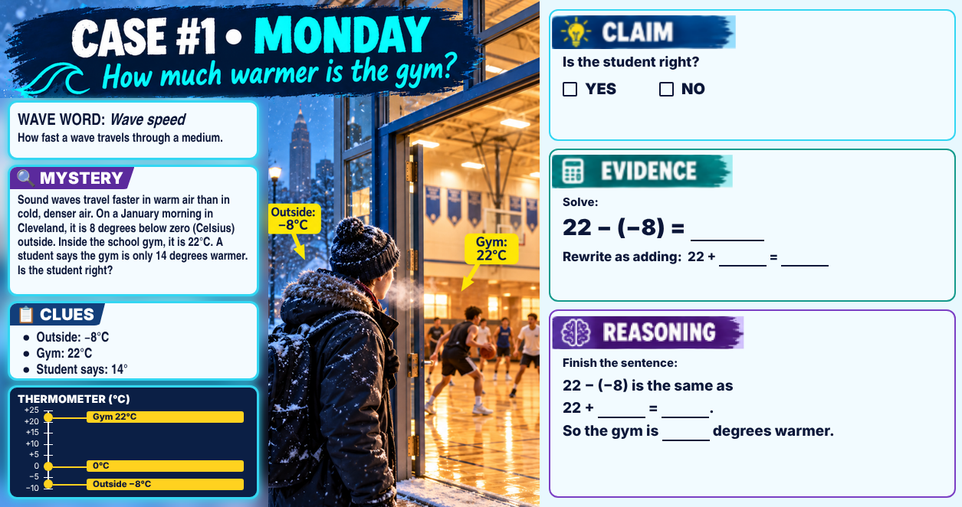
Classkick: 4.04 Math · Case #1
Notes:
Case #1 (gym). Answer key: Claim NO. Evidence: 22 − (−8) = 30; rewrite as adding 22 + 8 = 30. Reasoning: 22 − (−8) is the same as 22 + 8 = 30, so the gym is 30 degrees warmer, not 14.

Slide 7

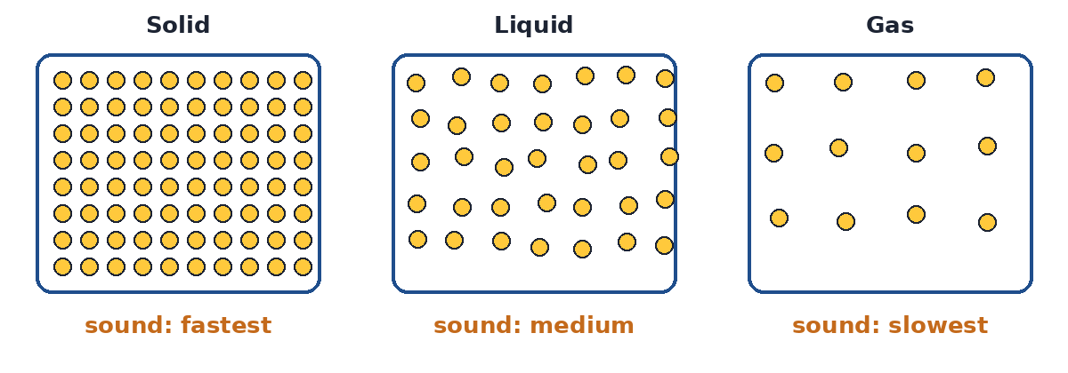
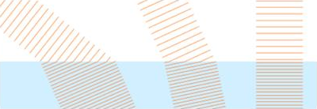
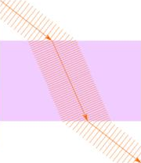
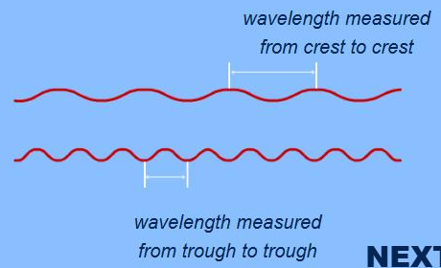
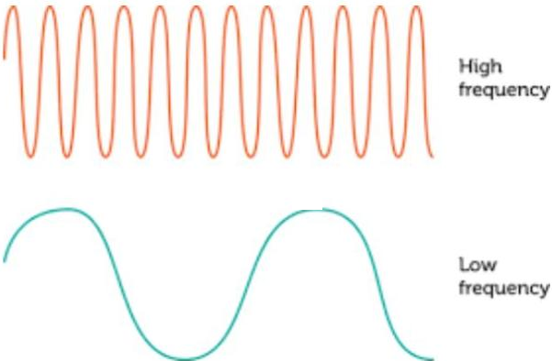
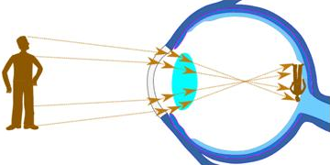
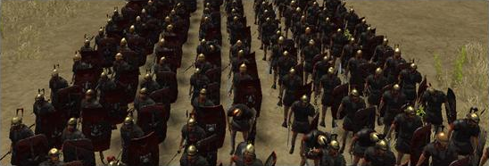
Vocab Check-In
From your Unit 4 vocabulary pretest. Today we focus on the starred words.
refraction ★
density ★
medium ★
normal
the bending of a wave when it enters a different medium
how much mass is packed into a space; glass and water are denser than air
the material a wave travels through (air, water, glass)
an imaginary line at a right angle (90°) to the surface
wavelength ★
frequency ★
lens
wave speed
the distance from one crest to the next crest
the number of waves that pass a point each second
a curved, clear object that bends light to focus it
how far a wave travels each second; it depends on the medium
Notes:
Pre Vocab survey words today: refraction, density, medium, wavelength, frequency. Normal, lens, and wave speed are lesson words.

Slide 8
What Is Refraction?
Classkick: 4.04 Part 1 · Q3
Refraction = the bending of a wave when it enters a different medium.
In the new medium:
speed changes
frequency stays the same
wavelength changes
direction bends (if it hits at an angle)
Pictures from the 4.04 page: the pulses bunch up in the water, and the fish looks shifted at the waterline.
Notes:
Classkick Q3 (air into glass): speed slows down; frequency stays the same; wavelength changes; direction bends. 4.07 Quest Q2 and Mission Q7-Q8.

Slide 9


Watch: Refraction
Classkick: 4.04 Part 1 · Q1
Watch the red ray:
Air into glass: toward or away from the normal?
Glass into air: toward or away?
Straight in: does it bend?
Refraction video from the 4.04 page (plays here in Slide Show)
▶ Backup: YouTube
Notes:
Classkick Q1: a) toward, b) away, c) straight. Refraction Lab Q3 and Mission Q7. Streams from YouTube, so you need internet.

Slide 10
Toward or Away From the Normal?
Classkick: 4.04 Part 1 · Q1
Into a DENSER medium
light slows down and bends TOWARD the normal
Into a LESS dense medium
light speeds up and bends AWAY from the normal
Straight in (90°)
no bending, but the speed still changes
Normal: an imaginary line at a right angle (90°) to the surface. Angles are measured from the normal.
Notes:
Pictures from the 4.04 page. The plastic is denser, so the light bends toward the normal going in and away coming out, and leaves at the same angle it entered.

Slide 11
Classkick: 4.04 Part 1 · Q1, Q3
Engageli Poll
Light shines at an angle from the air into a glass block. Glass is denser than air. What happens to the light?
A. Speeds up, bends toward the normal
B. Slows down, bends toward the normal
C. Slows down, bends away from the normal
D. Same speed, goes straight
Notes:
Answer: B. Entering a denser medium, light slows down and bends toward the normal. (Mission Q7-Q8, 4.07 Quest Q2.)

Slide 12

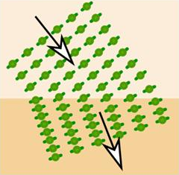
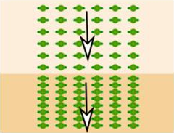
Why Does It Bend? The Marching Band
Classkick: 4.04 Part 1 · Q2, Q4
Flat ground: fast
Light does the same thing when it enters a denser medium.
At an angle: one side slows first, so the line turns.
Straight on: everyone slows together, no turn.
Notes:
Pictures from the 4.04 page. Q2: slow down, changes, denser (extra word: faster). Q4: not bend, slows down, denser (extra: speeds up).

Slide 13
Who Is Right?
A straw in a glass of water looks broken right at the water line. Who explains it best?
Ava says:
Ben says:
Cam says:
Dee says:
"The water pushes on the straw and really bends it."
"Light bounces off the water like a mirror."
"Light changes speed between water and air, so it bends."
"The water soaks up the light, so part of the straw disappears."
A. Ava
B. Ben
C. Cam
D. Dee
Notes:
Answer: C (Cam). Refraction: light changes speed when it crosses between water and air, so it bends, and the straw only looks broken. Ava: the straw is still straight. Ben: that is reflection. Dee: that is absorption, which makes light dimmer, not bent. Matches 4.07 Quest Q3.

Slide 14
Graph Poll
Read the graph.
A light ray goes from air into each material at an angle. In which one does it bend MOST?
A. ice
B. olive oil
C. diamond
D. all the same
Notes:
Answer: C. diamond. Light slows down the most in diamond (0.41 c), and a bigger change in speed means more bending. These materials are not the ones in the Refraction Lab, so the lab answers stay hidden.

Slide 15
Graph Poll
Read the graph.
The ray started at 45°. What pattern does the graph show?
A. Slower material, bigger angle
B. Slower material, closer to the normal
C. The angle never changes
D. Faster material, more bending
Notes:
Answer: B. The slower the light goes in a material, the more it bends toward the normal (smaller angle). Same light ray at 45° from the normal in air.

Slide 16
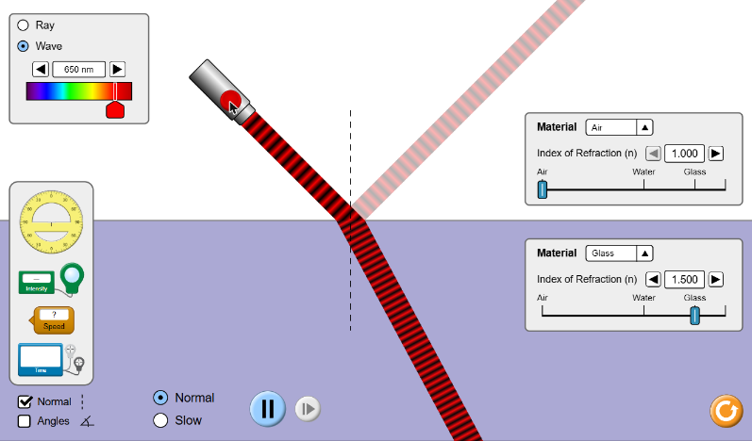
Refraction Lab: PhET Bending Light
Classkick: 4.04 Lab · Q5–Q7
1
Open More Tools. Switch Ray to Wave. Set 650 nm.
2
Press the red button to turn on the laser.
3
Set the top and bottom materials: AIR / AIR, then AIR / GLASS, then AIR / WATER.
4
Put the Speed tool on the top beam, then the bottom beam. Record the speeds.
▶ Open PhET Bending Light
The speed tool compares speed to c, the speed of light in empty space.
Notes:
Screenshot of PhET Bending Light, More Tools (air into glass). Lab Q5 data: air/air 1.00 c both, no bend; air/glass 0.67 c, bends; air/water 0.75 c, bends. Q6: slowest in glass; air to air straight; bent toward the normal. Q7: slows down, 0.67 c, bends, normal (extra: speeds up).

Slide 17

Get Ready for the Refraction Lab
Classkick: 4.04 Refraction Lab Map
Air → Air
Air → Glass
Same medium on both sides: no change in speed and no bending.
Glass is denser, so light slows down and bends toward the normal.
Don't fall for it
Watch out!
Light does NOT speed up in glass. Denser medium = slower light = bending.
Light is slower in denser materials. Sound is the opposite: faster in solids.
4.04 Refraction Lab (10 pts): assigned today. Due Mon, Nov 23 (extended time: Mon, Nov 30). Test each answer in PhET!
Notes:
The Lab Map questions match the graded 4.04 Refraction Lab. Lab Map repeats the lab slide, so you can hand out the answers.

Slide 18

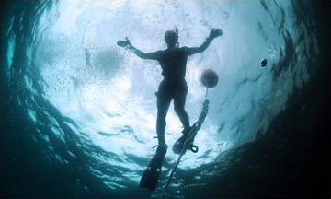
Refraction in Real Life
Your eye
Looking up from underwater
A plastic block
The lens bends light to focus it on the back of the eye. The image is upside down, and your brain flips it!
The whole sky squeezes into a bright circle at the surface.
Light bends going in and bends back coming out.
Notes:
Pictures from the 4.04 page. Classkick Q3 adds: our eyes use refraction to focus light on the back of the eye.

Slide 19
Key Ideas
1
Refraction = a wave bends when it enters a new medium.
2
The speed changes. The frequency stays the same, so the wavelength changes.
3
Into a denser medium, light slows down and bends toward the normal.
4
Light is slower in denser materials. Sound is faster in solids.
Re-rate your goals: 1 = Not yet, 2 = Getting there, 3 = I can teach it

