Slide 1
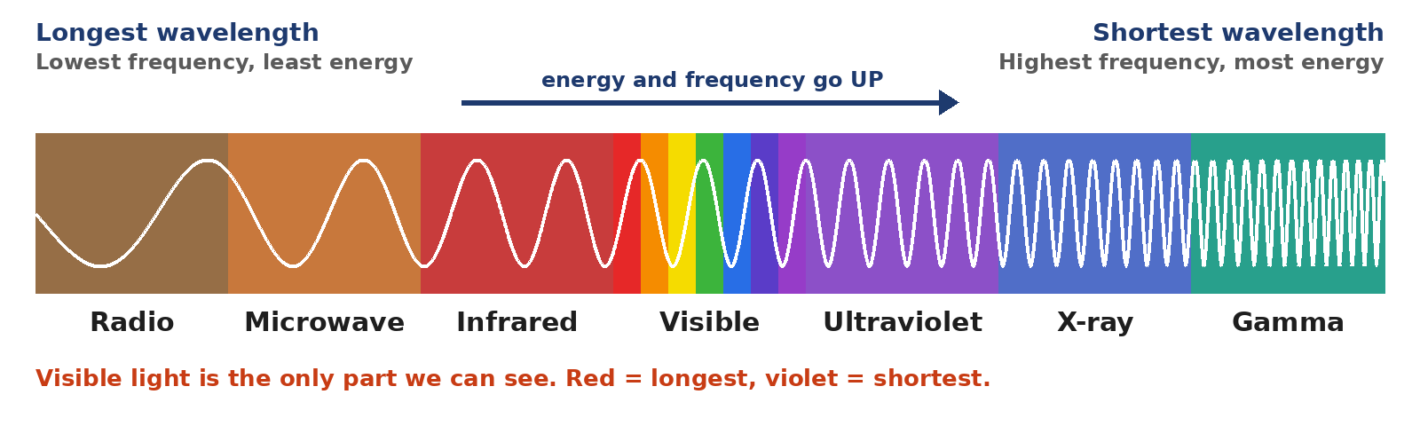
4.08 Electromagnetic Spectrum
What makes each kind of light wave different?
Notes:
Unit 4a Waves, lesson 4.08 (Mon, Nov 23). Keep the talk short: Part 1 (drag and drop) and Part 2 (escape room) take most of the class. Classkick: The 4 Rules, Case #1, Part 1 Q1-Q3, Part 2 escape room certificate. 4.04 Refraction Lab due today.

Slide 2


Watch First: The EM Spectrum
Notes:
YouTube video embedded (plays in Slide Show with internet). Original link: https://www.youtube.com/watch?v=OYK7G6r0Pec. While watching, students listen for the 7 kinds of EM waves in order.

Slide 3





Today's Goals
I can put the EM spectrum in order from longest to shortest wavelength.
I can explain how frequency, wavelength, and energy are linked.
I can match each EM wave to how we use it.
I can use what I know to escape the EM escape room.
Rate each goal:
1
Not yet
2
Getting there
3
I can teach it
Notes:
Objective from the 4.08 page: explore the EM spectrum and the different types of EM waves.

Slide 4

Ohio Science Standards
7.PS.4 Energy can be transferred through a variety of ways.
In this lesson
EM spectrum video
Integers: The 4 Rules + Case #1
Part 1: EM Spectrum drag and drop
Part 2: EM Spectrum Escape Room
Light and other EM waves do not need a medium. They can travel through a vacuum (empty space).
They can also travel through some materials, like clear glass.
As the frequency of a wave goes up, its wavelength goes down.
Source: Ohio's Learning Standards for Science (2018), Grade 7 Physical Science; content statement paraphrased.

Slide 5
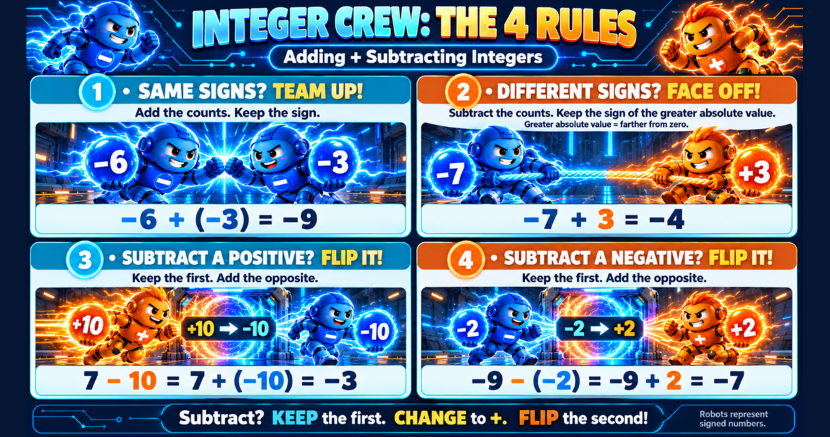
Classkick: 4.08 Math · The 4 Rules
Notes:
Week 3 integer rules. 1: Same signs, add and keep the sign. 2: Different signs, subtract and keep the sign of the greater absolute value. 3 and 4: Subtracting? Keep the first, change to +, flip the second.

Slide 6
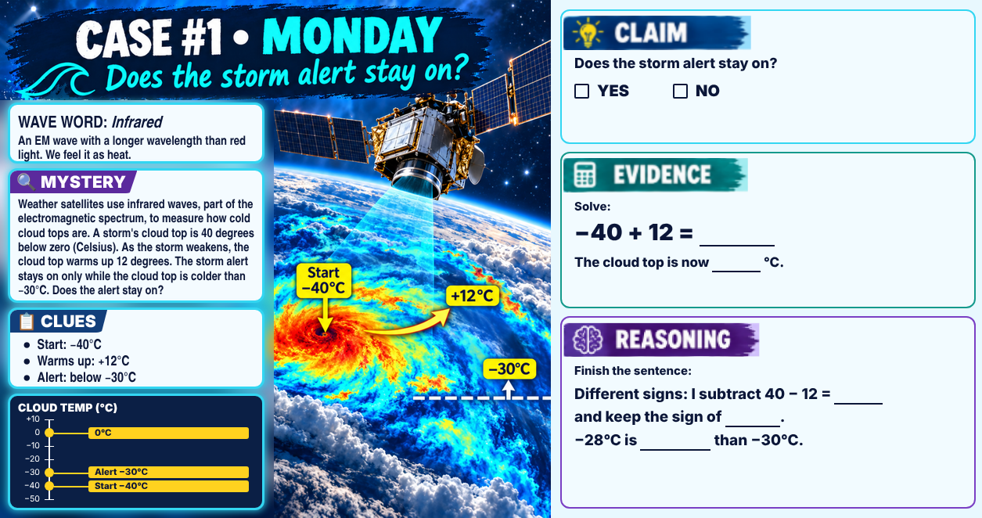
Classkick: 4.08 Math · Case #1
Notes:
Case #1 (storm alert). Key: Claim NO. Evidence: −40 + 12 = −28. Reasoning: different signs, subtract 40 − 12 = 28 and keep the sign of −40. −28°C is warmer than −30°C, so the alert turns off. Wave word: infrared.

Slide 7
Part 1: Put the Spectrum in Order
Classkick: 4.08 Part 1 · Q1
Remember the order: Raging Martians Invaded Venus Using X-ray Guns
All EM waves travel through space at the speed of light. Higher frequency = shorter wavelength = more energy.
Notes:
Q1 key: radio, microwave, infrared, visible light, ultraviolet, X-ray, gamma ray (extra word: sound, which is not an EM wave). Mnemonic is optional.

Slide 8

Engageli Poll
Which EM wave has the MOST energy?
A. radio waves
B. visible light
C. gamma rays
D. microwaves
Notes:
Answer: C. Gamma rays have the shortest wavelength and highest frequency, so the most energy (Q3c). Quick check only; move on to Part 1.

Slide 9

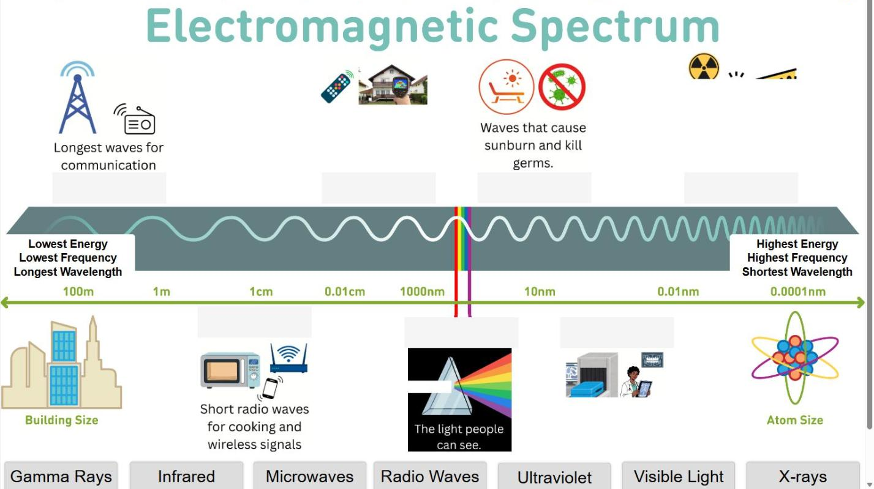
Part 1: EM Spectrum Drag and Drop
Classkick: 4.08 Part 1 · Q2–Q3
About 15 minutes
Drag each wave onto the spectrum. Press Check.
Q2: Use the pictures to match each clue to its wave.
Q3: Use the size scale (building to atom).
▶ Open the EM Spectrum drag and drop
Notes:
Screenshot of Classkick Link 1. Q2 key: TV remotes/thermal cameras = infrared; cooking and wireless = microwaves; sunburn/kill germs = ultraviolet; medical images/security scanners = X-rays; highest energy, nuclear reactions = gamma rays (extra: radio waves). Q3: building; atom; highest.

Slide 10

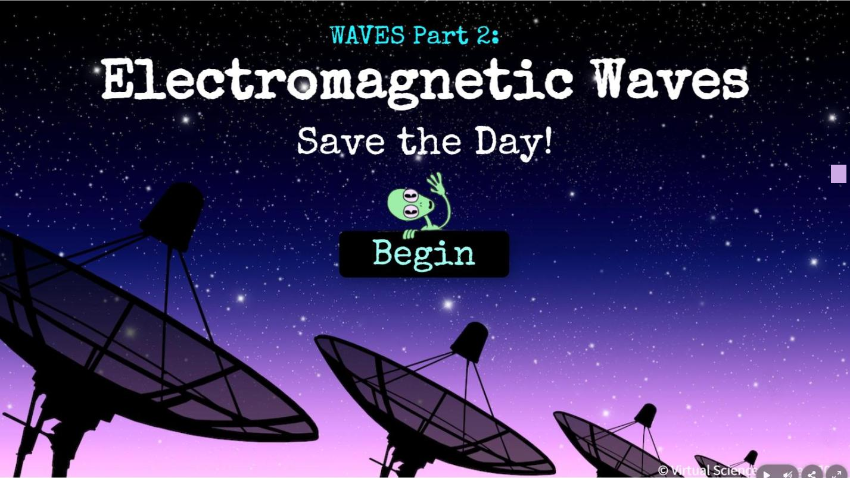
Part 2: EM Spectrum Escape Room
Classkick: 4.08 Part 2 · Certificate
Use the rest of class
Click Begin. Use your notes and Part 1 to solve each puzzle.
Keep going until you escape.
The LAST screen is a certificate. Type your name.
▶ Open the EM Spectrum Escape Room
Notes:
Screenshot of the Genially escape room (Classkick Part 2 link). It is long; students who do not finish keep going on their own and paste the certificate later.

Slide 11




Paste Your Certificate in Classkick
Classkick: 4.08 Part 2 · Certificate
1. Snip it
2. Copy it
3. Paste it
Windows + Shift + S
Ctrl + C
Ctrl + V
Chromebook: Ctrl + Shift + Show windows. Drag a box around the certificate.
If it did not copy already.
Click the box on the Classkick slide, then paste. Your name must show.
Notes:
Same steps as the Classkick Part 2 slide.

Slide 12
Key Ideas
1
All EM waves travel through space at the speed of light. They need no medium.
2
Order: radio, microwave, infrared, visible, ultraviolet, X-ray, gamma.
3
Higher frequency = shorter wavelength = more energy.
4
Radio waves can be as long as a building. Gamma rays are as small as an atom.
Re-rate your goals. Not done with the escape room? Finish it and paste your certificate.

