Slide 1
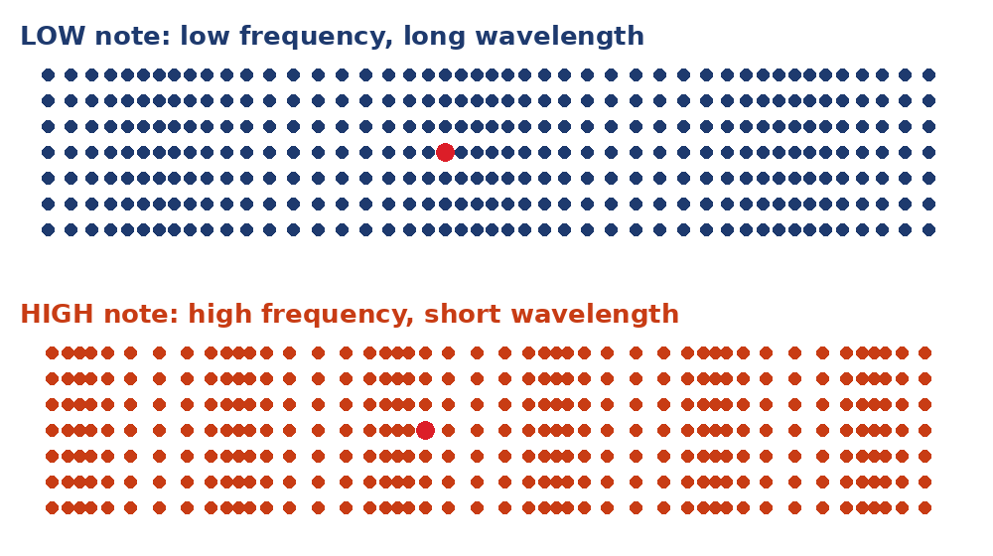
4.11 Sound Waves Lab
How does sound travel, and what changes pitch and loudness?
Notes:
Unit 4a Waves, lesson 4.11 (Tue, Dec 1). Classkick: Case #2 (decibels), Part 1 Music Lab Sound Waves (Q1-Q4), Part 2 PhET Sound Waves (Q5-Q9). Use Chrome. Keep talk short; the lab is the lesson. Nothing graded from 4.11.

Slide 2

Think About It
You pluck a guitar string harder. What changes about the sound?
A. It gets higher
B. It gets louder
C. It travels faster
D. Its wavelength gets shorter
Notes:
Answer: B. A harder pluck = bigger amplitude = more energy = louder. Pitch, speed, and wavelength stay the same.

Slide 3





Today's Goals
I can explain how sound travels as a longitudinal wave.
I can connect pitch to frequency and wavelength.
I can connect loudness to amplitude and energy.
I can explain why sound needs a medium.
Rate each goal:
1
Not yet
2
Getting there
3
I can teach it
Notes:
Objective from the 4.11 page: analyze sound waves and how they travel through different media.

Slide 4

Ohio Science Standards
7.PS.4 Energy can be transferred through a variety of ways.
In this lesson
Integers: Case #2
Part 1: Music Lab Sound Waves
Pitch vs. loudness
Part 2: PhET Sound Waves (4 screens)
Can sound travel with no air?
Mechanical waves need a medium. The medium moves, then returns to its rest position.
The energy of a mechanical wave increases with amplitude.
Wave speed depends on the material: sound travels faster through most solids than gases.
Source: Ohio's Learning Standards for Science (2018), Grade 7 Physical Science; content statement paraphrased.

Slide 5
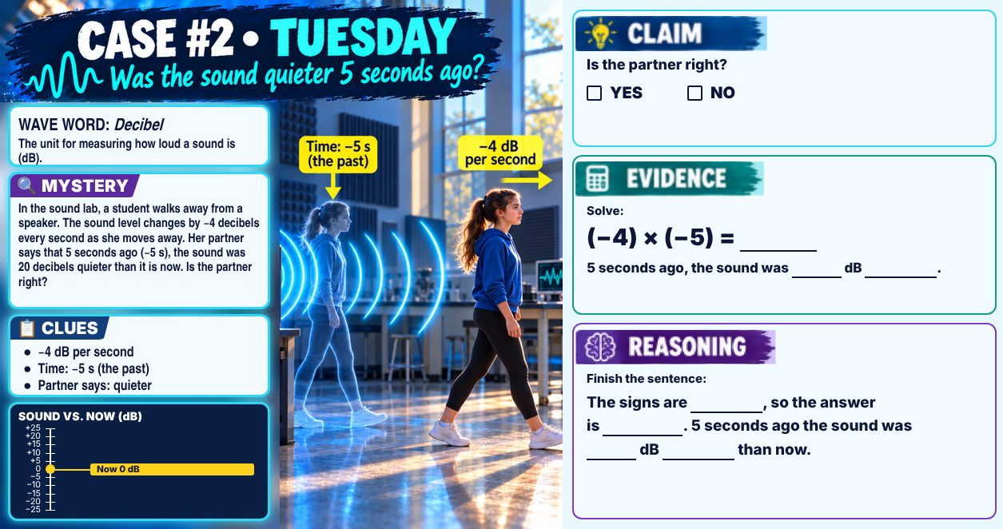
Classkick: 4.11 Math · Case #2
Notes:
Case #2 (decibels). Key: Claim NO. Evidence: (−4) × (−5) = 20; 5 seconds ago the sound was 20 dB louder. Reasoning: the signs are the same, so the answer is positive; it was 20 dB louder, not quieter. Wave word: decibel.

Slide 6



Today's Lab Plan
Use Chrome
Part 1: Music Lab
Part 2: PhET Sound Waves
Parts of the lab only work in the Chrome browser.
Play low and high notes. Watch the dots.
Intro, Measure, Two Sources, and Air Pressure screens.
Q1–Q4 · about 15 min
Q5–Q9 · rest of class
Notes:
Lab directions from the 4.11 page. Headphones help for the Listener Audio steps.

Slide 7
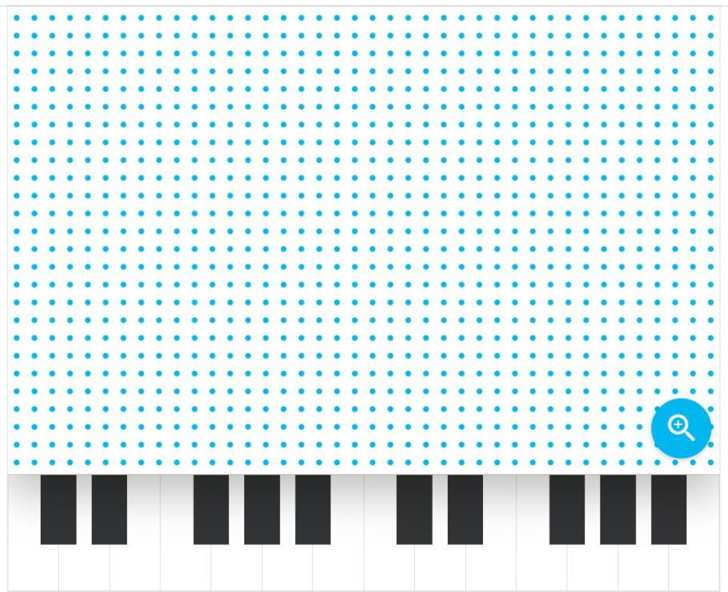
Part 1: Music Lab Sound Waves
Classkick: 4.11 Part 1 · Q1–Q4
Play a LOW note, then a HIGH note. Compare the dots. (Q1)
Watch the red particle. Where does it end up? (Q2)
Watch the blue dots. Which way do they move compared to the sound wave? (Q3)
A sound gets higher. What happens to the compressions? (Q4)
▶ Open Music Lab: Sound Waves
Notes:
Q1: low note: low pitch, slower, farther apart, longer; high note: high pitch, faster, closer, shorter; higher pitch = higher frequency. Q2: back and forth; its place; energy (extra: the end). Q3: back and forth; in the same direction as; longitudinal. Q4: higher; often; shorter (extra: longer).

Slide 8

Low Note vs. High Note
Classkick: 4.11 Part 1 · Q1–Q4
Watch the red dot. It only moves back and forth. The energy moves on.
High note: particles vibrate more often, so the compressions are closer and the wavelength is shorter.
Same air, same speed: both waves travel equally fast.
Notes:
Animation for Part 1 discussion. Both waves move across at the same speed; only the frequency and wavelength differ.

Slide 9
Engageli Poll
You turn UP the volume on a speaker. Which part of the sound wave changes?
A. Frequency
B. Amplitude
C. Wave speed
D. Wavelength
Notes:
Answer: B. Louder = bigger amplitude = more energy. Pitch (frequency) and wavelength stay the same; the speed is set by the air.

Slide 10
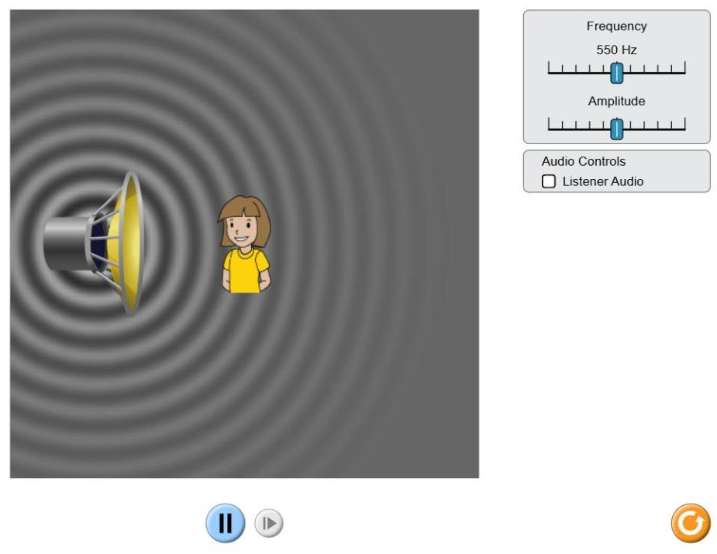
Part 2: PhET Intro Screen
Classkick: 4.11 Part 2 · Q5–Q6
Check Listener Audio.
Slide the FREQUENCY up. Watch the rings and listen. (Q5)
Now slide the AMPLITUDE up. (Q6)
▶ Open PhET Sound Waves
Notes:
Q5: closer together; shorter; higher. Q6: darker and brighter; louder; more; stays the same.

Slide 11
Compare: Pitch vs. Loudness
 | Pitch (high or low) | Loudness (loud or soft)
Set by… | frequency | amplitude
Higher pitch / louder means… | higher frequency | bigger amplitude
Wavelength | gets shorter | stays the same
Energy | — | more energy
Wave speed in air | stays the same | stays the same
In PhET: rings closer together = higher pitch. Darker, brighter rings = louder.
Notes:
Compare slide for Q5-Q6. The Energy row: in this unit, energy is tied to amplitude.

Slide 12
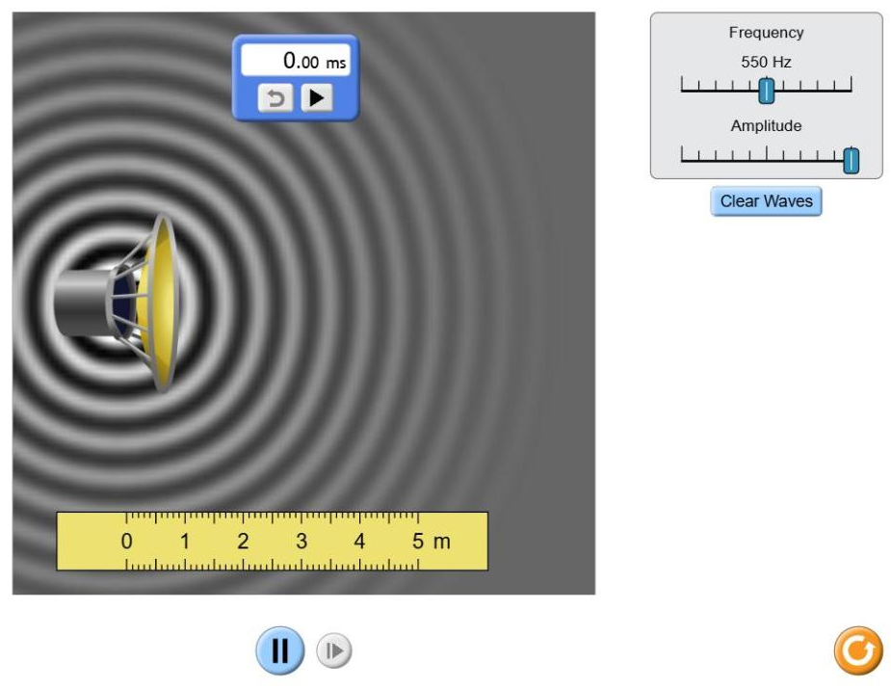
Part 2: Measure Screen
Classkick: 4.11 Part 2 · Q7
Set the frequency. Press Pause.
Drag the ruler from one light ring to the next light ring.
Record the wavelength in meters.
Frequency | Wavelength (m)
200 Hz | ___
500 Hz | ___
1000 Hz | ___
▶ Open PhET Sound Waves
Notes:
Q7: 200 Hz about 1.7 m; 500 Hz about 0.7 m; 1000 Hz about 0.3 m. Higher frequency = shorter wavelength.

Slide 13
Graph Poll
Read the graph.
What pattern does the graph show?
A. Fastest in gases
B. Fastest in solids
C. Same in all
D. Fastest in liquids
Notes:
Answer: B. Particles in solids are close together, so they pass vibrations along quickly (4.05 and the 4.11 objective: how sound travels through different media). Values are approximate, at room temperature.

Slide 14
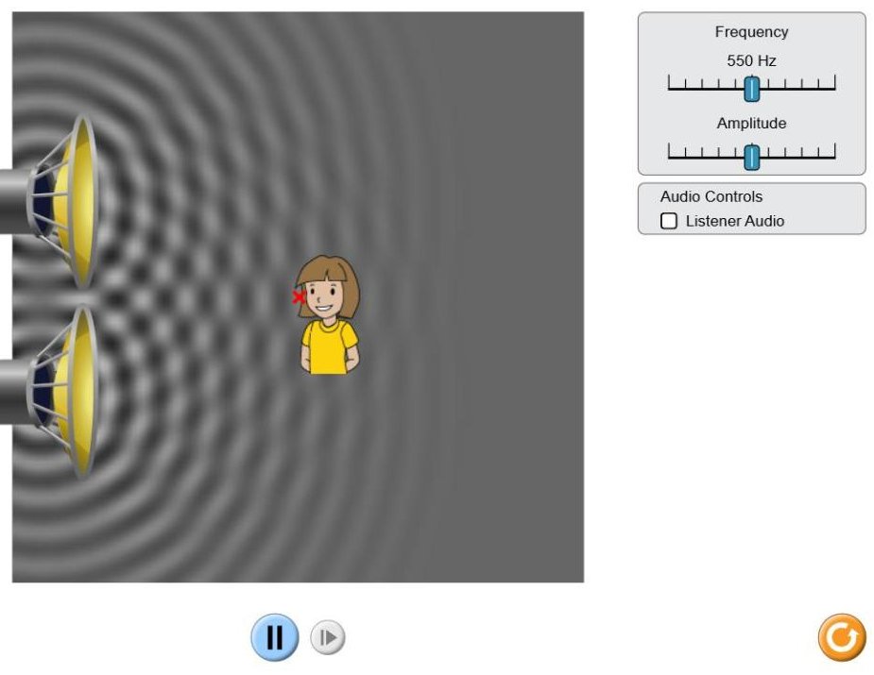
Part 2: Two Sources Screen
Classkick: 4.11 Part 2 · Q8
Check Listener Audio.
Drag the girl up and down. Listen for loud and quiet spots.
Loud spot: crest meets ___. Quiet spot: crest meets ___. (Q8)
▶ Open PhET Sound Waves
Notes:
Q8: loud = constructive (crest meets crest); quiet = crest meets trough = destructive. Ties back to 4.10.

Slide 15
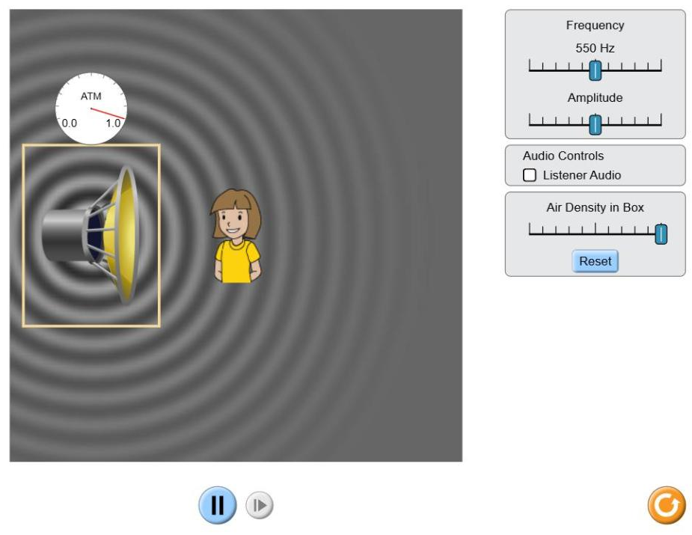
Part 2: Air Pressure Screen
Classkick: 4.11 Part 2 · Q9
Check Listener Audio.
Slide Air Density in Box all the way down.
Watch the waves leaving the box. Listen. (Q9)
▶ Open PhET Sound Waves
Notes:
Q9: fade away; cannot; medium.

Slide 16
Who Is Right?
In a space movie, a ship explodes and you hear a huge BOOM. Could that really happen in space?
Ava says:
Ben says:
Cam says:
Dee says:
"Yes. Explosions are so loud that the sound can reach anywhere."
"No. Sound needs a medium, and space has almost no air to carry it."
"Yes. The light from the explosion carries the sound with it."
"Yes, but you hear it later because space is so big."
A. Ava
B. Ben
C. Cam
D. Dee
Notes:
Answer: B (Ben). Sound is a mechanical wave; with no particles to push, it cannot travel (PhET Air Pressure screen, Q9). Light can cross space, but it does not carry sound.

Slide 17
Key Ideas
1
Sound is a longitudinal, mechanical wave made by vibrations.
2
Higher pitch = higher frequency = shorter wavelength.
3
Louder = bigger amplitude = more energy. The wavelength stays the same.
4
Sound needs a medium. No air = no sound. It is fastest in solids.
Re-rate your goals. Not done? Finish Part 2 on your own.

