Slide 1

4.05 Waves and Their Medium
How does the medium change the speed of a wave?
Notes:
Unit 4a Waves, lesson 4.05 (Tue, Nov 17). Classkick: Case #2 warm-up, Wave Speed and Temperature Lab Parts 1-2 (Q1-Q3), Parts 3-5 (Q4-Q6), and the Speed of Sound in Water graph (Q7-Q10). Animations play in Slide Show.

Slide 2





Today's Goals
I can explain why we see lightning before we hear thunder.
I can find speed with speed = distance ÷ time.
I can explain why sound travels faster in warm air and water.
I can compare sound speed in solids, liquids, and gases.
Rate each goal:
1
Not yet
2
Getting there
3
I can teach it
Notes:
Objective from the 4.05 page: Students will explore how waves require a medium to travel and how the medium moves temporarily.

Slide 3

Ohio Science Standards
7.PS.4 Energy can be transferred through a variety of ways.
In this lesson
Integer warm-up
Vocab check-in
Wave Speed and Temperature Lab
Counting thunder
Hot air vs. cold air
Solids, liquids, and gases
Graph reveal: sound in water
Mechanical waves need a medium. The medium moves, then returns to its rest position.
The speed of a wave depends on the material (sound travels faster through most solids than gases).
Changing the medium, like its temperature, changes the wave speed.
Inquiry skills (Grades 5–8): "Use appropriate mathematics, tools and techniques to gather data" and "Think critically and logically to connect evidence and explanations" (today's Wave Speed and Temperature Lab).
Source: Ohio's Learning Standards for Science (2018), Grade 7 Physical Science; content statement paraphrased.

Slide 4
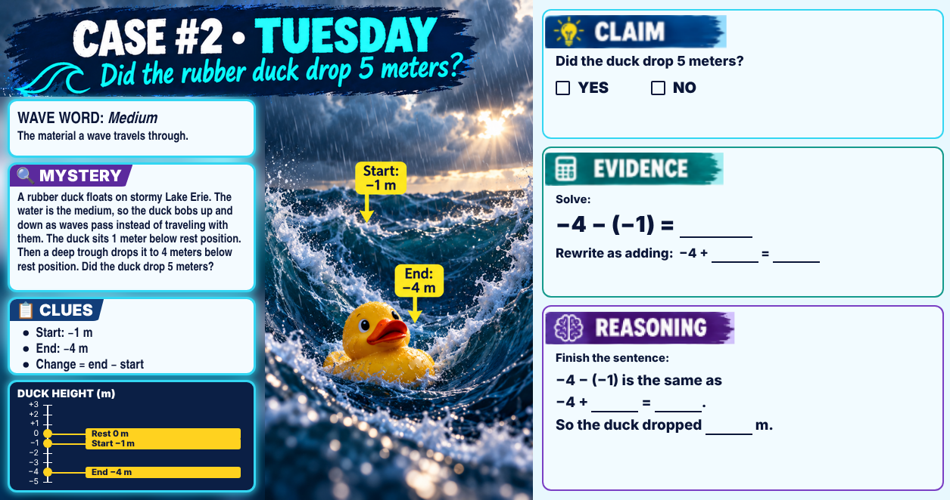
Classkick: 4.05 Math · Case #2
Notes:
Integer warm-up, Case #2 (rubber duck). Answer key: Claim NO. Evidence: −4 − (−1) = −3; rewrite −4 + 1 = −3. Reasoning: −4 − (−1) is the same as −4 + 1 = −3, so the duck dropped 3 m, not 5 m.

Slide 5

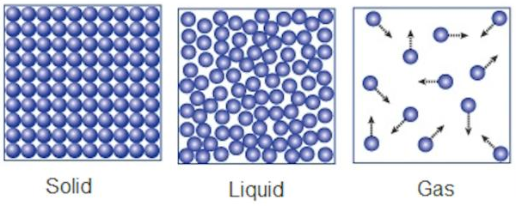
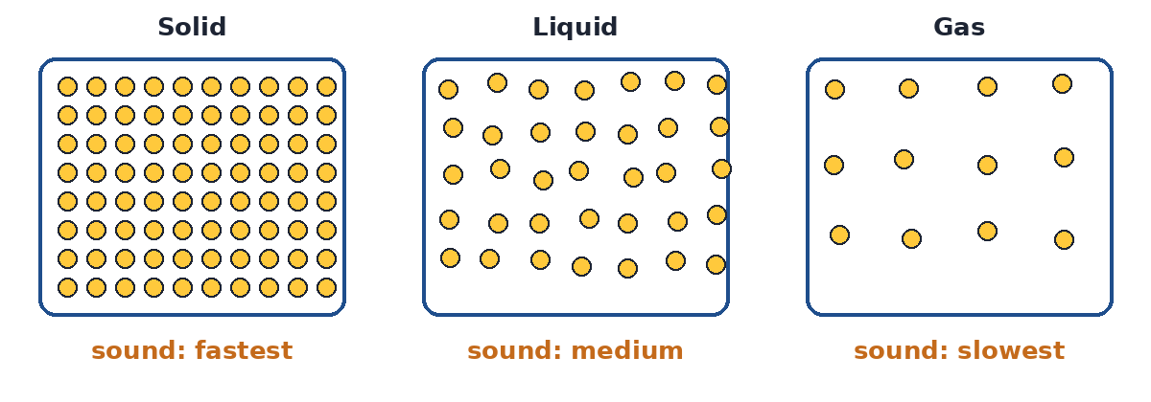
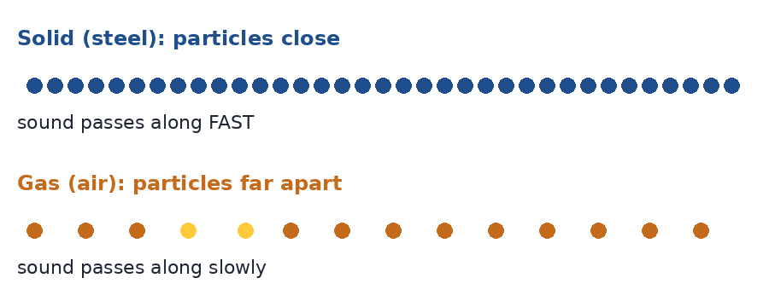
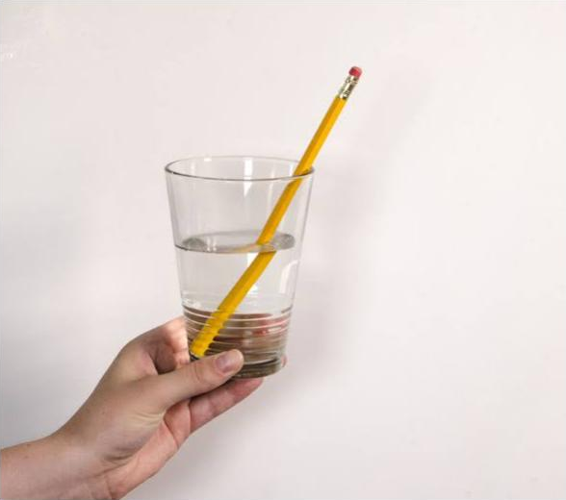
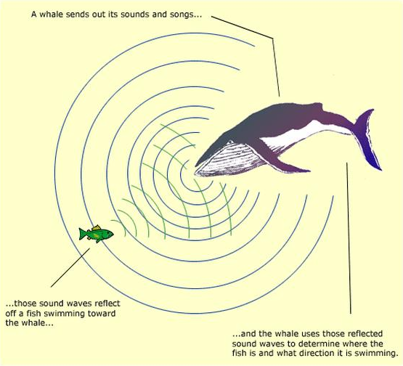
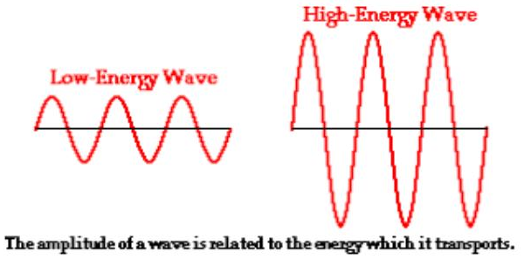
Vocab Check-In
From your Unit 4 vocabulary pretest and the 4.05 page. Starred words are on the pretest.
medium ★
density ★
wave speed
elasticity
the material a wave travels through (solid, liquid, or gas)
the amount of mass in a given volume
how fast a wave travels through a medium
how well a material springs back to its shape; stiff steel passes waves fast
refraction ★
reflection
absorption
energy ★
the bending of waves when they enter a new medium
when waves bounce back after hitting a surface
when wave energy is taken in by the medium
the ability to do work or cause change
Notes:
Pre Vocab survey words: medium, density, refraction, energy. Wave speed, elasticity, reflection and absorption are the 4.05 page key vocabulary.

Slide 6


Watch First: Speed of Sound and Temperature
Classkick: 4.05 Part 1 · Link 1
Listen for:
How fast does sound travel in air?
Does sound go faster in warm or cold air?
Why does temperature matter?
Plays here in Slide Show (needs internet)
▶ Backup: YouTube
Notes:
Classkick Link 1 (watch before the lab). About 343 m/s in air; faster in warm air; warm particles move faster and pass the sound along faster.

Slide 7

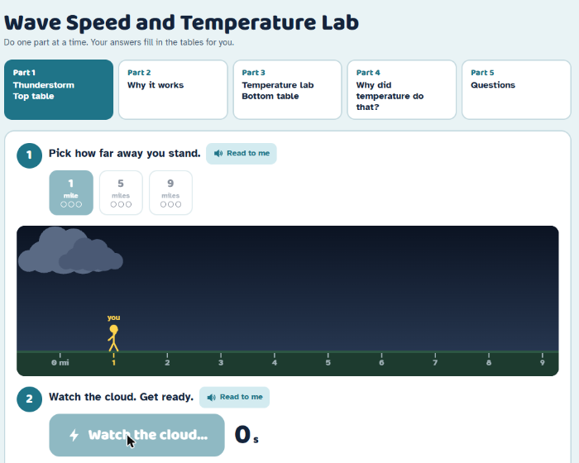
Lab Part 1: Count the Thunder
Classkick: 4.05 Part 1 · Q1
1
Pick 1, 5, or 9 miles.
2
Click Make lightning. Watch the cloud for the flash.
3
Click I hear thunder right when you hear the BOOM.
4
Do each distance 3 times. The Top table fills in for you.
5
Copy your Top table onto your Classkick.
▶ Open the Wave Speed and Temperature Lab
Notes:
Your GitHub lab, Part 1. Answers are about 4.7 s for 1 mile (1,609 m), 23.5 s for 5 miles, 42 s for 9 miles, so about 343 m/s each time. Counts will not be exact, and that is OK.

Slide 8
Find the Speed of Sound
Classkick: 4.05 Part 1 · Q1
speed = distance ÷ time
Try the 1-mile row together:
1,609 m ÷ 4.7 s ≈ 343 m/s
Now try 5 miles and 9 miles. What do you notice about the speed?
Farther away = more TIME, but the SPEED stays the same.
Distance | Your average time | Speed
1 mile = 1,609 m | 4.7 s | 1,609 ÷ 4.7 ≈ ?
5 miles = 8,047 m | 23.5 s | ?
9 miles = 14,484 m | 42 s | ?
Notes:
8,047 ÷ 23.5 ≈ 342 m/s; 14,484 ÷ 42 ≈ 345 m/s. All about 343 m/s. Distance changes the time, not the speed.

Slide 9
Lab Part 2: Why Does It Work?
Classkick: 4.05 Part 1 · Q2
Light
an electromagnetic wave
about 300,000,000 m/s
does NOT need air
Sound
a mechanical wave
about 343 m/s in air
NEEDS a medium (air bumps air)
Lightning makes light and sound at the same time. Light gets to you almost instantly, so you see the flash first.
Notes:
Q2: light first; light is electromagnetic and does not need air; sound is mechanical and needs a medium; 343 m/s. (4.07 Quest Q8-Q9, Mission Q15-Q16.)

Slide 10


Use It in a Real Storm
Classkick: 4.05 Part 1 · Q3
Sound goes about 1 mile every 5 seconds. Count the seconds, then divide by 5.
You count 15 seconds
You count 10 seconds
You count 30 seconds
15 ÷ 5 = ___ miles away
10 ÷ 5 = ___ miles away
30 ÷ 5 = ___ miles away
Stay safe: When thunder roars, go indoors. Wait 30 minutes after the last thunder.
Notes:
Q3: 15 ÷ 5 = 3 miles; 10 ÷ 5 = 2 miles. Extra: 30 ÷ 5 = 6 miles.

Slide 11
Lab Part 3: Does Temperature Matter?
Classkick: 4.05 Part 2 · Q4
Do one distance at a time. Click each temperature, then click Save. Here is the 1-mile row:
Distance | Time @ 20 °F | Speed @ 20 °F | Time @ 60 °F | Speed @ 60 °F | Time @ 100 °F | Speed @ 100 °F
1 mile | 4.9 s | 327.4 m/s | 4.7 s | 340.7 m/s | 4.5 s | 354.1 m/s
5 miles | ? | ? | ? | ? | ? | ?
9 miles | ? | ? | ? | ? | ? | ?
Think: Look across a row. Which temperature made the thunder arrive soonest? A shorter time means a faster speed.
▶ Open the lab: Part 3
Not done? This part can be finished Friday.
Notes:
Q4 (Bottom table). Every distance: 327.4 m/s at 20 °F, 340.7 at 60 °F, 354.1 at 100 °F. Warmer air = faster sound. This part is OK to move to Friday.

Slide 12

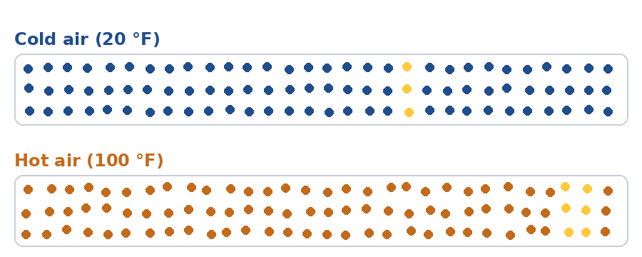
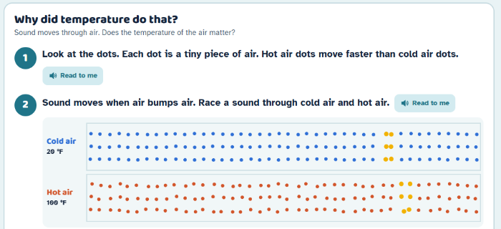
Lab Part 4: Why Did Temperature Do That?
Classkick: 4.05 Part 2 · Q5
Animation: watch the yellow sound wave race.
Your lab: click Start the race.
Hot air particles move faster, so they bump into each other and pass the sound along faster.
Notes:
Q5: hot air wins; hot air dots move faster; sound passes from particle to particle faster. About 0.6 m/s faster for each 1 °C.

Slide 13

Lab Part 5: Questions
Classkick: 4.05 Part 2 · Q6
Which is faster?
1
a light wave / a sound wave
Sound travels faster in...
4
warm air / cold air
If you only change the medium (the air), the wave speed...
5
changes / stays the same
Notes:
Q6 (lab Part 5 questions 1, 4, 5): a light wave; warm air; changes.

Slide 14
Solids, Liquids, and Gases
Medium | Speed of sound
air (gas) | about 343 m/s
water (liquid) | about 1,480 m/s
steel (solid) | about 5,960 m/s
Ear on the track! Sound travels about 17 times faster through steel rails than through air, so you hear the train coming through the track first.
Notes:
Particle picture from the 4.05 page. Mission Q17: sound is fastest in steel because the particles in a solid are packed closely together. Watch out: light is the opposite (slower in denser materials).

Slide 15

At a New Medium, a Wave Can...
Refract (bend)
Reflect (bounce back)
Be absorbed (taken in)
The pencil looks broken because light bends going from water to air.
A whale's sound bounces off a fish. The echo tells the whale where the fish is.
The medium takes in some of the energy, so sound gets fainter over distance.
Notes:
Pictures from the 4.05 page (pencil and whale).

Slide 16
Classkick: 4.05 Part 3 · Q7–Q10
Graph Reveal
Step 1: What do you notice about the shape of the line?
No labels yet! Just look at the shape.
▶ Open the graph reveal
Notes:
Gradual graph reveal, like the Virtual Science Teachers graph on the 4.05 page. Ask: the line goes up, and it curves (it rises a little less each time).

Slide 17
Classkick: 4.05 Part 3 · Q7–Q10
Graph Reveal
Step 2: What does the x-axis show?
Read the bottom of the graph.
▶ Open the graph reveal
Notes:
The x-axis shows water temperature (°C). Q7a.

Slide 18
Classkick: 4.05 Part 3 · Q7–Q10
Graph Reveal
Step 3: What does the y-axis show?
Read the side of the graph.
▶ Open the graph reveal
Notes:
The y-axis shows the speed of sound (m/s). Q7b. Read each point: about 1,400; 1,450; 1,480; 1,510; 1,530 (Q8).

Slide 19

Classkick: 4.05 Part 3 · Q7–Q10
Graph Poll
Step 4: What is the pattern? Answer the poll!
A. As water warms, sound gets faster.
B. As water warms, sound gets slower.
C. Temperature does not change sound speed.
D. Sound is slower in water than in air.
Notes:
Answer: A. As water gets warmer, sound gets faster (Q7c, Q9a). D is wrong: at 20 °C sound is about 1,480 m/s in water and 343 m/s in air, about 4 times faster in water (Q9c). Q9d: false, it goes up less each time. Q10: trend, up, faster.

Slide 20
Who Is Right?
Two hikers clap at the same canyon wall, one on a 35 °C summer day and one on a −5 °C winter day. Whose echo comes back sooner?
Ava says:
Ben says:
Cam says:
Dee says:
"The winter echo, because cold air is heavier and pushes sound faster."
"The same time, because air is air no matter the temperature."
"The summer echo, because warm air particles move faster and pass sound faster."
"The winter echo, because sound travels better when it is quiet and cold."
A. Ava
B. Ben
C. Cam
D. Dee
Notes:
Answer: C (Cam). Warm air particles move faster, so they pass the vibration along faster: about 0.6 m/s faster per 1 °C, so about 24 m/s faster on the summer day. This is what students saw in lab Parts 3-4. Ava and Dee: cold air is slower. Ben: temperature changes the medium, so it changes the speed.

Slide 21
Key Ideas
1
Light arrives first: about 300,000,000 m/s. Sound in air is about 343 m/s.
2
speed = distance ÷ time. Distance changes the time, not the speed.
3
Sound is faster in warm air and warm water: the particles pass it along faster.
4
Sound is fastest in solids, slower in liquids, and slowest in gases.
Re-rate your goals: 1 = Not yet, 2 = Getting there, 3 = I can teach it

