Slide 1
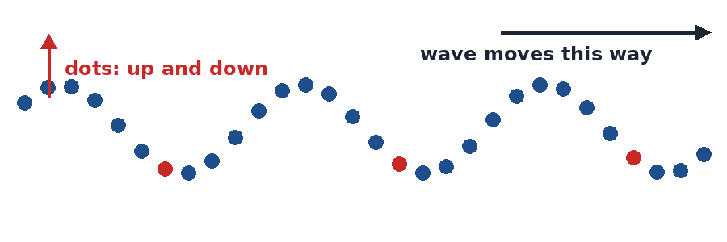
4.06 Transverse Waves
How does the medium move in a transverse wave?
Notes:
Unit 4a Waves, lesson 4.06 (Wed, Nov 18). Classkick: Case #3 warm-up, Part 1 Make a Transverse Wave (Q1-Q4), Part 2 Transverse Waves in a Toy Spring (Q5-Q8). JavaLab pages show ads, so preview them before class. Animations play in Slide Show.

Slide 2
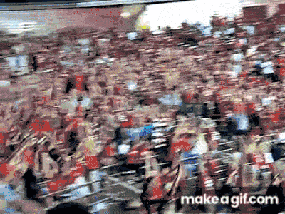
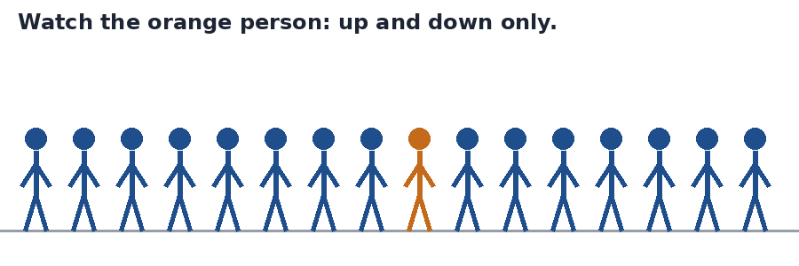

Think About It
The crowd does "the wave." What actually travels around the stadium?
A. the people
B. the wave (energy)
C. the seats
D. nothing moves
Notes:
Hook. Answer: B. Each person stands up and sits back down in their own seat. Only the wave (the energy) travels around the stadium. The crowd is the medium. Stadium picture is from the 4.06 page.

Slide 3





Today's Goals
I can describe how the medium moves in a transverse wave.
I can explain that a wave carries energy, not matter.
I can tell mechanical transverse waves from electromagnetic ones.
I can explain what frequency and amplitude change.
Rate each goal:
1
Not yet
2
Getting there
3
I can teach it
Notes:
Objective from the 4.06 page.

Slide 4

Ohio Science Standards
7.PS.4 Energy can be transferred through a variety of ways.
In this lesson
Integer warm-up
Vocab check-in
What is a transverse wave?
Make a wave (JavaLab)
Mechanical or electromagnetic?
Toy spring: frequency and amplitude
Parts of a wave
Mechanical waves need a medium. The medium moves, then returns to its rest position.
The speed of a wave depends on the material (sound travels faster through most solids than gases).
Mechanical waves are transverse or longitudinal, depending on how the medium moves.
Inquiry skills (Grades 5–8): "Use appropriate mathematics, tools and techniques to gather data" and "Think critically and logically to connect evidence and explanations" (today's JavaLab and toy spring activities).
Source: Ohio's Learning Standards for Science (2018), Grade 7 Physical Science; content statement paraphrased.

Slide 5
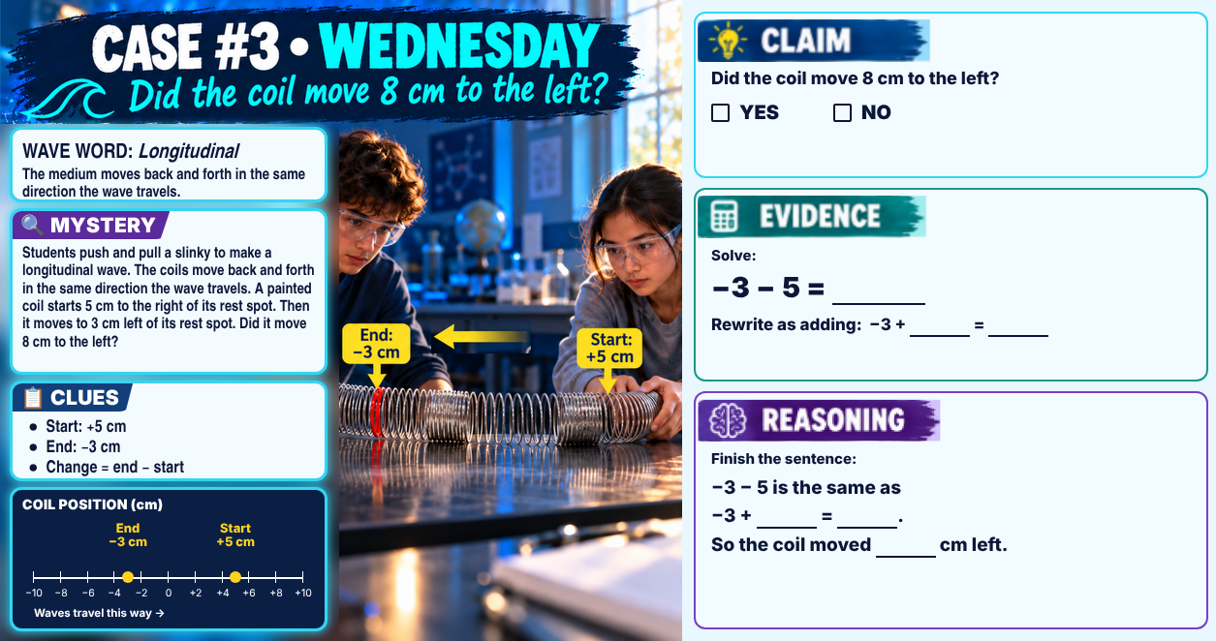
Classkick: 4.06 Math · Case #3
Notes:
Integer warm-up, Case #3 (slinky). Answer key: Claim YES. Evidence: −3 − 5 = −8; rewrite −3 + (−5) = −8. Reasoning: −3 − 5 is the same as −3 + (−5) = −8, so the coil moved 8 cm left.

Slide 6

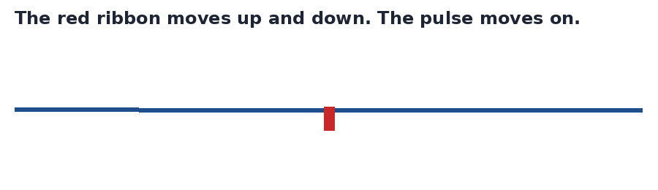
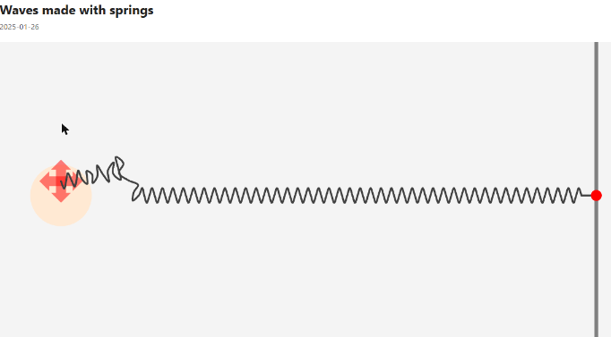
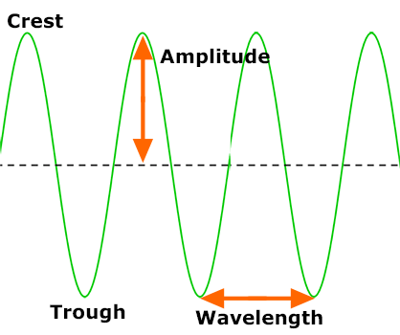
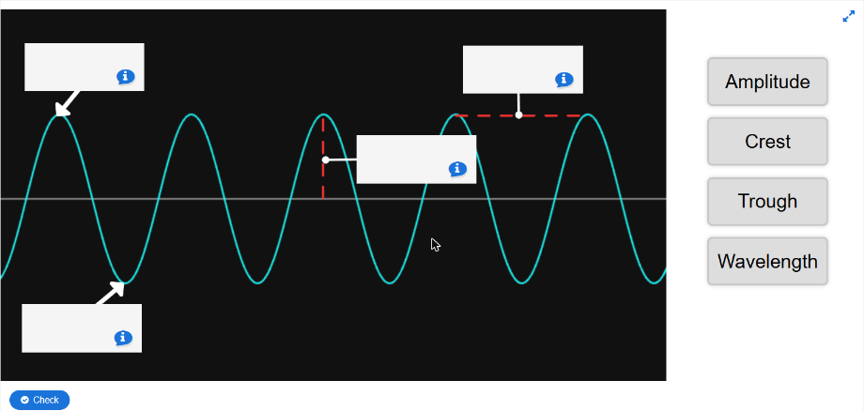
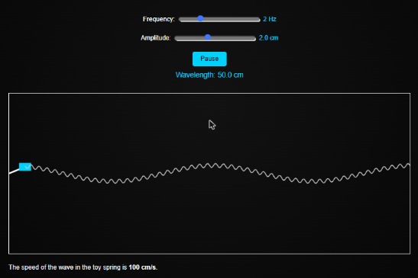

Vocab Check-In
From your Unit 4 vocabulary pretest and the 4.06 page. Starred words are on the pretest.
wave ★
medium ★
transverse wave ★
perpendicular
a disturbance that carries energy from one place to another
the material a wave travels through: air, a rope, or a spring
the medium moves up and down, at right angles to the wave
at a right angle (90°), like the corner of a paper
crest / trough
wavelength ★
amplitude ★
electromagnetic wave ★
the highest point / the lowest point of a transverse wave
the distance from one crest to the next crest
how far the medium moves from rest; bigger = more energy
needs no medium; light, radio waves, and X-rays
Notes:
Pre Vocab survey words: wave, medium, transverse wave, wavelength, amplitude, electromagnetic wave. Perpendicular and crest/trough are lesson words. Mechanical wave: needs a medium (rope, guitar string, spring).

Slide 7
A Wave Carries Energy, Not Stuff
Classkick: 4.06 Part 1 · Q2
Tie a ribbon to the middle of a rope and flick the end. The ribbon jumps up and drops back down, but it stays in the middle of the rope. The rope (the medium) stays in place. The ENERGY travels down the rope.
Notes:
From the 4.06 page. Q2: each dot wiggles in place; returns to its place; energy travels across the screen.

Slide 8
What Is a Transverse Wave?
Classkick: 4.06 Part 1 · Q1
Transverse wave: the medium moves up and down, but the wave moves forward.
Those two directions make a right angle (they are perpendicular), like the corner of a piece of paper.
Try it: shake a rope tied to a doorknob, or pluck a guitar string.
Notes:
Q1: each coil moves up and down; the wave moves to the right; at right angles to the wave; transverse.

Slide 9

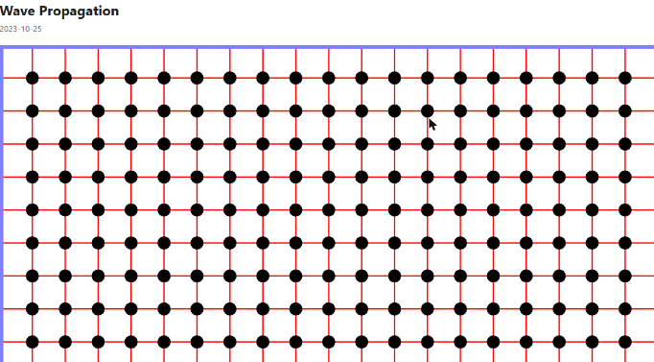
Part 1: Make a Transverse Wave
Classkick: 4.06 Part 1 · Q1–Q2
Link 1: Waves made with springs
Link 2: Wave Propagation
Click Up-Down. Drag the red handle up and down. Watch ONE coil.
Check Leaving traces. Drag one dot and let go. Where does each dot end up?
▶ Open Waves made with springs
▶ Open Wave Propagation
Notes:
Screenshots of the JavaLab simulations (Classkick Links 1-2). JavaLab shows ads, so preview the pages before class. Answers: Q1 up and down; to the right; at right angles; transverse. Q2 wiggles in place; returns to its place; energy.

Slide 10


Mechanical or Electromagnetic?
Classkick: 4.06 Part 1 · Q3–Q4
Mechanical
Electromagnetic (EM)
needs a medium to travel
does NOT need a medium; can cross empty space
Examples: a rope shaken up and down • a plucked guitar string • a spring shaken up and down
Examples: sunlight • radio signals • X-rays
Both kinds can be transverse. That is how sunlight crosses almost-empty space to reach Earth, but a wave on a rope cannot.
Notes:
Q3: medium, electromagnetic, space (extra: longitudinal). Q4: spring mechanical; guitar string mechanical; sunlight EM; radio EM; rope mechanical.

Slide 11
Classkick: 4.06 Part 1 · Q4
Engageli Poll
All of these are transverse waves. Which one can travel through empty space?
A. a rope wave
B. a plucked guitar string
C. sunlight
D. a spring shaken up and down
Notes:
Answer: C. Sunlight is an electromagnetic wave, so it does not need a medium. The others are mechanical waves and need a medium.

Slide 12
Part 2: Transverse Waves in a Toy Spring
Classkick: 4.06 Part 2 · Q5–Q6
Frequency | Wavelength
1 Hz | ___ cm
2 Hz | 50 cm
4 Hz | ___ cm
5 Hz | ___ cm
Move ONLY the Frequency slider. Read the Wavelength under the Pause button. (2 Hz is done for you.)
▶ Open the toy spring sim
The shape: an up-and-down S shape with crests and troughs.
Notes:
Screenshot of the Virtual Science Teachers toy spring sim (Classkick Link 1). Q5: up-and-down S shape; up and down; transverse. Q6: 1 Hz 100 cm, 2 Hz 50 cm, 4 Hz 25 cm, 5 Hz 20 cm; frequency changes the wavelength.

Slide 13
Graph Poll
Read the graph.
What happens to the wavelength as the frequency goes up?
A. It gets longer
B. It gets shorter
C. It stays the same
D. It goes up, then down
Notes:
Answer: B. Higher frequency = shorter wavelength. (Different rope from the Classkick sim, so the Q6 answers stay hidden.) speed = wavelength × frequency: 300 × 1 = 150 × 2 = 300 cm/s.

Slide 14
Now Move Only the Amplitude
Classkick: 4.06 Part 2 · Q7
Frequency changes...
Amplitude changes...
Neither one changes...
how close the waves are (the wavelength)
the height of the wave
the wave speed (100 cm/s in the toy spring)
Higher frequency = shorter wavelength.
Bigger amplitude = more energy.
Same medium = same speed.
▶ Open the toy spring sim
Notes:
Q7: amplitude changes the height of the waves; a bigger amplitude carries more energy; the wave speed (100 cm/s) stays the same.

Slide 15
Graph Poll
Read the graph.
What does a bigger amplitude do to the wave speed?
A. Makes it faster
B. Makes it slower
C. Nothing: it stays the same
D. Doubles it
Notes:
Answer: C. The speed stays at 100 cm/s. Amplitude changes the height and the energy, not the speed. The medium sets the speed.

Slide 16

Parts of a Transverse Wave
Classkick: 4.06 Part 2 · Q8
Crest = top. Trough = bottom. Wavelength = crest to crest. Amplitude = rest line to crest.
▶ Open the Properties of Waves diagram
Notes:
Labeled diagram from the 4.06 page; drag-and-drop from Virtual Science Teachers (Classkick Link 2). Q8: crest, trough, wavelength, amplitude (extra word: compression, which belongs to longitudinal waves in 4.07).

Slide 17
Who Is Right?
A ribbon is tied to the middle of a rope. You flick the rope and a wave passes. Where does the ribbon end up?
Ava says:
Ben says:
Cam says:
Dee says:
"At the far end of the rope, because the wave carries it there."
"Back where it started. The rope moves up and down; only the energy travels."
"Higher than before, because the wave lifted it up."
"On the floor, because the wave knocks it off the rope."
A. Ava
B. Ben
C. Cam
D. Dee
Notes:
Answer: B (Ben). In a transverse wave the medium moves up and down and returns to its rest position. Only the energy travels down the rope. 4.06 Check Your Understanding, and 4.03 Quest Q2 / Mission Q2 and Q11.

Slide 18
Key Ideas
1
A wave carries energy, not matter. The medium moves in place.
2
Transverse wave: the medium moves up and down, at right angles to the wave.
3
Transverse waves can be mechanical (rope, guitar string) or electromagnetic (light).
4
Higher frequency = shorter wavelength. Bigger amplitude = more energy. Speed stays the same.
Re-rate your goals: 1 = Not yet, 2 = Getting there, 3 = I can teach it

