Slide 1
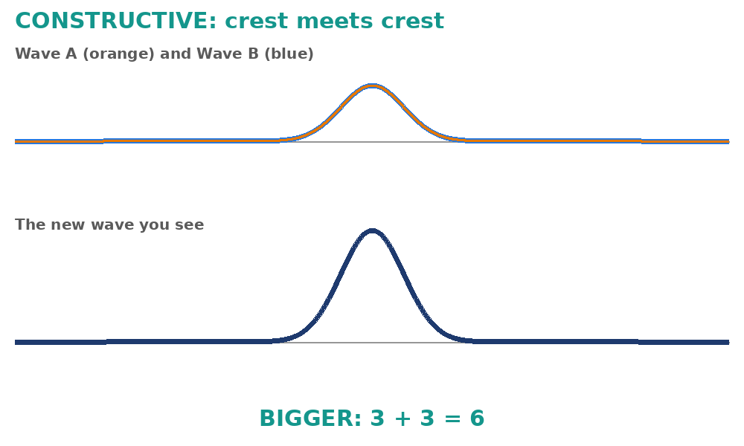
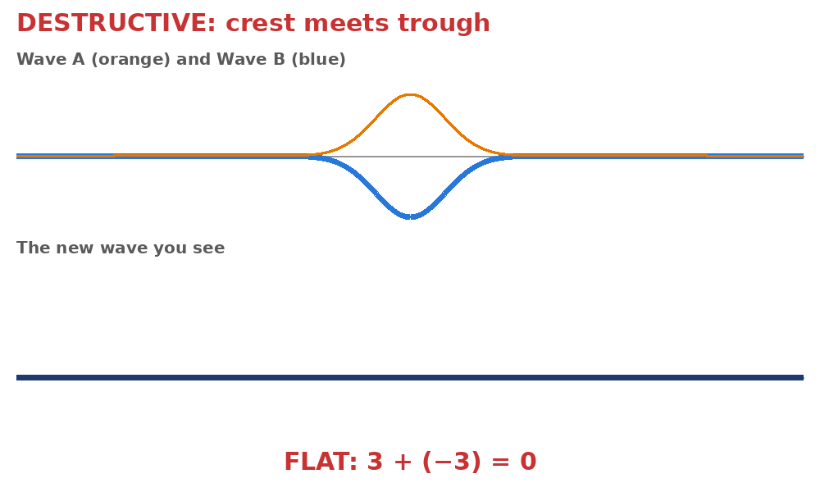
4.10 Wave Interference
What happens when two waves meet?
Notes:
Unit 4a Waves, lesson 4.10 (Mon, Nov 30). Classkick: Power Up! + Case #1, Week 4 calendar, Part 1 Wave Interference (Q1-Q4), Part 2 Interference Missions (Q5-Q7, code + certificate). 4.07 Quest closes today (regular). Animations play in Slide Show.

Slide 2
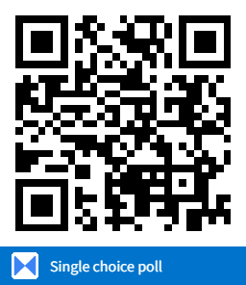
Think About It
You drop two pebbles into a calm pool. The rings of ripples spread out and meet. What happens?
A. They bounce off each other
B. They pass through each other and combine for a moment
C. They stop and disappear
D. They stick together forever
Notes:
Hook from Let's Dive Deeper. Answer: B (superposition). Waves can be in the same place at the same time; they combine, then keep going unchanged.

Slide 3





Today's Goals
I can explain what happens when two waves meet.
I can tell constructive from destructive interference.
I can add amplitudes to find the new wave.
I can give real-world examples of interference.
Rate each goal:
1
Not yet
2
Getting there
3
I can teach it
Notes:
Objective from the 4.10 page: investigate how waves can interfere with one another.

Slide 4

Ohio Science Standards
7.PS.4 Energy can be transferred through a variety of ways.
In this lesson
Integers: Power Up! + Case #1
Wave interference video
Constructive vs. destructive
Add the amplitudes
Real-world interference
Part 2: Interference Missions
Waves can be described by their speed, wavelength, amplitude, and frequency.
Vibrations cause wavelike disturbances that transfer energy from one place to another.
Today: when waves overlap, their amplitudes combine.
Source: Ohio's Learning Standards for Science (2018), Grade 7 Physical Science; content statement paraphrased.

Slide 5
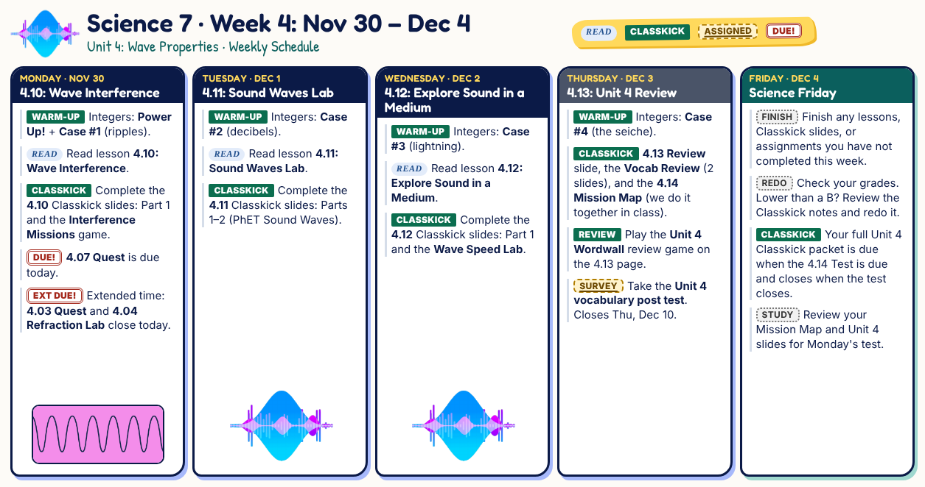
Classkick: Week 4 Schedule
Notes:
Week 4 calendar (packet slide #45). 4.07 Quest closes today (regular), Thu Dec 3 (extended).

Slide 6
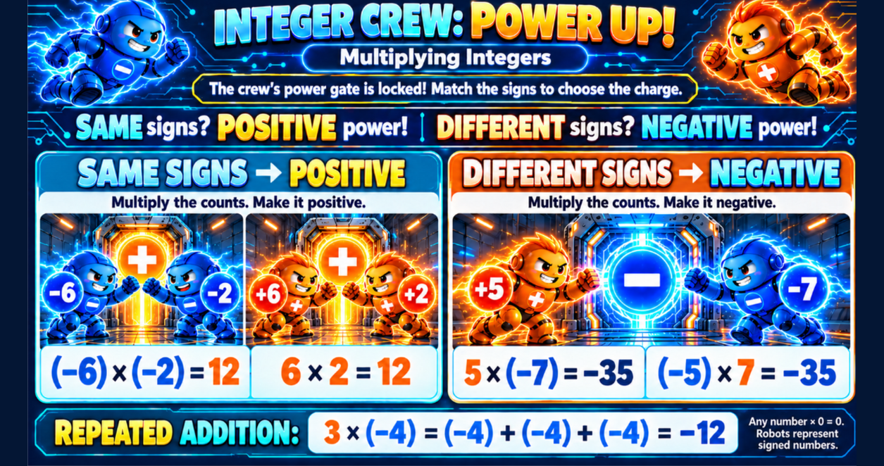
Classkick: 4.10 Math · Power Up!
Notes:
Week 4 integer rule: multiplying. Same signs = positive. Different signs = negative. Repeated addition: 3 × (−4) = (−4) + (−4) + (−4) = −12.

Slide 7
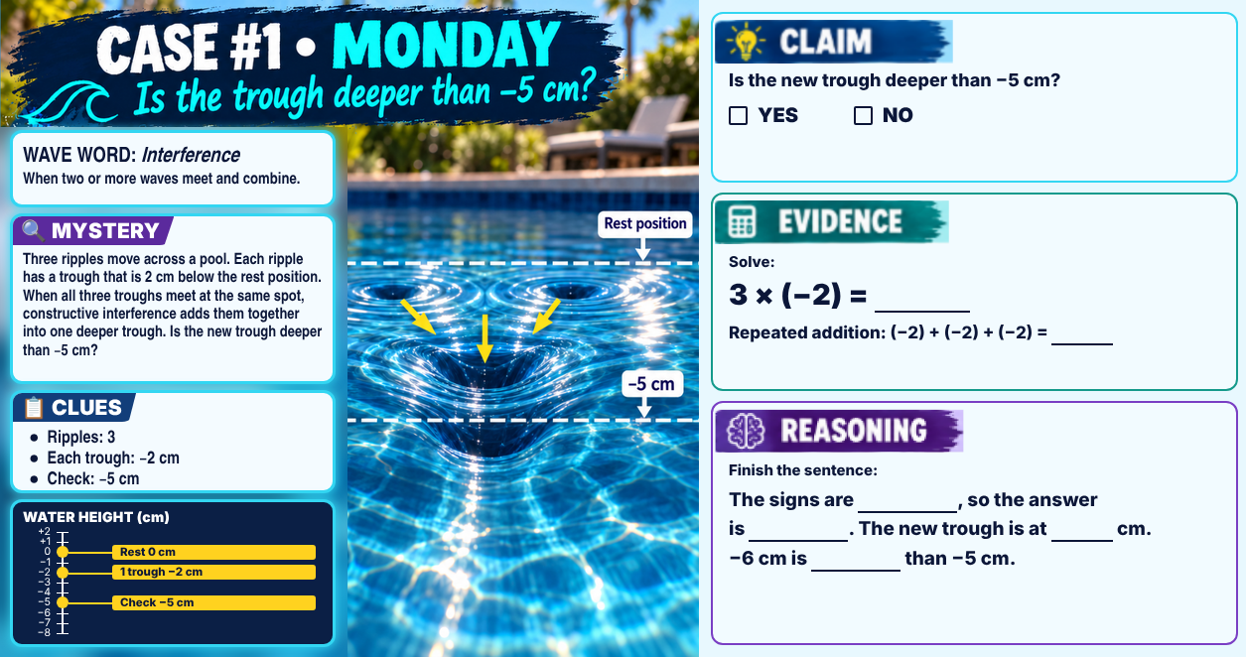
Classkick: 4.10 Math · Case #1
Notes:
Case #1 (ripples). Key: Claim YES. Evidence: 3 × (−2) = −6; (−2) + (−2) + (−2) = −6. Reasoning: the signs are opposite, so the answer is negative; the new trough is at −6 cm, deeper than −5 cm. Wave word: interference. This case IS constructive interference (trough + trough + trough).

Slide 8


Watch: Wave Interference
Classkick: 4.10 Part 1 · Q1
Notes:
The Wave Interference video from the Classkick Q1 link (YouTube kPe1z4GC1uU), embedded. Plays in Slide Show with internet.

Slide 9
Constructive Interference
Classkick: 4.10 Part 1 · Q1
Crest meets crest (in phase).
The amplitudes ADD. The new wave is bigger.
Like two friends pushing a swing at the same time: it goes higher.
Notes:
Constructive also works trough + trough (a deeper trough), like today's ripple case.

Slide 10

Destructive Interference
Classkick: 4.10 Part 1 · Q1
Crest meets trough (out of phase).
The new wave is smaller. Same size? It cancels out to zero.
After they meet, both waves keep going on their own paths, unchanged.
Notes:
Q1 key: crest meets crest = constructive; crest meets trough = destructive (extra word: refraction).

Slide 11
Graph Poll
Read the graph.
Wave A and Wave B meet and make the navy wave. What kind of interference is this?
A. Constructive
B. Destructive
C. Refraction
D. Reflection
Notes:
Answer: A. Crests line up with crests (in phase): 2 + 1 = 3 units, a bigger wave.

Slide 12
Add the Amplitudes (Use Integers!)
Classkick: 4.10 Part 1 · Q2
Wave A | Wave B | Add them | New wave
crest +1 | crest +3 | 1 + 3 | +4 (bigger)
crest +4 | trough −1 | 4 + (−1) | +3 (smaller)
trough −2 | trough −2 | (−2) + (−2) | −4 (deeper trough)
crest +5 | trough −5 | 5 + (−5) | 0 (flat!)
Crest = positive (+). Trough = negative (−). Add them like integers to get the new wave.
Notes:
Worked examples (different numbers from Classkick Q2). Q2 key: 3 + 3 = 6; 2 + 3 = 5; 4 + 4 = 8; 2 + (−2) = 0 (extra numbers: 1, 3).

Slide 13
Graph Poll
Read the graph.
Wave A (3 units) meets Wave B, crest to trough. What is the amplitude of the new wave?
A. 4 units
B. 2 units
C. 3 units
D. 0 units
Notes:
Answer: B. Destructive: 3 + (−1) = 2 units. The new wave is smaller but not flat, because the waves are not the same size.

Slide 14



Interference in Real Life
Classkick: 4.10 Part 1 · Q3
Noise-canceling headphones
Surfing waves
Radio dead spots
Soap bubbles
They make a sound wave that is the opposite of the noise. Crest meets trough: quiet!
Two ocean swells line up crest to crest and make a bigger wave.
Waves from two towers or stations cancel in some spots, so reception is poor.
Light waves reflecting off the bubble combine and make rainbow colors.
Destructive
Constructive
Destructive
Both
Notes:
Real World Examples and Fun Facts from the 4.10 page. Dr. Amar Bose began working on noise-canceling headphones in 1978. Q3 key: headphones destructive; surfing constructive; swing constructive; radio destructive.

Slide 15
Engageli Poll
Two kids jump on a trampoline at exactly the same moment, and they both bounce higher. What kind of interference is this most like?
A. Constructive
B. Destructive
C. Refraction
D. No interference
Notes:
Answer: A. The pushes line up (in phase), so they add together, like the swing example.

Slide 16
Who Is Right?
A crest and a trough of the same size meet and the rope goes flat. What happens to the two waves next?
Ava says:
Ben says:
Cam says:
Dee says:
"They are gone forever, because they canceled each other out."
"They bounce off each other and go back the way they came."
"They pass through each other and keep going, unchanged."
"They stick together and make one flat wave forever."
A. Ava
B. Ben
C. Cam
D. Dee
Notes:
Answer: C (Cam). Waves only combine while they overlap. Afterward each keeps going on its own path, unchanged (4.10 page: "Once they pass through each other, they continue on their original paths unchanged.").

Slide 17



Compare: Constructive vs. Destructive
Classkick: 4.10 Part 1 · Q4
Constructive
Destructive
crest meets crest (in phase)
amplitudes add
bigger wave
crest meets trough (out of phase)
amplitudes subtract
smaller wave, or flat (0)
Notes:
Q4 key: Constructive: crest meets crest, amplitudes add, new wave is bigger. Destructive: crest meets trough, new wave is smaller or flat (extra word: faster).

Slide 18

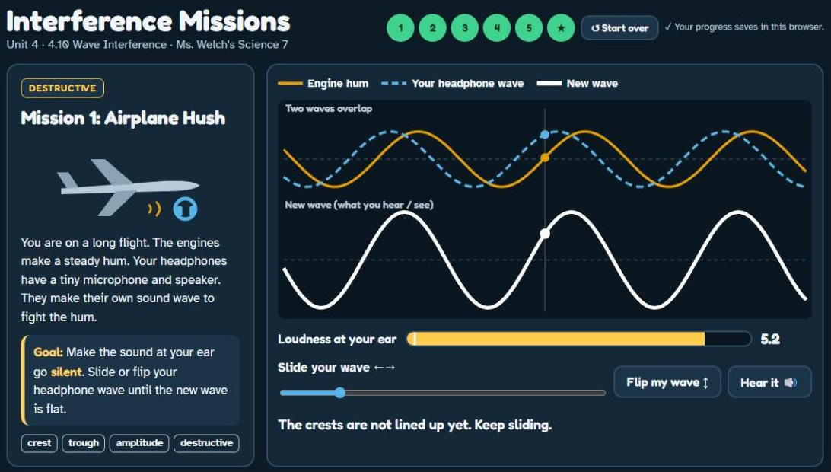
Part 2: Interference Missions
Classkick: 4.10 Part 2 · Q5–Q6
Use the rest of class
Airplane Hush
Surf's Up
Harbor Engineer
Lawn Mower Level
Road Trip Radio
Lightning Round
Check off each mission on your Classkick slide. Your progress saves in this browser.
▶ Open Interference Missions
Notes:
Your game (GitHub). Q6 key: a) crest met trough; b) 5 m; c) amplitude; d) destructive. If students switch computers, progress does not follow them.

Slide 19




Finish: Code and Certificate
Classkick: 4.10 Part 2 · Q7
1. Type your code
2. Copy the certificate
3. Paste it
Finish all 6 missions. Type the completion code in the Q7 box.
Click Copy certificate in the game (or snip it: Windows + Shift + S).
Click the box on the Classkick slide and press Ctrl + V.
Notes:
Completion code: (ask Ms. Welch) (do not show students; the game gives it after all 6 missions). Chromebook snip: Ctrl + Shift + Show windows.

Slide 20
Key Ideas
1
Interference: two waves overlap and combine into a new wave.
2
Constructive: crest meets crest. Amplitudes add. Bigger wave.
3
Destructive: crest meets trough. Smaller wave, or flat if they are the same size.
4
After they meet, the waves keep going, unchanged.
Re-rate your goals. Not done? Finish Interference Missions and paste your certificate.

