Slide 1
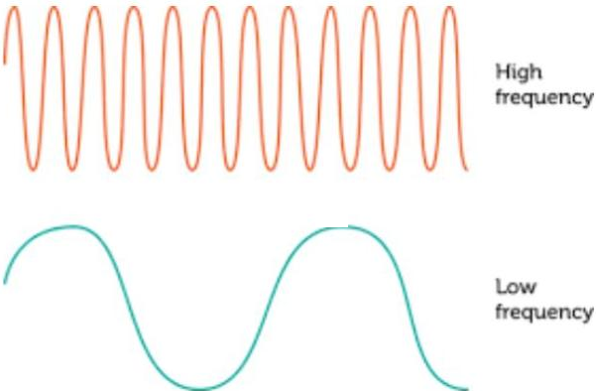
4.03 Frequency and Speed of a Wave
How are frequency, wavelength, and wave speed connected?
Notes:
Unit 4a Waves, lesson 4.03. Classkick: Case #4 warm-up, Part 1 (Q1-Q5), the CER lab (Parts 2-3), and the 4.03 Quest Map (Part 4). Teacher reminder: hand out the 4.03 Quest Map answers today. The CER can be finished Friday.

Slide 2





Today's Goals
I can define frequency and measure it in hertz (Hz).
I can explain: high frequency = short wavelength.
I can explain why frequency does NOT change wave speed.
I can explain how the medium changes wave speed.
Rate each goal:
1
Not yet
2
Getting there
3
I can teach it
Notes:
Objective from the 4.03 page: Students will learn how wave speed is affected by the medium through which it travels.

Slide 3

Ohio Science Standards
7.PS.4 Energy can be transferred through a variety of ways.
In this lesson
Integer warm-up
Vocab check-in
Frequency and hertz
Frequency and wavelength
Frequency does not change speed
The medium changes speed
CER lab + Quest Map
A wave travels at a constant speed through a material as long as the material is uniform.
The speed of a wave depends on the material (sound travels faster through most solids than gases).
Waves are described by speed, wavelength, amplitude, and frequency.
Inquiry skills (Grades 5–8): "Use appropriate mathematics, tools and techniques to gather data" and "Think critically and logically to connect evidence and explanations" (today's CER lab).
Source: Ohio's Learning Standards for Science (2018), Grade 7 Physical Science; content statement paraphrased.

Slide 4
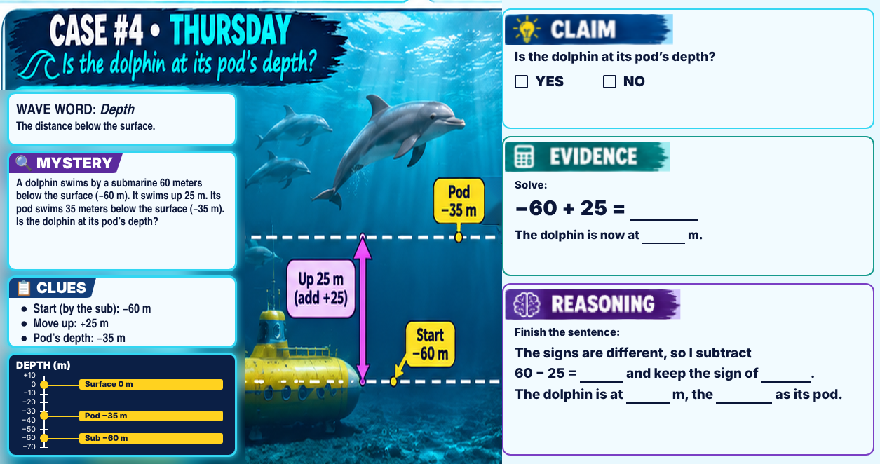
Classkick: 4.03 Math · Case #4
Notes:
Integer warm-up, Case #4 (dolphin), same as the packet slide before 4.03. Answer key: Claim YES. Evidence: −60 + 25 = −35; the dolphin is now at −35 m. Reasoning: different signs, subtract 60 − 25 = 35 and keep the sign of −60. The dolphin is at −35 m, the same as its pod.

Slide 5

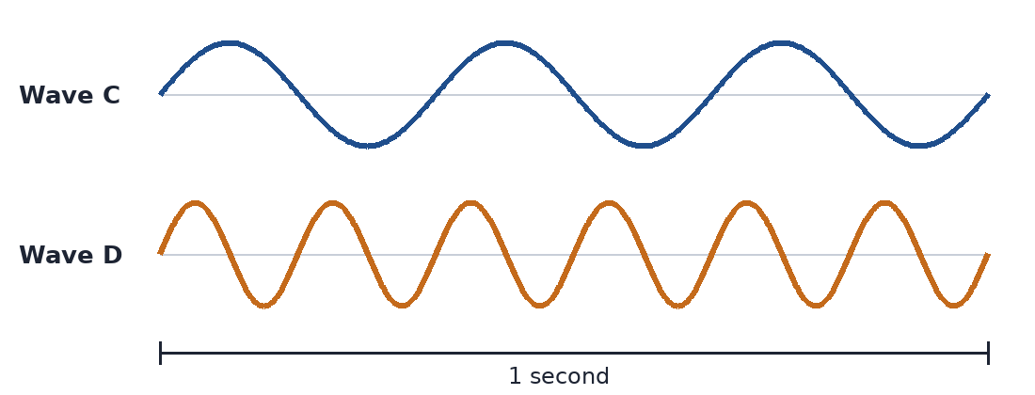
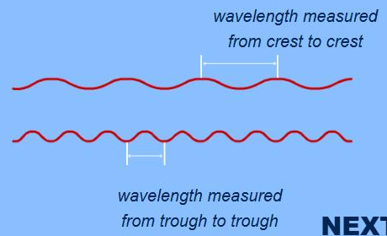
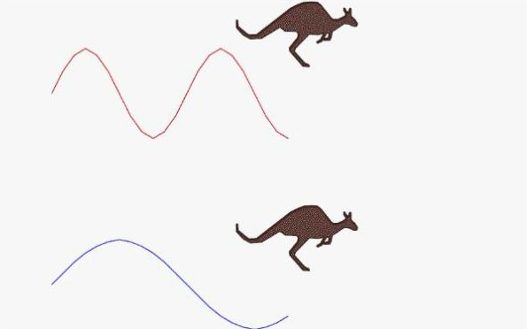
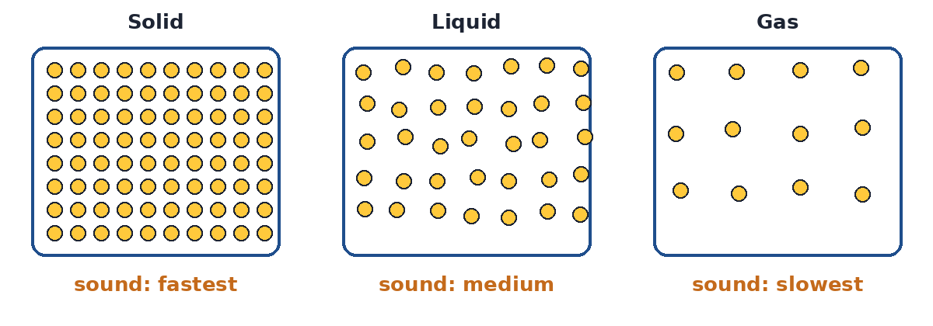
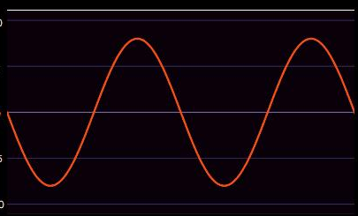
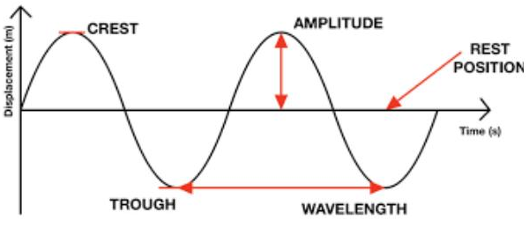
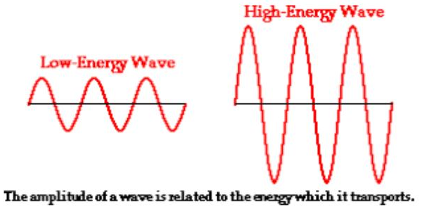
Vocab Check-In
From your Unit 4 vocabulary pretest. Today we focus on the starred words.
frequency ★
hertz (Hz)
wavelength ★
wave speed
the number of waves that go past a point in a given time
the unit for frequency: 1 Hz = 1 wave per second
the distance from one crest to the next crest
how far a wave travels in a given time: speed = distance ÷ time
medium ★
wave
amplitude
energy
the material a wave travels through (rope, water, air, steel)
a disturbance that carries energy from one place to another
how far a wave moves from its rest position
the ability to do work or cause change
Notes:
Pre Vocab survey words used today: frequency, wavelength, medium (plus wave, amplitude, energy review). Hertz and wave speed are new lesson words. Students rate each word 1-3 in the chat.

Slide 6
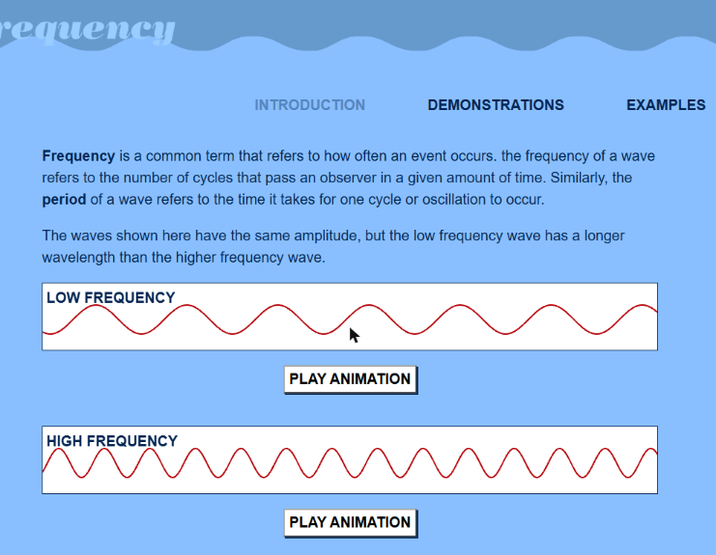
What Is Frequency?
Classkick: 4.03 Part 1 · Q1
Frequency = the number of waves that go past a point in a given time.
It is measured in hertz (Hz). 1 Hz = 1 wave per second.
Raise the frequency: more waves pass each second, and the waves get closer together.
▶ PBS: Exploring Frequency
Notes:
Screenshot of PBS Exploring Frequency (Classkick Link 1). Q1: closer together, more, hertz (Hz). Supports 4.03 Quest Q7 and Mission Q13.

Slide 7

Count the Waves
Classkick: 4.03 Part 1 · Q2
Wave C: ___ Hz
Wave D: ___ Hz
Higher frequency? C / D
Shorter wavelength? C / D
One cycle = one full up and one full down. We do this one together; you do Q2 on your Classkick.
Notes:
Model (different from the Classkick waves): Wave C = 3 Hz, Wave D = 6 Hz. D has the higher frequency and the shorter wavelength. Classkick Q2: A = 2 Hz, B = 5 Hz; B higher, B shorter. (4.03 Quest Q8.)

Slide 8

Classkick: 4.03 Part 1 · Q2
Graph Poll
Read the graph.
What is the frequency of this wave?
Hint: count full cycles in 1 second.
A. 2 Hz
B. 4 Hz
C. 8 Hz
D. 1 Hz
Notes:
Answer: B. 4 Hz (4 full cycles in 1 second). 8 Hz counts crests and troughs separately; 2 Hz counts half; 1 Hz is the time, not the cycles.

Slide 9
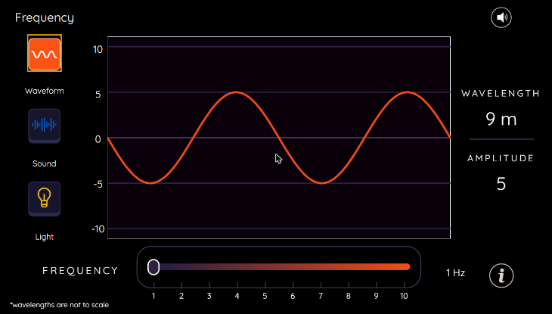
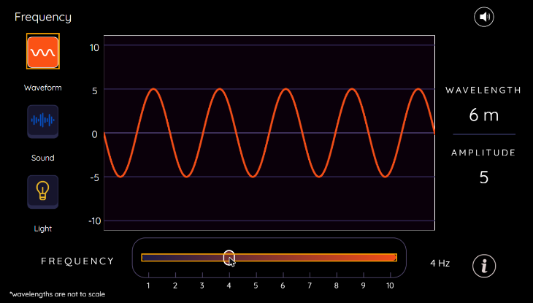
Frequency and Wavelength Go Together
Classkick: 4.03 Part 1 · Q3–Q4
Low frequency (1 Hz): long wavelength
High frequency (4 Hz): short wavelength
High frequency = short wavelength. Low frequency = long wavelength. The amplitude did not change.
▶ PBS: Frequency and Wavelength
Notes:
Screenshots of the PBS frequency slider (Classkick Link 2). Q3: number, hertz, distance, short, long (extra: speed). Q4: high, short, low, long (extra: fast). 4.03 Quest Q7-Q8, Mission Q5-Q6. PBS notes its wavelengths are not to scale.

Slide 10


Video: Wavelength, Frequency, and Amplitude
Listen for:
What does a high-pitched sound do to the frequency?
What happens to the wavelength when frequency goes up?
What does amplitude change: loudness or pitch?
Knowledge Platform (plays right here in Slide Show)
▶ Backup: YouTube
Notes:
Knowledge Platform: "The Wavelength, Frequency, and Amplitude of Sound" (on the 4.03 page). Streams from YouTube, so you need internet. Answers: higher pitch = higher frequency; higher frequency = shorter wavelength; amplitude changes loudness.

Slide 11
Engageli Poll
Wave D has a higher frequency than Wave C. Compared to Wave C, Wave D has a...
A. longer wavelength
B. shorter wavelength
C. faster speed
D. bigger amplitude
Notes:
Answer: B. shorter wavelength. More waves squeeze into the same space. C: in the same medium, speed stays the same. D: the amplitude is the same. Matches 4.03 Quest Q7-Q8.

Slide 12
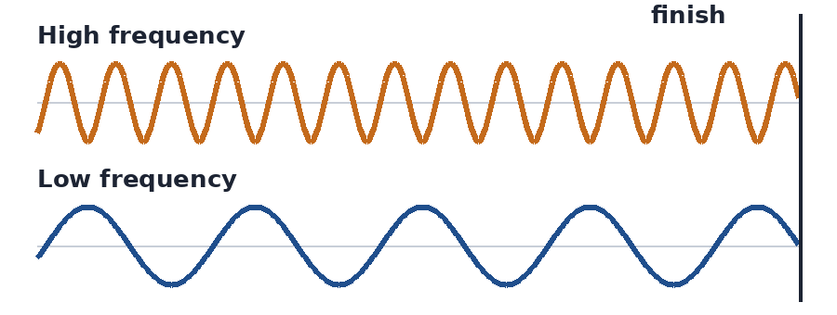
Frequency Doesn't Change Speed
Classkick: 4.03 Part 1 · Q5
Both kangaroos reach the end at the same time.
Watch: both waves finish together.
Remember: in the same medium, high and low frequency waves travel at the SAME speed. Wave speed depends on the medium, not the frequency.
Notes:
Kangaroo picture is from the 4.03 page (it animates there). The race animation plays in Slide Show. Q5: same time; medium. Student reminder for 4.03 Quest Q9: high and low sounds in the same medium arrive at the SAME TIME.

Slide 13
Who Is Right?
A high whistle and a low drum sound at the same moment across the gym. Who explains it best?
Ava says:
Ben says:
Cam says:
Dee says:
"The whistle reaches you first because high-frequency waves are faster."
"The drum reaches you first because its waves are bigger and stronger."
"They arrive at the same time because both travel through the same air."
"The drum wins because long wavelengths travel farther each second."
A. Ava
B. Ben
C. Cam
D. Dee
Notes:
Answer: C (Cam). In the same medium, all sound waves travel at the same speed; the medium sets the speed. Ava: frequency does not change speed. Ben: amplitude (loudness) does not change speed. Dee: wavelength changes with frequency, but speed stays the same. Classkick Part 1 Q5 and 4.03 Quest Q9.

Slide 14
The Medium Changes the Speed
Particles close together pass the energy along faster. Sound is usually fastest in solids and slowest in gases.
Same medium: same speed
Two mediums: two speeds
Notes:
Both videos are from the 4.03 page and play in Slide Show (internet needed). Key idea: wave speed depends on the medium. Speed = distance ÷ time.

Slide 15
Graph Poll
Read the graph.
What does the graph show about the two waves?
Tip: the lines are on top of each other.
A. Same speed: 3 m/s
B. High frequency is faster
C. Low frequency is faster
D. Neither wave moves
Notes:
Answer: A. Both travel 12 m in 4 s, so speed = 12 ÷ 4 = 3 m/s. In the same medium, frequency does not change speed (4.03 Quest Q9).

Slide 16

CER Lab: Frequency and Wavelength
Classkick: 4.03 Parts 2–3 · CER
Our question: "Does increasing the frequency of a wave on a string affect its wavelength? If so, how?"
1
Type your name, then click CONTINUE.
2
Set up PhET: damping none, tension high, No End, Oscillate, ruler.
▶ Open the CER lab
3
Measure crest to crest at 1.0, 1.5, 2.0, 2.5, and 3.0 Hz.
Click the blue ? on the website for sentence starters. Not done? Finish it on Friday.
4
Write your Claim, Evidence, and Reasoning from YOUR data.
5
Screenshot your CER and paste it on your Classkick.
Notes:
Virtual Science Teachers CER lab (Classkick Parts 2-3). The CER can be finished Friday if time runs out.

Slide 17

Get Ready for the 4.03 Quest
Classkick: 4.03 Part 4 · Quest Map
Lesson 4.01
Lesson 4.01
Crests are the high points. After the wave passes, the rope returns to its resting position.
Wavelength = crest to crest. Troughs below zero have negative numbers.
Lesson 4.02
Lesson 4.03
Bigger amplitude = more energy.
Higher frequency = shorter wavelength. Same medium = same speed.
4.03 Quest (10 pts): due Thu, Nov 19 (extended time: Mon, Nov 30). Use your Quest Map!
▶ Waves Review games (Wordwall)
Notes:
Teacher reminder: hand out the 4.03 Quest Map answers today. The Quest Map questions match the 4.03 Quest.

Slide 18
Key Ideas
1
Frequency = waves per second, measured in hertz (Hz).
2
High frequency = short wavelength. Low frequency = long wavelength.
3
In the same medium, all frequencies travel at the same speed.
4
The medium changes the speed: sound is usually fastest in solids.
Re-rate your goals: 1 = Not yet, 2 = Getting there, 3 = I can teach it

