Slide 1
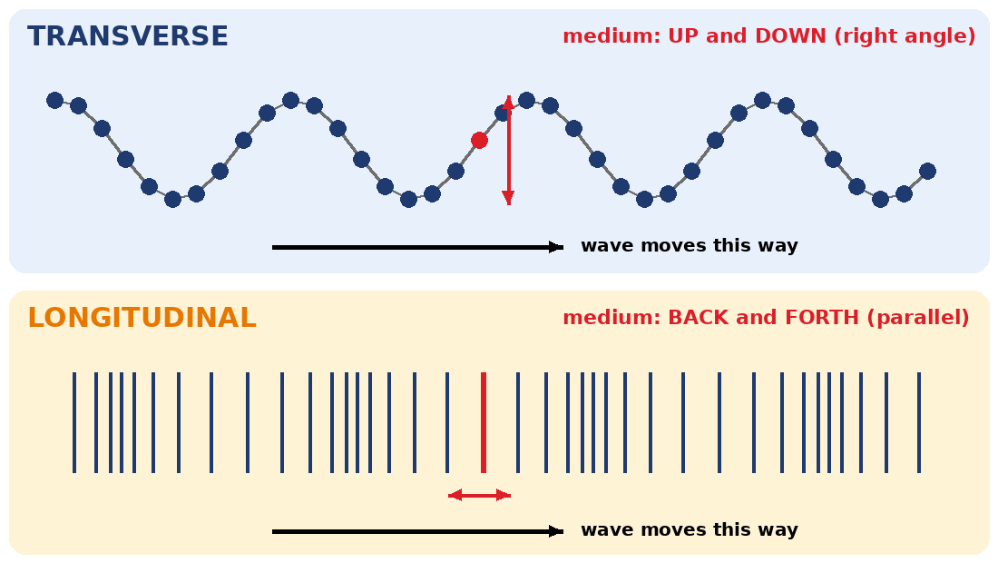
4.07 Longitudinal Waves
How does the medium move in a longitudinal wave?
Notes:
Unit 4a Waves, lesson 4.07 (Thu, Nov 19). Classkick: Case #4 warm-up, Parts 1-2 Make a Longitudinal Wave (Q1-Q4), Part 3 Practice Wave Parts (Q5), 4.07 Quest Map (#32). JavaLab shows ads, so preview it. Animations play in Slide Show.

Slide 2
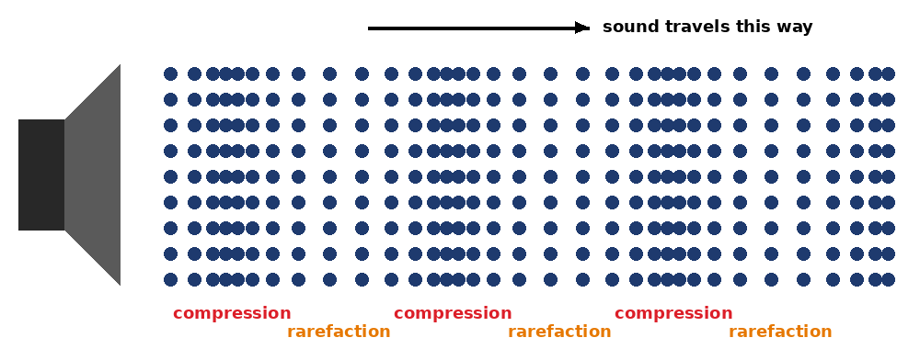

Think About It
How does the sound of a drum get from the drum to your ear?
A. Air from the drum flies to your ear
B. The drum pushes air particles, and they bump the next ones
C. Sound travels through empty space
D. Light carries the sound
Notes:
Hook from Think About It. Answer: B. Each air particle only moves back and forth; the energy is passed along. Do not reveal "longitudinal" yet.

Slide 3





Today's Goals
I can describe how the medium moves in a longitudinal wave.
I can identify compressions and rarefactions.
I can explain why sound is a longitudinal wave.
I can compare transverse and longitudinal waves.
Rate each goal:
1
Not yet
2
Getting there
3
I can teach it
Notes:
Objective from the 4.07 page.

Slide 4

Ohio Science Standards
7.PS.4 Energy can be transferred through a variety of ways.
In this lesson
Integer warm-up
Vocab check-in
What is a longitudinal wave?
Compare: transverse vs. longitudinal
Sound is a longitudinal wave
Toy spring: frequency and amplitude
Sound wave diagram
Mechanical waves need a medium. The medium moves, then returns to its rest position.
Vibrations make waves that carry energy. The energy of a mechanical wave increases with amplitude.
Mechanical waves are transverse or longitudinal, depending on how the medium moves.
Inquiry skills (Grades 5–8): "Use appropriate mathematics, tools and techniques to gather data" and "Think critically and logically to connect evidence and explanations" (today's tuning fork, toy spring, and oPhysics activities).
Source: Ohio's Learning Standards for Science (2018), Grade 7 Physical Science; content statement paraphrased.

Slide 5
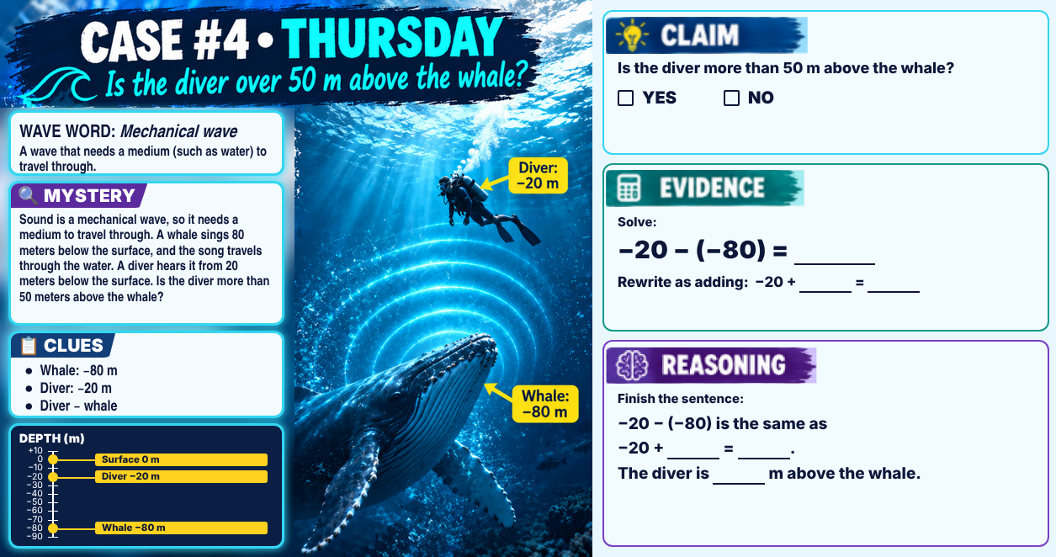
Classkick: 4.07 Math · Case #4
Notes:
Integer warm-up, Case #4 (whale). Key: Claim YES. Evidence: −20 − (−80) = 60; rewrite −20 + 80 = 60. Reasoning: −20 − (−80) is the same as −20 + 80 = 60. The diver is 60 m above the whale, and 60 is more than 50. Wave word: mechanical wave (sound needs a medium, like water).

Slide 6

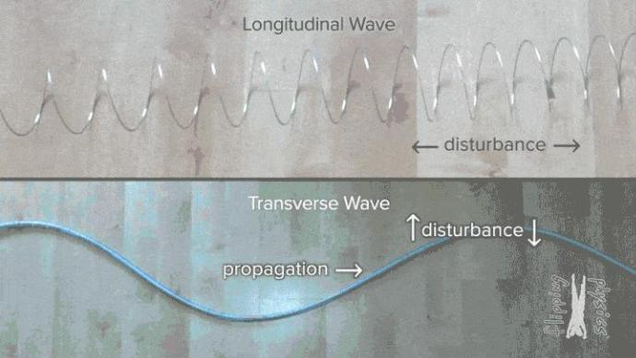
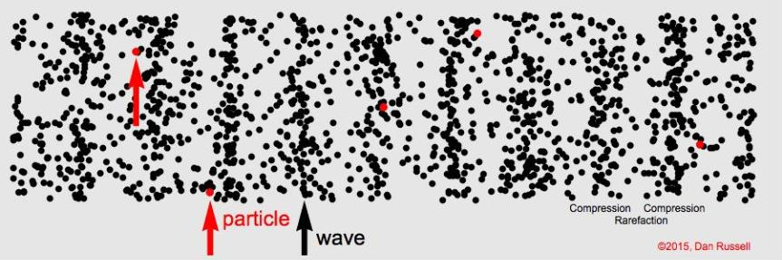
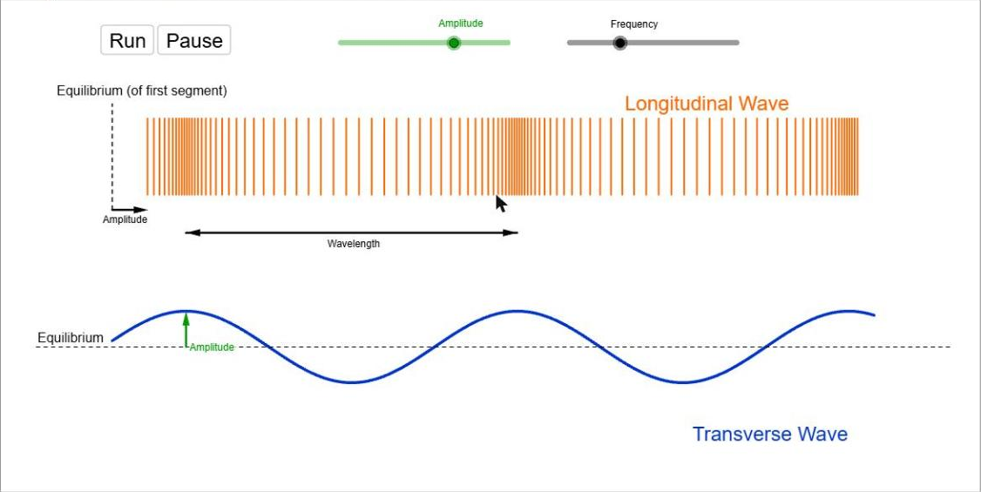
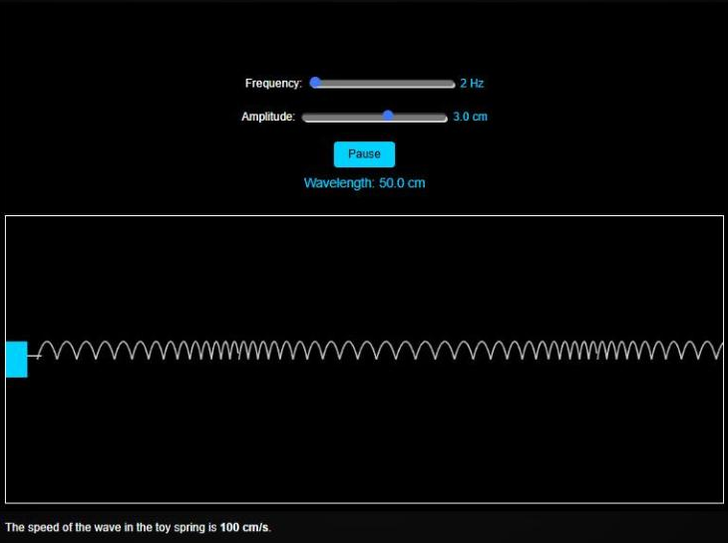
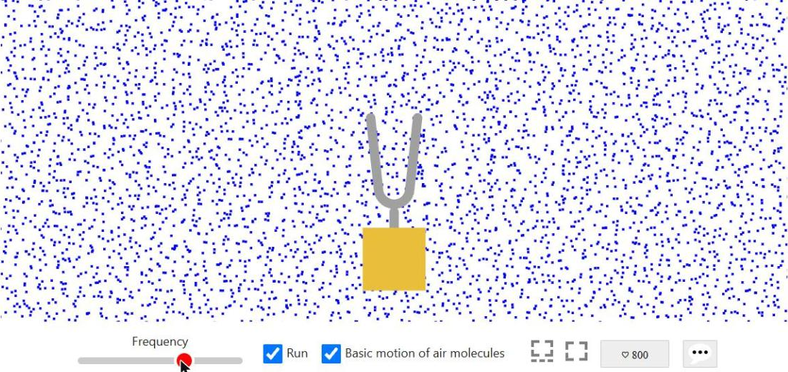
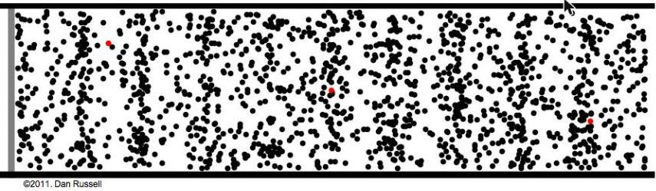
Vocab Check-In
From the 4.07 page. Starred words are on your Unit 4 vocabulary pretest.
longitudinal wave
parallel
compression
rarefaction
the medium moves back and forth, in the same direction as the wave
going the same direction, like two lanes on a road
where the particles are crowded close together
where the particles are spread farther apart
wavelength ★
amplitude ★
sound wave
medium ★
in a longitudinal wave: compression to compression
how far particles move from rest; bigger = tighter compressions, more energy
a longitudinal, mechanical wave made by vibrations
the material a wave travels through: air, water, or a spring
Notes:
Words from the 4.07 Key Vocabulary. Medium, wavelength, and amplitude are on the Pre Vocab survey.

Slide 7
What Is a Longitudinal Wave?
Longitudinal wave: the medium moves back and forth, in the SAME direction (parallel) as the wave.
Make one: stretch a slinky on the floor, then push and pull one end.
No hills or valleys. You see bunched-up and spread-out coils instead.
Notes:
Picture from the 4.07 page (Flipping Physics). Top spring: longitudinal. Bottom: transverse, from 4.06. Think About It: When you push and pull one end of a slinky, how do the coils move?

Slide 8
Compare: Watch the Red Coil
Different
Transverse: up and down, at a right angle.
Longitudinal: back and forth, parallel.
Same
The red coil ends up where it started.
Only the energy travels.
Turn and talk: What is the SAME about both waves? What is DIFFERENT?
Notes:
Compare-and-contrast animation (plays in Slide Show). Ask students to predict before you reveal the card. Both: matter does not travel with the wave; only energy travels.

Slide 9

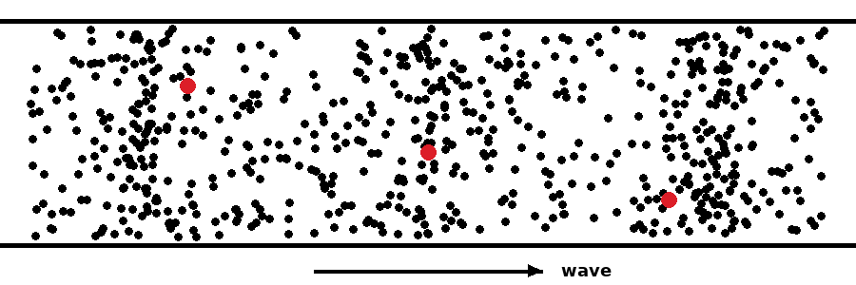
Prove It! Follow One Red Dot
Classkick: 4.07 Parts 1–2 · Q2
Does the red dot travel across the box, or just move back and forth?
The red dots move back and forth and stay near where they started. The bunched-up areas move across the box. That is the energy moving, not the matter.
Notes:
Top: animation. Bottom: still from the 4.07 page (Dan Russell). Classkick Q2c: after the wave passes, each coil returns to its place.

Slide 10
Compressions and Rarefactions
Compression: particles crowded together.
Rarefaction: particles spread apart.
The black arrow (wave) rides along. The red arrow (particle) just moves back and forth.
▶ Watch: Longitudinal Waves (1 min)
The narrator says "amplification." The science word is amplitude.
Notes:
Top picture from the 4.07 page (Dan Russell). The UNC-TV video is embedded on the Canvas page; the button opens it on PBS LearningMedia. Listen for compression, rarefaction, amplitude, wavelength.

Slide 11
Part 1: Sound Is a Longitudinal Wave
Classkick: 4.07 Parts 1–2 · Q1
A drum or tuning fork vibrates. It pushes and pulls the air next to it. Those air particles bump the next ones, so compressions and rarefactions travel to your ear.
Sound is mechanical, so it needs a medium. There is no sound in empty space.
▶ Open Tuning Fork and Sound Wave
Check Basic motion of air molecules. Slide Frequency up and down. JavaLab shows ads.
Notes:
Screenshot of JavaLab (Classkick Link 1). Q1: the fork pushes air molecules back and forth; sound travels by bumping air molecules; sound is a longitudinal wave.

Slide 12
Engageli Poll
An astronaut bangs a hammer outside the space station. Why can't anyone hear it?
A. Space is too cold
B. Sound needs a medium, and space has almost none
C. Sound is a transverse wave
D. Sound moves too fast in space
Notes:
Answer: B. Sound is a longitudinal, mechanical wave; it needs matter to push and pull. 4.07 Quest Q9: Sound cannot travel in space because sound needs a medium.

Slide 13

Compare: How They Move
 | Transverse wave | Longitudinal wave
How the medium moves | Up and down | Back and forth
Compared to the wave | At a right angle (perpendicular) | Same direction (parallel)
Shape | Hills and valleys | Bunched-up and spread-out areas
Does matter travel? | No. Only energy travels. | No. Only energy travels.
Needs a medium? | Mechanical ones do. Light does not. | Yes, always.
Examples | shaken rope, guitar string, light | slinky pushed in and out, sound
Notes:
Table from the 4.07 page. Point out the two rows that are the SAME (matter does not travel) and the row that differs only partly (needs a medium).

Slide 14



Your Turn: Build the Venn Diagram
1. Go to soops.io
2. Enter code 7A69D
3. Click Let's Go
Add one fact to Transverse, Longitudinal, or the middle (both).
Notes:
Soops collaborative Venn diagram (code 7A69D). Students add ideas before you show the finished Venn on the next slide. If you start a new Soops session, the code changes: update this slide. QR opens soops.io; students still type the code.

Slide 15
Compare: Venn Diagram
Transverse only
Both
Longitudinal only
Up and down
Right angle to the wave
Crests and troughs
Can be EM (light)
Carry energy, not matter
Have wavelength, amplitude, and frequency
Higher frequency = shorter wavelength
Bigger amplitude = more energy
Back and forth
Parallel to the wave
Compressions and rarefactions
Always mechanical (sound)
Notes:
Option: show the slide with the text hidden and have students call out where each fact goes. Longitudinal waves are always mechanical, so EM waves (light) are never longitudinal.

Slide 16
Engageli Poll
Which one is a LONGITUDINAL wave?
A. a plucked guitar string
B. sunlight
C. a slinky pushed in and out
D. a rope shaken up and down
Notes:
Answer: C. The others are transverse. Follow-up: name one transverse and one longitudinal wave from your everyday life (Check Your Understanding Q5).

Slide 17

Part 2: Longitudinal Waves in a Toy Spring
Classkick: 4.07 Parts 1–2 · Q2–Q3
Frequency | Wavelength
2 Hz | ___ cm
4 Hz | ___ cm
5 Hz | ___ cm
Watch ONE coil. Then move only the Frequency slider and read the Wavelength under the Pause button.
▶ Open the toy spring sim
Same toy spring as 4.06, but now the coils move back and forth.
Notes:
Screenshot of the VST sim (Classkick Link 2). Q2: back and forth; parallel; returns to its place. Q3: 2 Hz 50 cm, 4 Hz 25 cm, 5 Hz 20 cm; higher frequency = compressions closer together.

Slide 18
Graph Poll
Read the graph.
What happens to the wavelength of sound as the frequency goes up?
A. It gets longer
B. It gets shorter
C. It stays the same
D. It goes up, then down
Notes:
Answer: B. Higher frequency = compressions closer together = shorter wavelength. Same rule as transverse waves (4.03 Quest Q5, 4.07 Quest Q5). Uses sound in air, not the toy spring, so Q3 stays hidden.

Slide 19
Compare: Change the Amplitude and Frequency
Classkick: 4.07 Parts 1–2 · Q4
 | Transverse | Longitudinal
Bigger amplitude | Taller crests, deeper troughs. More energy. | Tighter compressions, wider rarefactions. More energy.
Higher frequency | Crests closer together: shorter wavelength. | Compressions closer together: shorter wavelength.
Wave speed (same medium) | Stays the same | Stays the same
▶ Open oPhysics: both waves
Notes:
oPhysics sim from the 4.07 page: click Run, then move each slider. Q4: bigger amplitude = compressions more crowded; more energy; wavelength stays the same; one wavelength is compression to compression.

Slide 20
Graph Poll
Read the graph.
What happens to the energy as the amplitude gets bigger?
A. It goes down
B. It stays the same
C. It goes up
D. It goes up, then down
Notes:
Answer: C. Bigger amplitude = more energy (4.07 Quest Q7). Extension: doubling the amplitude gives about 4 times the energy, so the energy grows faster than the amplitude.

Slide 21

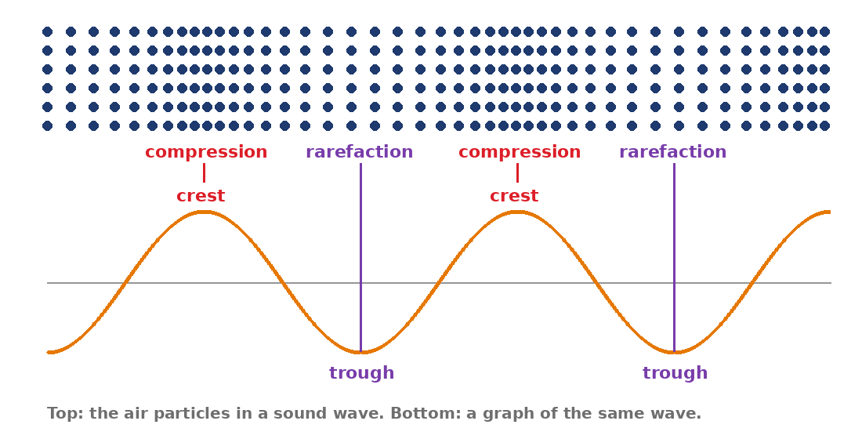
Compare: Drawing Sound as a Graph
 | Transverse | Longitudinal
Parts | crests and troughs | compressions and rarefactions
One wavelength | crest to crest | compression to compression
On a graph | crest = high point | compression = crest, rarefaction = trough
Scientists often draw sound like a transverse wave. The graph is a model. The air still moves back and forth.
Notes:
From the parts table on the 4.07 page. This sets up the Sound Wave Diagram (Part 3).

Slide 22

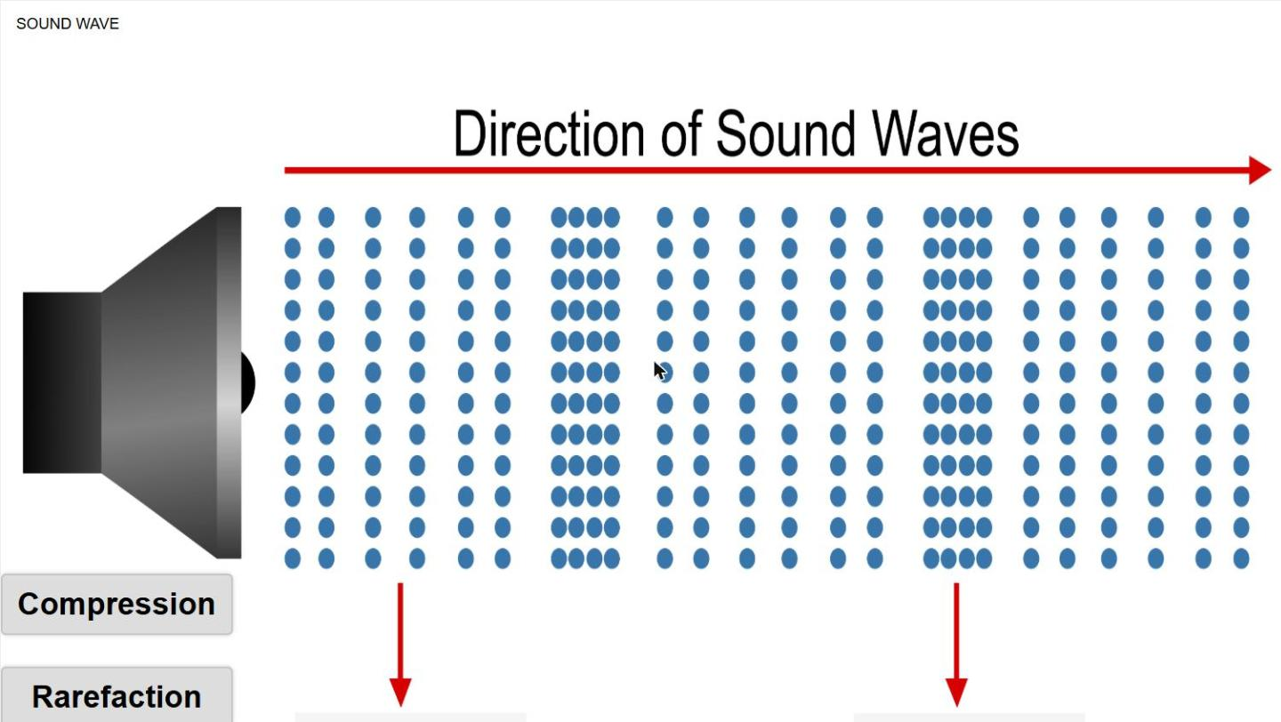
Part 3: Practice Wave Parts
Classkick: 4.07 Part 3 · Q5
Drag each label onto the diagram and press Check.
Bunched-up dots = compression (a crest on the graph).
Spread-out dots = rarefaction (a trough on the graph).
One wavelength: compression to the next compression.
▶ Open the Sound Wave Diagram
Notes:
Screenshot of the VST Sound Wave Diagram (Classkick Part 3 link). Q5: A and C compression = crest; B rarefaction = trough; one wavelength is A to C; bunched-up lines = longitudinal.

Slide 23
Who Is Right?
Mia draws sound as bunched-up lines. Leo draws it as a wavy line with crests and troughs. Who drew sound correctly?
Ava says:
Ben says:
Cam says:
Dee says:
"Only Mia. Sound is longitudinal, so a wavy line is wrong."
"Only Leo. Every wave has crests and troughs."
"Both. The wavy line is a graph: crests show compressions and troughs show rarefactions."
"Neither. Sound is invisible, so it cannot be drawn."
A. Ava
B. Ben
C. Cam
D. Dee
Notes:
Answer: C (Cam). Bunched-up lines show what the air does. The wavy line is a graph model of the same wave. Matches Classkick Q5 and the Sound Wave Diagram.

Slide 24
Engageli Poll
Can light ever be a longitudinal wave?
A. Yes, light is always longitudinal
B. No. Light is EM, and EM waves are always transverse
C. Only when it travels through water
D. Only in empty space
Notes:
Answer: B. Longitudinal waves push and pull on matter, so they are always mechanical. Light and other EM waves are always transverse (4.07 page; 4.07 Quest Q8: light can travel through empty space).

Slide 25
Key Ideas
1
Longitudinal wave: the medium moves back and forth, parallel to the wave.
2
Compressions are crowded areas. Rarefactions are spread-out areas.
3
Sound is a longitudinal, mechanical wave. It needs a medium.
4
Both kinds carry energy, not matter. On a graph, compression = crest and rarefaction = trough.
Re-rate your goals. Then start the 4.07 Quest Map (#32).
Notes:
4.07 Quest opens today (Thu, Nov 19); regular close Mon, Nov 30, extended Thu, Dec 3. It covers 4.02, 4.03, 4.04, 4.06, and 4.07 (refraction, speed/frequency/wavelength, amplitude/energy, light vs. mechanical waves).

