Slide 1
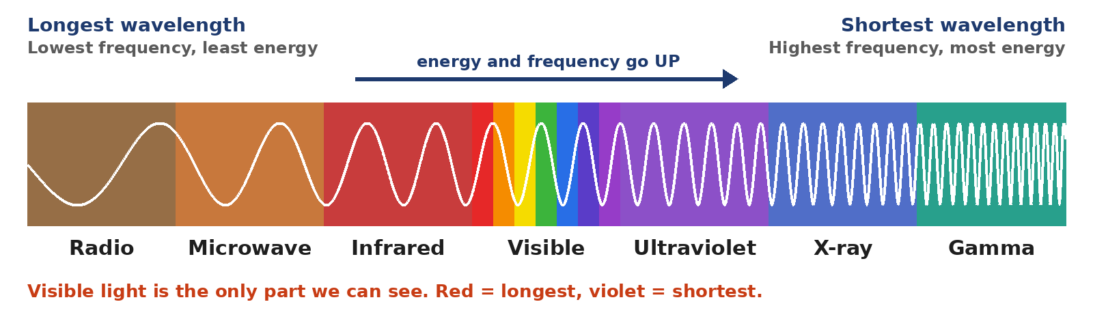
4.13 Unit 4 Review
Get ready for the 4.14 Unit 4 Mission
Notes:
Unit 4a Waves, lesson 4.13 (Thu, Dec 3). Classkick: Case #4 (seiche), 4.13 Review (Q1-Q5), Vocab Review Parts 1-2, 4.14 Mission Map (together), Mission reminder. Post Vocab survey closes Thu, Dec 10. Mission opens Mon, Dec 7. 4.07 Quest extended closes today.

Slide 2





Today's Goals
I can explain that waves carry energy, not matter.
I can label a wave and use the 10 focus words.
I can compare transverse, longitudinal, mechanical, and EM waves.
I am ready for the Unit 4 Mission.
Rate each goal:
1
Not yet
2
Getting there
3
I can teach it
Notes:
Objective: review the key ideas and vocabulary from Unit 4 to get ready for the 4.14 Unit 4 Mission.

Slide 3
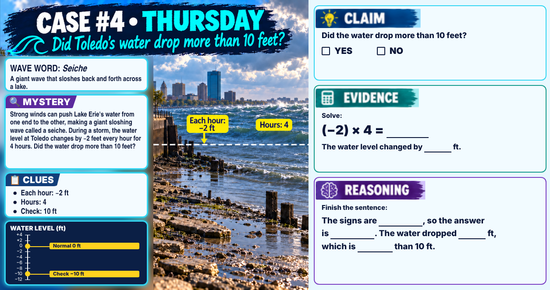
Classkick: 4.13 Math · Case #4
Notes:
Case #4 (seiche). Key: Claim NO. Evidence: (−2) × 4 = −8; the water level changed by −8 ft. Reasoning: opposite signs, negative; the water dropped 8 ft, less than 10 ft. Wave word: seiche.

Slide 4





Today's Review Plan
4.13 Review
Vocab Review
Post Vocab survey
Mission Map
Classkick Q1–Q5 + Wordwall game
Part 1 Picture Match + Part 2 Use the Words
Rate the 10 words again. Closes Thu, Dec 10.
We fill it in together. Use it on the Mission.
The 4.14 Unit 4 Mission opens Mon, Dec 7. Regular close: Mon, Dec 14. Extended: Mon, Dec 21.
Notes:
Mission dates from Canvas. Your Classkick packet is due when the Unit 4 test is due.

Slide 5
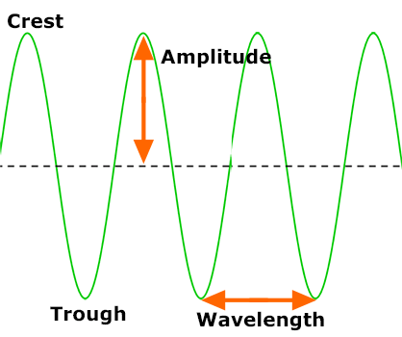
Parts of a Wave
Classkick: 4.13 Review · Q1
Word | Meaning
Crest | the highest point
Trough | the lowest point
Wavelength | crest to crest (or trough to trough)
Amplitude | rest line to crest. Bigger = more energy
Frequency | waves per second
Don't fall for it: crest to trough is NOT a wavelength.
Notes:
Q1 key: crest, trough, wavelength, amplitude (extra: frequency). Mission Q1, Q4.

Slide 6
The 10 Focus Words
Classkick: 4.13 Review · Q2
wave
medium
energy
frequency
wavelength
carries energy, not matter
the matter a wave travels through
the ability to do work or cause change
waves that pass a point each second
crest to crest
amplitude
transverse wave
electromagnetic wave
refraction
density
how far the medium moves from rest
medium moves at a right angle to the wave
can travel through empty space, like light
a wave bends in a new medium
how much mass is packed into a space
Notes:
The 10 Unit 4 focus words (Pre/Post Vocab survey). Q2 key: wave, medium, frequency, energy, density (extra: refraction). Quick game: read a meaning and have students shout the word.

Slide 7
Compare: Kinds of Waves
Classkick: 4.13 Review · Q3
 | Transverse (up and down) | Longitudinal (back and forth)
Mechanical (needs a medium) | guitar string, jump rope | sound, slinky pushed in and out
Electromagnetic (crosses empty space) | light, radio waves, X-rays | never! EM waves are always transverse
Every wave gets TWO labels: how it moves (transverse or longitudinal) AND what it needs (mechanical or electromagnetic).
Notes:
Q3 key: rope wave transverse + mechanical; sound longitudinal + mechanical; sunlight transverse + EM; microwaves transverse + EM. Examples on the slide differ from Q3. Mission Q9-10, Q12, Q16.

Slide 8

Review Poll
Which wave is BOTH longitudinal AND mechanical?
A. Sunlight
B. A shaken jump rope
C. The sound of a drum
D. Radio waves
Notes:
Answer: C. Sound moves back and forth (longitudinal) and needs a medium (mechanical).

Slide 9

Compare: The Density Flip
Classkick: 4.13 Review · Q4
Light (EM wave)
Sound (mechanical wave)
SLOWER in denser stuff
FASTER in solids
fastest in air → slower in water → slower in glass
slowest in air → faster in water → fastest in steel
When it slows down at an angle, it bends: refraction (a straw looks broken).
Packed particles bump the next ones quickly.
Refraction: a wave bends when its speed changes in a new medium.
Notes:
Q4 key: a) slows down and bends; b) refraction; c) steel; d) air. Mission Q7-8, Q17.

Slide 10
Review Poll
Which statement is TRUE?
A. Light travels faster in glass than in air
B. Sound travels faster in steel than in air
C. Sound travels fastest in air
D. Light needs a medium to travel
Notes:
Answer: B. Sound is fastest in solids. Light is slower in denser materials, and it needs no medium.

Slide 11



The Big Rules
Energy, not matter
Amplitude
Frequency ↔ wavelength
Speed
The medium moves in place and returns. Only energy travels.
Bigger amplitude = more energy. It does NOT change the speed.
One goes up, the other goes down.
Only the medium changes wave speed.
EM spectrum: radio → microwave → infrared → visible → UV → X-ray → gamma (more energy →)
Notes:
Mission Map Parts 1, 3, and 6 in one slide.

Slide 12
Review Poll
You shake a rope faster, so the frequency goes UP. What happens to the wavelength?
A. It gets longer
B. It gets shorter
C. It stays the same
D. The wave gets taller
Notes:
Answer: B. Frequency and wavelength go in opposite directions (Mission Q5-6).

Slide 13
Who Is Right?
Why are gamma rays more dangerous than radio waves?
Ava says:
Ben says:
Cam says:
Dee says:
"Gamma rays are the biggest waves, so they hit harder."
"Gamma rays travel faster than radio waves."
"Gamma rays have the highest frequency and shortest wavelength, so they carry the most energy."
"Gamma rays need a medium, and radio waves do not."
A. Ava
B. Ben
C. Cam
D. Dee
Notes:
Answer: C (Cam). Gamma rays have the shortest wavelength (atom-sized), highest frequency, and most energy. All EM waves travel at the speed of light, and none need a medium (Mission Q13-14).

Slide 14

Play: Review Waves and EMS
Classkick: 4.13 Review · Q5
Wordwall review game
Play the game.
Then answer on Classkick:
Why can we see the Sun but not hear it?
Light is an electromagnetic wave. It can travel through empty space.
Sound is a mechanical wave. It needs a medium, and space has almost none.
▶ Open the Wordwall review
Notes:
Q5 key: electromagnetic; medium (extra: longitudinal). The answer card can be hidden until students try. The Unit 4 Review Game on the 4.13 page is another option.

Slide 15
Vocab Review: Parts 1 and 2
Classkick: Vocab Review · Parts 1–2
Part 1: Picture Match
Part 2: Use the Words
Use the picture and the meaning. Drag the focus word into each box.
Odd one out, the concert story, and explain one word to a 5th grader.
▶ Open Wave Vocab Flashcards (SERP)
▶ Open Wave Diagram Labeling
Explain it to a 5th grader: Amplitude is how tall a wave is from the middle line. A big ocean wave has a big amplitude and more energy, so it can knock you over.
Notes:
Part 1 key and Part 2 key are in the answer key packet. The sample answer on the slide is from the Part 2 key (Q4); have students pick a different word.

Slide 16
Before the Mission
Take the Unit 4 Post Vocab survey
Rate each of the 10 words again to show how much you grew. It closes Thu, Dec 10.
wave
medium
energy
frequency
wavelength
amplitude
transverse wave
electromagnetic wave
refraction
density
Notes:
The Post Vocab survey is in Canvas. Compare with the Pre Vocab survey from the start of the unit.

Slide 17
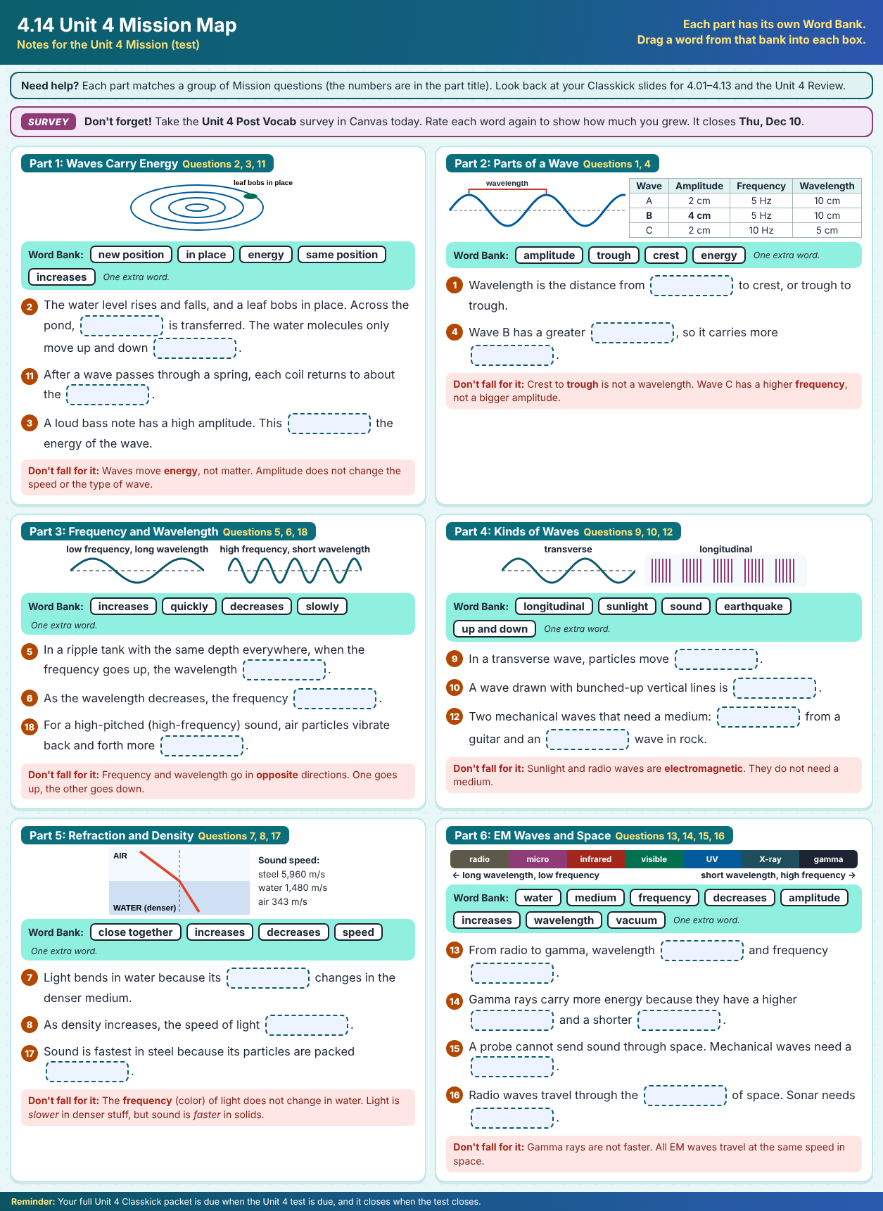
4.14 Mission Map: Together
Classkick: 4.14 Mission Map
6 parts, one for each group of Mission questions
Waves carry energy (Q2, 3, 11)
Parts of a wave (Q1, 4)
Frequency and wavelength (Q5, 6, 18)
Kinds of waves (Q9, 10, 12)
Refraction and density (Q7, 8, 17)
EM waves and space (Q13–16)
Notes:
Fill in the Mission Map together (packet slide #60). Each part has its own word bank with one extra word. Keys are in the answer key packet.

Slide 18
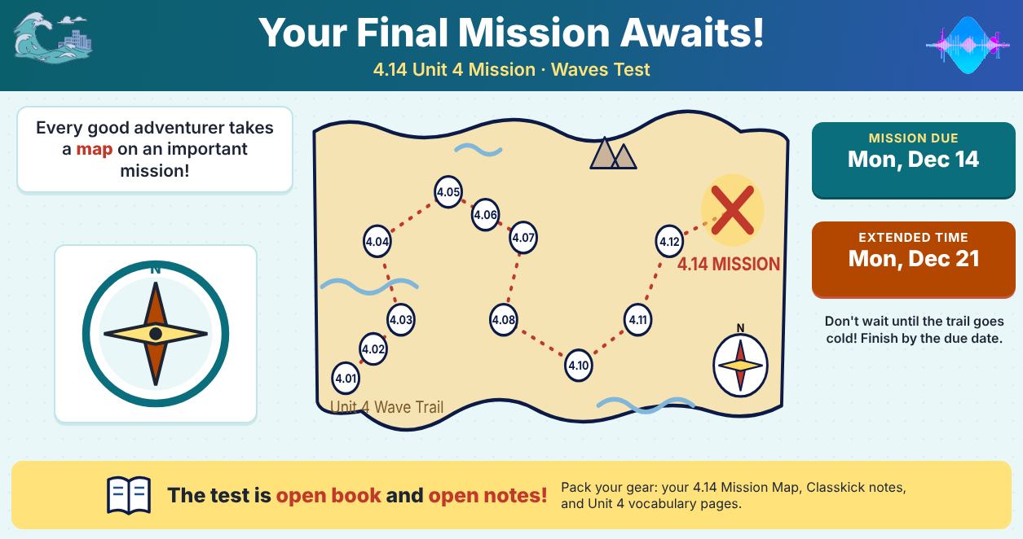
Classkick: Mission Reminder
Notes:
Packet slide #61. Extended time: Mon, Dec 21.

Slide 19
Key Ideas
1
Waves carry energy, not matter.
2
Transverse = up and down. Longitudinal = back and forth. Mechanical needs a medium; EM does not.
3
Frequency up = wavelength down. Bigger amplitude = more energy.
4
Only the medium changes speed. Light: slower in denser stuff. Sound: fastest in solids.
Re-rate your goals. Mission opens Mon, Dec 7. You've got this!

