Slide 1
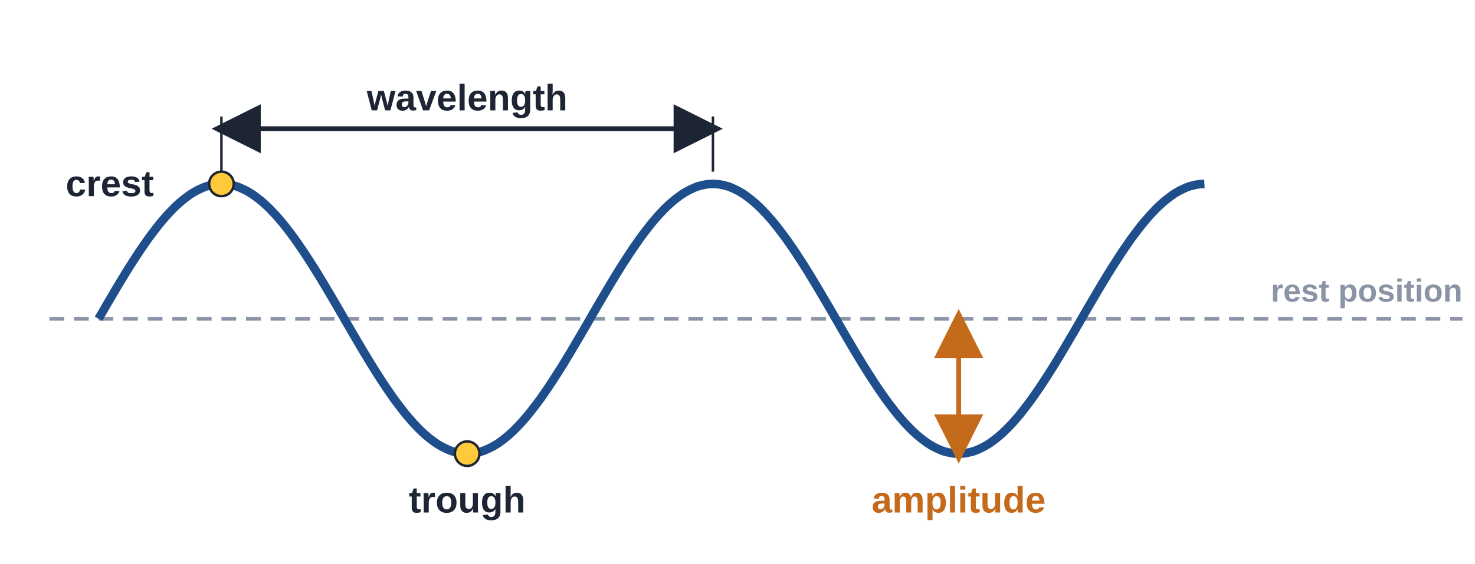
4.01 Describe a Wave
What is a wave, and how do we measure one?
Notes:
Unit 4a Waves, lesson 4.01. Students follow along in the 4.01 Classkick (Part 1 and Part 2).

Slide 2





Today's Goals
I can explain that a wave carries energy from one place to another.
I can tell a transverse wave from a longitudinal wave.
I can label a crest, trough, rest position, wavelength, and amplitude.
I can measure wavelength and describe frequency.
Rate each goal:
1
Not yet
2
Getting there
3
I can teach it
Notes:
Students rate each goal 1-3 in the chat or on paper. They re-rate on the Key Ideas slide.

Slide 3

Ohio Science Standards
7.PS.4 Energy can be transferred through a variety of ways.
In this lesson
What a wave is
Transverse vs. longitudinal
Parts of a wave
Measuring wavelength and amplitude
Frequency and speed
Graph CER
Waves can be described by their speed, wavelength, amplitude, and frequency.
Vibrations cause wave-like disturbances that carry energy.
Mechanical waves need a medium; the medium returns to its rest position.
Waves can be transverse or longitudinal.
Inquiry skills (Grades 5–8): "Develop descriptions, models, explanations and predictions" and "Think critically and logically to connect evidence and explanations" (today's CER).
Source: Ohio's Learning Standards for Science (2018), Grade 7 Physical Science; content statement paraphrased.
Notes:
7.PS.4 statement quoted; the wave content elaboration is paraphrased.

Slide 4
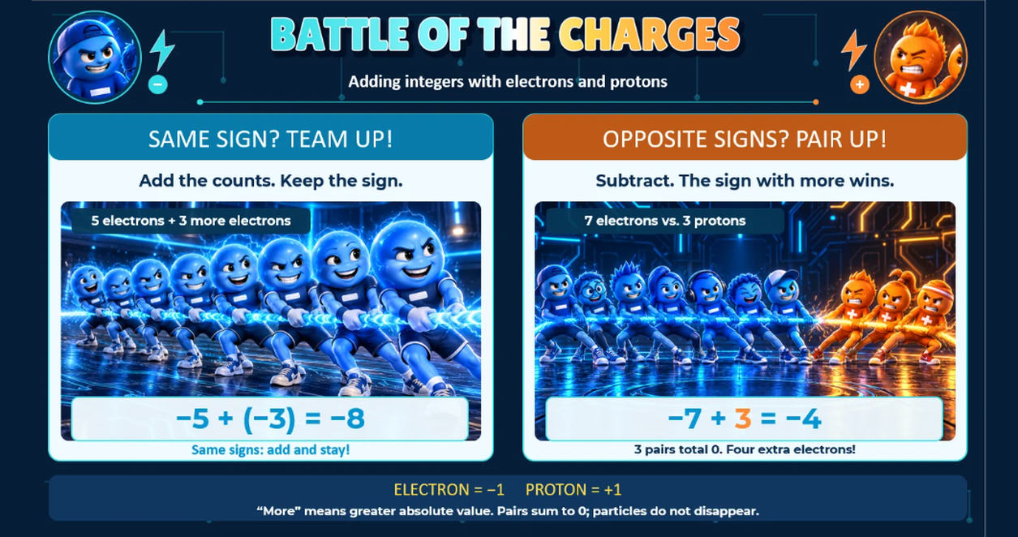
Classkick: 4.01 Math · Battle
Notes:
Integer warm-up: Battle of the Charges. Same signs: add and keep the sign (−5 + (−3) = −8). Opposite signs: subtract, the sign with more wins (−7 + 3 = −4).

Slide 5
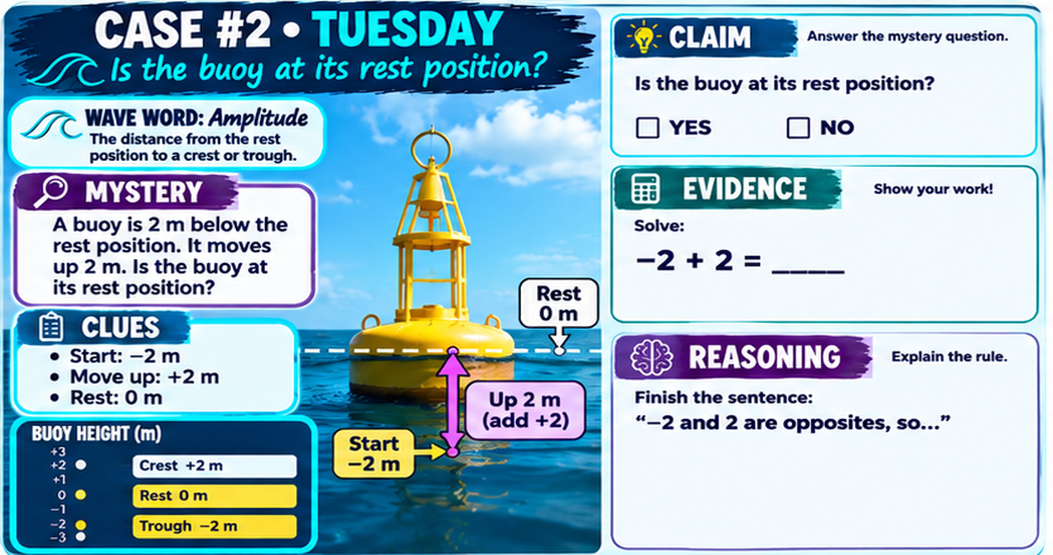
Classkick: 4.01 Math · Case #2
Notes:
Integer warm-up Case #2 (buoy). Answer key: YES, 0. Opposites add to 0, so the buoy is back at its rest position (0 m).

Slide 6

Vocabulary
wave
vibration
medium
rest position
a disturbance that carries energy from one place to another
a quick back-and-forth or up-and-down motion that starts a wave
the material a wave travels through (rope, water, air)
where the medium sits when no wave is passing
transverse
longitudinal
crest / trough
cycle
the medium moves up and down, across the wave
the medium moves back and forth, along the wave
the highest point / the lowest point of a wave
one complete wave that repeats (one crest + one trough)
wavelength
amplitude
frequency
speed
the length of one cycle, crest to crest
the distance from the rest position to a crest
how many cycles pass in a period of time
how far the wave travels each second

Slide 7

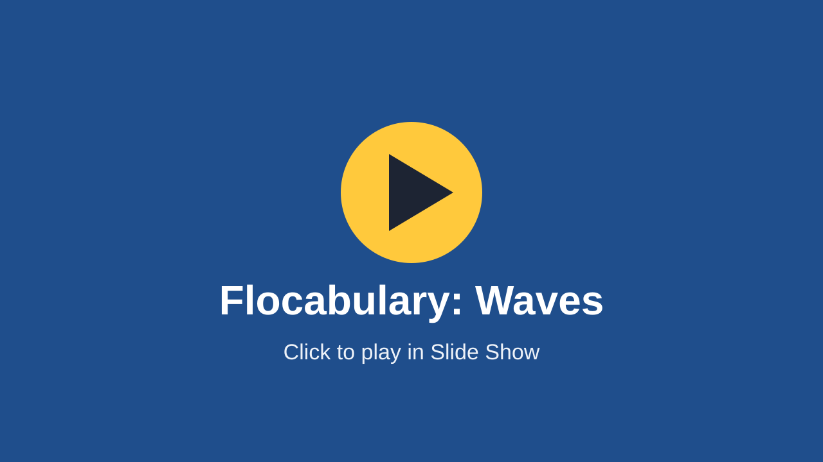
Waves Song
Listen for these words:
energy
medium
crest and trough
wavelength and amplitude
frequency
transverse and longitudinal
Flocabulary: Waves (plays right here in Slide Show)
▶ Backup: open on YouTube
Type one word you heard in the chat!
Notes:
Flocabulary Waves song (also on the 4.01 page). Use it as a hook. Pause and point out the vocabulary words as they come up.

Slide 8



What Is a Wave?
Classkick: 4.01 Part 1 · Q2
A wave carries energy
Watch: guitar strings up close
A wave is a disturbance that carries energy from one place to another.
Look for: Which way does each string move? What makes the sound?
Vibrations cause waves
Pluck a guitar string and it vibrates. The vibration starts a wave.
The medium goes back
The medium (rope, water, air) moves, then returns to its rest position. Energy travels on.
▶ Open the 4.01 page
Mechanical waves (rope, water, sound) need a medium to travel through.
Notes:
Video: guitar strings close-up, embedded on the 4.01 page (not in the Classkick). Ask: the strings move side to side; the vibration makes the sound wave.

Slide 9


Waves Are Everywhere
Ocean waves
Rope waves
Watch a floating object. Does the water travel to the shore, or does the energy?
An athlete shakes exercise ropes. Which way does the rope move? Which way does the energy go?
▶ Play the PBS videos (4.01 page)
Extra videos: these are on the 4.01 page but not in the Classkick.
Notes:
PBS "Waves Are Everywhere" ocean and rope videos on the 4.01 page. Ocean: the water mostly moves up and down in place; the energy travels to shore. Rope: the rope moves up and down; the energy moves along the rope (transverse). Leads into the next poll.

Slide 10

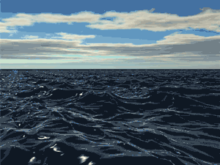
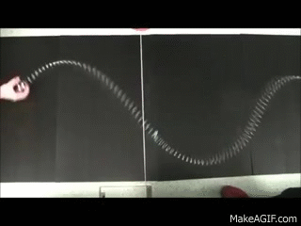
See It Move
Ocean: the water moves up and down in place. The energy moves across the ocean.
Spring toy: the coils move side to side, across the direction the energy travels: a transverse wave.
Notes:
The GIFs play in Slide Show. Ask: Does the water travel across the ocean? (No, it moves up and down; the energy travels.) The spring toy is shaken side to side, so this is a transverse wave. Next slide: pushing the spring back and forth makes a longitudinal wave.

Slide 11

Classkick: 4.01 Part 1 · Q2
Engageli Poll
Guitar-string waves and rope waves both carry ______ from one place to another.
A. the string
B. energy
C. air
D. the rope
Notes:
Answer: B. energy. A wave carries energy, not matter. The string and the rope (the mediums) move, then return to their rest position. Both are transverse waves.

Slide 12

Fill the Gaps
Classkick: 4.01 Part 1 · Q2
Waves are caused by __________. A mechanical wave carries __________ from one place to another. It needs a __________ to travel through. The medium moves, then goes back to its __________ position.
Word bank:
medium
speed
rest
vibrations
energy
One extra word.
Notes:
Same as Classkick Part 1 Q2. Answers: vibrations, energy, medium, rest. Extra word: speed.

Slide 13
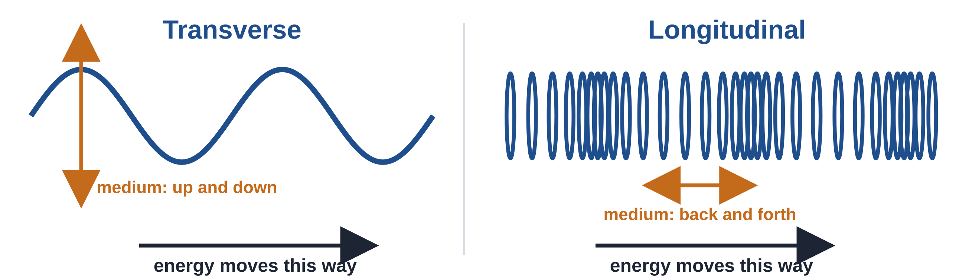
Two Ways a Medium Can Move
Classkick: 4.01 Part 1 · Q3
Transverse: the medium moves up and down, across the direction the energy travels. Example: shaking a rope.
Longitudinal: the medium moves back and forth, along the direction the energy travels. Example: pushing a spring toy.
Notes:
Classkick Part 1 Q3 (circle the type of wave).

Slide 14
Classkick: 4.01 Part 1 · Q3
Engageli Poll
You push and pull one end of a spring toy. The coils move back and forth, the same way the energy travels. What kind of wave is it?
A. transverse
B. longitudinal
C. not a wave
D. both kinds
Notes:
Answer: B. longitudinal. The coils move back and forth, along the direction the energy travels. Transverse = up and down, across the energy direction.

Slide 15
Parts of a Wave
Classkick: 4.01 Part 1 · Q1
Crest: high point
Trough: low point
Rest position: the flat middle line
Wavelength: one full cycle
Amplitude: rest position to a crest or trough
▶ Practice: Label the Parts (Wordwall)
Notes:
Classkick Part 1 Q1 uses the Wordwall labeling game on the 4.01 page.

Slide 16



Measuring a Wave
Classkick: 4.01 Part 2 · Q5
Cycle
Wavelength
Amplitude
One complete wave that repeats: one crest + one trough. A waveform is a curve that shows the wave's shape.
Measure crest to crest OR trough to trough. You get the same answer both ways!
Measure from the rest position to a crest (or to a trough). Bigger amplitude = more energy.
▶ Watch: Measuring Waves animation
Notes:
"Measuring Waves" animation is on the 4.01 page. Classkick Part 2 Q5: wavelength crest to crest = trough to trough = 4 m; amplitude 2 m.

Slide 17
Measure It Two Ways
Classkick: 4.01 Part 2 · Q5
Crest to crest: _____ m
Trough to trough: _____ m
Same both ways? YES / NO
Amplitude: _____ m
We do this one together. You do the rope wave on your Classkick (Part 2, Q5).
Notes:
Model wave (different from the Classkick wave): crests at 1.5 m and 7.5 m, troughs at 4.5 m and 10.5 m, so wavelength = 6 m both ways. Amplitude = 3 m (rest at 0 to a crest at 3). Classkick Q5 answers: 4 m, 4 m, YES, 2 m.

Slide 18
Classkick: 4.01 Part 2 · Q5
Graph Poll
Read the graph.
What is the amplitude of this wave?
Hint: start at the rest position (0).
A. 2 m
B. 4 m
C. 8 m
D. 16 m
Notes:
Answer: A. 2 m. Amplitude is rest position (0) to a crest (2 m). 4 m is crest to trough (too far). 8 m is the wavelength (crest at 2 m to crest at 10 m).

Slide 19

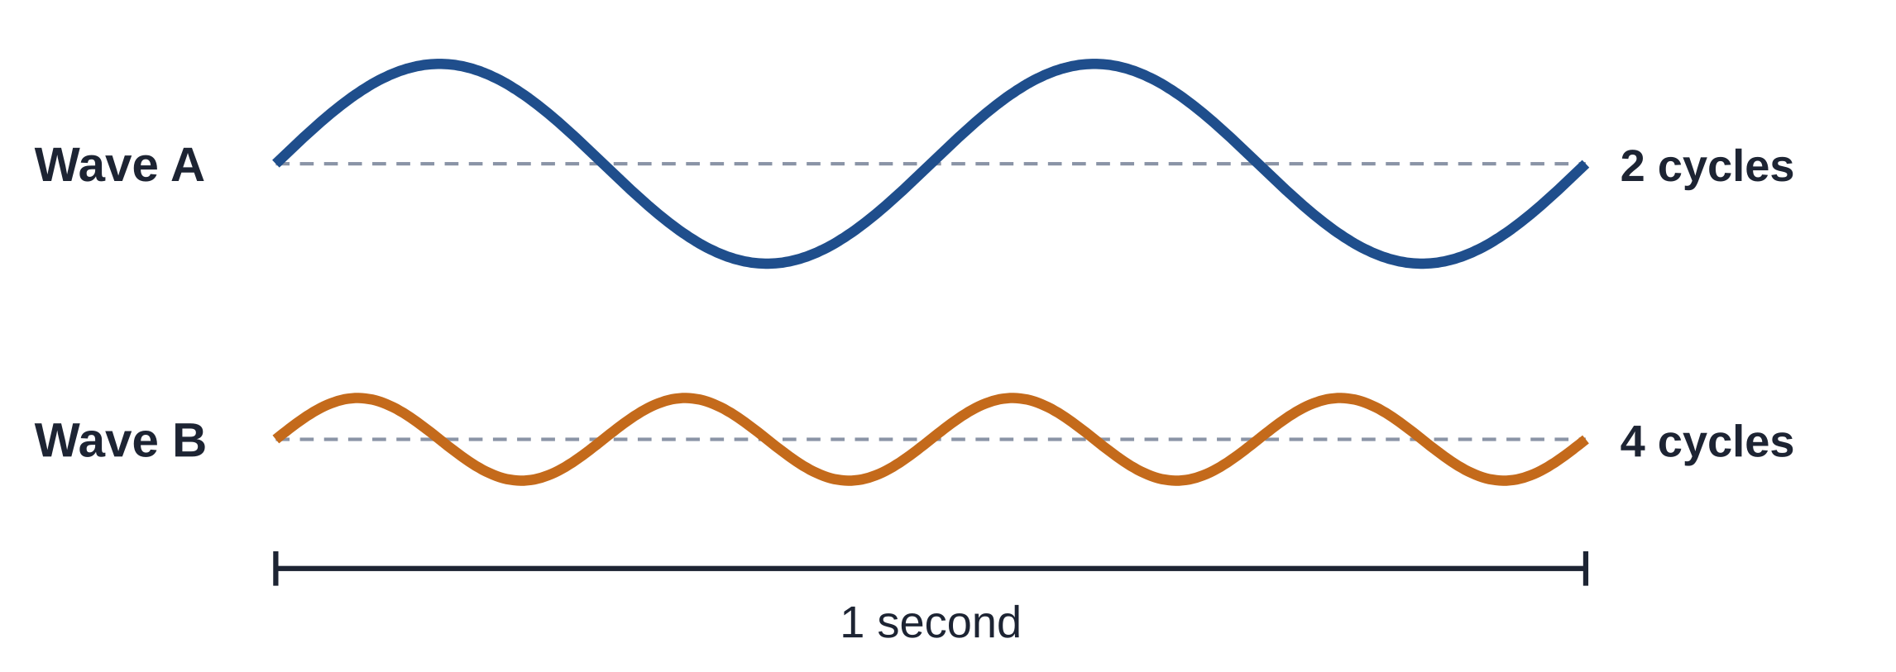

Frequency and Speed
Classkick: 4.01 Part 2 · Q6–Q7
Speed
speed = wavelength × frequency
A wave is 4 m long and 3 waves pass each second.
4 m × 3 per second = 12 m/s
Frequency = how many cycles pass in a period of time. Wave B has the higher frequency. Wave A is taller (bigger amplitude), so it carries more energy.
Light is a wave too. Red light has a longer wavelength than violet light.
▶ PBS: Measuring Wavelengths
Notes:
Q6 (Classkick): circle Wave B (higher frequency); it has 4 cycles (one cycle = one full up and one full down). The speed example here is extra (not in the Classkick). Q7 uses the PBS Practice Measuring Wavelengths interactive (top 4, middle 2, bottom 1 units; red is longer).

Slide 20
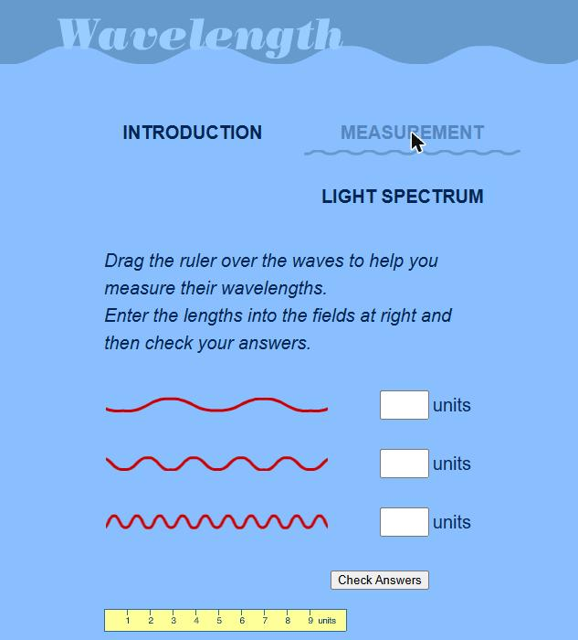
PBS: Measuring Wavelengths
Classkick: 4.01 Part 2 · Q7
Click Measurement.
Drag the yellow ruler onto a wave. Measure crest to crest.
Type each wavelength, then click Check Answers.
Then click Light Spectrum: which has the longer wavelength, red or violet?
▶ Open the PBS interactive
Notes:
Screenshot of the PBS LearningMedia Wavelength interactive (Classkick Part 2 Q7). Answers: top wave 4 units, middle 2, bottom 1. Red light has a longer wavelength than violet.

Slide 21
CER 1: Claim
Question
Which rope wave has the longer wavelength?
Claim: pick one.
A. Wave A
B. Wave B
C. They are the same
D. Can't tell from a graph
Notes:
Answer: A. Wave A. Its crests are 6 m apart; Wave B's crests are 3 m apart. Both have the same amplitude (2 m), so height is not the clue.

Slide 22
CER 2: Evidence
Fill in the blanks
Type your numbers in the chat.
Wave A has crests at 0 m, (1) ____ m, and 12 m.
Wave A's wavelength is (2) ____ m.
Wave B's wavelength is (3) ____ m.
Evidence frame: On the graph, Wave A's crests are ____ m apart and Wave B's crests are ____ m apart.
Notes:
Answers: (1) 6, (2) 6, (3) 3. Evidence: Wave A's crests are 6 m apart and Wave B's crests are 3 m apart. Students can type "6, 6, 3" in the chat.

Slide 23
CER 3: Reasoning
Reasoning: finish the sentence.
Wavelength is the distance from __________. Wave A's crests are farther apart, so Wave A has the longer wavelength.
A. one crest to the next crest
B. a crest to a trough
C. the rest position to a crest
D. the top of the graph to the bottom
Notes:
Answer: A. one crest to the next crest (or trough to trough). B is a common mistake. C is amplitude. Full CER: Wave A has the longer wavelength. Its crests are 6 m apart and Wave B's are 3 m apart. Wavelength is the distance from one crest to the next, so the wave with crests farther apart has the longer wavelength.

Slide 24
Key Ideas
1
A wave is a disturbance that carries energy, not matter.
2
Vibrations cause waves. Mechanical waves need a medium, which returns to its rest position.
3
Transverse: up and down. Longitudinal: back and forth.
4
Wavelength: crest to crest. Amplitude: rest to crest. Frequency: cycles per time.
Re-rate your goals: 1 = Not yet, 2 = Getting there, 3 = I can teach it
Notes:
Students re-rate the four goals from slide 2.

