Slide 1
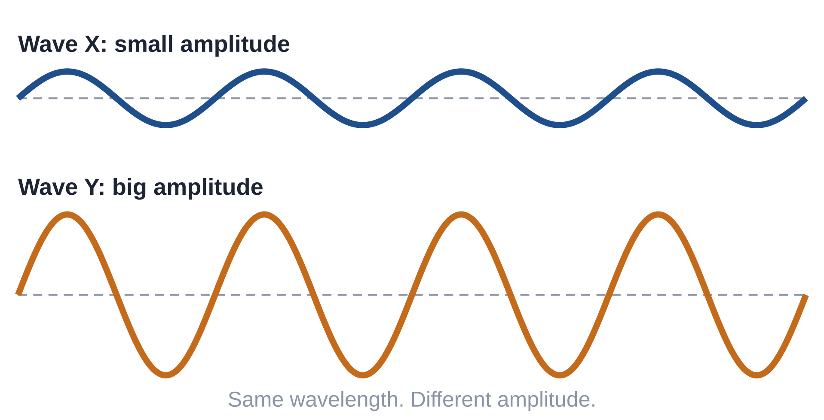
4.02 Amplitude
How does amplitude affect the energy of a wave?
Notes:
Unit 4a Waves, lesson 4.02. Students follow along in the 4.02 Classkick (Part 1 and Part 2). Today starts with the Wednesday integer case.

Slide 2





Today's Goals
I can measure amplitude from the rest position to a crest or trough.
I can explain that a bigger amplitude means more energy.
I can give real examples: louder sounds, a rope shaken harder, stronger earthquakes.
I can show that changing amplitude does not change wavelength or frequency.
Rate each goal:
1
Not yet
2
Getting there
3
I can teach it
Notes:
Objective from the 4.02 page: Students will describe how amplitude affects the energy of a wave. Students rate each goal 1-3 and re-rate at the end.

Slide 3

Ohio Science Standards
7.PS.4 Energy can be transferred through a variety of ways.
In this lesson
Integer warm-up
Vocab check-in
Measuring amplitude
Amplitude and energy
What amplitude does NOT change
Who is right? argument
Graph polls
Waves can be described by their speed, wavelength, amplitude, and frequency.
Vibrations cause wave-like disturbances that carry energy.
The energy of a mechanical wave increases with amplitude.
Inquiry skills (Grades 5–8): "Think critically and logically to connect evidence and explanations" and "Analyze and interpret data" (today's argument and graphs).
Source: Ohio's Learning Standards for Science (2018), Grade 7 Physical Science; content statement paraphrased.
Notes:
7.PS.4 statement quoted; elaboration paraphrased from the standard text on the 4.02 page.

Slide 4
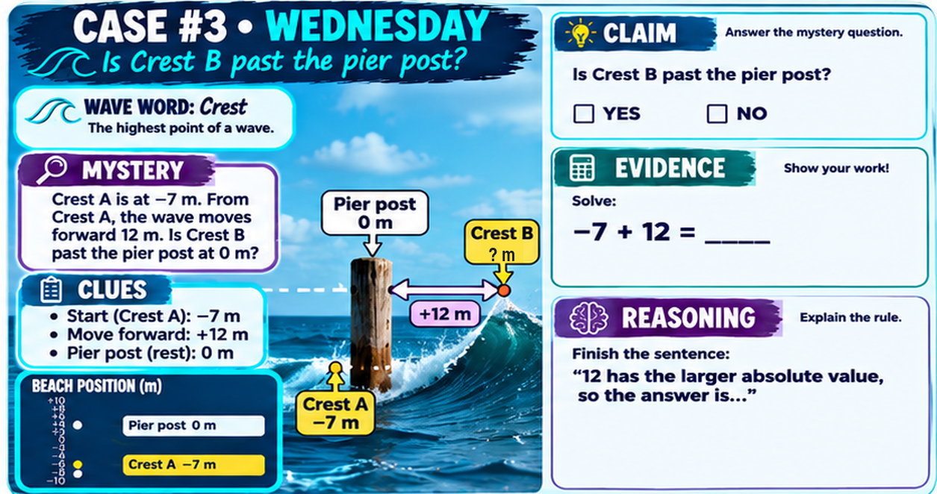
Classkick: 4.02 Math · Case #3
Notes:
Integer warm-up, Case #3 (pier post), same as the packet slide before 4.02. Answer key: Claim YES. Evidence: −7 + 12 = 5. Reasoning: different signs, subtract and keep the sign of the larger absolute value (positive), so Crest B is at +5 m, past the pier post.

Slide 5

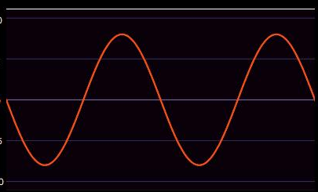
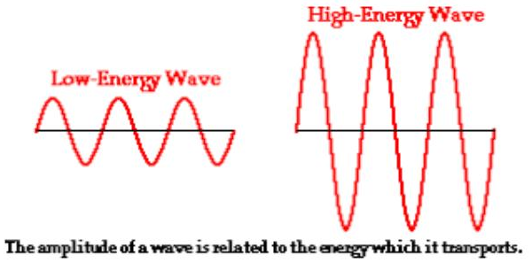
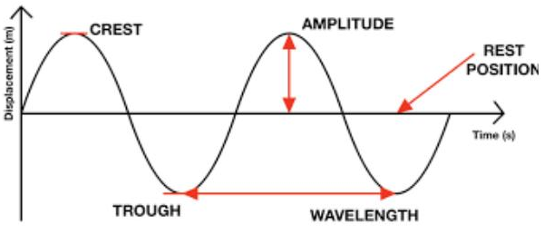
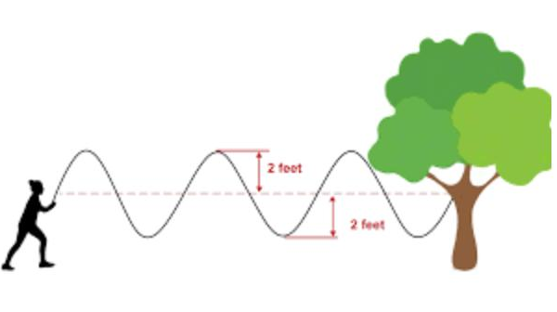
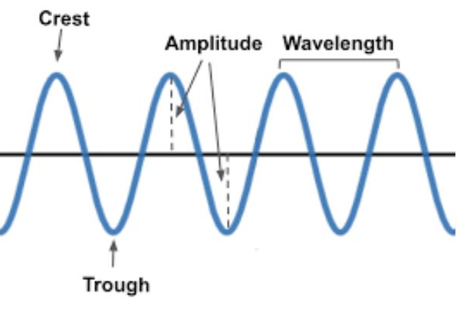
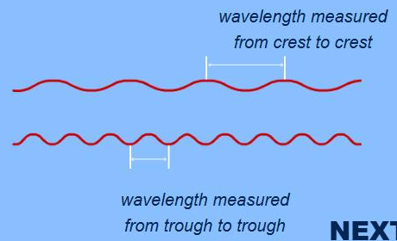
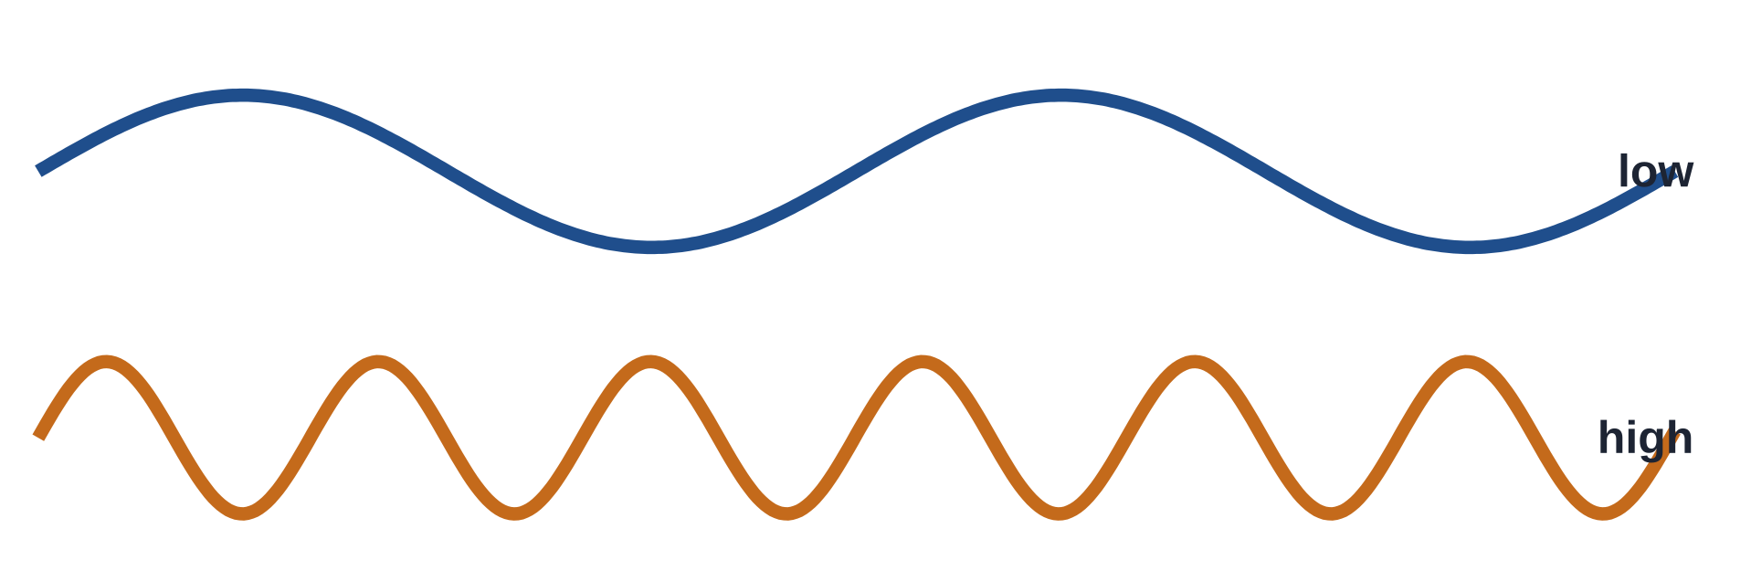
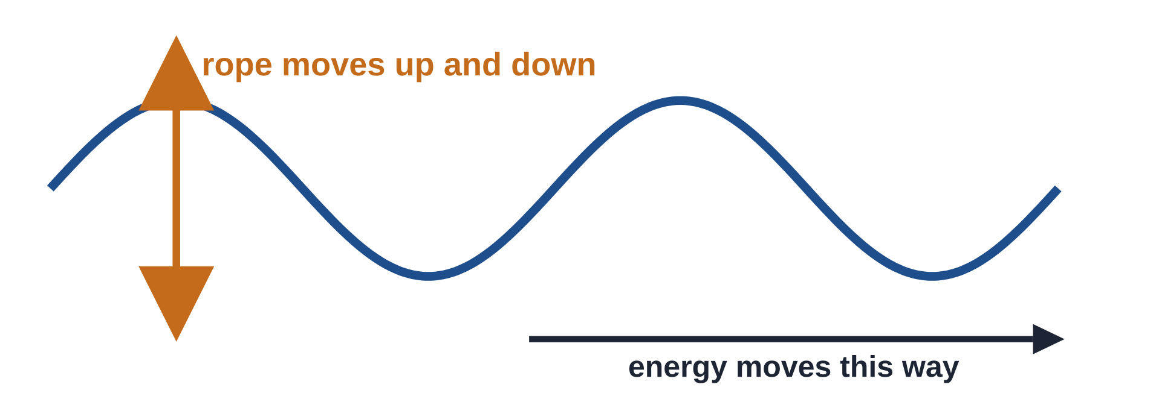
Vocab Check-In
From your Unit 4 vocabulary pretest. Today we focus on the starred words.
wave
energy ★
amplitude ★
medium
a disturbance that carries energy from one place to another
the ability to do work or cause change
how far a wave moves from its rest position
the material a wave travels through (rope, string, air)
crest / trough ★
wavelength
frequency
transverse wave
the highest point / the lowest point of a wave
the distance from one crest to the next crest
how many waves pass a point in a given time
the medium moves up and down, across the way the wave travels
Notes:
Pre Vocab survey words: Wave, Energy, Density, Wavelength, Frequency, Amplitude, Medium, Electromagnetic Wave, Refraction, Transverse Wave. Density, electromagnetic and refraction come later (4.04, 4.08), so they are left off here. Quick check: have students rate each word 1-3 in the chat.

Slide 6

Measuring Amplitude
Classkick: 4.02 Part 1 · Q1–Q2
Amplitude = how far the wave moves from its rest position to a crest or a trough.
Up to the crest: 2 ft. Down to the trough: 2 ft. Same both ways!
Watch out! Crest to trough is NOT the amplitude. This rope wave is 4 ft from trough to crest, so its amplitude is only 2 ft.
Notes:
Classkick Part 1 Q1 (label crest, trough, resting position, amplitude; extra word: wavelength) and Q2 (the amplitude is 2 feet). Picture from the 4.02 page.

Slide 7

Classkick: 4.02 Part 1 · Q2
Graph Poll
Read the graph.
What is the amplitude of this wave?
Hint: start at the rest position (0).
A. 3 ft
B. 6 ft
C. 8 ft
D. 16 ft
Notes:
Answer: A. 3 ft (rest position 0 up to a crest at 3). B. 6 ft is crest to trough. C. 8 ft is the wavelength. D. 16 ft is the whole graph.

Slide 8



Bigger Amplitude = More Energy
Classkick: 4.02 Part 1 · Q3–Q6
Pluck a guitar harder
bigger amplitude, louder sound
Turn up the volume
bigger amplitude, more energy
Shake a rope harder
taller waves, more energy
Which kind of wave carries MORE energy? (Q3)
▶ PBS Amplitude Demonstration
Stronger earthquakes
larger amplitude seismic waves
Click "amplitude," then move the blue slider.
Notes:
Classkick Part 1: Q3 Wave Y (bigger amplitude). Q4 taller, louder, more, larger. Q5 bigger, more. Q6 bigger, more. This is a direct relationship: when amplitude goes up, energy goes up. (4.07 Quest Q6-Q7.)

Slide 9

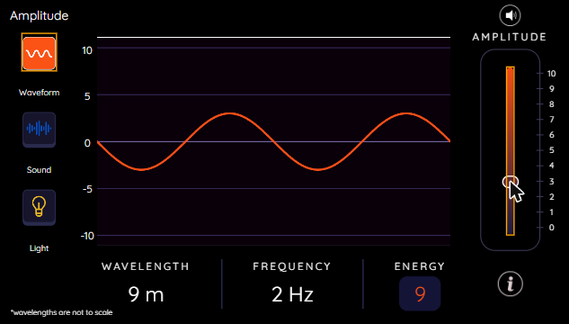
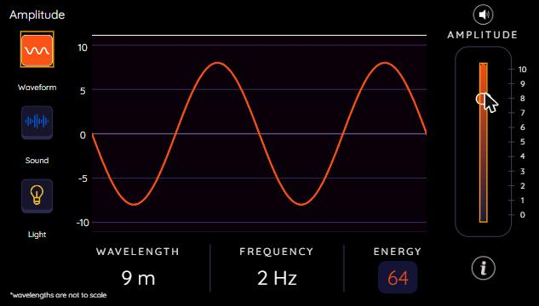
PBS Amplitude Demonstration
Classkick: 4.02 Part 1 · Q4
Low amplitude: energy 9
High amplitude: energy 64
Try it: click Waveform, then drag the Amplitude slider. Watch the ENERGY number. Did the wavelength or frequency change?
▶ Open the PBS interactive
Notes:
Screenshots of the PBS LearningMedia Amplitude Demonstration (the interactive on the 4.02 page and in Classkick Part 1 Q4). Low slider: energy 9. High slider: energy 64. Wavelength (9 m) and frequency (2 Hz) stay the same. Q4a: taller.

Slide 10
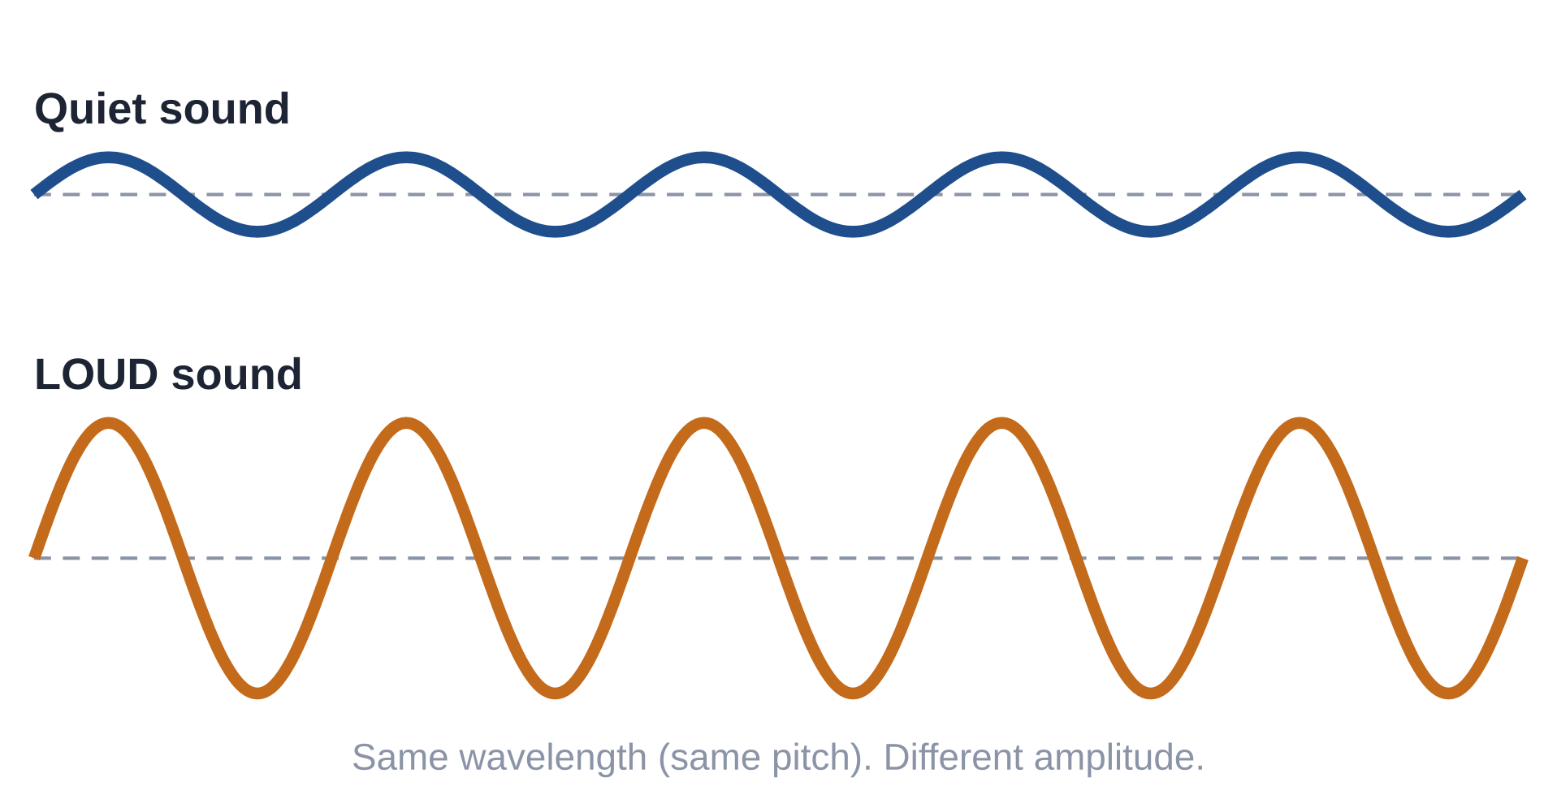
Classkick: 4.02 Part 1 · Q6
Engageli Poll
You turn UP the volume on a speaker. What happens to the sound waves?
A. They travel faster
B. Bigger amplitude, more energy
C. Higher pitch
D. Longer wavelength
Notes:
Answer: B. Louder = bigger amplitude = more energy. Volume does not change the speed (the medium sets speed), the pitch (frequency) or the wavelength. Matches the 4.07 Quest amplitude questions and Mission Q3.

Slide 11


Explore Amplitude in PhET
Classkick: 4.02 Part 2 · Q7–Q8
Water screen (Q7)
Sound screen (Q8)
Turn on the water. Move the Amplitude slider low, then high.
Turn the sound ON. Move the Amplitude slider up.
Look for: taller waves, drops hit harder, more energy.
Look for: louder sound, speaker moves farther. Does the pitch change?
▶ Open PhET Waves Intro
Notes:
Classkick Part 2 Q7: taller, harder, more energy. Q8: louder, farther, pitch stays the same, bigger. (4.03 Quest Q5-6 and Mission Q3 use these ideas.)

Slide 12
What Amplitude Does NOT Change
Classkick: 4.02 Part 2 · Q9–Q10
When amplitude goes up...
Sum it up (Q10)
Height of the wave
changes
Amplitude is how far the medium moves from its ________. A wave with a bigger amplitude carries more ________. A sound with a bigger amplitude is ________. Changing the amplitude does not change the ________.
Energy
changes
Wavelength (crest to crest)
stays the same
Number of waves (frequency)
stays the same
▶ Simple Wave Simulator (Q9)
Notes:
Q9: height changes; wavelength stays the same; number of waves stays the same. Q10: rest position, energy, louder, wavelength (extra word: speed). 4.07 Quest Q7: a larger amplitude means more energy, NOT faster, higher frequency or longer wavelength.

Slide 13
Who Is Right?
Maya shakes a jump rope harder than Leo. Only her waves knock over a cup at the other end. Why?
Ava says:
Ben says:
Cam says:
Dee says:
"Maya's waves travel faster, so they hit the cup harder."
"Maya's waves carry the rope itself down to the cup."
"Maya's waves have a bigger amplitude, so they carry more energy to the cup."
"Maya's waves have a longer wavelength, so they reach farther."
A. Ava
B. Ben
C. Cam
D. Dee
Notes:
Answer: C (Cam). Shaking harder makes a bigger amplitude, so the wave carries more energy, enough to knock over the cup. Ava: amplitude does not change speed (the rope, the medium, sets the speed). Ben: the rope moves up and down and returns to rest; only the energy travels. Dee: shaking harder changes the amplitude, not the wavelength. After the poll, ask a student to explain why one wrong answer is wrong. Same idea as 4.03 Quest Q6 (bigger amplitude = more energy = more erosion) and 4.07 Quest Q7.

Slide 14
Graph Poll
Read the graph.
Which statement does the graph support?
A. As amplitude goes up, energy goes up.
B. As amplitude goes up, energy goes down.
C. Energy stays the same.
D. Amplitude only changes frequency.
Notes:
Answer: A. A direct relationship: when amplitude increases, energy increases. Follow-up: which wave could knock over the most cups? The 40 cm wave, with the most energy. This mirrors 4.03 Quest Q5-Q6 (amplitude vs. energy table). Note: energy grows faster than amplitude (20 cm has 4 times the energy of 10 cm), so avoid saying "double the amplitude, double the energy."

Slide 15
Key Ideas
1
Amplitude = how far the medium moves from its rest position to a crest or trough.
2
Bigger amplitude = more energy. Louder sounds have larger amplitudes.
3
Shake a rope or pluck a string harder: bigger amplitude, more energy.
4
Changing amplitude does NOT change wavelength, frequency or speed.
Re-rate your goals: 1 = Not yet, 2 = Getting there, 3 = I can teach it
Notes:
Students re-rate the four goals from slide 2.

