Slide 1
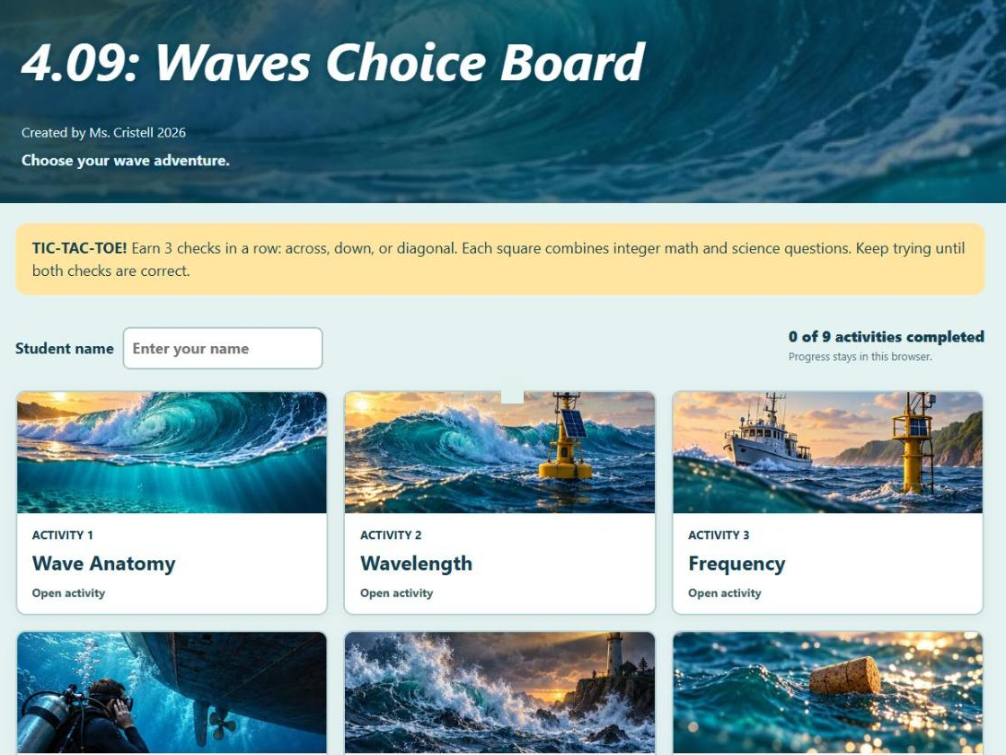
4.09 Review and Catch-Up
Lessons 4.01–4.08: catch up, review, and play
Notes:
Unit 4a Waves, lesson 4.09 (Tue, Nov 24). Last day before Thanksgiving break (no school Wed-Fri). Classkick: Case #2, Review and Catch-Up (Q1-Q4), Part 2 Choice Board (Q5-Q7), optional Bonus Lab, Week 3 checklist. Catch-up comes first; the review polls are optional if time is short.

Slide 2





Today's Goals
I can finish any Unit 4 Classkick slides I am missing.
I can explain that waves carry energy, not matter.
I can change amplitude and frequency to match a target wave.
I can use integers to describe waves.
Rate each goal:
1
Not yet
2
Getting there
3
I can teach it
Notes:
Review day for 4.01-4.08.

Slide 3
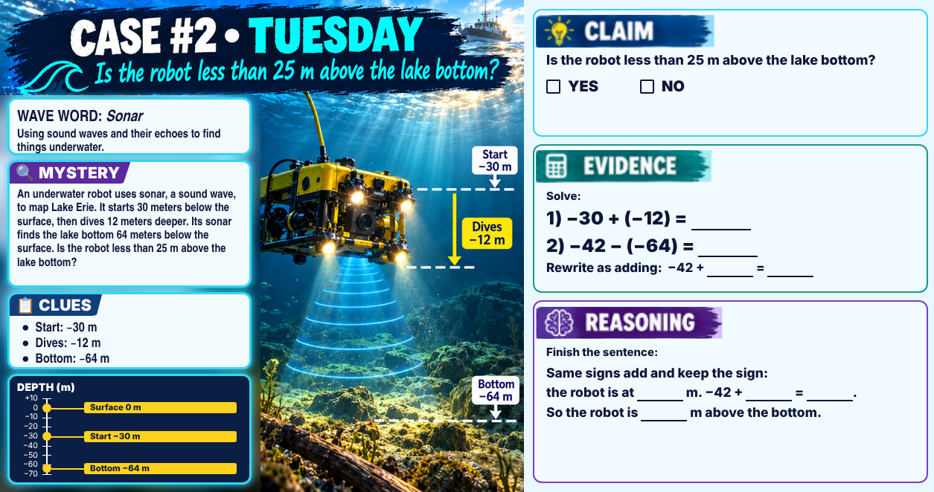
Classkick: 4.09 Math · Case #2
Notes:
Case #2 (robot). Key: Claim YES. Evidence: 1) −30 + (−12) = −42. 2) −42 − (−64) = 22; rewrite −42 + 64 = 22. Reasoning: same signs add and keep the sign, so the robot is at −42 m; −42 + 64 = 22 m above the bottom, and 22 is less than 25. Wave word: sonar.

Slide 4
Step 1: Catch Up
Classkick: 4.09 Review · Q1
4.01 Describe a Wave (Parts 1–2)
4.02 Amplitude (Parts 1–2)
4.03 Frequency and Speed + CER + Quest Map
4.04 Refraction + Refraction Lab Map
4.05 Temperature Lab (Parts 1–2) + Graph
4.06 Transverse Waves (Parts 1–2)
4.07 Longitudinal Waves (Parts 1–3) + Quest Map
4.08 EM Spectrum + Escape Room certificate
Not done? Go back and finish it today. Lower than a B on the 4.03 or 4.07 Quest? Review your Quest Map, then redo it.
Notes:
Classkick Q1. 4.03 Quest closes Nov 19 (regular) / Nov 30 (extended). 4.07 Quest closes Mon, Nov 30 (regular) / Thu, Dec 3 (extended). Packet is due with the Unit 4 test.

Slide 5

The Big Idea of Unit 4
Classkick: 4.09 Review · Q2
A wave is a disturbance that carries ENERGY from one place to another. It does NOT carry matter. The medium moves for a moment, then returns to where it started.
Describe a wave by
Mechanical waves
EM waves
At a boundary, waves can
amplitude, wavelength, frequency, and speed
need a medium (sound, water, rope)
cross empty space (light, radio, X-rays)
reflect, refract (bend), or be absorbed
Check yourself: A wave rolls past a buoy on Lake Erie. Does the buoy end up on the beach?
Notes:
Big Idea from the 4.09 page. Q2 key: a) YES, energy moves; b) NO, the matter does not travel; c) the ribbon moves up and down. Buoy: no, it bobs up and down and stays; only the energy reaches the shore.

Slide 6

Common Mix-Ups to Avoid
Don't say… | Say…
"The water travels to the shore with the wave." | "The energy travels. The water moves and returns to rest."
"Amplitude is crest to crest." | "Wavelength is crest to crest. Amplitude is rest line to crest."
"A high-frequency wave travels faster." | "In the same medium, all waves travel at the same speed."
"Sound travels fastest through air." | "Sound travels fastest through solids."
"Refraction is when light bounces off a surface." | "That's reflection. Refraction is bending into a new medium."
"Sound can travel through space." | "Sound needs a medium. Only EM waves cross empty space."
"Radio waves are sound waves." | "Radio waves are EM waves. A radio turns them into sound."
Notes:
Common Mix-Ups table from the 4.09 page.

Slide 7
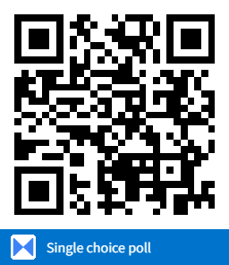
Review Poll · 4.01
A student draws a wave on a grid. The crests are at 2 m, 6 m, and 10 m. What is the wavelength?
A. 4 m
B. 2 m
C. 8 m
D. 10 m
Notes:
Answer: A. Crest to crest: 6 − 2 = 4 m (practice quiz Q2).

Slide 8
Review Poll · 4.03
At Ohio Stadium, a referee blows a high whistle at the same moment a tuba plays a low note. Both are the same distance from a fan. When does the fan hear them?
A. Both at the same time
B. Whistle first: high sounds travel faster
C. Tuba first: low sounds have more energy
D. The louder one first
Notes:
Answer: A. In the same medium, all sound waves travel at the same speed (practice quiz Q5).

Slide 9
Review Poll · 4.03
A wave travels down a 12 m rope in the gym in 3 seconds. What is its speed?
A. 36 m/s
B. 9 m/s
C. 4 m/s
D. 15 m/s
Notes:
Answer: C. speed = distance ÷ time = 12 ÷ 3 = 4 m/s (practice quiz Q6).

Slide 10
Review Poll · 4.04
A laser shines at an angle from air into a glass block. Glass is denser than air. What happens to the light?
A. Speeds up, bends away from the normal
B. Same speed, goes straight
C. Bounces straight back
D. Slows down, bends toward the normal
Notes:
Answer: D. Into a denser medium: slows down, bends toward the normal (practice quiz Q8).

Slide 11
Review Poll · 4.06 / 4.08
Two astronauts outside the space station can't hear each other shout, but they can talk by radio. Why?
A. Radio waves are louder than voices
B. Sound needs a medium; radio waves are EM waves that cross empty space
C. Sound is too slow to reach them
D. Helmets block every wave but radio
Notes:
Answer: B (practice quiz Q12). Sound is mechanical; radio waves are electromagnetic.

Slide 12
Review Poll · CER
Why does a student see lightning before she hears thunder? Claim: light is faster than sound. Evidence: 5 seconds between flash and thunder. Pick the best REASONING.
A. The flash came 5 seconds before the thunder
B. Light gets there first because light is faster
C. Sound must pass energy particle to particle; light is an EM wave and travels much faster
D. Thunder is louder when lightning is close
Notes:
Answer: C. A repeats the evidence, B uses the claim to explain itself, D is true but off-topic (CER test tip on the 4.09 page; practice quiz Q16).

Slide 13

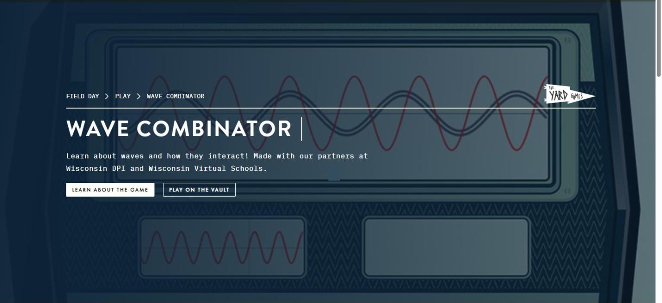
Link 1: Wave Combinator
Classkick: 4.09 Review · Q3
Review 4.02 and 4.03
Click Play on the Vault.
Change the waves to match the target.
Fill in the word bank on your Classkick slide.
Write the highest level you reached.
▶ Open Wave Combinator
Notes:
Q3 key: amplitude; shorter; bigger (extra word: longer). Students record their highest level.

Slide 14

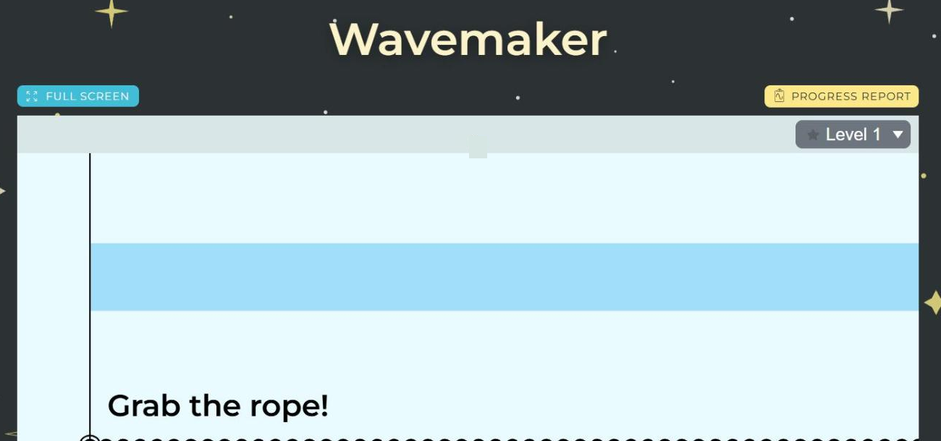
Link 2: Wavemaker
Classkick: 4.09 Review · Q4
Review 4.02, 4.03, and 4.06
Grab the rope.
Shake it to match the target shape.
Circle what worked on your Classkick slide.
▶ Open Wavemaker
Notes:
Q4 key: more waves = shook faster = higher frequency; taller wave = shook bigger.

Slide 15

Part 2: Waves Choice Board
Classkick: 4.09 Part 2 · Q5
Tic-tac-toe!
Type your name.
Finish 3 squares in a row: across, down, or diagonal.
Each square has 1 integer problem + 1 science question.
Snip your Congratulations screen and paste it in Classkick.
▶ Open the Waves Choice Board
Notes:
Choice board by Ms. Cristell. Squares: 1 Wave Anatomy, 2 Wavelength, 3 Frequency, 4 Mediums, 5 CER Mystery, 6 Wave Motion, 7 Wave Types, 8 Mechanical Waves, 9 EM Spectrum. It checks answers itself; progress saves in the browser.

Slide 16
Integers and Waves
Classkick: 4.09 Part 2 · Q6
a) A crest is at +5 cm. A trough is at −5 cm.
b) A rope moves from +3 cm down to −2 cm.
Crest − trough = ___ cm
Change = −2 − (+3) = ___ cm
c) Air warms from −6 °C to +9 °C.
d) Does the warmer air make sound go faster or slower?
Change = 9 − (−6) = ___ °C
Change = end − start. Subtracting a negative = adding. Rest position = 0: above is +, below is −.
Notes:
Q6 key: a) 5 − (−5) = 10 cm; b) −5 cm; c) 15 °C; d) faster (about 0.6 m/s faster per 1 °C).

Slide 17

Done Early?
Classkick: 4.09 Part 2 · Q7
Unit 4 Vocab: Blooket
Unit 4 Vocab: Gimkit
Q7 vocab review
Q7 vocab review
▶ Open
▶ Open
The Case of the Missing Cell Phone
Bonus Lab: The Particle Wave
Decode radio waves by amplitude (4.02, 4.08)
Does wavelength change wave speed? (4.03)
▶ Open
▶ Open
Notes:
Optional. Blooket and Gimkit sets are on the Classkick Part 2 slide (Q7). Missing Cell Phone is embedded on the 4.09 page. Particle Wave bonus lab is packet slide #43.

Slide 18
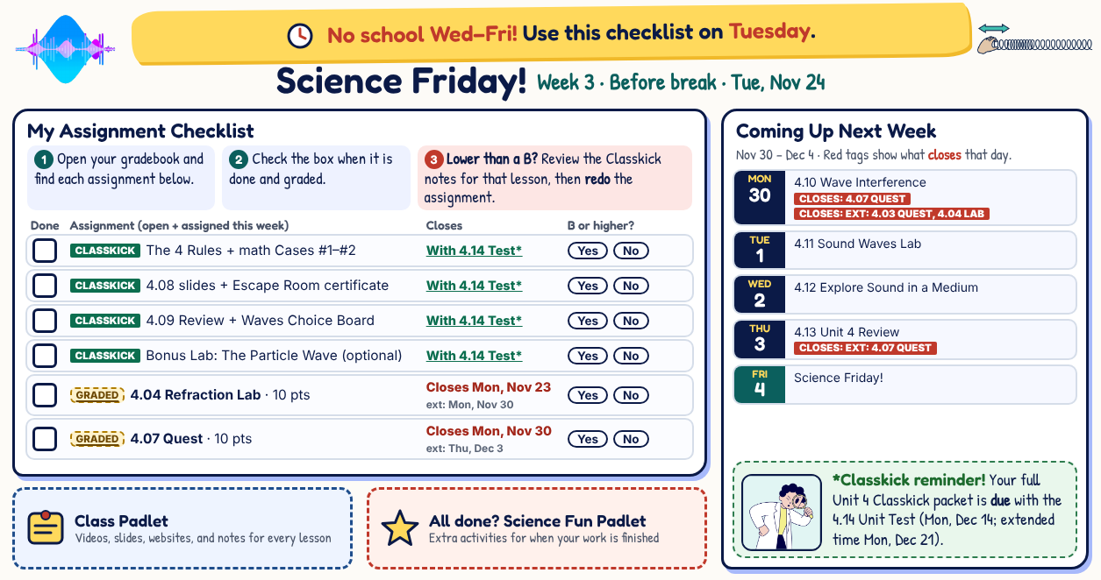
Classkick: Week 3 Checklist
Notes:
Packet slide #44. Thanksgiving week has no Friday, so students use the checklist today.

Slide 19
Before You Go
1
Waves carry energy, not matter.
2
Mechanical waves need a medium. EM waves can cross empty space.
3
Frequency up = wavelength down. Same medium = same speed.
4
Finish your catch-up list and the Week 3 checklist.
Re-rate your goals. Happy Thanksgiving! No school Wed–Fri.

