Slide 1
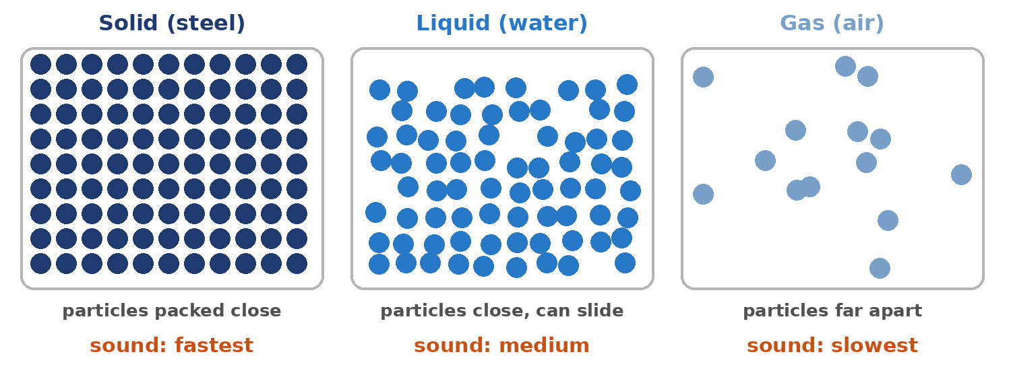
4.12 Explore Sound in a Medium
What changes the speed of sound? What does not?
Notes:
Unit 4a Waves, lesson 4.12 (Wed, Dec 2). Classkick: Case #3 (lightning), Part 1 OpenSciEd sound sim (Q1-Q3), Part 2 Wave Speed Lab (Q4-Q7, code + certificate). The Wave Speed Lab is long and saves progress, so start it early. Keep the talk short.

Slide 2

Think About It
Your friend taps a metal railing at the far end of a bridge. Which tap reaches you first?
A. The sound through the air
B. The sound through the railing
C. Both at the same time
D. Neither: sound can't travel in metal
Notes:
Answer: B. Sound travels much faster through a solid (steel about 5,960 m/s) than air (about 343 m/s). This is a 4.09 Check yourself question.

Slide 3





Today's Goals
I can explain how loudness and pitch show up in a sound wave.
I can explain why sound is fastest in solids.
I can tell what changes wave speed and what does not.
I can explain why there is no sound in space.
Rate each goal:
1
Not yet
2
Getting there
3
I can teach it
Notes:
Objective: analyze sound waves and how they travel through different media.

Slide 4
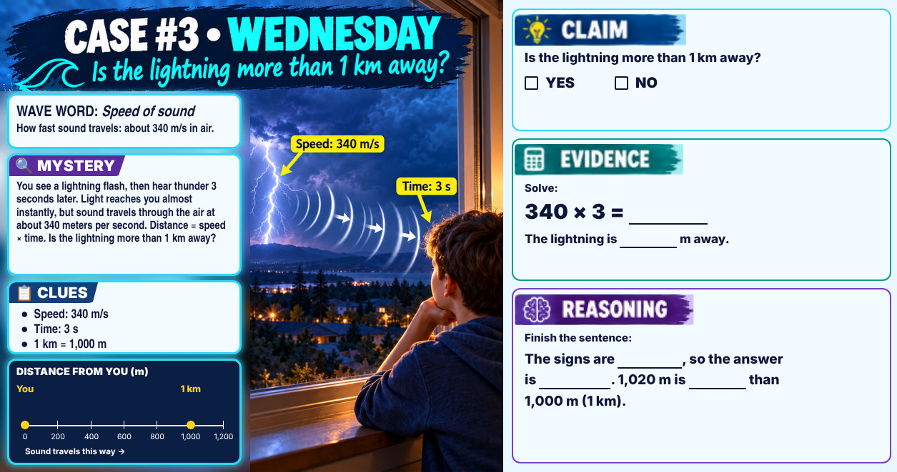
Classkick: 4.12 Math · Case #3
Notes:
Case #3 (lightning). Key: Claim YES. Evidence: 340 × 3 = 1,020 m. Reasoning: same signs, positive; 1,020 m is more than 1,000 m (1 km). Wave word: speed of sound.

Slide 5




Today's Plan
Part 1: OpenSciEd Sound Sim
Part 2: Wave Speed Lab
Not done?
Loud vs. soft, high vs. low. Watch the particles.
7 missions + Fact or Myth. Earn a code and certificate.
The Wave Speed Lab saves your progress in this browser. Finish it on your own.
Q1–Q3 · about 15 min
Q4–Q7 · rest of class
Keep the same computer
Notes:
The planner flags 4.12 as over time. Short talk, then lab time.

Slide 6
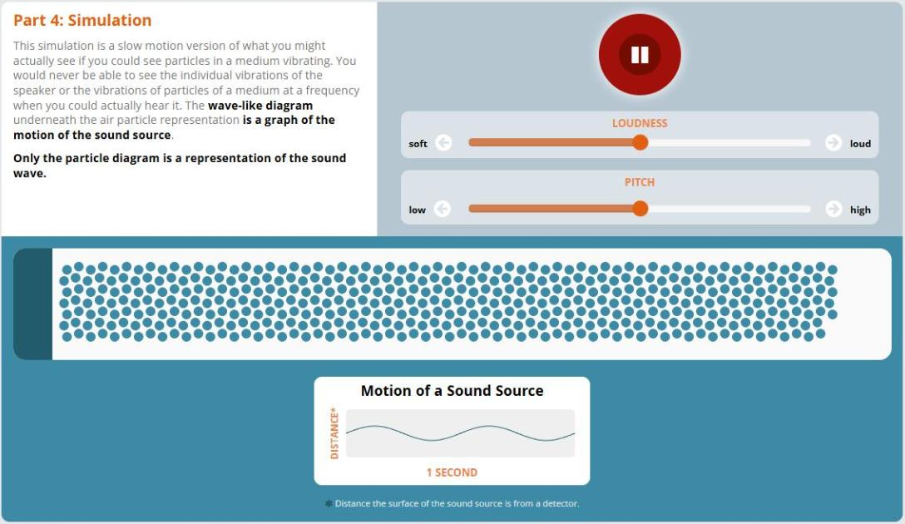
Part 1: How Does Sound Move Through a Medium?
Classkick: 4.12 Part 1 · Q1
Press Play.
Move ONLY the Loudness slider. Watch the graph and the particles.
Reset. Move ONLY the Pitch slider.
Do the particles travel to the end, or vibrate back and forth?
▶ Open the OpenSciEd sound sim
Notes:
Q1 key: Loudness soft→loud: graph taller; particles pushed closer together. Pitch low→high: more waves in 1 second; bunches closer together. Loudness = amplitude; pitch = frequency; particles vibrate back and forth; longitudinal. Only the particle diagram is the sound wave; the graph shows the motion of the source.

Slide 7

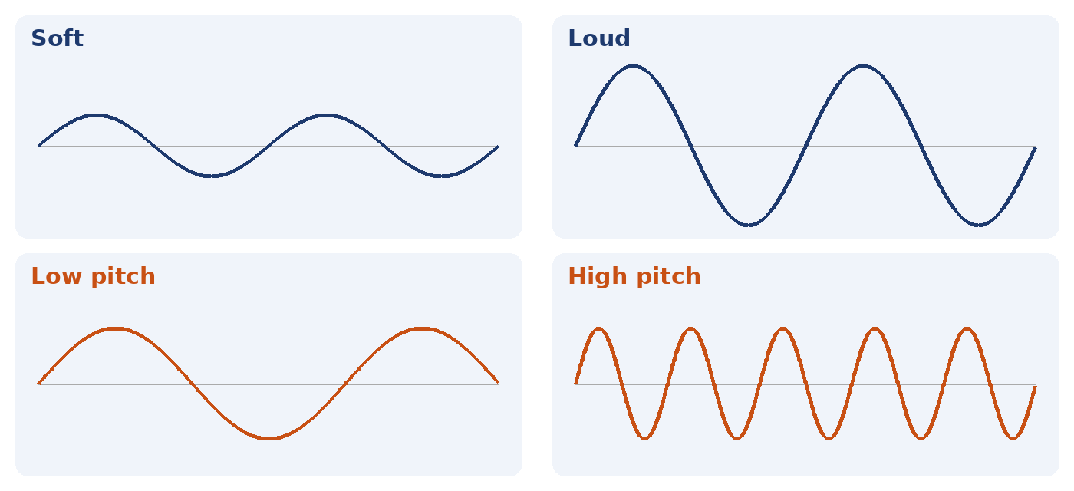
Reading Sound Graphs
Classkick: 4.12 Part 1 · Q2
Taller wave = bigger amplitude = louder = more energy.
More waves in 1 second = higher frequency = higher pitch.
Neither one changes the speed. Only the medium does.
Read the HEIGHT for loudness. Count the WAVES for pitch.
Notes:
Q2 is in Classkick with its own Sound A and Sound B graphs. This slide teaches the skill with different graphs.

Slide 8
Graph Poll
Both graphs show 1 second.
Which sound is LOUDER and has the HIGHER pitch?
A. Sound C
B. Sound D
C. They are the same
D. You can't tell
Notes:
Answer: B. Sound D is taller (bigger amplitude = louder) and has more waves in 1 second (higher frequency = higher pitch).

Slide 9
Sound and the Medium
Classkick: 4.12 Part 1 · Q3
Particles packed close together bump the next ones quickly, so sound is fastest in solids. Space has no particles, so there is no medium and no sound.
Notes:
From "Sound and the Medium" on the 4.12 page. Q3 key: close together; no particles (extra: far apart).

Slide 10
Graph Poll
Read the graph.
You make a sound 1 km away. Through which material does it reach you FIRST?
A. air
B. water
C. steel
D. all at the same time
Notes:
Answer: C. Steel: about 0.17 s. Water: about 0.68 s. Air: about 2.9 s. Shortest time = fastest speed. Watch out: the shortest bar is the fastest material.

Slide 11
Who Is Right?
Maya says, "If I yell LOUDER, my voice will reach my friend across the field faster." Who is right?
Ava says:
Ben says:
Cam says:
Dee says:
"Maya is right. Louder sounds are faster."
"Maya is wrong. Louder means bigger amplitude, but only the medium changes the speed."
"Maya is right. More energy always means more speed."
"Maya is wrong. Quiet sounds are faster."
A. Ava
B. Ben
C. Cam
D. Dee
Notes:
Answer: B (Ben). Amplitude, frequency, and wavelength do not change wave speed; the medium does (4.12 Key Ideas; Quest and Mission questions on frequency vs. speed).

Slide 12
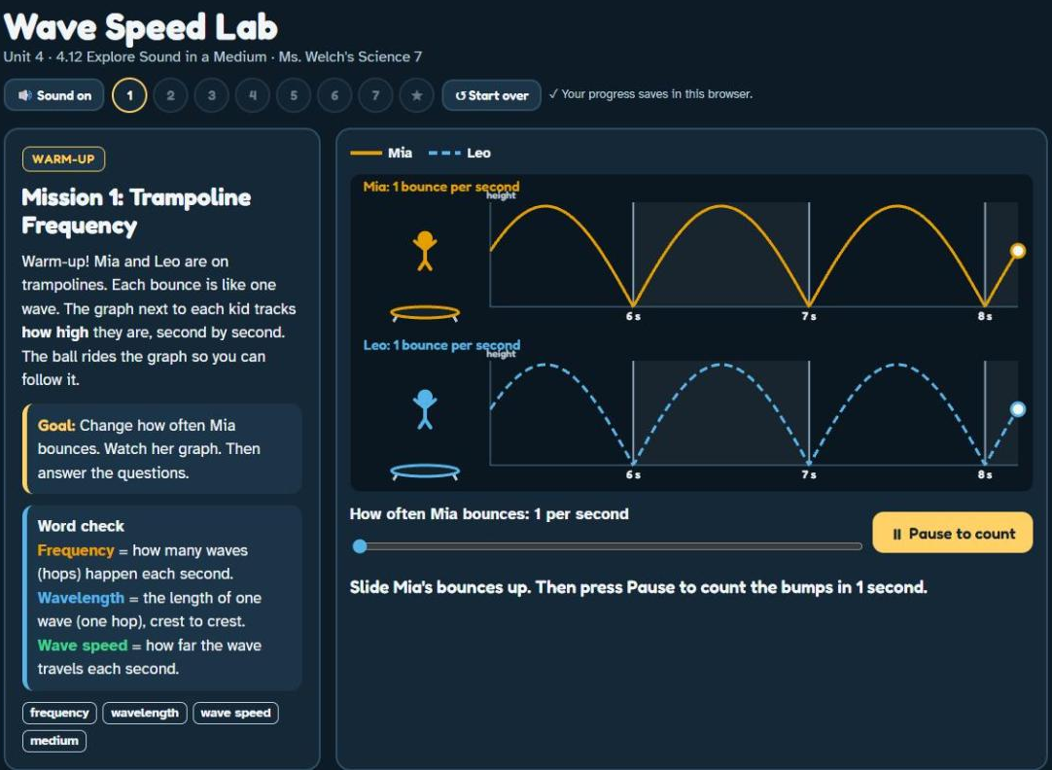
Part 2: Wave Speed Lab
Classkick: 4.12 Part 2 · Q4–Q6
Use the rest of class
Trampoline Frequency
Who Will Win? (predict)
The Big Race
Hops Make Waves
Rope Race (4 rounds)
Same Note, New Medium
Tin Can Phones
★ Fact or Myth?
▶ Open the Wave Speed Lab
Notes:
Your Wave Speed Lab (GitHub). Q5 key: a) sped up; b) steel; c) same time; d) the same speed. Q6: medium; water; together (see the Classkick key for the word bank).

Slide 13




Finish: Code and Certificate
Classkick: 4.12 Part 2 · Q7
1. Type your code
2. Copy the certificate
3. Paste it
Finish every mission. Type the completion code in the Q7 box.
Click Copy certificate in the lab (or snip it: Windows + Shift + S).
Click the box on the Classkick slide and press Ctrl + V.
Notes:
Completion code: (ask Ms. Welch) (do not show students). Chromebook snip: Ctrl + Shift + Show windows.

Slide 14
Key Ideas
1
Sound is a longitudinal, mechanical wave. It needs a medium.
2
Loudness = amplitude (more energy). Pitch = frequency.
3
Only the medium changes wave speed. Frequency, wavelength, and amplitude do not.
4
Sound is fastest in solids, slower in liquids, slowest in gases.
Re-rate your goals. Not done? Finish the Wave Speed Lab and paste your certificate.

