Slide 1
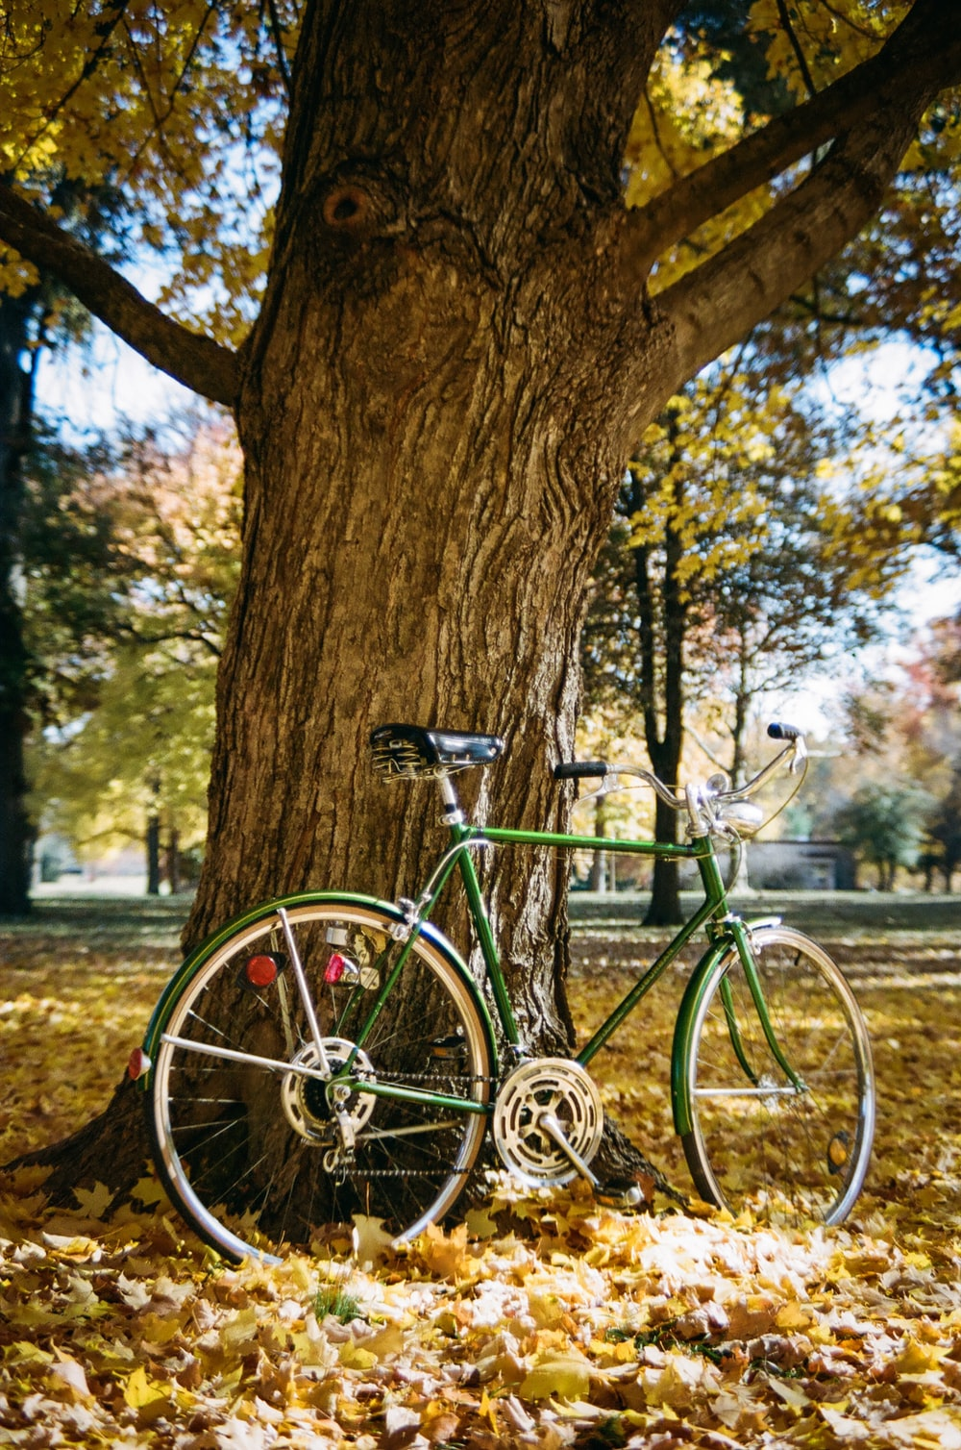
Annotation Evaluation
„Do you see a bicycle?”
Image: https://images.unsplash.com/photo-1605580881526-97eefdfcc66d?ixid=MnwxMjA3fDB8MHxwaG90by1wYWdlfHx8fGVufDB8fHx8&ixlib=rb-1.2.1&auto=format&fit=crop&w=632&q=80

Slide 2
content
DATA UNDERSTANDING
DATA CLEANING
DATA ANALYSIS

Slide 3
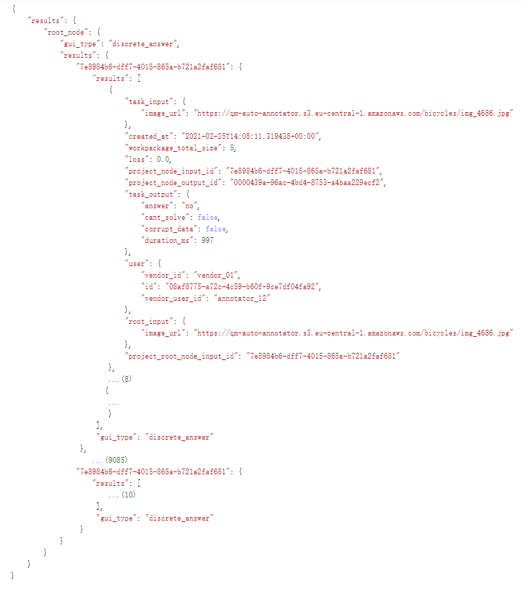
Understanding
Structure of the data:
object | type
data | dict
└─ “results” | dict
└─ “root_node” | dict
├─ “gui_type“
└─ “results“ | dict
└─ 9087 crowds with uuid | dict
├─ “gui_type“
└─ “results“ | list
└─ 10 tasks | dict

Slide 4
Understanding
Some information of a single task:
object | type
task | dict
├─ “task_input” | dict
└─ “image_url”
├─ “task_output“ | dict
├─ “answer“
├─ “cant_solve“
├─ “corrupt_data“
└─ “duration_ms“
└─ “user“ | dict
└─ “vendor_user_id“

Slide 5
CLEANING
Collect information in a pandas.DataFrame:
 | image | user | answer | solvable | corrupt | duration | reference | correct
67959 | img_6281 | annotator_01 | 0.0 | 1 | 0 | 1473 | 0 | 1
62783 | img_1856 | annotator_02 | 1.0 | 1 | 0 | 863 | 1 | 1
88183 | img_4138 | annotator_02 | 0.0 | 1 | 0 | 1357 | 0 | 1
69589 | img_0274 | annotator_13 | 1.0 | 1 | 0 | 847 | 1 | 1
65470 | img_0732 | annotator_12 | 0.0 | 1 | 0 | 1108 | 1 | 0
71105 | img_2279 | annotator_12 | 1.0 | 1 | 0 | 726 | 1 | 1
80232 | img_0005 | annotator_08 | 0.0 | 1 | 0 | 1404 | 0 | 1
27617 | img_3888 | annotator_20 | 1.0 | 1 | 0 | 1398 | 1 | 1
6619 | img_1814 | annotator_02 | 0.0 | 1 | 0 | 1470 | 0 | 1
19623 | img_8223 | annotator_12 | 0.0 | 1 | 0 | 1184 | 0 | 1

Slide 6
Cleaning
Basic information of the DataFrame:
Column | Non-Null Count | Dtype
image | 90870 | object
user | 90870 | object
answer | 90849 | float64
solvable | 90870 | int64
corrupt | 90870 | int64
duration | 90870 | int64
reference | 90870 | int64
correct | 90870 | int64
 | duration
count | 90870
mean | 1284.33
std | 1351.96
min | -99999
25% | 887
50% | 1058
75% | 1328
max | 42398
21 tasks have no available answers
5 tasks are with nun-positive duration, which should not be possible
replace with mean of normal duration by the same user (annotator)

Slide 7
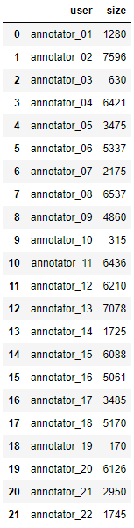
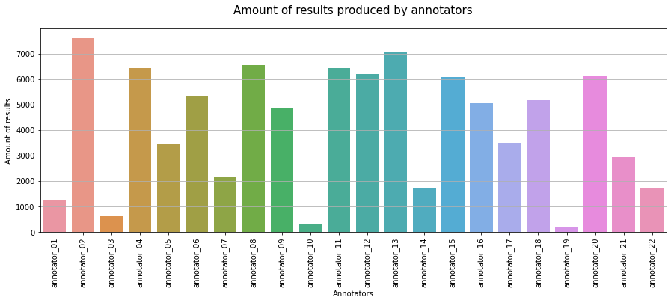
ANALYSIS
Amount of results contributed by 22 annotators

Slide 8
ANALYSIS
Questions for which annotators highly disagree
df_dis = data_fix.groupby(['image']).mean()
df_dis.loc[df_dis['answer']==0.5]
 | answer | solvable | corrupt | duration | reference | correct
image
img_0391 | 0.5 | 1.0 | 0.0 | 1418.9 | 1.0 | 0.5
img_0490 | 0.5 | 1.0 | 0.0 | 2192.0 | 0.0 | 0.5
img_0627 | 0.5 | 1.0 | 0.0 | 1913.2 | 1.0 | 0.5
img_0666 | 0.5 | 1.0 | 0.0 | 1281.4 | 0.0 | 0.5
img_0669 | 0.5 | 1.0 | 0.0 | 1406.3 | 0.0 | 0.5
... | ... | ... | ... | ... | ... | ...
img_7701 | 0.5 | 1.0 | 0.0 | 1307.9 | 0.0 | 0.5
img_8397 | 0.5 | 1.0 | 0.0 | 4120.4 | 0.0 | 0.5
img_8812 | 0.5 | 1.0 | 0.0 | 1441.7 | 0.0 | 0.5
img_8819 | 0.5 | 1.0 | 0.0 | 1651.0 | 1.0 | 0.5
img_8894 | 0.5 | 1.0 | 0.0 | 1555.3 | 1.0 | 0.5
There are 68 questions/images, for which annotators highly disagree.

Slide 9
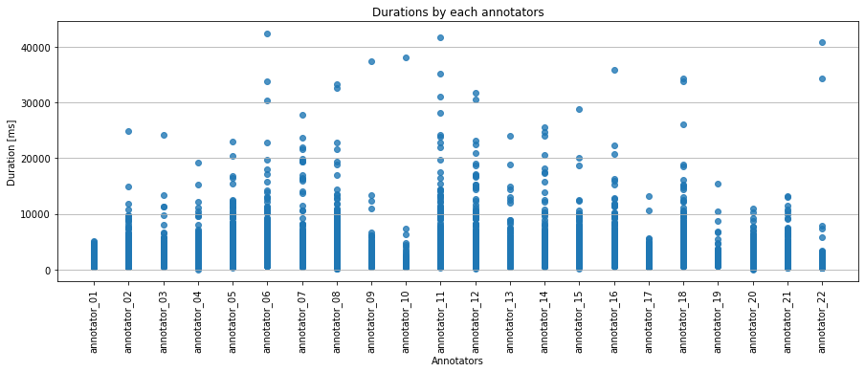
ANALYSIS
Average, min and max annotation times (durations)
 | duration
mean | 1289.95
median | 1058
max | 42398
min | 10

Slide 10
ANALYSIS
Average, min and max annotation times (durations)
duration before and after replacing the negative
count 90870.000000 mean 1284.333873 std 1351.960465 min -99999.000000 25% 887.000000 50% 1058.000000 75% 1328.000000 max 42398.000000
count 90849.000000 mean 1290.050170 std 1124.059174 min 10.000000 25% 887.000000 50% 1058.000000 75% 1328.000000 max 42398.000000

Slide 11
ANALYSIS
How often does each occur in the project?
17 annotations were unsolvable (0.0187%)
4 annotations were corrupted (0.0044%)
Annotations without answer are exactly the sum of unsolvable and corrupt annotations.

Slide 12
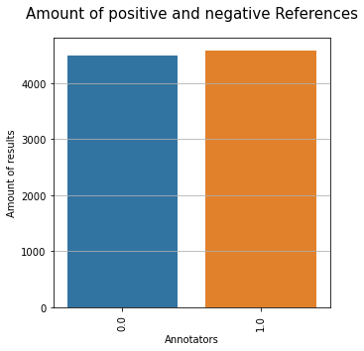
ANALYSIS
Is the reference set balanced?
There are 45860 positive samples in the reference,which is 50.47% of the hole set.
The reference is balanced.

Slide 13
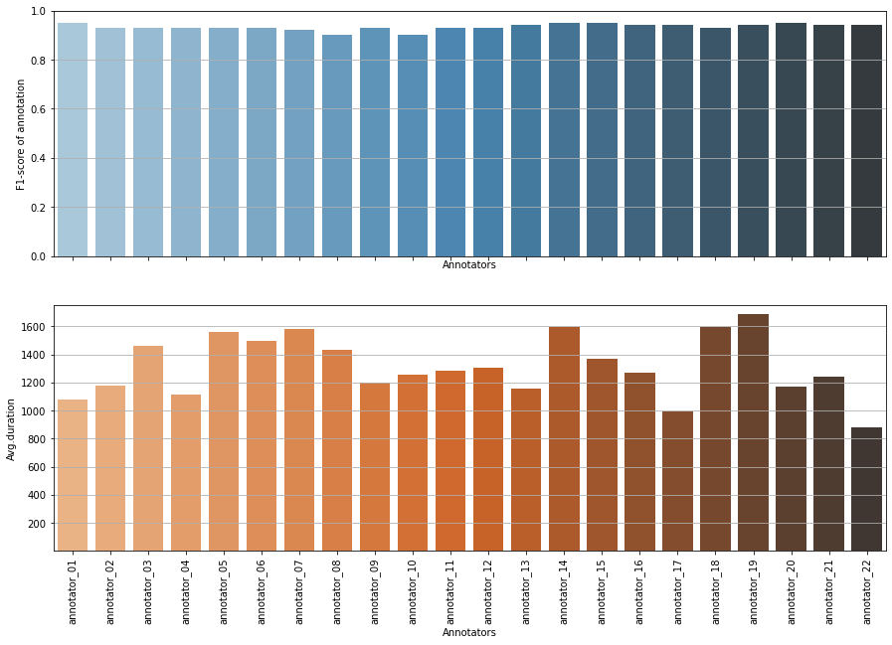
ANALYSIS
Identiy good and bad annotators

Slide 14
ANALYSIS
 | user | total amount | positive amount | correct amount | avg.duration | accuracy | precision | recall | F1
0 | annotator_01 | 1280 | 673 | 1214 | 1077.32 | 0.95 | 0.94 | 0.96 | 0.95
1 | annotator_02 | 7594 | 3750 | 7101 | 1178.24 | 0.94 | 0.94 | 0.93 | 0.93
2 | annotator_03 | 630 | 295 | 585 | 1460.25 | 0.93 | 0.96 | 0.90 | 0.93
3 | annotator_04 | 6417 | 3369 | 5960 | 1114.21 | 0.93 | 0.92 | 0.94 | 0.93
4 | annotator_05 | 3475 | 1744 | 3256 | 1562.09 | 0.94 | 0.94 | 0.93 | 0.93
5 | annotator_06 | 5336 | 2901 | 4945 | 1496.94 | 0.93 | 0.90 | 0.96 | 0.93
6 | annotator_07 | 2174 | 1130 | 1990 | 1578.35 | 0.92 | 0.91 | 0.93 | 0.92
7 | annotator_08 | 6534 | 3385 | 5878 | 1434.72 | 0.90 | 0.89 | 0.91 | 0.90
8 | annotator_09 | 4860 | 2477 | 4536 | 1198.81 | 0.93 | 0.92 | 0.95 | 0.93
9 | annotator_10 | 315 | 192 | 280 | 1252.97 | 0.89 | 0.84 | 0.97 | 0.90
10 | annotator_11 | 6435 | 3136 | 6026 | 1279.98 | 0.94 | 0.95 | 0.92 | 0.93
11 | annotator_12 | 6210 | 3357 | 5774 | 1306.31 | 0.93 | 0.91 | 0.95 | 0.93
12 | annotator_13 | 7078 | 3497 | 6702 | 1155.01 | 0.95 | 0.95 | 0.94 | 0.94
13 | annotator_14 | 1724 | 862 | 1633 | 1595.58 | 0.95 | 0.95 | 0.95 | 0.95
14 | annotator_15 | 6088 | 2971 | 5774 | 1365.29 | 0.95 | 0.96 | 0.94 | 0.95
15 | annotator_16 | 5061 | 2491 | 4769 | 1269.79 | 0.94 | 0.96 | 0.93 | 0.94
16 | annotator_17 | 3485 | 1697 | 3283 | 991.89 | 0.94 | 0.96 | 0.92 | 0.94
17 | annotator_18 | 5167 | 2681 | 4841 | 1593.03 | 0.94 | 0.92 | 0.95 | 0.93
18 | annotator_19 | 170 | 89 | 161 | 1687.78 | 0.95 | 0.94 | 0.95 | 0.94
19 | annotator_20 | 6125 | 3048 | 5809 | 1173.21 | 0.95 | 0.95 | 0.95 | 0.95
20 | annotator_21 | 2950 | 1504 | 2773 | 1238.92 | 0.94 | 0.93 | 0.95 | 0.94
21 | annotator_22 | 1741 | 883 | 1644 | 880.04 | 0.94 | 0.94 | 0.95 | 0.94
Identiy good and bad annotators
Annotators, who had high F1 (>0.94) and took low avg.annotation time (<1174) are good: 'annotator_01', 'annotator_13', 'annotator_17', 'annotator_20', 'annotator_22'
Annotators, who had low F1 (<0.93) and took long avg. annotation time (>1488) are bad: 'annotator_05', 'annotator_06', 'annotator_07', 'annotator_18'

Slide 15
THANKS FOR YOUR ATTENTION!

