Slide 1
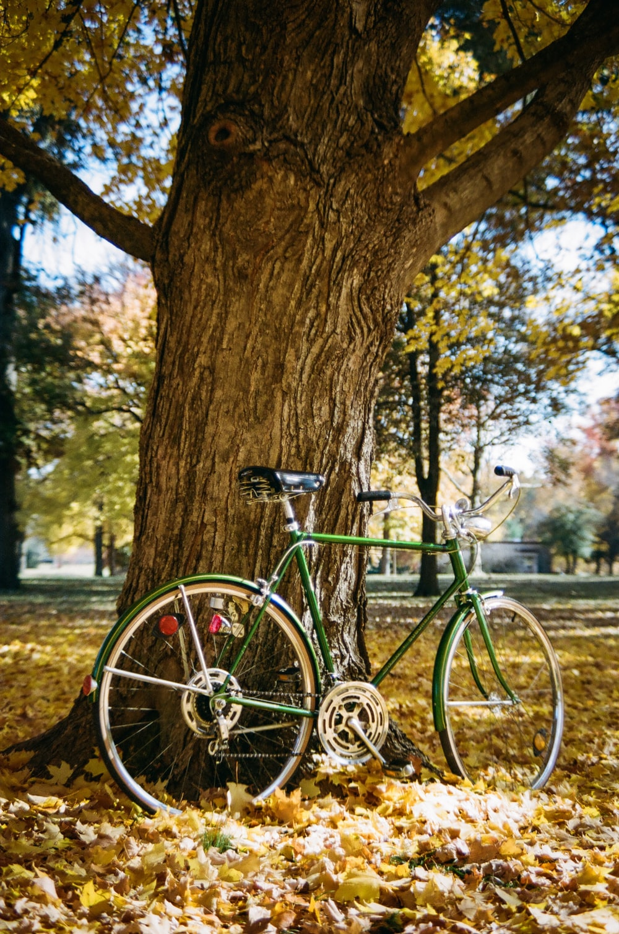
Annotation Evaluation
„Do you see a bicycle?”
Image: https://images.unsplash.com/photo-1605580881526-97eefdfcc66d?ixid=MnwxMjA3fDB8MHxwaG90by1wYWdlfHx8fGVufDB8fHx8&ixlib=rb-1.2.1&auto=format&fit=crop&w=632&q=80

Slide 2
content
DATA UNDERSTANDING
DATA CLEANING
DATA ANALYSIS

Slide 3
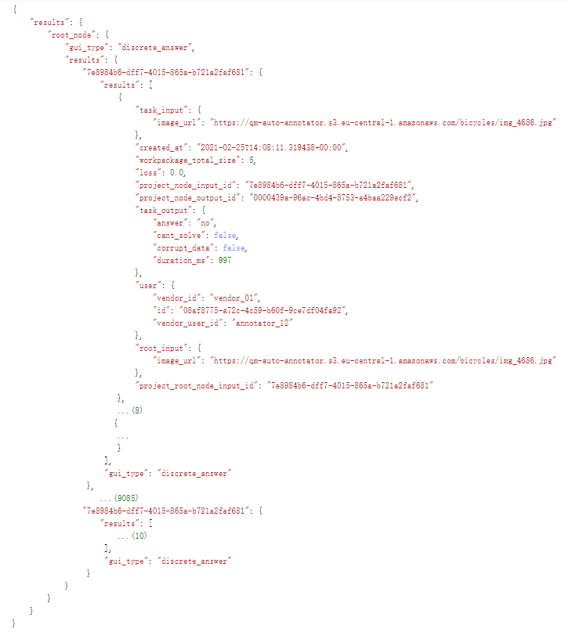
Understanding
Structure of the data:
object | type
data | dict
└─ “results” | dict
└─ “root_node” | dict
├─ “gui_type“
└─ “results“ | dict
└─ 9087 crowds with uuid | dict
├─ “gui_type“
└─ “results“ | list
└─ 10 tasks | dict

Slide 4
Understanding
Some information of a single task:
object | type
task | dict
├─ “task_input” | dict
└─ “image_url”
├─ “task_output“ | dict
├─ “answer“
├─ “cant_solve“
├─ “corrupt_data“
└─ “duration_ms“
└─ “user“ | dict
└─ “vendor_user_id“

Slide 5
CLEANING
Collect information in a pandas.DataFrame:
 | image | user | answer | solvable | corrupt | duration | reference | correct
67959 | img_6281 | annotator_01 | 0.0 | 1 | 0 | 1473 | 0 | 1
62783 | img_1856 | annotator_02 | 1.0 | 1 | 0 | 863 | 1 | 1
88183 | img_4138 | annotator_02 | 0.0 | 1 | 0 | 1357 | 0 | 1
69589 | img_0274 | annotator_13 | 1.0 | 1 | 0 | 847 | 1 | 1
65470 | img_0732 | annotator_12 | 0.0 | 1 | 0 | 1108 | 1 | 0
71105 | img_2279 | annotator_12 | 1.0 | 1 | 0 | 726 | 1 | 1
80232 | img_0005 | annotator_08 | 0.0 | 1 | 0 | 1404 | 0 | 1
27617 | img_3888 | annotator_20 | 1.0 | 1 | 0 | 1398 | 1 | 1
6619 | img_1814 | annotator_02 | 0.0 | 1 | 0 | 1470 | 0 | 1
19623 | img_8223 | annotator_12 | 0.0 | 1 | 0 | 1184 | 0 | 1

Slide 6
Cleaning
Basic information of the DataFrame:
Column | Non-Null Count | Dtype
image | 90870 | object
user | 90870 | object
answer | 90849 | float64
solvable | 90870 | int64
corrupt | 90870 | int64
duration | 90870 | int64
reference | 90870 | int64
correct | 90870 | int64
 | duration
count | 90870
mean | 1284.33
std | 1351.96
min | -99999
25% | 887
50% | 1058
75% | 1328
max | 42398
21 tasks have no available answers
5 tasks are with nun-positive duration, which should not be possible
replace with mean of normal duration by the same user (annotator)

Slide 7
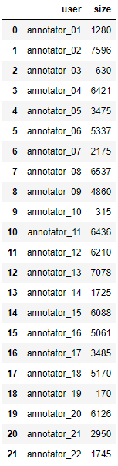
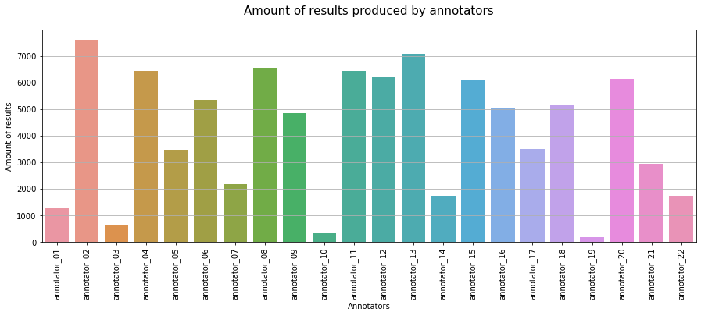
ANALYSIS
Amount of results contributed by 22 annotators

Slide 8
ANALYSIS
Questions for which annotators highly disagree
 | image | total amount | positive amount | correct amount | avg.duration | accuracy | reference
105 | img_0105 | 10 | 0 | 0 | 1048.8 | 0.0 | 1.0
179 | img_0179 | 10 | 0 | 0 | 4627.3 | 0.0 | 1.0
201 | img_0201 | 10 | 0 | 0 | 1388.0 | 0.0 | 1.0
220 | img_0220 | 10 | 0 | 0 | 1361.8 | 0.0 | 1.0
286 | img_0286 | 10 | 0 | 0 | 1757.2 | 0.0 | 1.0
... | ... | ... | ... | ... | ... | ... | ...
8667 | img_8667 | 10 | 0 | 0 | 1266.3 | 0.0 | 1.0
8726 | img_8726 | 10 | 0 | 0 | 1813.4 | 0.0 | 1.0
8742 | img_8742 | 10 | 0 | 0 | 1039.9 | 0.0 | 1.0
8919 | img_8919 | 10 | 0 | 0 | 1410.9 | 0.0 | 1.0
8944 | img_8944 | 10 | 0 | 0 | 1532.5 | 0.0 | 1.0

Slide 9
ANALYSIS
Questions for which annotators highly disagree
There are 3524 images/questions for which all annotators totally disagree (negative).
88 of the images/questions are incorrectly as negative annotated (false negative).

Slide 10
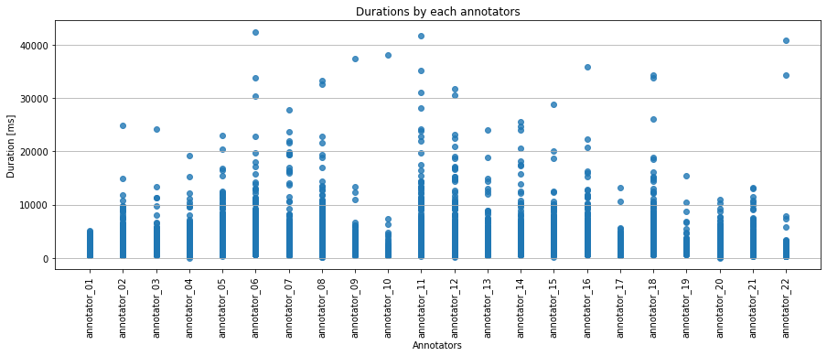
ANALYSIS
Average, min and max annotation times (durations)
 | duration
mean | 1289.95
median | 1058
max | 42398
min | 10

Slide 11
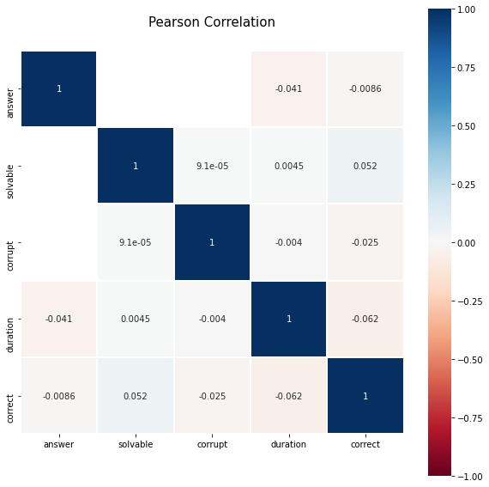
ANALYSIS
How often does each occur in the project?
17 annotations were unsolvable (0.0187%)
4 annotations were corrupted (0.0044%)
There is no obvious trend.

Slide 12
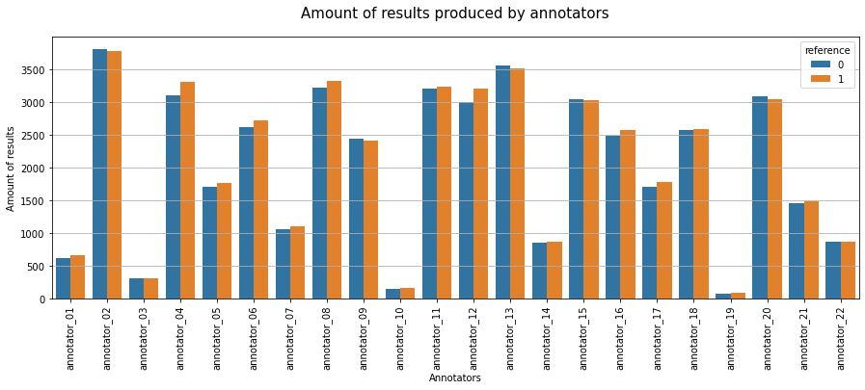
ANALYSIS
Is the reference set balanced?

Slide 13
ANALYSIS
Is the reference set balanced?
There are 45860 positive samples in the reference,which is 50.47% of the hole set.
The reference is balanced.

Slide 14
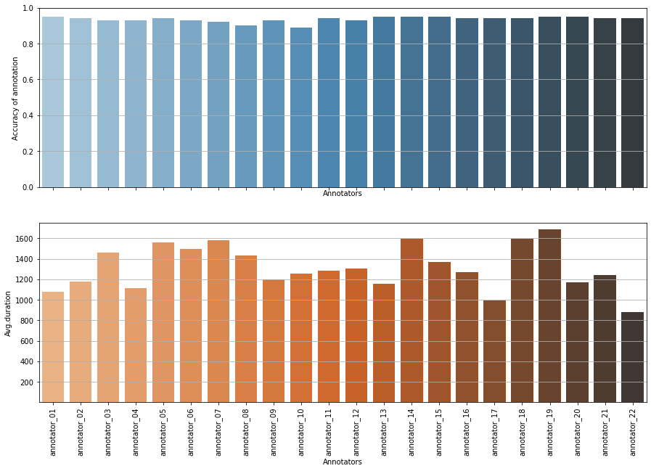
ANALYSIS
Identiy good and bad annotators

Slide 15
ANALYSIS
 | user | total amount | positive amount | correct amount | avg.duration | accuracy | precision | recall
0 | annotator_01 | 1280 | 673 | 1214 | 1077.32 | 0.95 | 0.94 | 0.96
1 | annotator_02 | 7594 | 3750 | 7101 | 1178.24 | 0.94 | 0.94 | 0.93
2 | annotator_03 | 630 | 295 | 585 | 1460.25 | 0.93 | 0.96 | 0.90
3 | annotator_04 | 6417 | 3369 | 5960 | 1114.21 | 0.93 | 0.92 | 0.94
4 | annotator_05 | 3475 | 1744 | 3256 | 1562.09 | 0.94 | 0.94 | 0.93
5 | annotator_06 | 5336 | 2901 | 4945 | 1496.94 | 0.93 | 0.90 | 0.96
6 | annotator_07 | 2174 | 1130 | 1990 | 1578.35 | 0.92 | 0.91 | 0.93
7 | annotator_08 | 6534 | 3385 | 5878 | 1434.72 | 0.90 | 0.89 | 0.91
8 | annotator_09 | 4860 | 2477 | 4536 | 1198.81 | 0.93 | 0.92 | 0.95
9 | annotator_10 | 315 | 192 | 280 | 1252.97 | 0.89 | 0.84 | 0.97
10 | annotator_11 | 6435 | 3136 | 6026 | 1279.98 | 0.94 | 0.95 | 0.92
11 | annotator_12 | 6210 | 3357 | 5774 | 1306.31 | 0.93 | 0.91 | 0.95
12 | annotator_13 | 7078 | 3497 | 6702 | 1155.01 | 0.95 | 0.95 | 0.94
13 | annotator_14 | 1724 | 862 | 1633 | 1595.58 | 0.95 | 0.95 | 0.95
14 | annotator_15 | 6088 | 2971 | 5774 | 1365.29 | 0.95 | 0.96 | 0.94
15 | annotator_16 | 5061 | 2491 | 4769 | 1269.79 | 0.94 | 0.96 | 0.93
16 | annotator_17 | 3485 | 1697 | 3283 | 991.89 | 0.94 | 0.96 | 0.92
17 | annotator_18 | 5167 | 2681 | 4841 | 1593.03 | 0.94 | 0.92 | 0.95
18 | annotator_19 | 170 | 89 | 161 | 1687.78 | 0.95 | 0.94 | 0.95
19 | annotator_20 | 6125 | 3048 | 5809 | 1173.21 | 0.95 | 0.95 | 0.95
20 | annotator_21 | 2950 | 1504 | 2773 | 1238.92 | 0.94 | 0.93 | 0.95
21 | annotator_22 | 1741 | 883 | 1644 | 880.04 | 0.94 | 0.94 | 0.95
Identiy good and bad annotators
Annotators, who had high accuracy and took low avg.annotation time are good: 'annotator_01', 'annotator_13', 'annotator_20'
Annotators, who had low accuracy and took long avg. annotation time are bad: 'annotator_06', 'annotator_07'

Slide 16
THANKS FOR YOUR READING!

