Slide 1
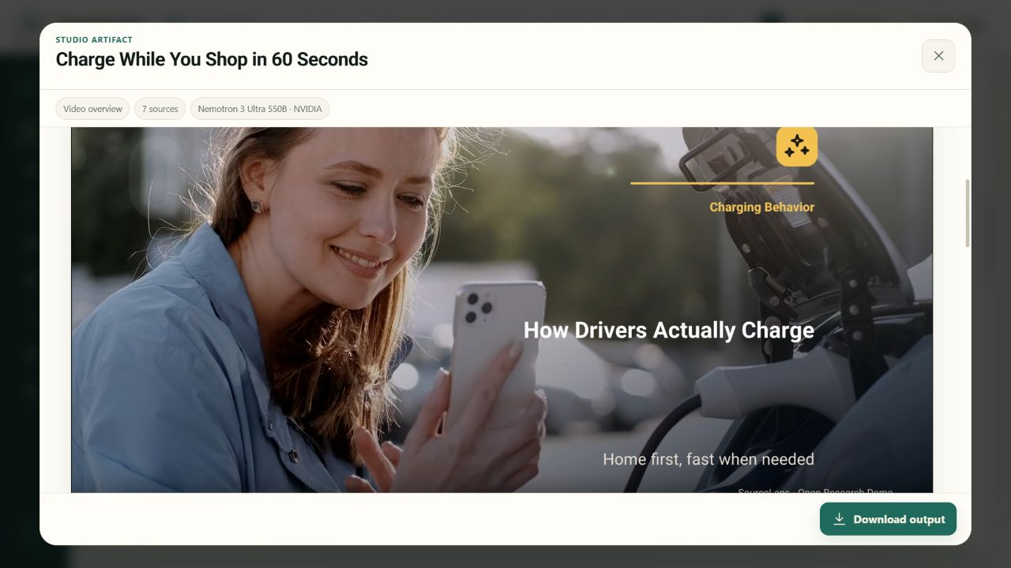
SourceLens — Final System Evaluation
A real bilingual run—from trusted sources to 26 useful outputs
Charge While You Shop · 10 August 2026
Notes:
[Sources]
Charge While You Shop public demo
docs/demo/README.md

Slide 2
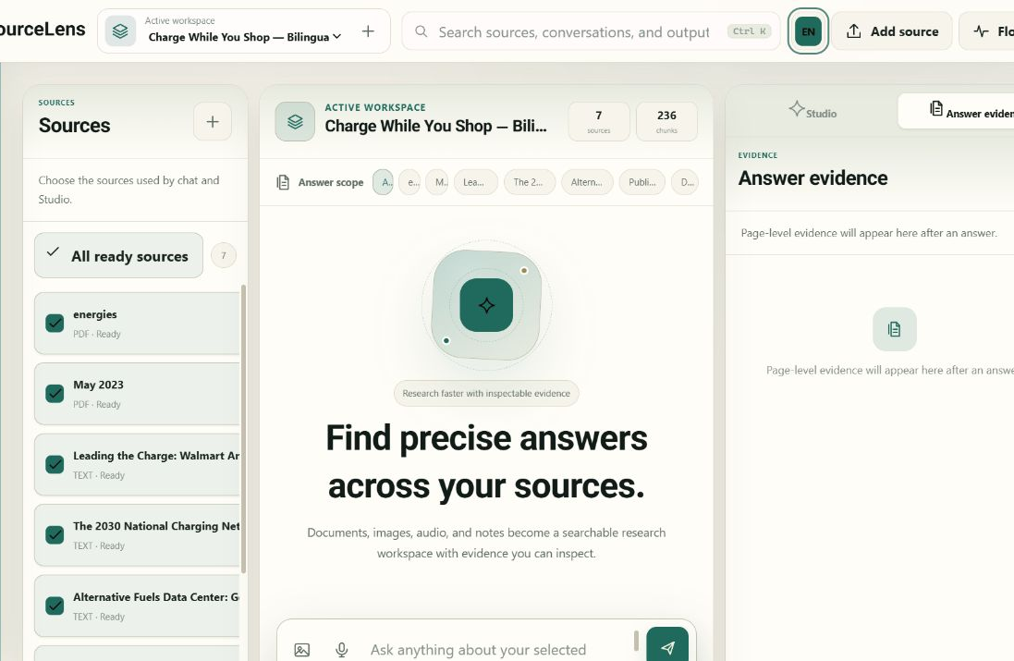
SOURCELENS
Seven sources. One transparent evidence boundary.
7
236
ready sources
indexed chunks
Two CC BY 4.0 papers and five official web sources were added through the same Upload and Search flows available in the app.
2 open papers + 5 official web sources
02
Notes:
[Sources]
docs/demo/source-research.md
https://www.mdpi.com/1996-1073/14/15/4598
https://publications.jrc.ec.europa.eu/repository/handle/JRC133895

Slide 3
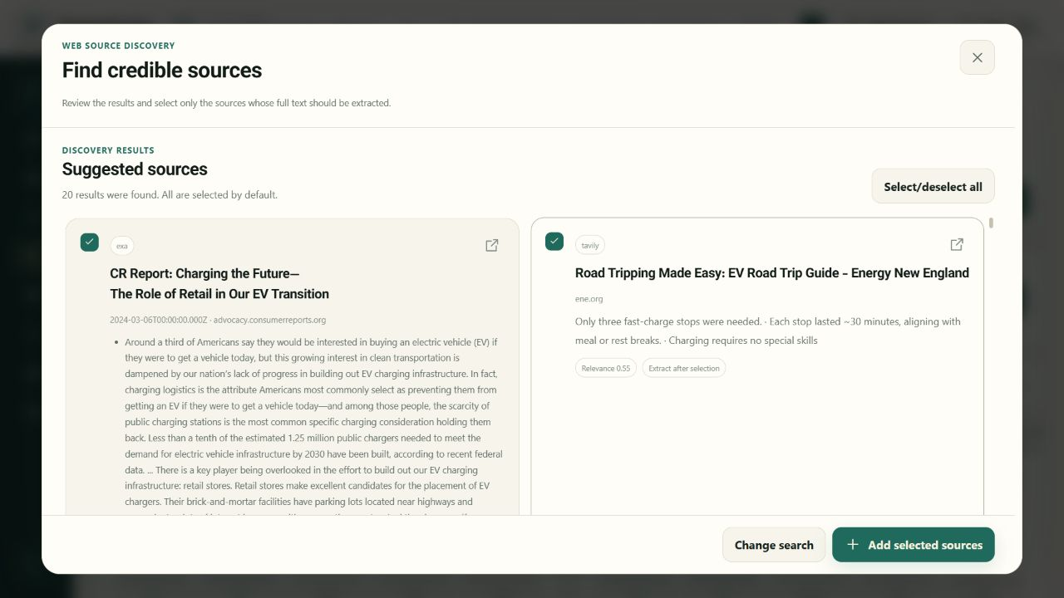
SOURCELENS
Search becomes a reusable research source
The app searched the web, let the user select results, extracted the pages, and indexed them beside the uploaded papers.
Search · select · extract · index
03
Notes:
[Sources]
docs/demo/assets/04-web-search-en.png
docs/demo/source-research.md

Slide 4
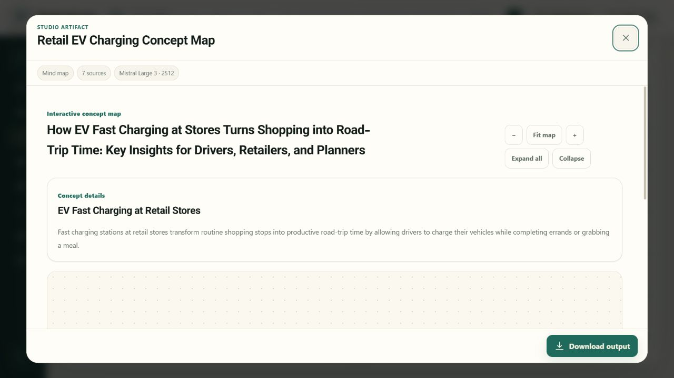
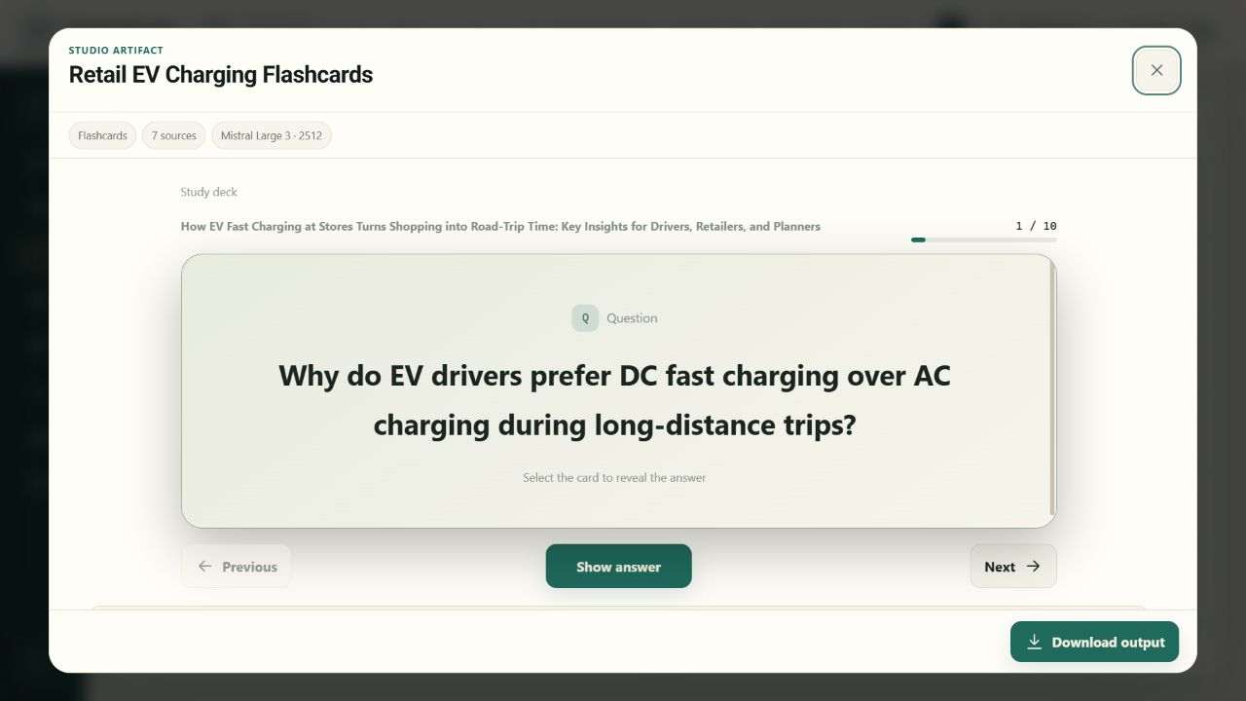
SOURCELENS
Studio turns one corpus into many useful forms
The same 236 chunks produced all 13 Studio formats in English and Persian—26 app-generated artifacts in total.
04
Notes:
[Sources]
docs/demo/outputs/en/index.json
docs/demo/outputs/fa/index.json

Slide 5
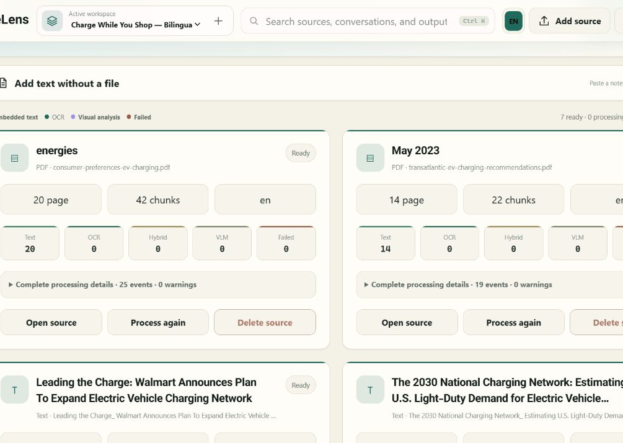
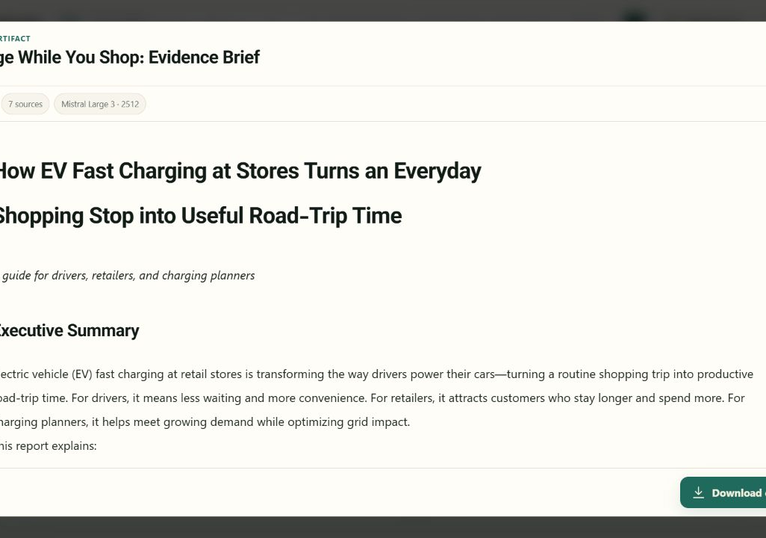
SOURCELENS
Grounded answers—from retrieval to citation
Source selection, hybrid retrieval, synthesis, and the evidence panel share one explicit source boundary.
05
Notes:
[Sources]
docs/retrieval-benchmark.md
docs/demo/assets/03-source-cards-en.png
docs/demo/assets/10-report-en.png

Slide 6
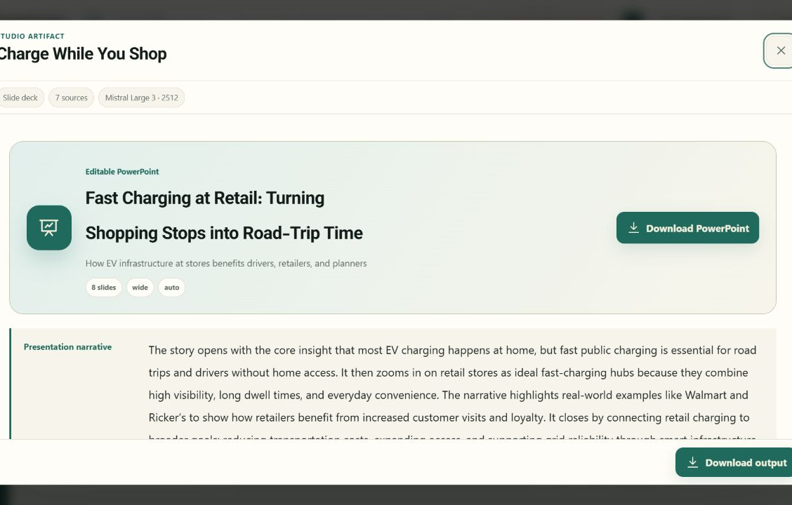
SOURCELENS
Live, durable, inspectable execution
live events and real progress
cancel and retry
restart recovery
downloads and quality manifests
06
Notes:
[Sources]
Studio live-event stream
artifact status, retry, cancellation, and restart recovery tests

Slide 7
SOURCELENS
Thirteen formats, two languages, one corpus
Audio
Report
Concept map
Flashcards
Quiz
Infographic
Data table
Chart
Timeline
Comparison
Research gaps
PowerPoint
Video
26 application outputs; no manual content rewriting
07
Notes:
[Sources]
docs/demo/outputs/en/index.json
docs/demo/outputs/fa/index.json

Slide 8
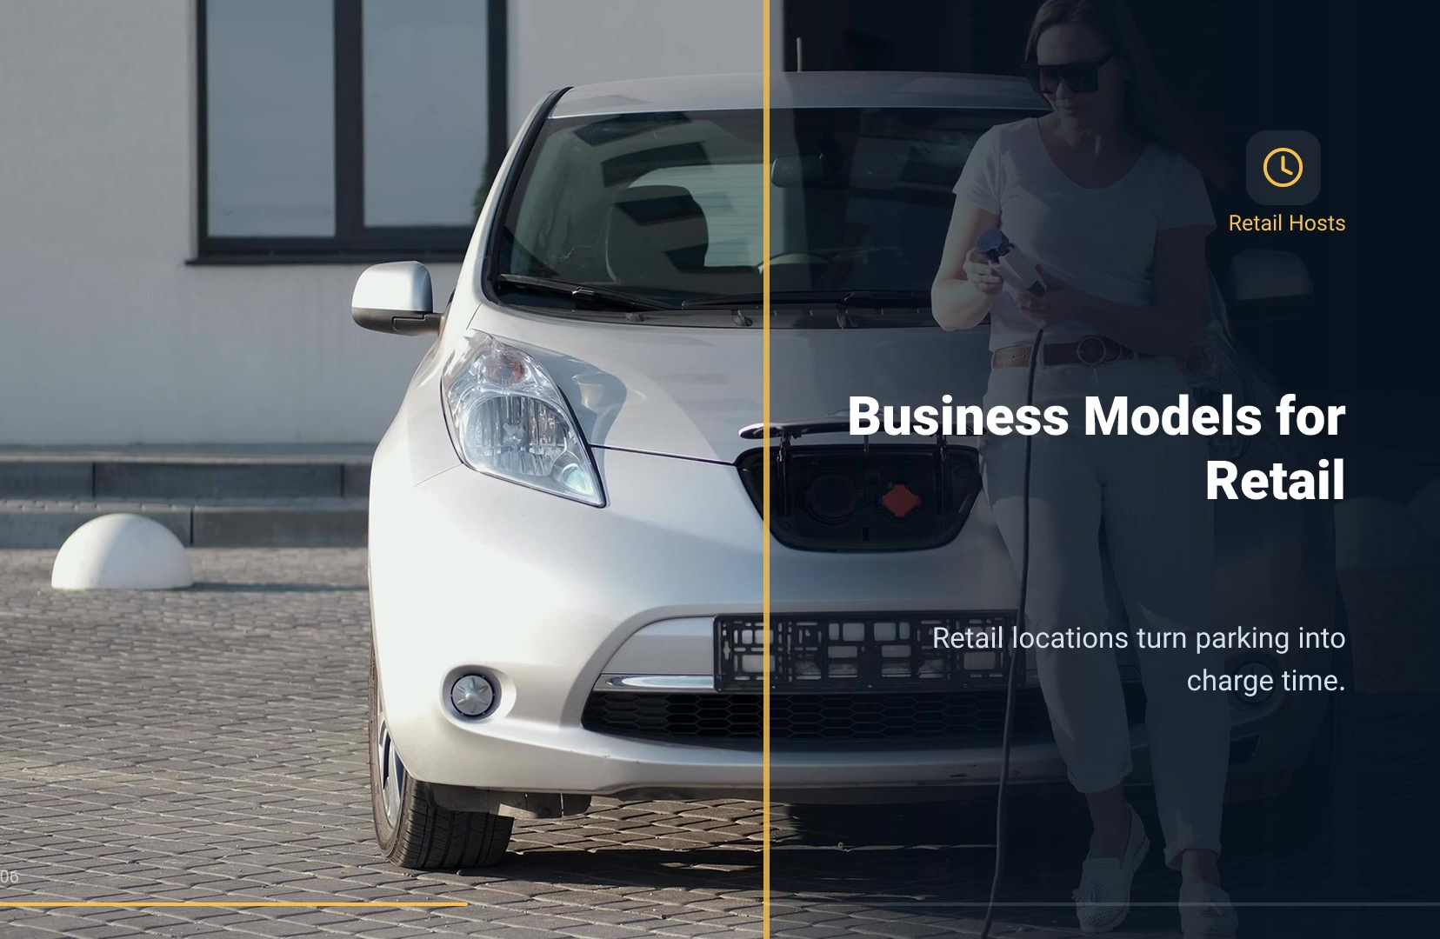
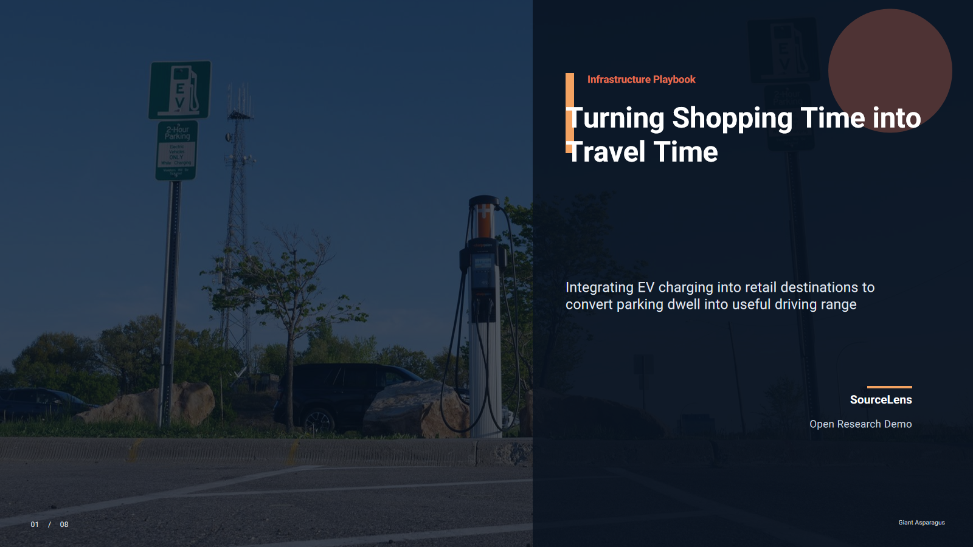
SOURCELENS
Editable slides and cinematic video
Editable PowerPoint built from verified evidence
Full HD video with real API media
https://github.com/msmahdinejad/SourceLens/raw/main/docs/demo/outputs/en/charge-while-you-shop-slide-deck.pptx
https://github.com/msmahdinejad/SourceLens/raw/main/docs/demo/outputs/en/charge-while-you-shop-video-overview.mp4
08
Notes:
[Sources]
https://github.com/msmahdinejad/SourceLens/raw/main/docs/demo/outputs/en/charge-while-you-shop-slide-deck.pptx
https://github.com/msmahdinejad/SourceLens/raw/main/docs/demo/outputs/en/charge-while-you-shop-video-overview.mp4
https://www.pexels.com/license/

Slide 9
SOURCELENS
Quality gates passed
26
50 s
Full HD
8
ready artifacts
video runtime
video resolution
editable slides
The full Python suite passed
Node tests, JavaScript syntax, and license audits are green
Videos: natural-speed audio, H.264 + AAC, captions, and clean timelines
09
Notes:
[Sources]
scripts/validate_public_demo.py
docs/retrieval-benchmark.md

Slide 10
SOURCELENS
Natural bilingual audio with Live 3.1
13 dialogue turns
Puck + Kore voices
Downloadable transcript
The app prepared a source-grounded dialogue, then rendered it with Gemini Live 3.1 and Puck with Kore or Aoede at natural speed.
117.38 seconds
Gemini 3.1 Live
Unchanged speaking speed
10
Notes:
[Sources]
docs/demo/outputs/en/charge-while-you-shop-audio-overview.mp3
docs/demo/outputs/en/charge-while-you-shop-audio-overview-transcript.txt

Slide 11
SOURCELENS
Release evidence: quality, licensing, reproducibility
Retrieval
Artifacts
recorded recall and citation precision
hash, size, and sidecar manifests
Media
Video
real Pexels assets with exact credit
Full HD, H.264, AAC
Privacy
Release
no key, private ID, or local path
Windows/Linux CI and license audit
11
Notes:
[Sources]
scripts/validate_public_demo.py
docs/retrieval-benchmark.md
THIRD_PARTY_LICENSES.md
.github/workflows/ci.yml

Slide 12
Release verdict
The end-to-end run validates multilingual ingestion, Search, agentic retrieval, durable live Studio jobs, structured learning outputs, editable slides, natural audio, and licensed-media video.
Every published artifact is the app's own output; manifests preserve hashes, quality checks, and media provenance.
https://github.com/msmahdinejad/SourceLens
Notes:
[Sources]
SourceLens final demo run, 2026-08-10
docs/demo/README.md
docs/demo/README.fa.md
docs/demo/source-research.md

