Slide 1
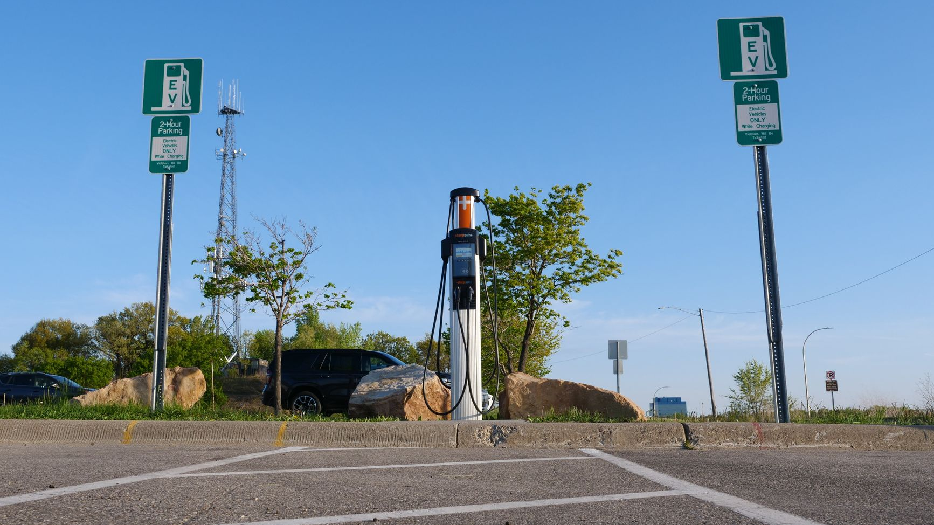
Infrastructure Playbook
Turning Shopping Time into Travel Time
Integrating EV charging into retail destinations to convert parking dwell into useful driving range
SourceLens
Open Research Demo
01
/
08
Giant Asparagus
Notes:
Opening the presentation on how retail charging infrastructure aligns routine shopping intervals with necessary electric vehicle recharging.
[Sources]
- [[S1]]
- Image: https://www.pexels.com/photo/electric-vehicle-charging-station-in-urban-setting-37576194/

Slide 2
02
Dual-Purpose Dwell Times
Balancing long-duration Level 2 convenience with rapid DC fast charging at retail sites
Level 2 Ports
DC Fast Charging
Strategic Placement
Approx. 500,000 public L2 ports simulated across retail outlets and community centers provide occasional long-duration charging during extended visits.
182,000 public DC fast ports (ranging from 50 kW to 350+ kW) core to network success, giving drivers assurance of rapid turnaround when needed.
Locating chargers where drivers already park for other activities minimizes perceived friction and turns idle vehicle time into travel range.
02
/
08
Notes:
Explains the distinction between Level 2 and DC fast charging in public retail environments as modeled in national infrastructure projections.
[Sources]
- [[S2]]

Slide 3
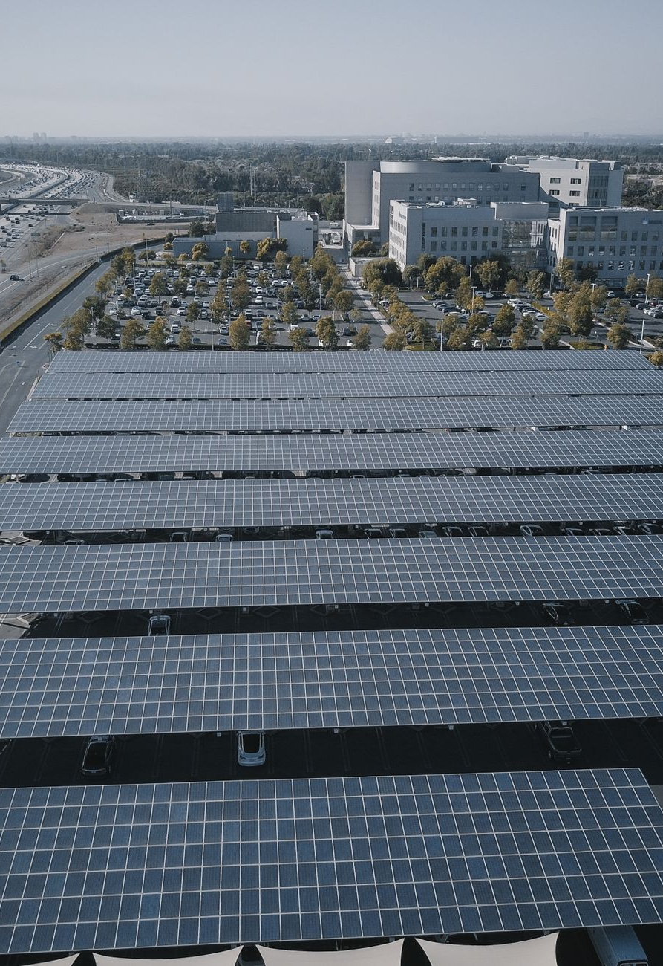
03
Bridging Convenience and Scale
National retail footprints provide unmatched proximity for everyday drivers
03
/
08
Kindel Media
Notes:
Highlights Walmart's strategy of utilizing widespread retail footprints to make EV ownership accessible across rural, suburban, and urban communities.
[Sources]
- [[S5]]
- Image: https://www.pexels.com/photo/aerial-footage-of-solar-panels-9799757/

Slide 4
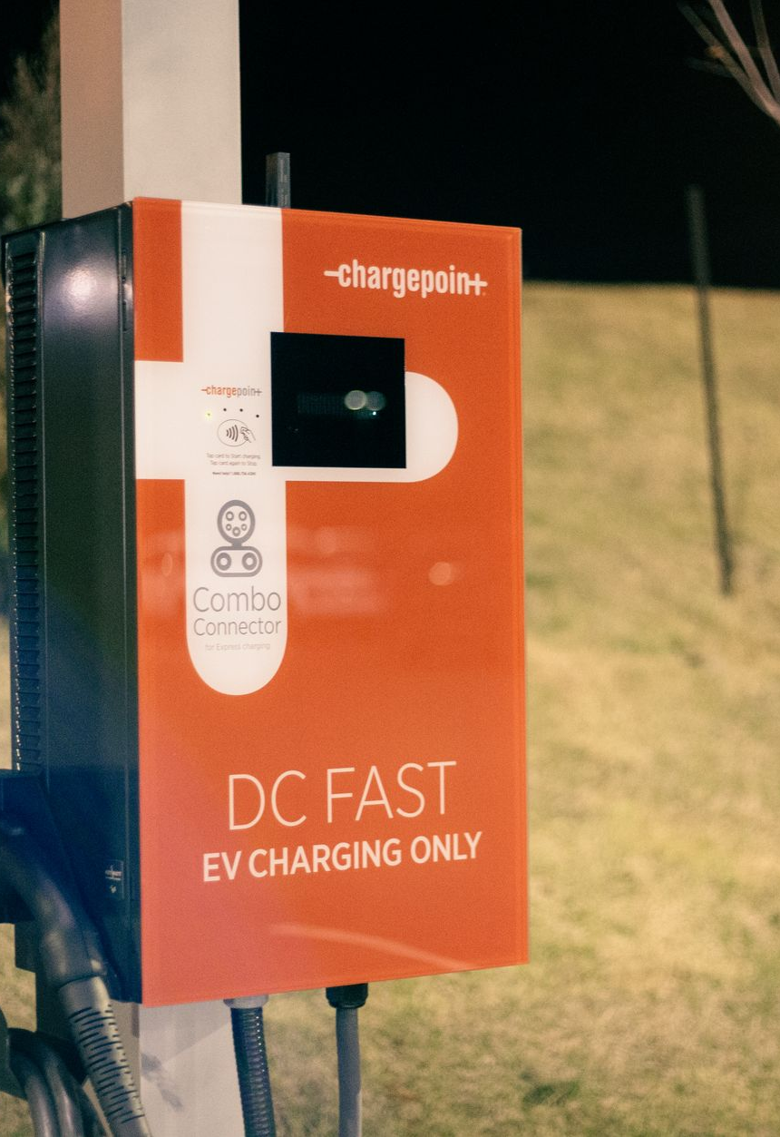
04
Early Retail Deployment: Ricker's Case Study
Pioneering citywide DC fast charging at convenience store locations in Indianapolis
04
/
08
Erik Mclean
Notes:
Examines how convenience store chains and automotive manufacturers collaborated to establish early dense deployment models.
[Sources]
- [[S4]]
- [[S8]]
- Image: https://www.pexels.com/photo/electric-vehicle-charging-station-on-roadside-5864153/

Slide 5
05
Modeling Travel Demand and Siting
Using advanced simulation suites to predict optimal charger placement and usage
EVI-Pro
EVI-RoadTrip
EVI-OnDemand
Typical daily charging needs based on national household travel surveys.
Simulates interregional travel and clusters fast-charging demand near r…
Estimates urban ride-hailing fleet electrification and public charging…
05
/
08
Notes:
Details the NREL modeling suite used to project infrastructure requirements across diverse light-duty vehicle use cases.
[Sources]
- [[S7]]
- [[S9]]
- [[S10]]

Slide 6
06
Grid Integration and Smart Charging
Coordinated strategies to optimize charging infrastructure for electrical grid support
01
02
03
Evaluate Strategies
Shift Demand
Provide Services
→
→
Assess charge management effectiveness to identify highest grid value during mass EV adoption.
Use smart charging patterns over daily cycles to integrate clean distributed energy resources.
Validate smart hubs for load flexibility, frequency regulation, and grid stabilization.
06
/
08
Notes:
Outlines the importance of pairing retail EV charging deployment with advanced grid management and demand shifting.
[Sources]
- [[S3]]

Slide 7

“
07
We've seen a steady increase in our customer base since installing the equipment a couple of years ago.
Jay Ricker, Owner of Ricker's Convenience Stores
Eliminating range anxiety through reliable on-the-go charging access
07
/
08
Gustavo Fring
Notes:
Demonstrates the direct business and consumer benefits realized when routine retail visits double as reliable vehicle recharging opportunities.
[Sources]
- [[S5]]
- [[S8]]
- Image: https://www.pexels.com/photo/modern-woman-using-station-for-charging-electromobile-4005049/

Slide 8
08
Accelerating the Transition
Key takeaways for scaling retail EV charging infrastructure successfully
1
2
3
Align with Retail Dwells
Leverage Partnerships
Plan for Grid Integration
Target locations where natural customer dwell times match appropriate Level 2 or DC fast charging speeds.
Combine automaker initiatives, clean cities coalitions, and site host investments to minimize deployment barriers.
Incorporate smart charging, storage, and load management to support long-term grid stability and clean energy goals.
08
/
08
Notes:
Concluding summary on actionable steps for expanding retail charging networks to turn parking intervals into productive travel range.
[Sources]
- [[S1]]
- [[S2]]
- [[S5]]

