Slide 1
EconTax

Slide 2
Elasticity
Concept of Elasticity
Price Elasticity of Demand
Cross Elasticity of Demand
Income Elasticity of Demand
Price Elasticity of Supply
Importance and Application

Slide 3



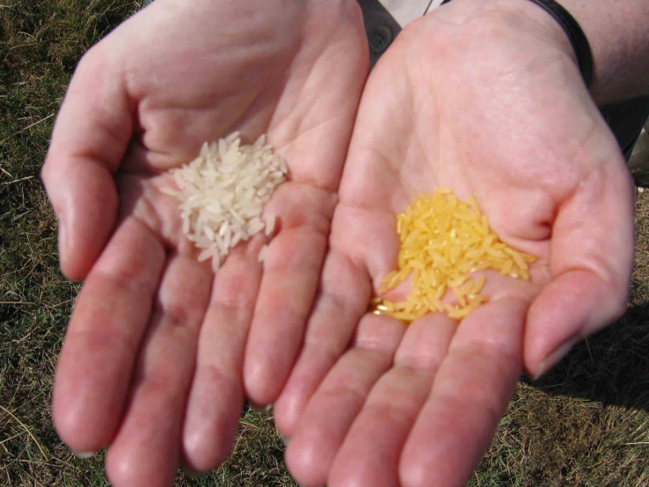

Slide 4


Elasticity
A concept which measures the responsiveness of Quantity Demanded (QD)or
Quantity Supplied (QS)
to one of its determinants .
Sometimes the responses are substantial, other times minimal or nonexistent.

Slide 5
Elasticity
percentage change in one variable in relation to the percentage change in another variable
Basic Formula to determine elasticity:
percentage change in variable y
percentage change in variable x
ELASTICITY =

Slide 6
Price Elasticity of Demand (PED)
measures the responsiveness of the QD with respect to the changes in its price.
Percentage change in QD that occurs with respect to a percentage change in price
Price elasticity of demand describes how changes in the cost of a product or service affect a company’s revenue.

Slide 7
`
Price Elasticity of Demand (PED)
For some products, a small change in price will dramatically influence how many units the customer will buy.
In other cases, price movements have little effect on demand.
Therefore, understanding the price elasticity of each offering is crucial to maximizing profit.

Slide 8
PED =Percentage change in Quantity Demanded
Percentage change in Price
PED = %change QD
% change P

Slide 9
Points Method – used when measuring a very small change in both price and quantity on a demand curve on a particular point
Q2 - Q1
Q1
P2 - P1
P1

Slide 10
Example:
Suppose a 10% increase in the price of an ice
cream cone causes the amount of ice cream
you buy to fall by 20%
PED 20%/10% = 2
Because the QD is negatively related to its price, the percentage change will always have the opposite sign as the percentage change in price.

Slide 11
If the QD for Iphone 2 increases 22% in response to a 10% decrease in price, the price elasticity of demand would be
22% / 10% = 1.5.

Slide 12
3. If quantity demanded for Iphone 6s
increases from 78 to 95 units,
the percentage change is 22%.
4. If quantity demanded for Iphone 6s
decreases from 95 units to 78 units,
the percentage change is 18%

Slide 13
If the price of petrol increased from 130p to 140p and demand fell from 10,000 units to 9,900. What is the PED?
% change in Q.D = (-100/10,000) *100 = – 1%
% change in price 10/130 ) * 100= 7.7%
Therefore PED = – 1/7.7 = -0.13

Slide 14
Elimination of Minus Sign
Economists usually ignore the minus sign and simply to present the absolute value of the elasticity of demand to avoid an ambiguity that might otherwise arise.

Slide 15
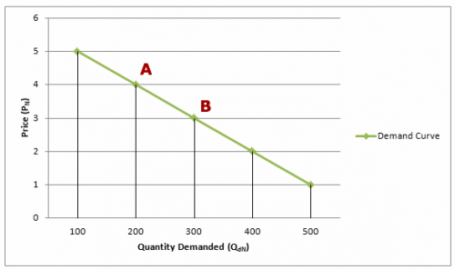
Example 1- Compute for PED from A to B

Slide 16
200 to 300 = 100/200 = 50%
4 to 3 = 1/4 = -25%
Therefore PED = 50/ -25 = – 2.0

Slide 17
Table 1 – Hypothetical Data of Point elasticity

Slide 18
Compute for PED :
Points A to E
Points E to A

Slide 19
Degree of Price Elasticity of Demand
Elastic Demand
Inelastic Demand
Unitary Elastic Demand

Slide 20
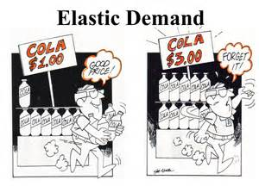
ELASTIC DEMAND (flat )
elasticity coefficient is greater than 1 (elasticity coefficient means the relative response of one variable to another )
small change in P results to a greater change in QD
products where there are many alternatives or which consumers are relatively price sensitive

Slide 21
Examples:
An increase in the price of Soda A (double), QD will decrease when consumers switch to less-expensive Sodas
furniture
motor vehicle
professional services
transportation service

Slide 22
Suppose that a 10% increase in the price of ice-cream cone causes the amount of ice cream you buy to fall by 20%. We calculate the percentage change in the price as:
PED = 20%= 2 reflects the change in the QD is proportionately
10% twice as large as the change in price.
2 is change in the QD is proportionately 2x as large as the change in the P.
A 22% increase in price leads to a 22% decrease in QD.

Slide 23
Because the QD of a good is negatively related to its price,
the %change in Q will always have the opposite sign as the percentage change in price.
The % change in P is a positive10%, and the % change in QD is a negative 20%.
Because of this, PED are sometimes reported as negative numbers.

Slide 24
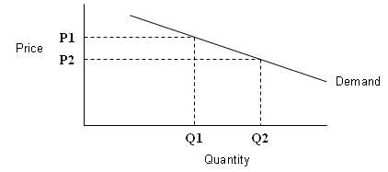
Elastic (flat)

Slide 25
2. INELASTIC DEMAND (STEEP)
If the Price Elasticity of demand coefficient, Ed is less than 1
Have fewer substitutes and price change doesn’t affect QD as much.
A change in price causes a smaller % change in demand

Slide 26
A good produced by a monopoly.
if Sky increase the cost of premiership pay per view, many football fans will pay the extra price. Though because it isn’t a necessity, demand may be less inelastic than say petrol.
Tap water
For householders, tap water is a necessity with no alternatives. If the water company increase the cost of water bills, people would keep buying the service. It would have to rise to a very high price before people disconnected their water supply. This is why tap water is regulated by the government.

Slide 27
Diamonds
Bought very infrequently, diamonds are the ultimate luxury with few exact alternatives. You could buy other precious gems, but others may not have the same allure as diamonds. A cut in price wouldn’t increase demand very much.
LRT/MRT Tickets
Possible alternatives : jeepney, bus,

Slide 28
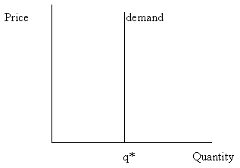
Gas, electricity, salt, oil, diamonds, Apple, Iphones, LRT ticket, Ipad …. A 22% increase in price leads to an 11% increase in QD

Slide 29
3. UNITARY DEMAND
When elasticity coefficient is equal to 1 .
A change in price is equal to a change in QD/exactly matches the change in QD
Examples
A 22% increase in price leads to 22% increase in QD

Slide 30
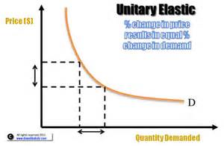

Slide 31
Extreme Cases of Price Elasticity of Demand
1. PERFECTLY ELASTIC DEMAND
when demand is totally responsive to changes in price.
a consumer will not buy a good or service if the price moves at all
If there is a small decrease in the P, QD will increase without limit
.

Slide 32
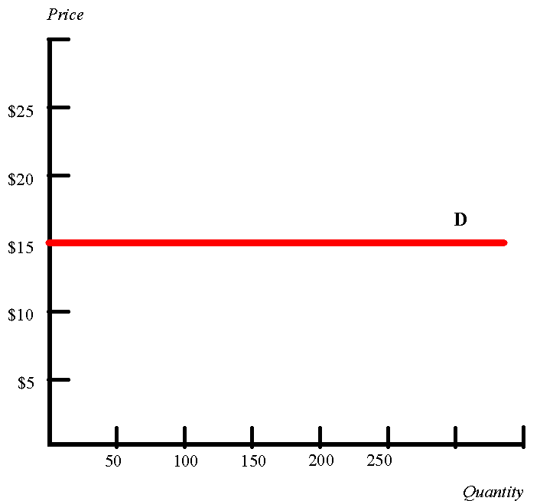
pink tennis balls. If the price of pink tennis balls went up, no one would buy them in lieu of yellow tennis balls.

Slide 33
Extreme Cases of Price Elasticity of Demand
2 PERFECTLY INELASTIC DEMAND
When QD totally does not respond to any changes in P
It has a price elasticity coefficient of infinite
A consumer will buy a good or service regardless of the movement of price.
In order for perfectly inelastic demand to exist, there can be no substitutes available.

Slide 34
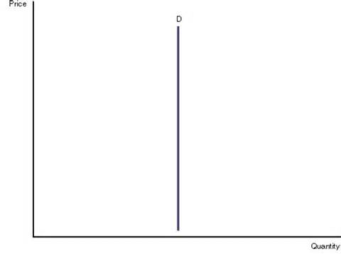
Examples food for a starving man insulin to a diabetic.

Slide 35
Effect on Total Revenue
Price Effect
an increase in price that will result to a
positive effect on revenue
Quantity Effect
an increase in price that will lead to less quantity sold and vice versa

Slide 36
Elasticity presents the identity that:
percentage change in Total Revenue
Is equal to the percentage change in
Quantity demanded plus the percentage change in price

Slide 37
Relationship between the PED and Total Revenue(TR)
1.If the PED is elastic (e > 1) , a price increase will make the TR fall, and vice versa
2. When the PED is inelastic (e <1), a price increase will give rise to TR and vice versa
3. When the PED is unitary elastic ( e=1) the change in price will not affect the TR

Slide 38
Relationship between the PED and Total Revenue(TR)
When the PED is perfectly elastic, a price increase creates a zero TR
When the PED is perfectly inelastic , a price increase will cause TR to increase

Slide 39
Other demand elasticities INCOME Elasticity of DEMAND
A measure of how much the quantity demanded of a good responds to a change in consumer income.
Percentage change in Quantity Demanded
Percentage in Income

Slide 40
Other Demand Elasticities INCOME Elasticity of DEMAND
Higher income raises quantity demanded
Because QD and Income move in the same direction, normal goods have positive income elasticities
Higher income lowers QD for inferior goods

Slide 41
Summary of Income Elasticity Coefficient
Types of Goods | Income Elasticity Coefficient
Normal, Luxury Good | Positive Elasticity, (e > 1)
Normal, Necessity Good | Positive Elasticity but less than 1
Inferior Good | Negative Elasticity

Slide 42
Hypothetical data for income elasticity

Slide 43
Solve for the income elasticity

Slide 44
Other Demand Elasticities Cross-Price Elasticity of DEMAND
A measure of how much the quantity demanded of one good respond to a change in the price of another good.
Percentage change in QD of good 1
Percentage change in QD of good 2
Mathematical symbol :
Exy = %change Qdx
% change Py

Slide 45
Other Demand Elasticities Cross-Price Elasticity of DEMAND
negative if X and Y are complementary goods, and positive if x and y are substitutes.
The higher the value of the cross-elasticity the stronger will be the degree of substitutability or complementarity of x and y.
The main determinant of the cross-elasticity is the nature of the commodities relative to their uses. If two commodities can satisfy equally well the same need, the cross- elasticity is high, and vice versa.

Slide 46
Other Demand Elasticities Cross-Price Elasticity of DEMAND
Example:
an increase in demand for cars will lead to an
increase in demand for fuel.
If the price of the complement falls, the quantity demanded of the other good will increase.
The value of the cross-price elasticity for complementary goods will thus be negative .

Slide 47
Other Demand Elasticities Cross-Price Elasticity of DEMAND
A positive cross-price elasticity value indicates that the two goods are substitutes.
As the price of one good rises, the demand for the substitute good increases.

Slide 48
Other Demand Elasticities Cross-Price Elasticity of DEMAND
Example:
if the price of coffee increases, consumers may purchase less coffee and more tea. Conversely, the demand for a substitute good falls when the price of another good is decreased. In the case of perfect substitutes, the cross elasticity of demand will be equal to positive infinity .

Slide 51
Price Elasticity of SUPPLY
Measures the responsiveness of quantity supplied in response to a percentage change in the price of products
Elasticity of supply tells us how fast supply responds to quantity demand and price increase.

Slide 52
PED =Percentage change in Quantity Supply
Percentage change in Price
PED = %change QS
% change P

Slide 53
Price Elasticity of SUPPLY
Example:
popular product that is in short supply for instance, the price may rise
The manufacturers of that product will increase output
to keep up with the demand.
The higher the elasticity of supply,
the faster the supply will increase when demand and price increase.

Slide 54
Price Elasticity of SUPPLY
Some goods/services are
more supply inelastic
however, whenever there is a supply shortage. Limited tickets to a concert may have a very inelastic supply. The price of the concert tickets can be raised to any amount, but because there is a fixed number of seats and tickets, the supply (of tickets sold) may not be increased by much if at all.

Slide 55
Degree in Price Elasticity of Supply
Elastic Supply
a change in price leads to a greater change in QS.
suppliers are sensitive at any change in price.
This reaction also applies if the price of a certain product decreases

Slide 56
Degree in Price Elasticity of Supply
Elastic Supply
a change in price leads to a greater change in QS.
suppliers are sensitive at any change in price.
This reaction also applies if the price of a certain product decreases
Example:
Goods that can be produced immediately by manufacturing firms

Slide 57
2. Inelastic Supply
a change in price leads to a lesser change in QS.
suppliers are weak in response to any price changes.
Example
Common to agricultural products which take time to produce.

Slide 58
3. Unitary Elastic Supply
a change in price leads to an equal change in quantity supplies.

Slide 59
Importance and Application of Elasticity
The concept of elasticity has several applications both in business and economic decision making.
Helps every policy formulating body develop and/or formulate appropriate strategies and programs.

Slide 60
Importance and Application of Elasticity
Businesses and government can do a better job in deciding what to produce, how much to charge and what items to tax.
It can determine the effect of price changes on the revenue.
Producers can assess consumers responsiveness with respect to any changes in the price of commodity

