Slide 1
Asset Management with Barcode Tagging System for Operations and Maintenance
De Guzman, Joanna
Mayor, Miguel
Tobias, Adrian

Slide 2
Abstract:
- Organizing and handling data is important.
- To achieve efficient organization of data.
- Explains the benefits of implementing an AMS.
- Efficiently and effectively handle the data and information about the weather stations of the company around the regions of the Philippines.

Slide 3
Introduction:
Creating a software solution that would improve upon the old existing system for the company called Weather.ph
What is Weather.ph?
What do they do?

Slide 4
Project Context
Operations and Maintenance Department handles the data of weather stations and do maintenance.
Hundreds of weather stations are located all over the regions of the Philippines.
A specific problem arises inside the department.

Slide 5
Purpose and Description
How to arrange and manage data.
Improve the ease of arrangement and management of data within the company.
Increase the reliability against the loss or errors.

Slide 6
Objectives:
- To improve the algorithm to a better and faster way which would minimize the delay of accessing the information.
- To come up with a proposal of usable methods that can lead into create a software that will solve the problem of Weather.com.ph completely
- To create a software solution which solves the inefficiency in the Operations and Maintenance department

Slide 7
Scope and Limitations:
Will not cover other departments such as Financial Department and Human resources.
Limited to the improvement of the old system by proposing a new software solution
Provides convenience and increase in productivity in the Operations and Maintenance Dept.

Slide 8
Technical Background:
Created with the Yii2 Framework
PHP Coding as well as some MySQL Database management
Consists of Weather Station entry CRUD, Service Report Handling CRUD, Scheduling and Barcode generation for the specific Weather Station
Accessible by mobile, computer and tablet devices

Slide 9
Review of Related Literature
Weather Station
Barcode
RFID vs. Barcode
Preventive Maintenance
Asset Management

Slide 10
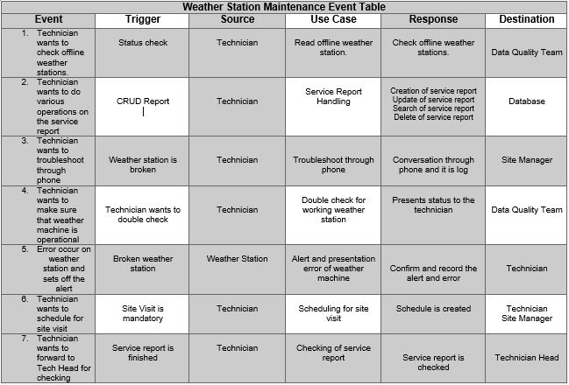
Diagrams

Slide 11
Communication Diagram
Use Case Diagram
Activity Diagram
Object Diagram

