Slide 1
Mastering CI and Git at Scale
Helix4Git and the Jenkins p4-plugin

Slide 2
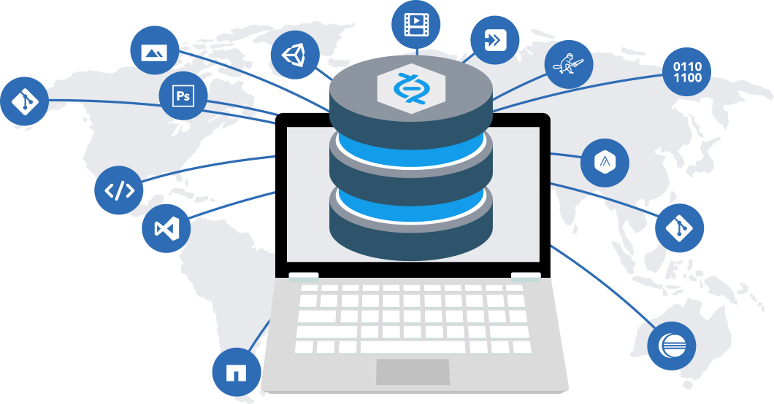
Version everything
Sources
Assets
And now Git
Notes:
Perforce has long had the moto ‘Version Everything’ and our customers really do; every thing from high energy physics to the latest scene in an animation movie.
Source code is only one part of the version management problem and Perforce over the years has helped our customers version all manor of large files and binary assets. Today we are taking that moto one step further and now versioning Git.
Git has scaled by creating many tiny repositories each with their own version history, but there is little help to coordinate how the repositories are used together.
Mono repos such as GitHub, GitLab, etc… help with the hosting of individual repositories, solving the management problem (by organisational grouping), but does little to manage the configuration issue.

Slide 3





Mono Repo
Single source of truth
Scaling & Global Replication
Breakdown Silos
Helix Clients
GitLab EE
Any Git Tool
GIT FUSION
GIT
CONNECTOR
Notes:
Perforce Helix has always been a mono repo, allowing users complete freedom to store and organise their data. There are no silos, repositories or boundaries to prevent the flow of change.
Files can be copied, referenced, branched or merged from any location to any other location. This flexibility can be too much, so to help we developed Streams to control the flow of changes. Streams defines a set of code paths, using the mainline or trunk based model and ensures merging and copy actions occur on the correct target; but a stream can be modified, reshaped as the demands on a project change with time.
Helix4Git can take any number of Git repositories and store their whole history, becoming a mono repo for Git too. This breaks down the silo of traditional Git storage; so files from one Git repository can be mapped with files from another Git repository, Perforce Stream or Workspace.
But is this really Git?
Our first offering (for those that remember) was GitFusion. GitFusion imported the Git content, but stored it in the Perforce Hierarchal data model – useful in some replication applications.
Helix4Git however, uses a Graph based data model similar to Git.
The data model allows Git clients to work against the Perforce server, without even knowing the repository is actually in Perforce. The Git Connector provides a http/ssl port for native Git clients.

Slide 4
Clone from Helix4Git
git clone https://localhost:4443/plugins/p4-plugin
Cloning into 'p4-plugin'...
remote: Counting objects: 8343, done.
remote: Compressing objects: 100% (2641/2641), done.
remote: Total 8343 (delta 3242), reused 8343 (delta 3242)
Receiving objects: 100% (8343/8343), 33.51 MiB | 61.46 MiB/s, done.
Resolving deltas: 100% (3242/3242), done.
GIT
CONNECTOR
Any Git Tool
Notes:
You can use Helix4Git with any Git command.
For example; a simple Git clone…
(this is mapped to localhost for my docker example, but in production you would run this on a server with a fully qualified domain name.)

Slide 5
Perforce Graph
p4 repos
//plugins/p4-plugin admin 2017/08/10 14:16:26 Automatically created by the initial push.
//plugins/scm-api-plugin gconn-user 2017/08/10 14:02:34 Mirror of https://github.com/jenkinsci/scm-api-plugin.git
p4 files //plugins/p4-plugin/*
//plugins/p4/.gitignore
//plugins/p4/GRAPH.md
//plugins/p4/Jenkinsfile
//plugins/p4/LICENSE.txt
//plugins/p4/NOTES.md
//plugins/p4/P4GROOVY.md
//plugins/p4/README.md
//plugins/p4/RELEASE.md
//plugins/p4/SETUP.md
//plugins/p4/WORKFLOW.md
//plugins/p4/pom.xml
Helix Clients
Notes:
You can access the same Git content using Perforce commands… for example `p4 files`
We have added a new command `p4 repos` to list your Git repos.
(the `p4 repos` output has two repos one was mirrored from GitHub and the other an initial push)

Slide 6
Adding from GitHub
git clone https://github.com/p4paul/jenkins-demo.git
Cloning into 'jenkins-demo'...
remote: Counting objects: 94, done.
remote: Compressing objects: 100% (49/49), done.
remote: Total 94 (delta 31), reused 94 (delta 31), pack-reused 0
Unpacking objects: 100% (94/94), done.
cd p4-plugin/
git remote add helix https://localhost:4443/plugins/demo.git
git push -u helix master
Counting objects: 8132, done.
Delta compression using up to 8 threads.
Compressing objects: 100% (2531/2531), done.
Writing objects: 100% (8132/8132), 33.50 MiB | 0 bytes/s, done.
Total 8132 (delta 3200), reused 8132 (delta 3200)
To https://localhost:4443/plugins/demo.git
* [new branch] master -> master
Branch master set up to track remote branch master from helix.
GIT
CONNECTOR
Notes:
You can add Git content with a simple `git push`.
This example clones some content from GitHub,
adds a new remote,
then pushes it into Helix.

Slide 7
WebHooks & Mirrors
gconn --mirrorhooks add plugins/scm-api-plugin \
https://github.com/jenkinsci/scm-api-plugin.git
Mirroring configured for:
Upstream repo: https://github.com/jenkinsci/scm-api-plugin.git
Downstream repo: //plugins/scm-api-plugin.git
Webhook URL: /mirrorhooks
Webhook secret token: 476b5d58-61fa-478f-950d-53887d3222d0
GIT
CONNECTOR
Notes:
The Git Connector’s (`gconn`) allows Perforce to mirror from a third party site and keep the changes up-to-date.

Slide 8
Blending Git
Using Git and Perforce repositories in your projects
Notes:
Now that you have Git content in Perforce, how can you use it?
You can blend Git repositories into your Projects, using Streams or Workspace Views; even slicing up a Git repository, down to the individual file.
Or pin a Git repository to a point in time, identified by SHA or Tag.

Slide 9
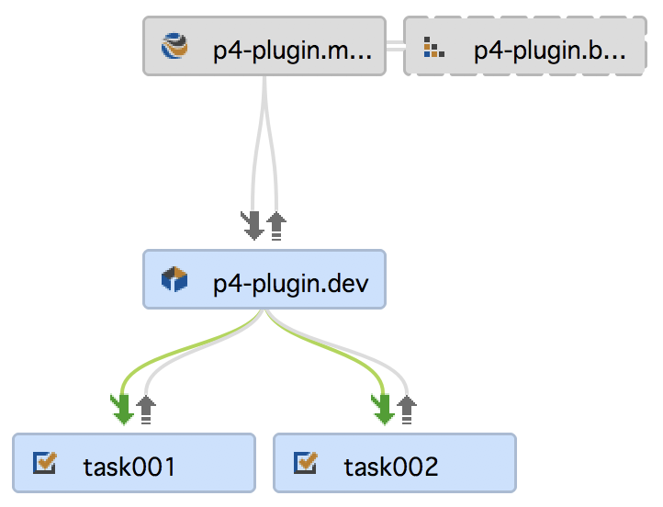
Git in Streams
scm-api-plugin
credentials-plugin
p4-plugin
//projects/p4-plugin.main
//p4java/main
Notes:
Take these Git and Perforce sources, you can map them into a parent stream,
then share them between other child streams.

Slide 10
Git in Streams
Stream: //projects/p4-plugin.main
Parent: none
Type: mainline
Paths:
share ...
import p4java/... //p4java/main/p4-java/com.perforce.p4java/...
import p4-plugin/... //plugins/p4-plugin.git/...@master
import scm-api-plugin/... //plugins/scm-api-plugin.git/...@scm-api-2.0.2
import credentials-plugin/... //plugins/credentials-plugin.git/...@credentials-2.1.11
Notes:
Here is a typical view:
The share … inherits everything from the parent branch.
The first import is a Perforce depot path, but you wouldn't know that...
the only way to distinguish it would be to know the depot type (that //p4java is a Perforce depot and //p4plugin is a Graph depot).
The other three imports are from Graph depots and contain Git content (in fact some of the Git content used by the p4-plugin)
The @master and @scm-api tags are Git references to particular versions, but can now be manage by the Stream.

Slide 11
Git in Workspaces
Client: proj.ws
Root: /Users/pallen/Demos/jenkins-demo/test
Stream: //projects/p4-plugin.main
View:
//projects/p4-plugin.main/... //proj.ws/...
//p4java/main/p4-java/com.perforce.p4java/... //proj.ws/p4java/...
//plugins/credentials-plugin/... //proj.ws/credentials-plugin/...
//plugins/p4-plugin/... //proj.ws/p4-plugin/...
//plugins/scm-api-plugin/... //proj.ws/scm-api-plugin/...
ChangeView:
//plugins/p4-plugin.git@master
//plugins/scm-api-plugin.git@scm-api-2.0.2
//plugins/credentials-plugin.git@credentials-2.1.11
Notes:
For completeness here is the corresponding Workspace view,
you can see the ChangeView field is used to control the history.

Slide 12
Helix4Git with Jenkins
Using the p4-plugin with Git and Perforce repositories.
Notes:
So how to use Helix4Git with Jenkins...

Slide 13
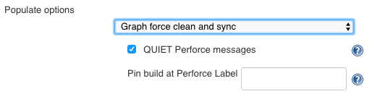
The p4-plugin with Helix4Git
Populate Option ‘Graph force clean and sync’
Pipeline Syntax
p4sync charset: 'none',
credential: 'p41666',
graphClean(pin: '', quiet: true),
source: streamSource('//stream/main')
Notes:
The p4-plugin now supports Helix4Git (1.7.x), almost everything is hidden from the user, except the Populate option.
You will need to use the ‘Graph force clean and sync’ option for syncing Pure Graph or a mixture of Graph and Perforce content.

Slide 14
Demo
GitHub p4paul/jenkins-demo
docker-compose up
Jenkins: http://localhost:4040/
P4PORT: localhost:4000
Git Connector: https://localhost:4443/

