Slide 1



Know your bill. Manage your usage.
Team New York Style Pizza · UP Manila · IDOL Hackathon 2026, Challenge 2
Notes:
Clarence: Let us start with a number that should cost almost nothing. [beat]

Slide 2

45 kWh
What Lorna's family uses in a month.
Notes:
Clarence: Forty-five kilowatt-hours. That is what Lorna's family uses in a month. A fan, a few lights, a rice cooker.

Slide 3

LORNA
  A 4Ps mother behind a shared sub-meter.
  Uses 45 kWh a month.
  Still pays her full share.
Lorna is a sample household.
Notes:
Clarence: Lorna is a 4Ps mother. At fifty kilowatt-hours or less, low-income families get one hundred percent off most charges.

Slide 4


Same family. Two bills.
On her own meter
Behind a shared meter
about ₱13
₱677.77
If eligible, on her own meter: the lifeline discount takes off most charges (universal charges stay).
Her share of our sample bill, in a month, the meter reads 180 kWh.
Notes:
Clarence: On her own meter, the lifeline discount would take off almost all of her bill. [slow] In our sample month, she pays six hundred seventy-eight pesos.

Slide 5

Four kitchens. One meter.
Reyes
180 kWh
one Meralco service
52 kWh
Santos (Lorna)
45 kWh
Dela Cruz
38 kWh
Garcia
45 kWh
Sample compound.
Notes:
Clarence: Because Lorna does not have a meter. She has a kahati. Four kitchens: one Meralco service, four private sub-meters. On their own, three of the four would likely qualify.

Slide 6
Above 100 kWh, the discount is gone.
On their own, three of the four families would likely qualify. Together, the meter reads 180 kWh.
Lorna: 45
Shared meter: 180
100% off
35%
20%
No discount
0
50
70
100
200
kWh a month
Lifeline tiers: RA 11552. 100% to 50 kWh: ERC Res. No. 02, s. 2026. 35% and 20%: Meralco, from April 2026 billing.
Notes:
Clarence: Together, the meter reads one hundred eighty. And above one hundred, the discount disappears.

Slide 7

Nobody took it
from her.
Photo: patrickroque01, Wikimedia Commons, CC BY-SA 4.0
Notes:
Clarence: Nobody took it from her. [beat]

Slide 8

The system just
never saw her.
Notes:
Clarence: The system just never saw her.

Slide 9


Team New York Style Pizza
UP Manila
Samantha Bracamonte
Clarence Pagaduan
Khent Sembran
Stephany Chan
Frontend Developer
Lead Developer
Branding and Pitch Lead
Branding and Pitch Lead
Notes:
Sam: We are Team New York Style Pizza from UP Manila. I am Sam, with Clarence, Khent and Stephany.

Slide 10
Notes:
Sam: And we built Kahati.

Slide 11
11%
of 3 million 4Ps households had enrolled in the lifeline discount by November 2025: about 334,000.
Gulf News, 18 Feb 2026.
Notes:
Sam: By November 2025, only about eleven percent of three million 4Ps households had enrolled. [beat]

Slide 12
Many 4Ps beneficiaries
“do not have individual meters.”
Department of Energy, on one reason families miss the discount.
Daily Tribune, 2 Jan 2024.
Notes:
Sam: One reason, in the Department of Energy's words: many 4Ps beneficiaries "do not have individual meters."

Slide 13
The discount follows the meter,
not the family.
Notes:
Sam: The discount follows the Meralco account.

Slide 14
Who it is for
Proxy: 32.6% of NCR homes rent (2020)
Renters on sub-meters
Landlords and organizers
Lifeline-eligible families
Own-meter homes
In shared compounds, boarding houses and dorms.
Who must follow ERC's sub-metering rules.
4Ps or certified low-income, behind someone else's meter.
Low-income, through the forecast and the 50 kWh line.
Notes:
Sam: Kahati is for renters behind private sub-meters, the landlords who split the bill, and low-income families on their own meter.

Slide 15
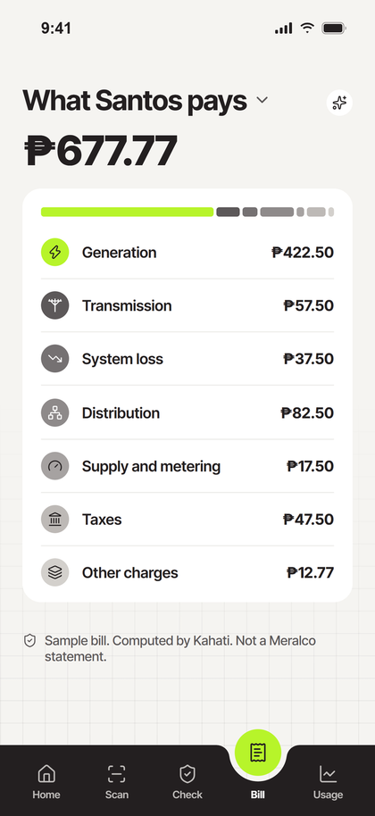
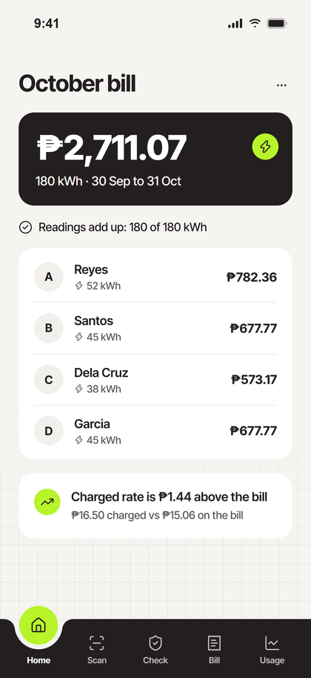
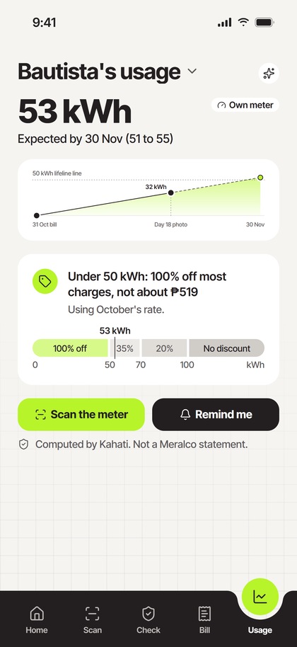
What does
For any household, including the ones behind someone else's meter. In English and Filipino.
What the bill is made of
A split that adds up
A warning before 50 kWh
Notes:
Sam: Meralco's app serves the account holder. Kahati is for the family with no account, and it trusts no reading until they all add up to the number Meralco printed.

Slide 16
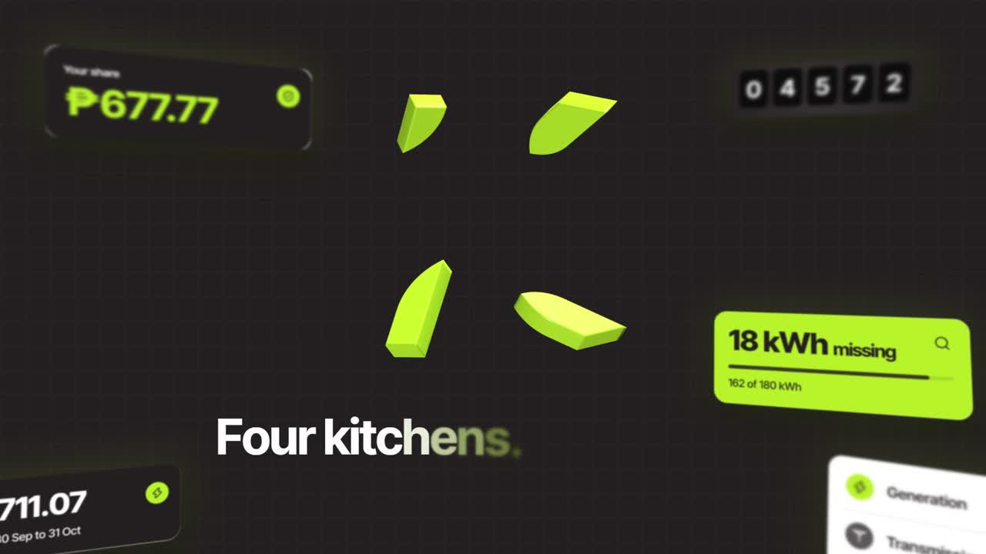
Notes:
[Click to play. Nobody talks. Khent switches the display to the phone as the film ends.]

Slide 17
LIVE DEMO
kahati-app.vercel.app · sample households only
Notes:
[Before the pitch: check the app is empty (Bill and Usage say "scan first"). Start from the built-in sample: Home, ⋯, "Use the built-in sample" (or open kahati-app.vercel.app/#fresh); "Reset the demo" keeps a loaded lab month. If a scan says "could not be read" or hangs, retry once, then "Type it instead". Do one throwaway scan two minutes before the slot, so the first read on stage is not a cold start. About a minute of this section is scanning and tapping: let the screen work, do not fill the silence.]
Khent: The live app, with sample households only.
[Use only the printed sample bill: never scan a real bill on stage (the prototype uses Gemini's standard API). Home asks the setup question. Tap "Scan the bill" on the "Sharing one Meralco meter?" card, then scan the bill.]
Khent: Google Gemini Flash-Lite reads the bill; the photo is read, not kept. This bill is the one number we trust.
[Scan all four sub-meters live with the camera, about 3 seconds each: point, shutter, confirm, Keep and go next. Do not use Load the rest; the scans are the demo.]
Khent: Each photo is read twice, the serial must match, and a person confirms every number.
[Scan the Bautistas' meter (12552) live. Then open Usage and point, in order: the bill's reading (31 Oct), the day-18 photo dot, the dashed line, the 50 kWh line, then the tier bar.]
Stephany: The Bautistas have their own meter. Their forecast: the bill's reading, a photo on day eighteen, a dashed line to the read date. 53 kilowatt-hours, just over the line. [beat] Stay under fifty, and it is one hundred percent off most charges instead of about 519 pesos.
[Do not tap "Remind me mid-month" on stage: it downloads a calendar file. Never say it sends a reminder.]
Stephany: Today, the bill and one photo. After about six bills, it learns how hot days change their use, from Open-Meteo temperatures. After two years, a seasonal model. No pre-training, no made-up data.
[Tap Home. Open the ⋯ menu to show the Filipino option, then close it without switching. Then tap Bill.]
Khent: Home: the readings add up to the bill. Every screen comes in English or Filipino, one tap in this menu. Bill: Lorna's share, in seven lines. If she is eligible, on her own Meralco meter: about thirteen pesos instead of 678.
[Tap Check and type 20 for Dela Cruz.]
Stephany: Now the cheat. Dela Cruz types twenty, not thirty-eight. [beat] Kahati marks it typed, and eighteen kilowatt-hours go missing, in front of everyone. Until it is fixed, the gap is split by kilowatt-hour.
[Tap Home.]
Stephany: Lorna's share just went from 677.77 to 752.48. [beat] That is what under-reporting does to the neighbours.
[Back to Check: retype 38 for Dela Cruz now. Then open Bill and pick Santos (no new link or tab).]
Khent: Lorna doesn't need an account: she gets her own link to this page. [beat] And she can ask Kahati why. It answers only from her own numbers, and a guard checks every figure.
[Point at the footnote: "Computed by Kahati. Not a Meralco statement." Then tap the Ask Kahati icon on Santos's Bill and the preset "Why is my share this amount?" (a preset, not a typed question). Let the answer show for two seconds. Never say "Ask for a new photo" sends anything: it only opens the phone's share sheet with a neutral message.]

Slide 18
How we built it
Phone browser
Kahati API
Google Gemini
Open-Meteo
React 19 and TypeScript, built with Vite, with a live in-page camera. Nothing to install.
Next.js 16 and TypeScript on Vercel. Stateless:
no database. The phone holds the month.
Flash-Lite reads the bill, and reads each meter twice. If the reads disagree, a person checks.
Daily temperatures for the forecast once a family has about six bills.
→
→
→
✓
A person confirms every number
✓
Photos are read, not kept
✓
Account number: last 4 digits only
✓
Over 350 automated tests
Notes:
[About 20 seconds, as the display switches back from the phone. Point at each box left to right. Keep the staged-forecast slide for Q&A.]
Clarence: Quickly, how it's built. A phone web app in React and TypeScript, with a live camera and nothing to install. A Next.js API on Vercel that keeps no database: the phone holds the month. Google Gemini reads every photo twice, a person confirms every number, and photos are not kept. And over 350 automated tests check it.

Slide 19
How the forecast works
1
2
3
4
Bill day
One photo mid-month
After about 6 bills
After about 24 months
Next month is about this month, labelled a rough guess.
32 kWh in 18 days is 1.78 a day. 12 days left: 53 kWh by 30 Nov, ±10% on the rest (51 to 55).
kWh = base + extra per hot degree above about 24°C, with Open-Meteo temperatures. Built in our API.
SARIMAX, a seasonal model with temperature. Road ahead.
Each household is fitted on its own bills: no pre-training, no synthetic data. Pesos use Meralco's published rate; Kahati never forecasts it.
Notes:
[Hold about 5 seconds while Clarence finishes; it backs up the forecast Stephany showed in the demo. Keep it up longer only if a judge asks.]

Slide 20
Families see their bill
the way an account holder does.
And a warning before the 50 kWh line, not after.
Notes:
Sam: Families see their bill like an account holder.

Slide 21
Its only input is
the bill Meralco already prints.
Nothing new to run. In return: the lifeline reaches the families it was built for, and new accounts through the normal application.
Notes:
Sam: Kahati asks nothing new of Meralco; its only input is the bill Meralco already prints. In return: the lifeline reaches the families it was built for, and new accounts come through Meralco's normal process.

Slide 22
Kahati digitises what
the ERC already asks landlords to do.
ERC Resolution No. 02, s. 2010 (DSOAR Article VI): no profit on the resale, readings on Meralco's reading day, the master bill posted for tenants.
Notes:
Sam: It digitises what the ERC already asks landlords to do.

Slide 23
Every compound that joins
is counted, with consent.
So metering and lifeline drives go where shared meters are.
Notes:
Sam: With consent, compounds that join show where shared meters are.

Slide 24
The road ahead
Free for families
Paid by boarding houses
Through barangays, DSWD and local social welfare offices, who certify eligibility.
A premium tier for dorms and bedspaces with sub-meters pays for the free tier.
Notes:
Khent: Free for families, through barangays and social welfare offices; boarding houses and dorms pay for a premium tier.

Slide 25
Opt-in compound totals
So metering drives go where the data says they are needed.
Notes:
Khent: Later, opt-in compound totals to guide metering drives.

Slide 26
LORNA
  End of the month again.
  The meter still reads 180 kWh.
Lorna is a sample household.
Notes:
Clarence: We started with Lorna. [beat] The meter still reads one hundred eighty.

Slide 27
This time,
Lorna sees her share.
Notes:
Sam: [slow] But this time, Lorna sees her share. And for the first time, the system sees her.

Slide 28
Not for the meter.
Notes:
Clarence: That is why we built this. [beat] Not for the meter.

Slide 29
For the family behind it.
Team New York Style Pizza · kahati-app.vercel.app
Notes:
All: For the family behind it.
Clarence: We are New York Style Pizza. [beat] Salamat po.

