Slide 1
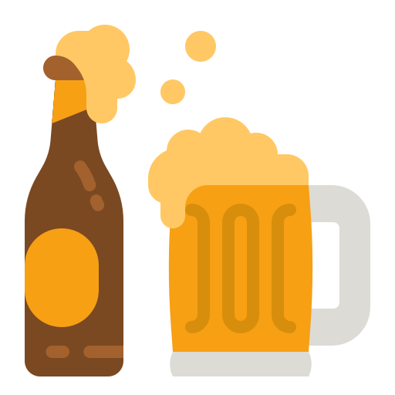
Beer Challenge
Marina Sanchez
10/21/2022

Slide 2
content
Top Breweries With The Strongest Beers
The Best Years For The Beer Lovers
Fruity Beers I Would Recommend
People’s Favourite Beer Styles
Important Features According To Users
Sentiment Vs Overall Score In Beer Styles
Similar Drinkers
Links

Slide 3
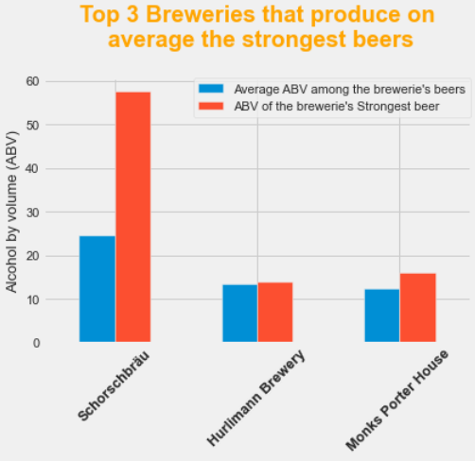
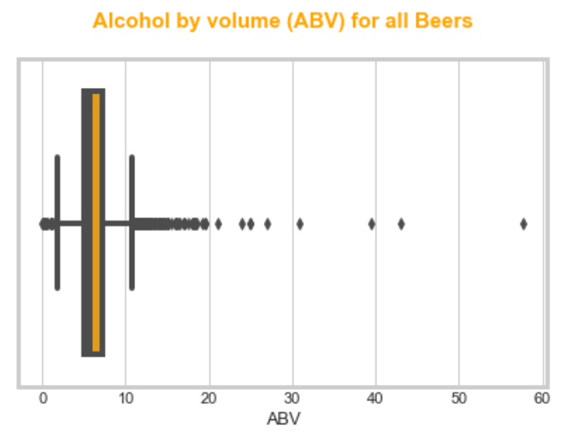
TOP BREWERIES WITH THE STRONGEST BEERS
The breweries Schorschbräu, Hurlimann Brewery and Monks Porter House produce, on average, the strongest beers
Schorschbräu produces the strongest beer (ABV 57.7)
Hurlimann Brewery and Monks Porter do not produce any of the strongest beers (ABV above 15).
median
6.29
max
57.7

Slide 4
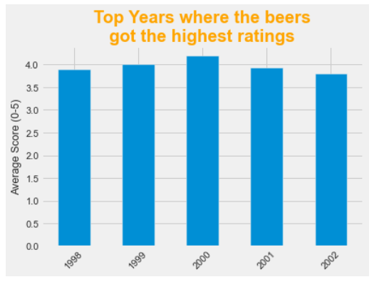

The best years for THE beer lovers
It looks like the period from 1998 to 2002 were good years.
But year 2000 was the best year for the beer lovers!

Slide 5
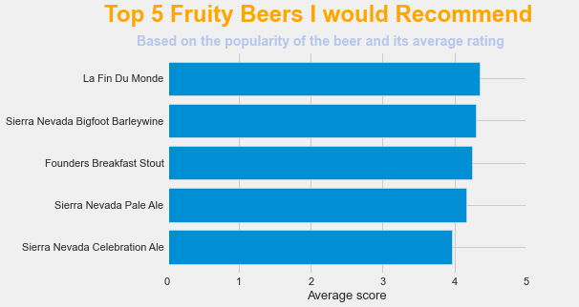
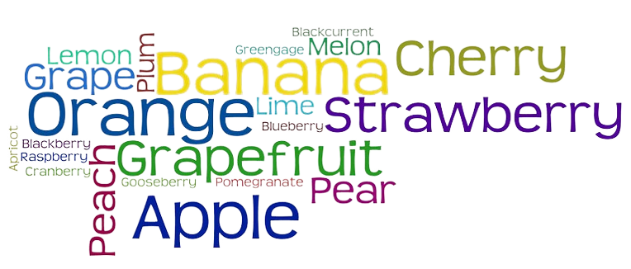

fruity beers i would recommend
I love fruity beers…
The written reviews of these popular beers say they are fruity!
And when I like something I recommend it!

Slide 6
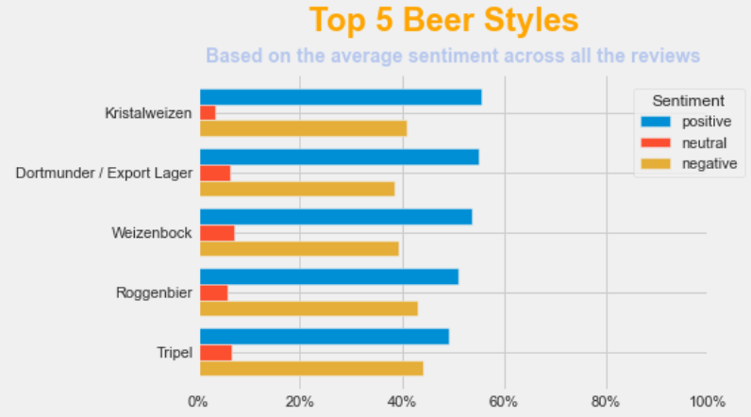
PEOPLE’s FAVorite BEER STYLE

Slide 7
more insights

Slide 8
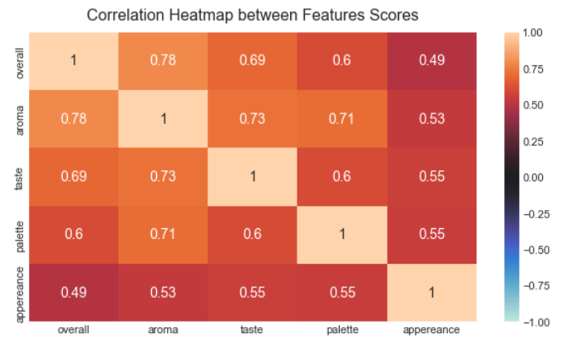
Important features
We can see a pretty strong positive correlation between overall score and:
Aroma (0.78)
Taste (0.69)
Palette (0.60)
Appereance (0.49)
But which one of them has the most influence over the overall score? We will find out in the next slide!

Slide 9
Important features
To find the most influencing factor I have fitted four simple linear regressions between the overall review and each of the predictors individually
Dependent variable: overall review score | Independent variables: Aroma, Taste, Palette, Appereance
Factor | Coefficient | R-squared
Aroma | 0.996 | 0.985
Taste | 1.009 | 0.980
Palette | 1.007 | 0.974
Appereance | 0.982 | 0.975
All the models explain more than 95% of the variability in overall: great fits!
These four factors are relevant to the users when defining the quality of a beer in the following order: Taste Palette Aroma Appearance

Slide 10
Sentiment vs. overall score in BEER Styles
Do the emotions expressed in the reviews match the average numerical score for each beer style?
Spoiler… No!
PROCESS
Sentiment Analysis Classification: tag the reviews as Positive, Neutral or Negative
Crosschek between predominant sentiment and average numerical scores
Con’t in next slide

Slide 11
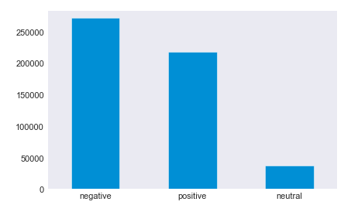
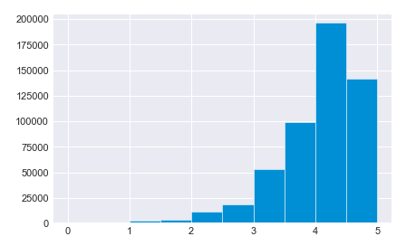

Sentiment vs overall score in BEER Styles
In the sentiment plot predominate negative emotions | but in the scores plot predomnate good ratings!
Number of reviews by sentiment tag
Number of reviews by score
Considering Negative ( or ), Neutral ( ) and Positive( and )
We find a missmatch in 86% of the reviews!
Why?
Maybe users tend to express more their negative thoughts, even though their overall opinion is positive.
The Sentiment Model didn't perform very well in detecting the overall sentiment of the reviews.

Slide 12
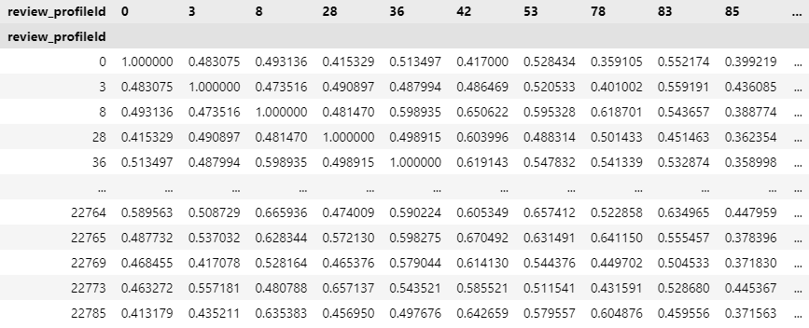
Similar drinkers
Reccomender System based on TFIDF and Cosine Similarity of the written reviews
Similar users are paired according to the similarity in the content of their written reviews
Cosine Similarity Matrix

Slide 13
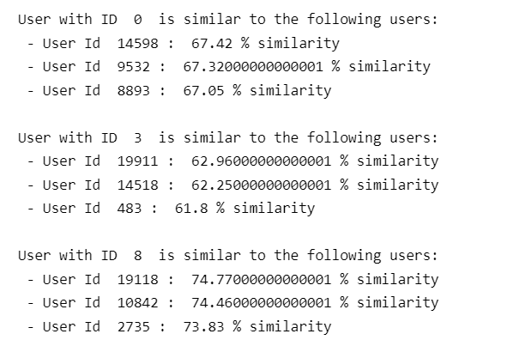
Similar drinkers
Results
Example of the output generated for some of the users (see code in GIT for all the details)
The similar users are chosen according to their cosine similarity in the table of previous slide

Slide 14
LINKs
GIT Repository with source code: https://github.com/msmillan7/BeerChallenge

