Slide 1
To Secure Data in Mobile Cloud Computing Environments more Efficiently and Controllably
Megan Smith

Slide 2
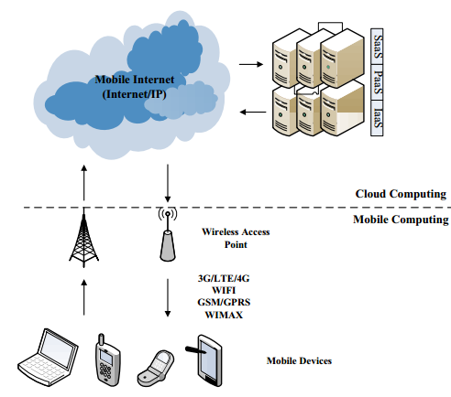
What is Mobile Cloud Computing (MCC)?
A large-scale economic and business computing paradigm with virtualization as its core technology.
An extension of mobile devices.
Development of parallel processing, distributed and grid computing on the Internet
An overall combination of mobile computing, mobile internet and cloud computing.

Slide 3
What are the Issues?
Resource allocation of mobile devices is limited.
Varying levels of security needs among end-users.
Lack of Access Control
Lack of Supervisory Control

Slide 4
Previous Work
Reallocation resources for security services
Incremental cryptography for security schemes
Cloud security service based on mobile internet framework
Improved security service scheme in mobile cloud computing
Efficient and secure operation for mobile cloud computing
Security and privacy in mobile cloud computing

Slide 5
Proposed Work
A combined effort of all previous work
Efficiency of mobile cloud security services
Resource allocation based on security needs
Reducing the complexity of cryptographic algorithms
Customization of mobile cloud security services
Classifying cloud security services to maximize reward for the user
Adopting an access control model so users can dynamically adjust varying security needs

Slide 6
Improved Security Service Schema
Cloud security service should take account of the differential security demands coming from different enterprises and users
An on-demand security scheme
Real-time dynamic adjustments when users change their demands in the mobile cloud environment
A security self-adaptive scheme
Cloud security services should be able to adapt to the permission changes dynamically
A cloud service access control scheme

Slide 7
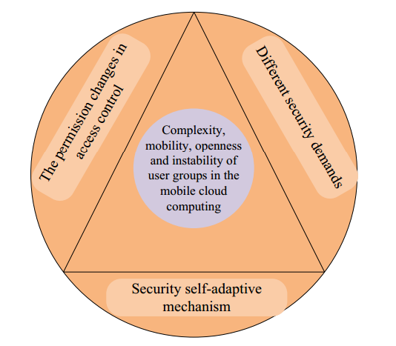

Slide 8
Classifying Security Needs in the Cloud
Two categories:
Normal security service
Critical security service
Normal Security services provide:
Encryption, decryption, authentication, etc.
Critical Security services provide:
Normal security services
Longer key size, strict security access policies, isolations for protected data, etc.
Data isolation prevents storage sharing
More computation resources needed for higher security services

Slide 9
How to obtain maximal system rewards with higher security services?
A Security Service Admission Model (SSAM)
Leverages the maximal system rewards with the system resource constraints
Model focus on a cloud service blocking probability
When a service arrives, the SSAM calculates the total reward for each state under different actions and selects an action with a higher reward

Slide 10
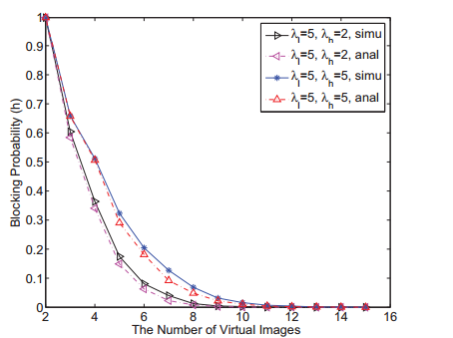
L
Normal Security service
Occupies 1 Vis in cloud
H
Critical Security service
Occupies 2 Vis in cloud
* Virtual Image (VI) – availability of system resource

Slide 11
Reducing the Complexity of Cryptographic Algorithms
Challenges
Intensive computational resources for mobile devices are required to run encryption and decryption algorithms
Exposing critical customer secrets to the public cloud
How to update encrypted data that is stored in the mobile cloud system without causing tremendous overhead

Slide 12
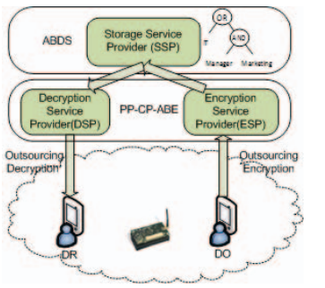
Encryption and Decryption Architecture of Mobile Cloud Environment
Privacy Preserving Cipher text Policy Attribute-Based Encryption
Outsource intensive part of encryption/decryption algorithms
Does not reduce security levels

Slide 13
Data Management Issues and Solutions
Frequent data updates are expensive for file management
The service provider needs to re-encrypt the data and upload the whole data file again with every update
High communication and computation overhead

Slide 14
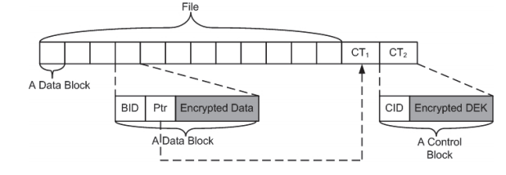
Divide file into blocks and encrypt individually
Can upload and re-encrypt a single updated file to avoid re-encrypting the entire data
Called “Lazy” Encryption Strategy

Slide 15
Evaluation Results
FOLDER_TIME | FILE_TIME
328020438 | 2690375
374925160 | 4309048
336169823 | 5612538
365536859 | 3060296
395561201 | 3204843
388121724 | 3419525
339538458 | 6041048
337451076 | 3532427
333019721 | 3536703
327985798 | 3328863
353327751 | 3854878
360722754 | 4057587
359128885 | 4427935
336573102 | 3408834
373417251 | 3041479
342701391 | 2947395
346087132 | 3060724
342337029 | 5795574
369369927 | 3876261
Processing time it takes to upload, encrypt, decrypt and return data to user
Shows increased processing time for larger files
Results in nanoseconds

Slide 18
Conclusion
Reduce the computational expenses of mobile cloud computing:
Allow users to define their own personal level of security
Incorporate better encryption/decryption operations for updated files

Slide 19
References
Zhou Lian-chi; Xiu Chun-di, “Cloud Security Service Providing Schemes Based on Mobile Internet Framework”, Computer Science and Electronics Engineering (ICCSEE), 2012 International Conference on, vol.3, no., pp.307,311,23-25 March 2012
Qinyun Dai; Haijun Yang; Qinfeng Yao; Yaliang Chen, “An improved security service scheme in mobile cloud environment”, Cloud Computing and Intelligent Systems (CCIS), 2012 IEEE 2nd International Conference on, vol.01,no., pp.407, 412, Oct.30 2012-Nov. 1 2012
Zhibin Zhou; Dijiang Huang, “Efficient and secure data storage operations for mobile cloud computing”, Network and service management (cnsm), 2012 8th International Conference and 2012 workshop on systems virtualizations management (svm), vol., no., pp.37, 45, 22-26 Oct.2012
Hongbin Liang; Dijiang Huang; Cai, L.X.; Xuemin Shen; Daiyuan Peng, “Resource allocation for security services in mobile cloud computing”, Computer Communications Workshop (INFOCOM WKSHPS), 2011 IEEE Conference on, vol., no., pp.191, 195, 10-15 April 2011
Khan, A.N.; Kiah, M.L.M.; Khan, S.U.; Madani, S.A.; Khan, A.R., “A study of incremental cryptography for security schemes in mobile cloud computing environments”, Wireless Technology and Applications (ISWTA), 2013 IEEE Symposium on, vol., no., pp.62, 67, 22-25 Sept. 2013
Hui Suo; Zhuohua Liu; Jiafu Wan; Keliang Zhou, “Security and privacy in mobile cloud computing”, Wireless Communications and Mobile Computing Conference (IWCMC), 2013 9th International, vol., no., pp.655, 659, 1-5 July 2013

