Slide 1
Job Search Engine
MIDTERM PROJECT REPORT
March 20, 2025
Chris Pappelis
cfp4@hood.edu
Matthew Smith
mps3@hood.edu
github.com/msmithp/
job-search-engine

Slide 2
Project Overview
What is the Job Search Engine?
Objectives:
Streamline CS job searching
Present in-demand CS skills
Notes:
Matthew

Slide 3
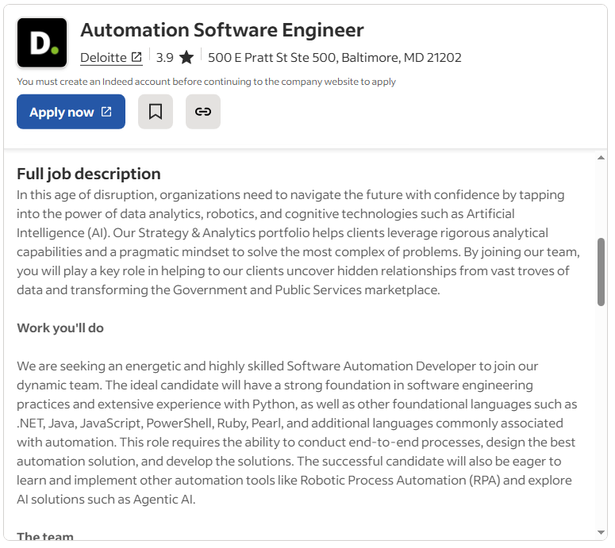
Previous Work & Project Plan
Other systems
Problems with job searching
Amount of information
Inaccurate filtering
Our plan
Notes:
Chris

Slide 4
Technical Description
Main features
Job search
Skill search
Dashboard
Languages used
Python
TypeScript
Tech stack:
Node.js
React
Django
PostgreSQL
Notes:
Chris

Slide 5
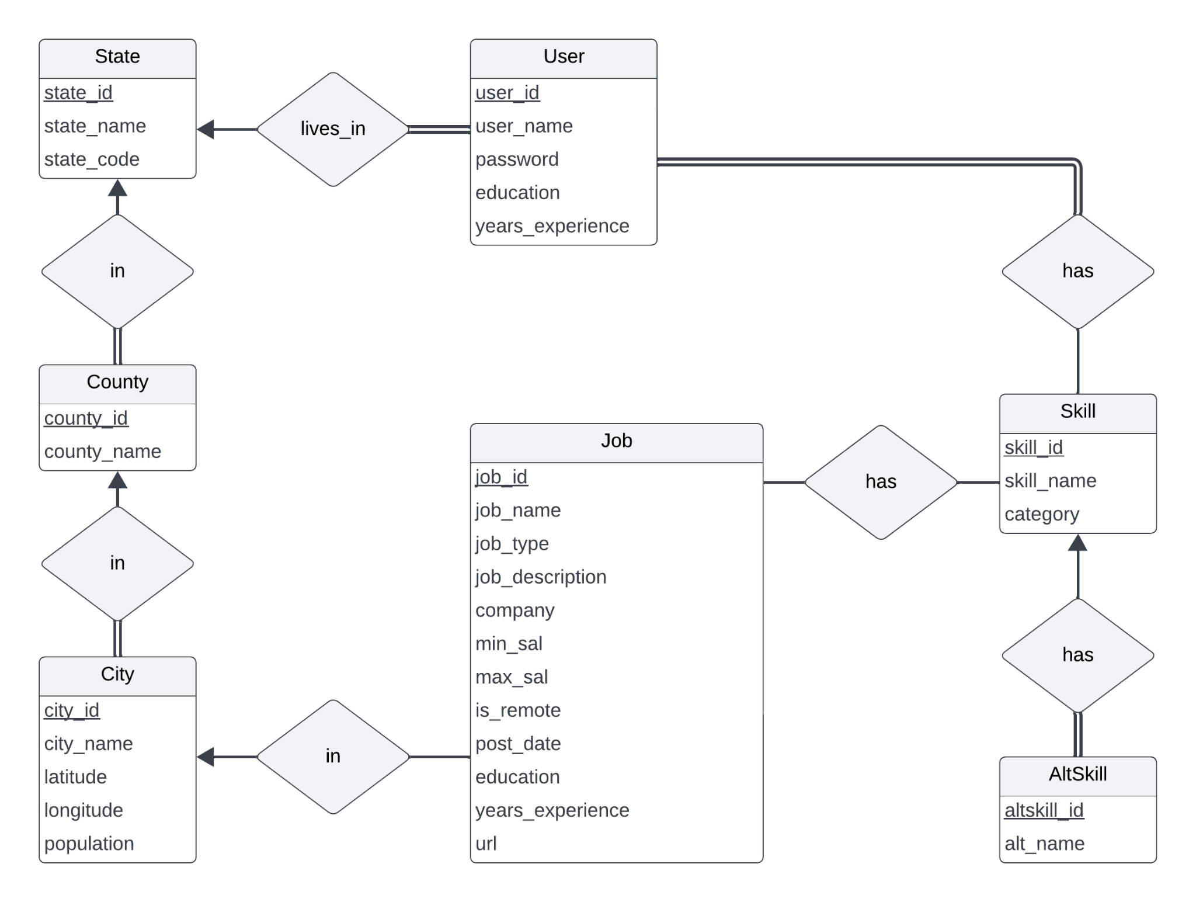
Technical Description
Notes:
Chris

Slide 6
Accomplishments
1,265
lines of code
Major features
Web scraper
Database implementation
Skill and requirement extraction
Skill chart visualization
Job search functionality
Compatibility calculation
Quality of work
Size
4,000
scraped jobs
9
database tables
Notes:
Matthew

Slide 7
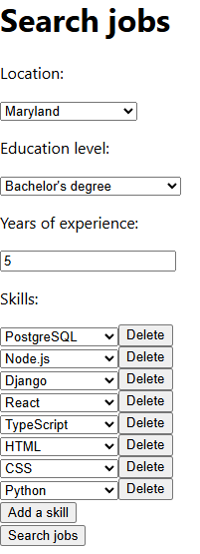
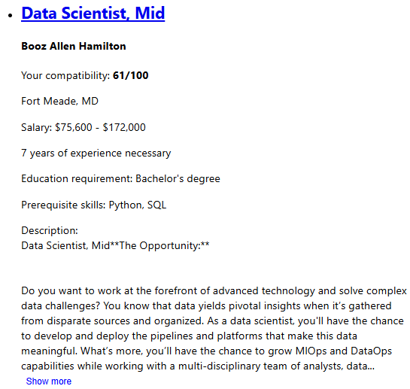
Project Status
Notes:
Matthew

Slide 8
Team Effort
Team operation
Waterfall methodology
Tools used
Team Member | Role | Hours of Work
Chris Pappelis | Back-end Lead | 35
Matthew Smith | Front-end Lead | 53
Notes:
Chris

Slide 9
Lessons Learned
Interface planning
Dependency management
Type safety
Notes:
Matthew

Slide 10
Expected Future Work
Activity | Implementation | Expected Due Date
Skill map visualization | Leaflet, GeoJSON | March 27
Account system | React, Django | April 8
Dashboard | Use pre-existing functionality | April 17
UI refinement | HTML, CSS styling | May 1
Notes:
Matthew

Slide 11
Demo

Slide 12
Questions?
Presentation files can be found at
github.com/msmithp/job-search-engine/tree/main/
documentation/midterm_presentation.

