Slide 1
Job Search Engine
CAPSTONE PROJECT PRESENTATION
May 9, 2025
Chris Pappelis
cfp4@hood.edu
Matthew Smith
mps3@hood.edu
github.com/msmithp/
job-search-engine

Slide 2
Project Overview
What is the Job Search Engine?
Objectives:
Streamline CS job searching
Present in-demand CS skills
Notes:
Matthew

Slide 3
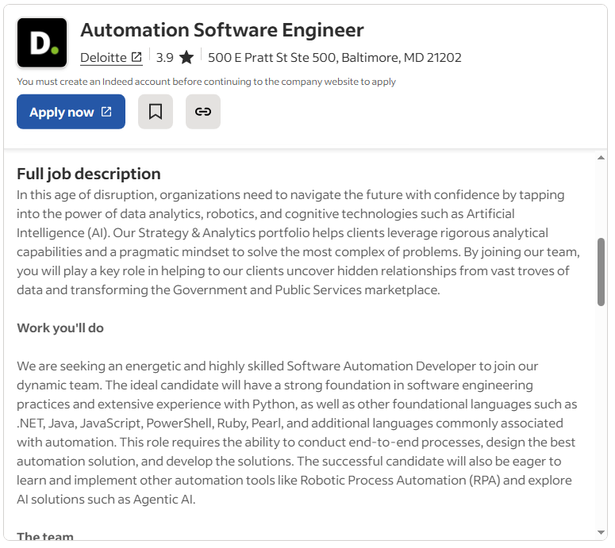
Previous Work & Project Plan
Existing solutions
Problems with job searching
Amount of information
Inaccurate results
Our plan
Notes:
Chris

Slide 4




Technical Description
Languages
Python
TypeScript
Libraries
JobSpy
Leaflet
Chart.js
Size
4,600 lines of code
9 database tables
7,000+ jobs
Tech stack:
Notes:
Chris

Slide 5
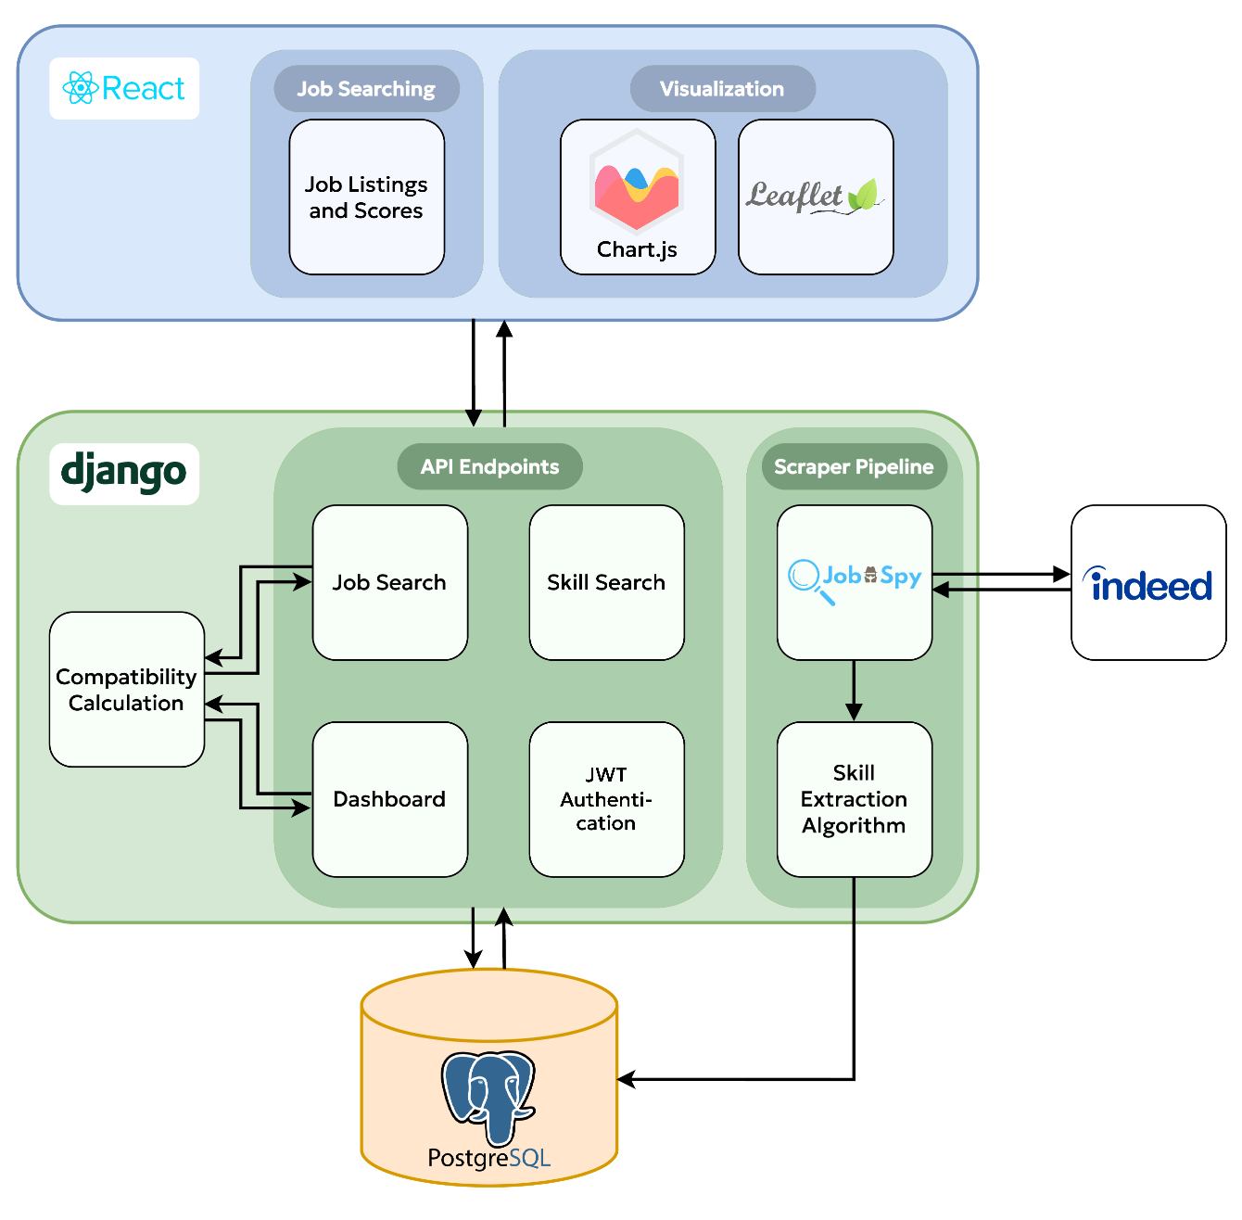
System Architecture
Notes:
Matthew

Slide 6
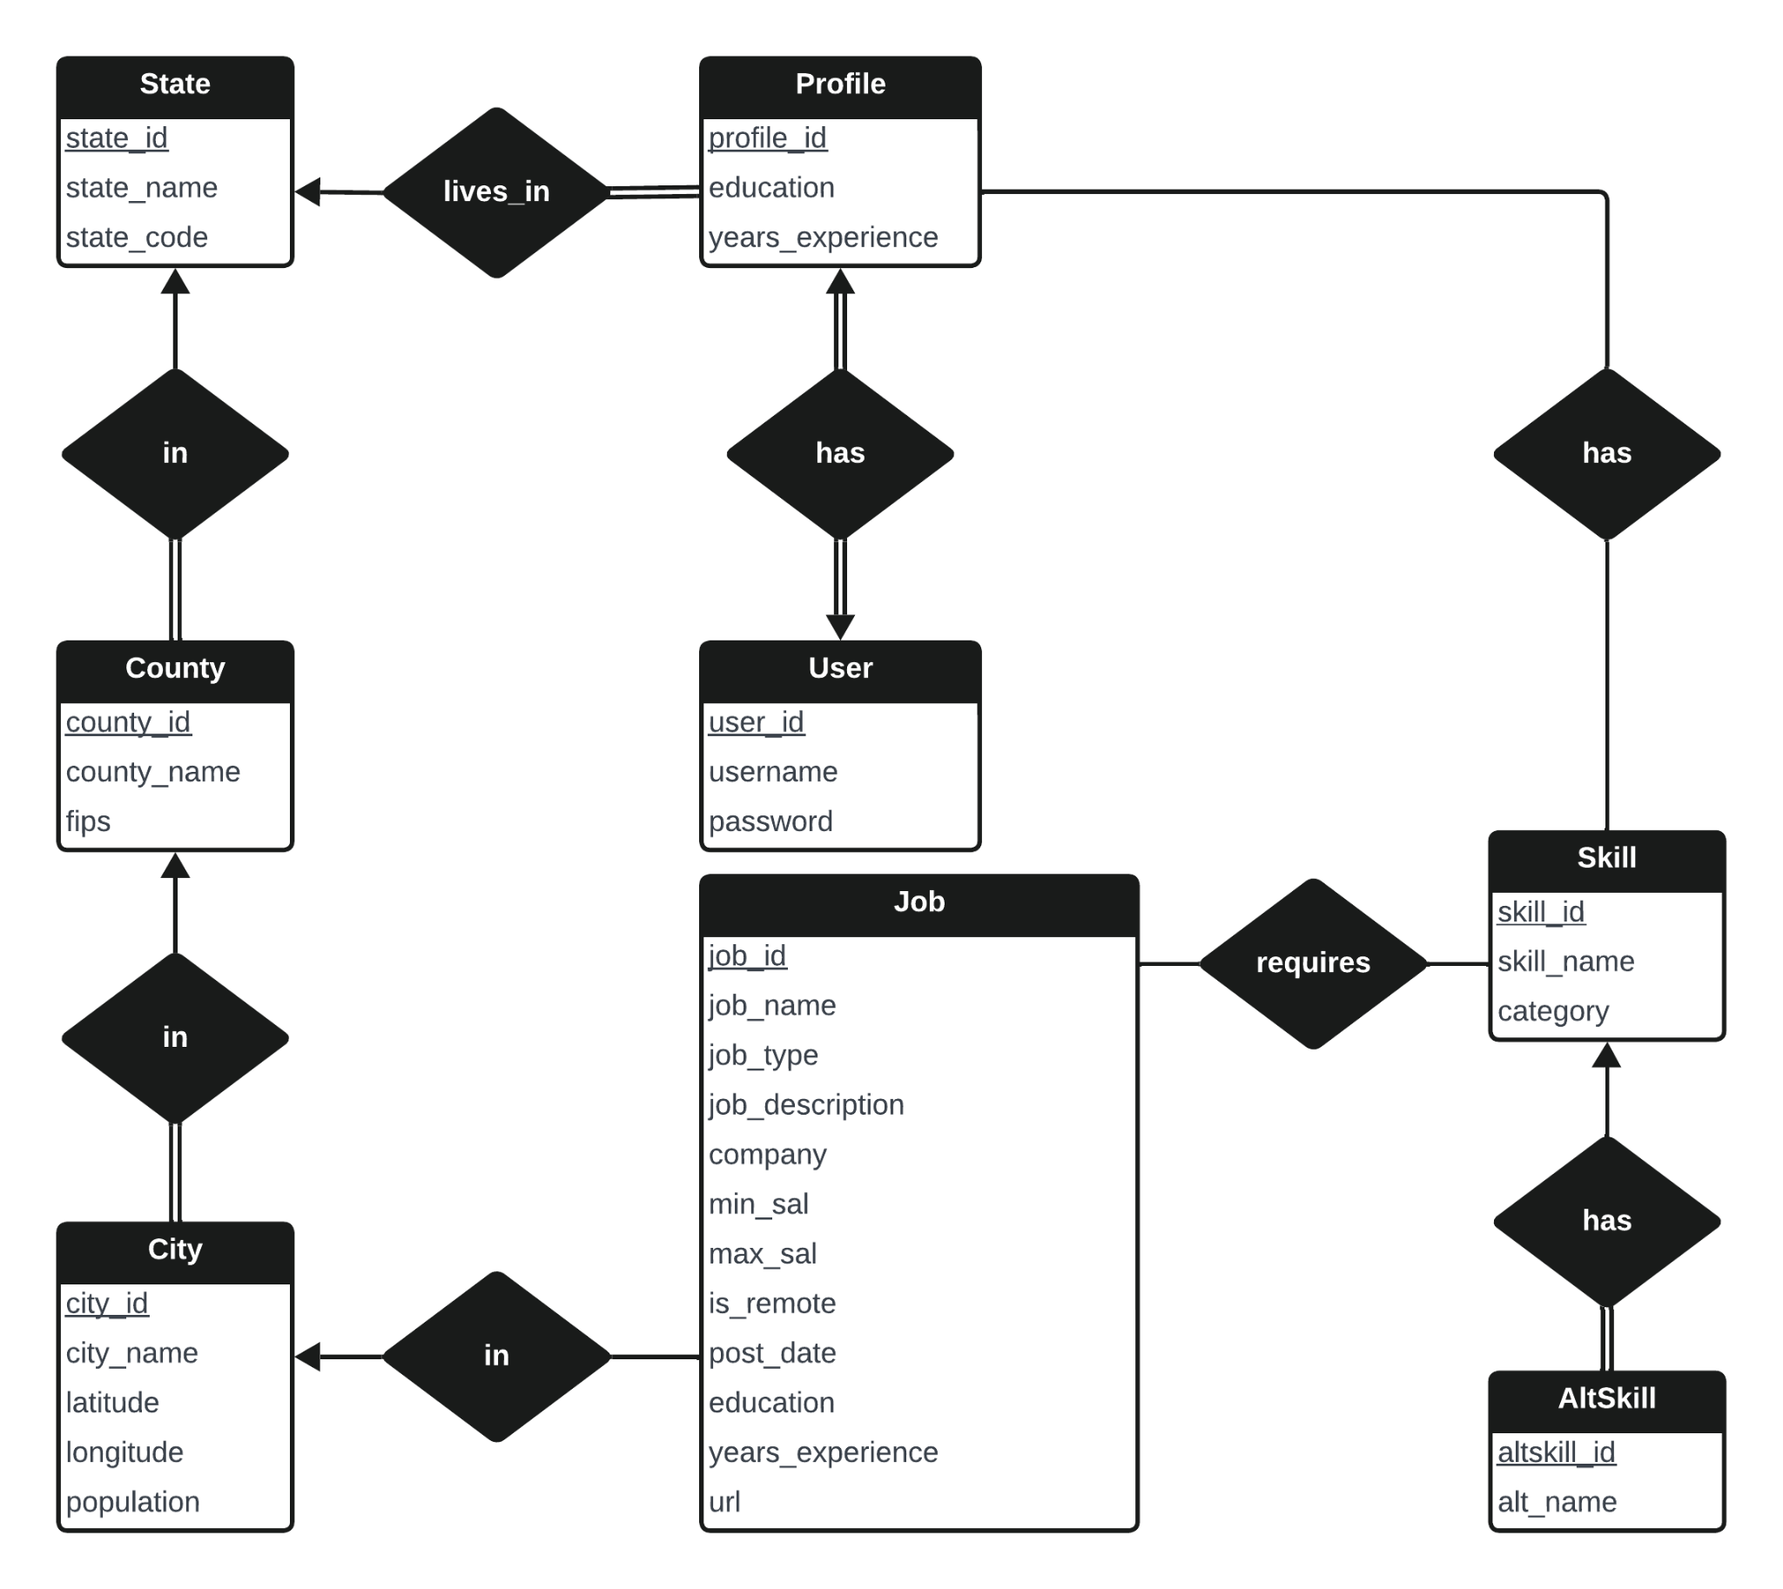
Database Schema
Notes:
Chris

Slide 7
Accomplished Work
Web scraper
Skill and requirement extraction
Skill visualization
Job search functionality
Compatibility calculation
Authentication system
Dashboard
Notes:
Matthew

Slide 8
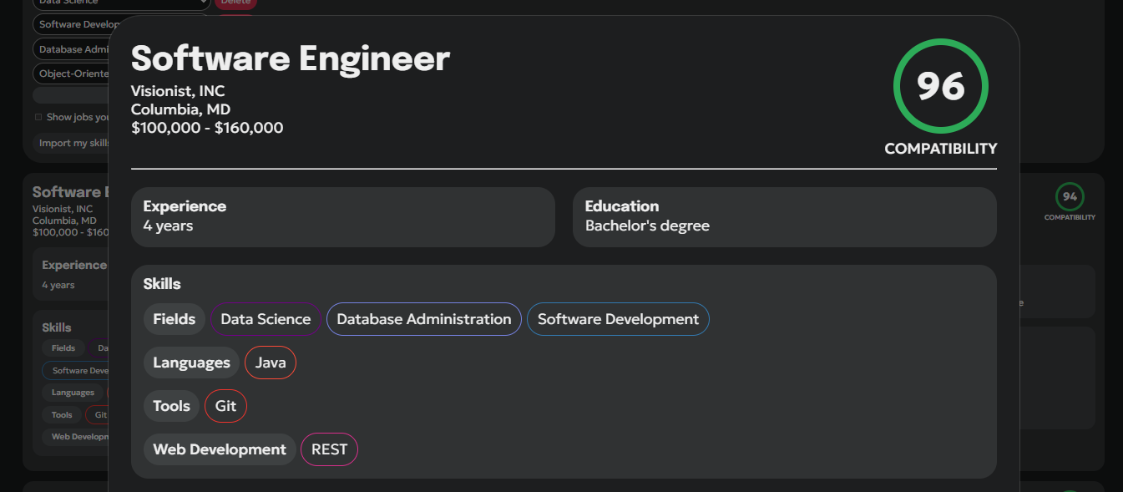
Example Usage
Notes:
Matthew

Slide 9
Lessons Learned
Interface planning
Type safety
Compatibility calculation
Overcomplication and penalization
Notes:
Matthew

Slide 10
Future Work
Component | Future Improvements
Scraper | Handle expired job listings, filter irrelevant jobs
Skill Extraction | Consider case sensitivity
Back-end | More modular functions, optimized queries
Front-End | Job search result pages, score breakdown by category
UI/UX | Sorting, filtering, better skill selection
Notes:
Matthew

Slide 11
Demo

Slide 12
Questions?
Presentation files can be found at
github.com/msmithp/job-search-engine/tree/main/
documentation/final_presentation

