Slide 1
Business Communication for Data Analytics Project
Tools & Skills for effective communication

Slide 2
Expectations will be high
Masters with experience in latest tools and technologies
Expectations will be high in terms of
Ability to solve data analytic problems
Shouldering project responsibilities to success
Project planning (resource planning, risk planning, milestones and deliverables)
Estimation (scoping, manpower, resources requirement, time requirements)
Execution and control (stakeholder management, change management, cost management)
Closure (documentation, archival, handover, training)

Slide 3
Objectives of this session
Discuss the different stages of an analytic project
Understand the stages in detail in terms of key activities
Communication tools and techniques in each stage
Documenting the project
Business proposal
Cost Benefit analysis

Slide 4
Data analytics project lifecycle stages
Phase 1
Business problem understanding, define metrics, deliverables, scope the project, apply process analysis, MindMap, RCA etc. Make sure that the way you understood the problem is exactly the way customer wants you to understand
Phase2
Data Identification, acquisition, analysis and understanding. Ensure you collect the data needed for the project nothing more nothing less. Remember, data comes at a cost. Minimize the cost without sacrificing data quality
Phase3
Data Preparation , cleaning, structuring, synthetic data generation. Ensure data is in a state where it can be used for analysis and extracting information. If data does not seem to be promising, have to go back to phase2
Phase4
Exploratory data analytics, apply techniques such as segmentation, cause effect analysis etc. Formulate hypothesis reflecting your understanding of the reasons for the customer churn. Extract as much information as possible leaving nothing on the table unused
Phase5
Design appropriate testing strategy to validate your hypothesis. Hypothesis, unless supported with scientific data analysis can be misleading and go unnoticed till its too late
Phase6
Compile project report, present to stakeholders, apply visualization and storytelling to communicate findings and results. Make a business proposal to the customer

Slide 5
Phase 1 Understanding business problem
Case - Customer churn and retention (Churn management)
What will be your approach to this project?
Given the geopolitical situation, the effect of Covid pandemic, the retail environment is changing rapidly. With looming recession, supply chain disruption, wafer-thin margins, I
ncreasing unemployment etc., the retail business try to remain afloat selling goods at competitive prices and large volumes to existing customers. In such situations acquiring new customers and gaining their loyalty is next to impossible. It costs business much more than retaining existing customers. In short, preventing customer churn in these tough times is more critical than acquiring new potentially loyal customers.
The retail customer XYZ ltd., has engaged you to suggest strategies to stem the current customer churn which is likely to impact business adversely if not managed on priority basis. XYZ Ltd. has ten retail outlets across different cities and also facilitates online purchase from each outlet. Some of these outlets are facing this crisis more than others. Overall, the drop in customer base is evident across all the outlets
The business problem is “Customer churn is x% and started to impact profitability and needs to be reduced (if possible to zero) by at least 10%”

Slide 6
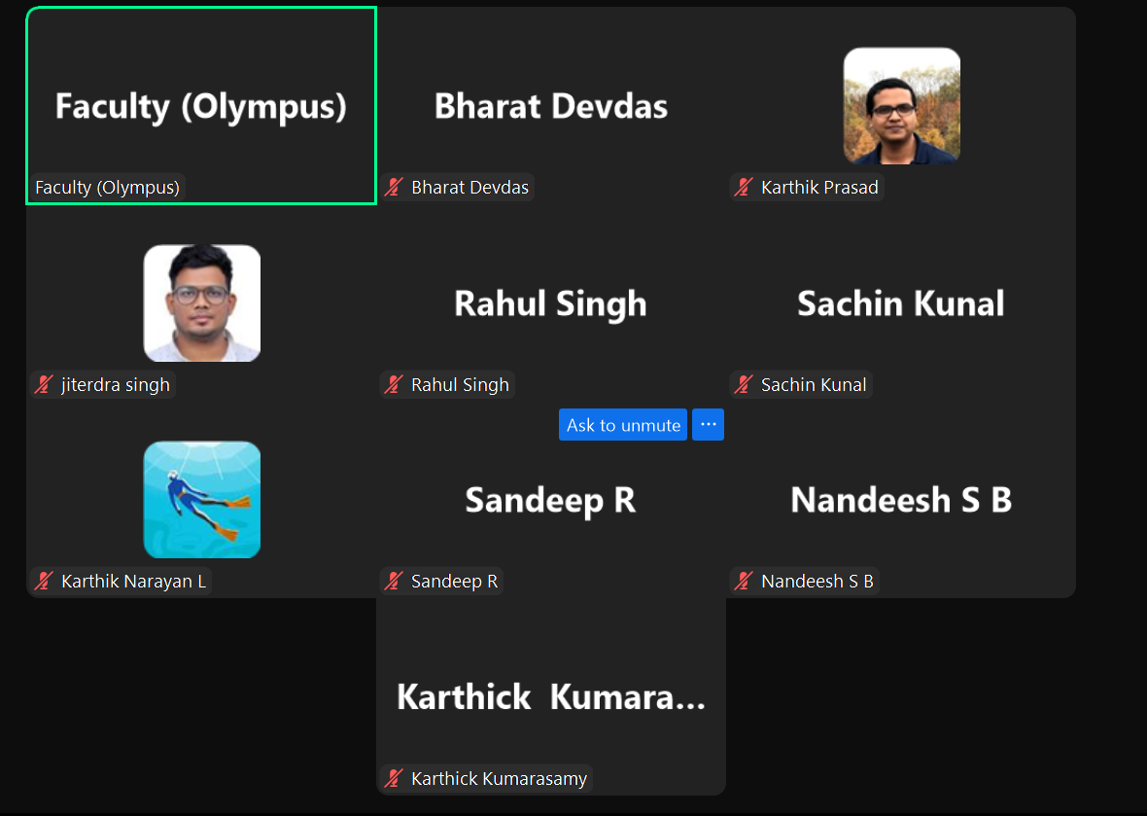
Inactive participants except Karthik Kunal

Slide 7
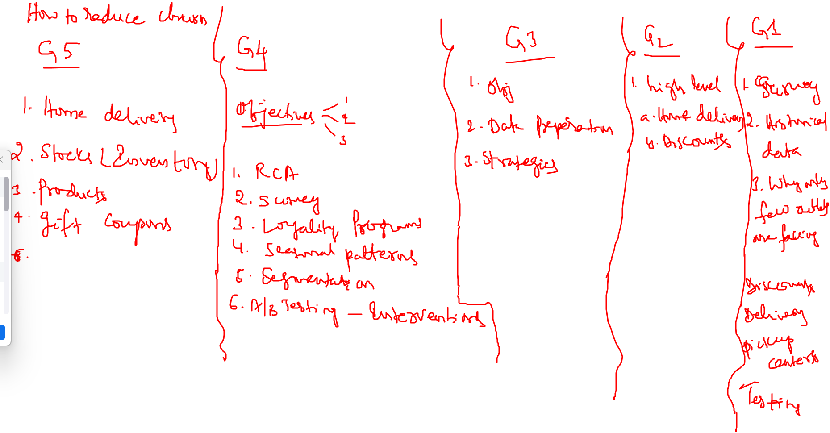

Slide 8
Understanding business problem
Business requirements are stated in business language. “Reduce customer churn to 5% from the current 15%”
Understand the business problem
Identify stakeholders / key stakeholders in the project
Stakeholder analysis in terms of key stakeholders, internal external etc.
Collect stakeholder information reflecting their views of the problem
Document information gathered to reflect the understanding and maybe in form of notes, emails, document exchange etc.
Confirming the understanding with the customer stakeholders
Compile the findings into a presentation/ report
Confirm your understanding and signoff with customer stakeholders

Slide 9
Understanding business problem
Case 1 - Customer churn and retention (Churn management)
Possible high level approach for Phase 1
For churn reduction, understand the churn definition used by the customer. Identify the stakeholders(internal and external), their roles and responsibilities and relation to the business
Identify possible reasons for churn. This can be done through brainstorming session with key stakeholders, survey of stores and customers, inspection of the stores in person etc.
Represent the information gathered in a comprehensive yet easy to understand way. For example, using “Mind Map” diagram

Slide 10
Understanding business problem Mind map of possible reasons
New competitors
promotions
Product related
Competitors
Promotion campaign
Store Related
Business
Customer Churn
Location change
Stock
Customers
Geopolitical
Demographic change
Customer churn may the result of one of more factors. The factors can broadly be categorized into business related, Customer related and competition related. For example, a store may be facing customer churn due to
frequent stock outs
Store staff behavior
Location of the stores
Arrival of competitors
Change in customer details

Slide 11
Understanding business problem
Case 1 - Customer churn and retention (Churn management)
Possible high level approach for Phase 1
Take each of the identified potential reason for customer churn and understand it better using appropriate visualization tools¹ such as “Process Flow diagram, root cause analysis using “Fishbone diagram”, “Pareto Chart”, BCG matrix etc.
Collect data to objectively analyze the potential reasons for the given business problem
Consolidate and compile findings into a comprehensive report including the scope of the project
Present the findings to the key stakeholders and take a signoff to begin the project
Ref:https://www.knowledge-communication.org/pdf/conceptual-mngt-tool-mep.pdf, https://www.slideshare.net/AminSaari1/gsm5160-strategic-management-mba-quick-notes , https://www.adelaide.edu.au/writingcentre/sites/default/files/docs/learningguide-mindmapping.pdf

Slide 12
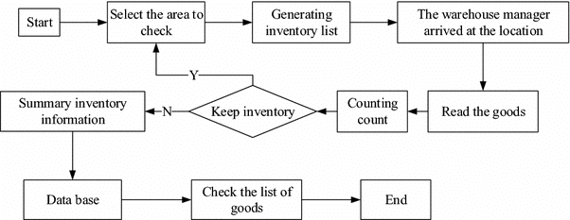
Understanding business problem Inventory Management Process Flow
What is the process of stock management in the store. Flowcharts / process diagrams are useful tools to get a comprehensive view of the process. The process steps may have opportunities for improvement.
Focusing on each of the potential opportunities one at a time, for example “Stock”, find out why products often go out of stock.
Source: https://www.researchgate.net/figure/Stock-inventory-business-flow-chart_fig5_323375425

Slide 13
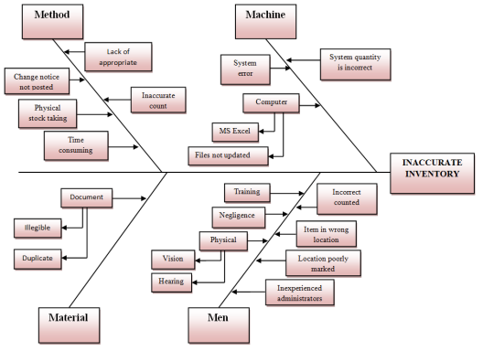
Understanding business problem Ishikawa / Fishbone diagram for root cause analysis
Ishikawa diagram¹ is a powerful visual way of identifying possible root cause/s for a given problem
It is usually done using brainstorming by experts with the clear problem statement (inaccurate inventory)
Starts by identifying all possible major categories of the cause of the problem. These are the main branch
Each major category is further explored to identify sub-categories.
Source: https://iopscience.iop.org/article/10.1088/1757-899X/872/1/012071/pdf
1 - https://asq.org/quality-resources/fishbone

Slide 14
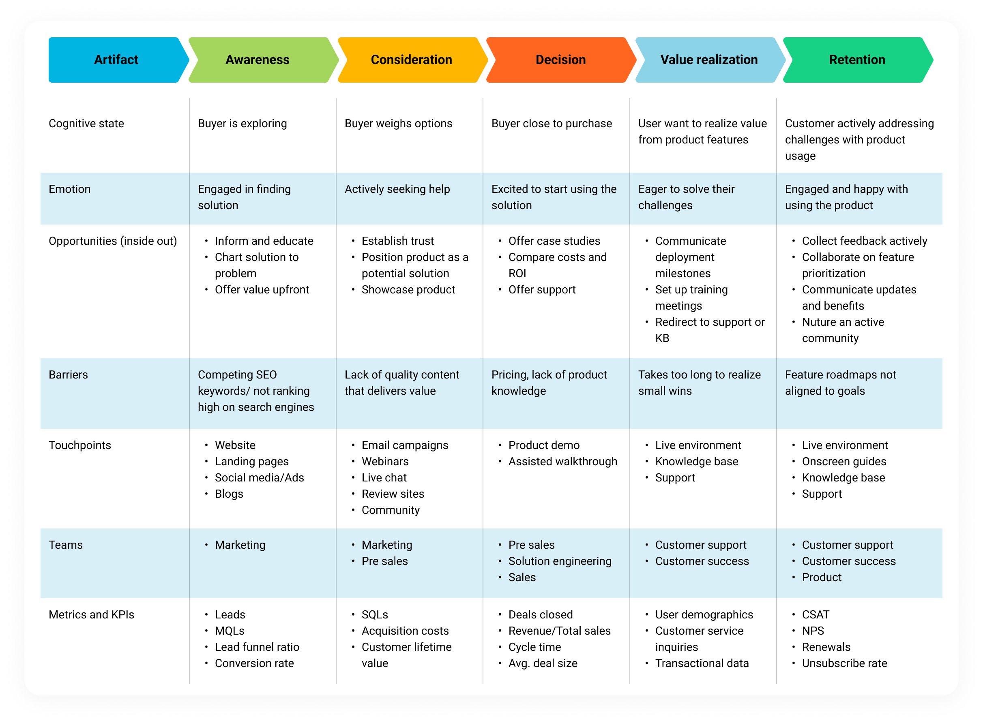
Understanding business problem Customer Lifecycle & Touchpoints
Map customer lifecycle to various touchpoints, functions/teams, challenges/barriers to understand customer experience in each stage of the lifecycle. Visualize the findings in an easily comprehensible format such as a grid.
Identify the reasons for churn at every stage¹. Churn from the “Consideration” stage and onwards is a loss that should be minimized as much as possible
Source: https://freshdesk.com/customer-journey/journey-mapping-examples-blog/
1 - https://www.chargify.com/blog/combat-churn-customer-lifecycle/

Slide 15
Phase 2 Identify Data needed for the analysis
Case - Customer churn and retention (Churn management)
Customer Data (not exhaustive)
Customer demographics (gender, age, address, income group etc.)
Tenure (duration for which a customer)
Products and services customer purchased / used
Customer account information such as preferred payment method, data of registering, payment plans, postal address, contact information etc.
Purchase history – successful purchases, cancellations, returns, payment method, payment amount, frequency of purchase
Customer service call history details
Customer reviews , ratings

Slide 16
Phase 2 Identify Data needed for the analysis
Case - Customer churn and retention (Churn management)
Transaction Data (not exhaustive)
Transaction id
Customer id
Store id (if not online)
DateTime
Transaction Session id (if online)
POS_id (if in person)
Transaction amount
Payment method
Payment gateway (if not cash)
Product_id
Discount if any
Customer ratings
Customer reviews

Slide 17
Phase 2 Identify Data needed for the analysis
Case - Customer churn and retention (Churn management)
Sessions Data (not exhaustive)
Session id
Customer id
Datetime
Channel type
Session duration
Customer rating
Customer review

Slide 18
Phase 2 Identify Data needed for the analysis
Case - Customer churn and retention (Churn management)
Qualitative and Quantitative data
Qualitative analysis refers to the analysis of non-numerical data such as customer reviews, interviews, survey responses, support ticket queries and feedback, net promotion scores etc. It gives a direct view to the possible reasons for the problem at hand
Quantitative analysis is based on numerical data. It and involves simple statistical analysis to begin with which may be followed by mathematical modelling and inferential statistical testing. While numerical data based analysis reflects the magnitude of the problem and its impact in quantitative terms, it does not tell you why it is happening.
Both quantitative and qualitative analysis together help get a compressive view of the given problem
https://www.scribbr.com/methodology/qualitative-research/

Slide 19

Phase 2 Identify Data needed for the analysis
Case - Customer churn and retention (Churn management)
Qualitative Data collection approach
Surveys through questionnaire - collect information in form of response to open-ended and close-ended questions from the concerned stakeholders
Interviews – collect information from stakeholders through one-on-one interviews
Observations – collect information passively through observations in the field
Focus groups – collect information through a focused discussion initiated amongst a group representation the concerned stakeholders
Secondary research – collect information through study and analysis of literature, existing data generated by the process of interest

Slide 20

Phase 4 Exploratory Data Analysis
Qualitative data analysis -
Content analysis – examine the text for the kind of words used, frequency of usage, contents in text. Use techniques such as TF_IDF, word vectorization to transform content to numbers for further analysis such as Named Entity Recognition, sentiment analysis etc.
Thematic analysis – discover, analyze and interpret patterns in qualitative response using techniques such as clustering, LDA etc.
Narrative analysis – interpret participants testimonials, interview responses, shared experiences etc. for example, to perform sentiment analysis
Grounded theory analysis – formulate theories / hypothesis based on the analysis of data collected directly from the concerned stakeholders (ground realities)
Discourse analysis – Relatively more involved and deeper than the previous techniques. Used along with the other techniques to understand why rather than what. For example, why a customer feels the way she does?
Ref: https://www.hotjar.com/qualitative-data-analysis/methods/

Slide 21
Phase 4 Exploratory Data Analysis
Case - Customer churn and retention (Churn management)
Quantitative data analysis –
Descriptive statistics
Basic counts
Central values and spread
Outlier analysis
Correlation analysis
Store based/ segment based analysis
Customer lifecycle stage based analysis

Slide 22
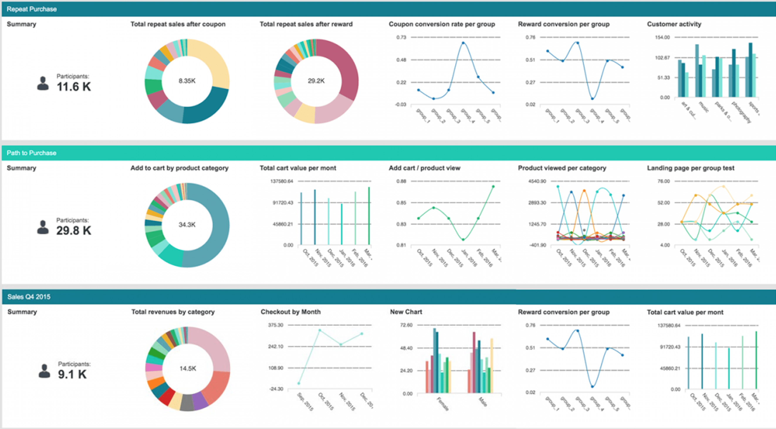
Phase 4 Exploratory Data Analysis
Case - Customer churn and retention (Churn management)
Present the findings in visual form using appropriate graphing techniques such as (Pie charts, Column charts, Trend charts etc. Use sober colors for the logical groups if any
Image Source: https://www.pointillist.com/blog/reduce-churn-customer-journey-analytics/

Slide 23
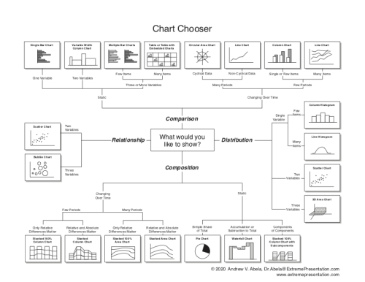
Phase 4 Exploratory Data Analysis
There are broadly four categories into which information we wish to present can be bucketed –
Comparison
Distribution
Composition
Relationship
For each type of information, there are appropriate graphing techniques that will be relatively more effective than others
Refer : https://extremepresentation.typepad.com/blog/2006/09/choosing_a_good.html

Slide 24
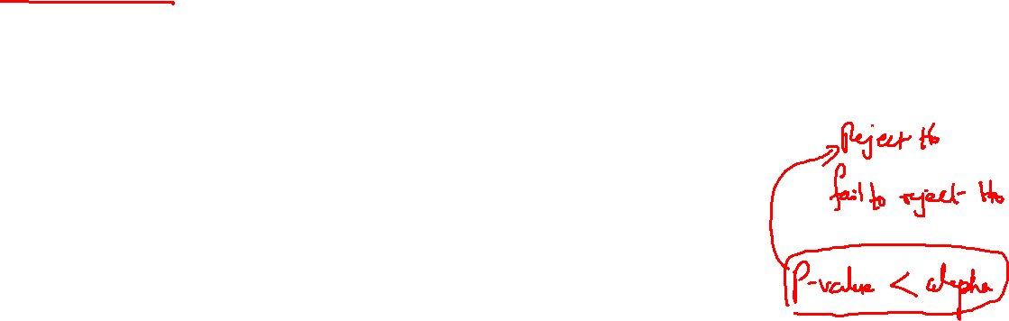
Phase 5 Hypothesize to reflect possible causes
Case - Customer churn and retention (Churn management)
Based on the data analysis, formulate hypothesis reflecting your belief of various determinants of customer churn. For example –
Customer dissatisfaction with product / service quality
H1a – Frequent out of stock of products is positively related to customer churn
H1b - Customer rating for store experience is negatively related to customer churn
Customer dissatisfaction with store location
H2a – Time to park car is positively related to customer churn
H2b – Time to reach store is positively related to customer churn
Formulate multiple hypothesis based on the findings from data analysis
Image Source: https://www.pointillist.com/blog/reduce-churn-customer-journey-analytics/

Slide 25
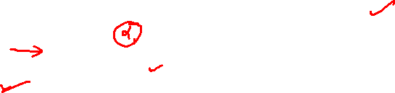
Phase 5 Hypothesis and testing strategy
Case - Customer churn and retention (Churn management)
For each one of the formulated hypothesis we need to scientifically accept or reject the corresponding null hypothesis. For this we can employ the statistical tools for hypothesis testing
There are 5 main steps in hypothesis testing:
State your research hypothesis as a null hypothesis and alternate hypothesis (H_{o}) and (Ha or H1).
Collect data in a way designed to test the hypothesis.
Perform an appropriate statistical test.
Decide whether to reject or fail to reject your null hypothesis.
Present the findings to stakeholders
Source: https://www.scribbr.com/statistics/hypothesis-testing/

Slide 26
Phase 6 Present Analysis Findings
Case - Customer churn and retention (Churn management)
After all the data preparation, analysis and testing, present the findings to the customers in form of comprehensive report and a concise presentation –
Presentation should reflect the key aspects of every stage of the analytics journey
A brief explanation of the dataset/s in terms of what it reflects, how it was gathered, how it was prepared for analysis, and the key findings appropriately represented using visual tools
Present the leading causes for customer churn along with data and supporting statistical analysis
For each of the identified cause, suggest ways of eliminating the cause. Incorporate inputs gathered from stakeholders for each cause
Define metrics and measurement process to assess the impact of the suggested approach to customer churn
Image Source: https://www.slideteam.net/customer-churn-analysis-powerpoint-presentation-slides.html

Slide 27

Phase 6 Present Analysis Findings
Reporting Structure for Customer Churn Analysis and Findings
Executive Summary
Introduction
Company profile
Literature Survey
Competitive landscape
Customer satisfaction
Customer value perceptions
Customer behavior
Brand image
Brand loyalty
Barriers to switching
Research method
Significance of study
Research design
Sampling
Data sources
Research approach
Pilot study
Pre test
Tools for data collection
Scoring process
Statistical analysis
Limitations of the study
Data Analysis and interpretation
Findings
Recommendations
Conclusions
Annexure
References
Questionnaire/s
Meta Data/ Data Structures
Note:
The structure is In context of churn analysis. The sub-bullets may change depending on the research

Slide 28
Phase 6 Present Analysis Findings
No second chance to make a first impression. The opening paragraph of your paper will provide your readers with their initial impressions of your argument, your writing style, and the overall quality of your work.
Reporting Structure for Customer Churn Analysis and Findings
To provide overview of main points of the report. Should restate the purpose of the report, highlight the major points of the report, and describe any results, conclusions, or recommendations from the report. It should include enough information so the reader can understand what is discussed in the full report
Executive Summary
Introduction
Company profile
Research method
Significance of study
Research design
Sampling
Data sources
Research approach
Pilot study
Pre test
Tools for data collection
Scoring process
Statistical analysis
Limitations of the study
Research methodology seeks to inform: Why a research study has been undertaken, how the research problem has been defined, in what way and why the hypothesis has been formulated, what data have been collected and what particular method has been adopted, why particular technique of analyzing data has been used and a host of similar other questions are usually answered

Slide 29

Phase 6 Present Analysis Findings
Reporting Structure for Customer Churn Analysis and Findings
It allows researchers to gain a better understanding of the existing body of knowledge on their topic of study. It also helps them to identify any gaps in the research and to formulate their research questions accordingly.
Literature Survey
Competitive landscape
Customer satisfaction
Customer value perceptions
Customer behavior
Brand image
Brand loyalty
Barriers to switching
Data Analysis and interpretation
Findings
Recommendations
Conclusions
Annexure
References
Questionnaire/s
Meta Data/ Data Structures
refers to the process of using diverse analytical methods to review data and arrive at relevant conclusions. The interpretation of data helps researchers to categorize, manipulate, and summarize the information in order to answer critical questions.
Describes what the researcher(s) found when they analyzed their data. Its primary purpose is to use the data collected to answer the research question(s) posed in the introduction, even if the findings challenge the hypothesis

Slide 30
Phase 6 Present Analysis Findings
https://libguides.usc.edu/writingguide/introduction
https://curiousdesire.com/why-literature-review-is-important/
https://limbd.org/research-methodology-importance-types-of-research-methodology-in-research/
https://www.datapine.com/blog/data-interpretation-methods-benefits-problems/#:~:text=The%20interpretation%20of%20data%20helps,needs%20to%20be%20done%20properly
https://www.jmu.edu/uwc/files/link-library/empirical/findings-results_section_overview.pdf

Slide 31
Project Proposal
Structure
Cover sheet (project title, project code, authorized person with signature)
Table of contents (list the contents of the proposal)
Executive Summary – (Short, precise summary of the proposal. Describe how the project helps address customer problem)
Organization – (Describe your organization in terms of mission, goals, structure, Project Stakeholders)
Project Description
Background
Objective of the project
Project plan (including milestones, deliverables, risk plans, release plans)
Resource requirements (Hardware, software, manpower, tools,
Budget estimates (costing for the resources)
Project monitoring and reporting
Closure and handover

Slide 32
Cost Benefit Analysis (CBA)
A cost-benefit analysis (CBA) is a process of comparing the cost of executing a project with the benefits expected from the same.
For a project to get management approval the benefits should be more than the cost incurred.
Estimating the costs is relatively easier and based on available data but estimating benefits which will accrue over time is more challenging.
Which means the true cost benefit information of a project will become clear to us only over time after implementing the project outcomes!

Slide 33
Cost Benefit Analysis (CBA)
The two most popular CBA methods are –
Net Present Value - NPV
Benefit – Cost ratio

Slide 34
Cost Benefit Analysis (CBA) Net Present Value
For calculating Net Present Value, use the following steps:
Find out the future benefits.
Find out the present and future costs.
Calculate the present value of future costs and benefits
The present value factor is 1/(1+r)^n. Here r is the rate of discounting, and n is the number of years.
Present Value of Future Benefits = Future Benefits * Present Value Factor.
Present Value of Future Costs = Future Costs * Present Value Factor
Calculate the Net Present Value using the formula:
NPV = ∑ Present Value of Future Benefits – ∑ Present Value of Future Costs
Project should be undertaken If the Net Present Value (NPV) is positive. If the NPV is negative, the project should not be undertaken

Slide 35
Cost Benefit Analysis (CBA) Benefit Cost ratio
For calculating Net Present Value, use the following steps:
Find out the future benefits.
Find out the present and future costs.
Calculate the present value of future costs and benefits
The present value factor is 1/(1+r)^n. Here r is the rate of discounting, and n is the number of years.
Present Value of Future Benefits = Future Benefits * Present Value Factor.
Present Value of Future Costs = Future Costs * Present Value Factor
Benefit-Cost Ratio = ∑ Present Value of Future Benefits / ∑ Present Value of Future Costs
Project should be undertaken If the BFR > 1.

Slide 36
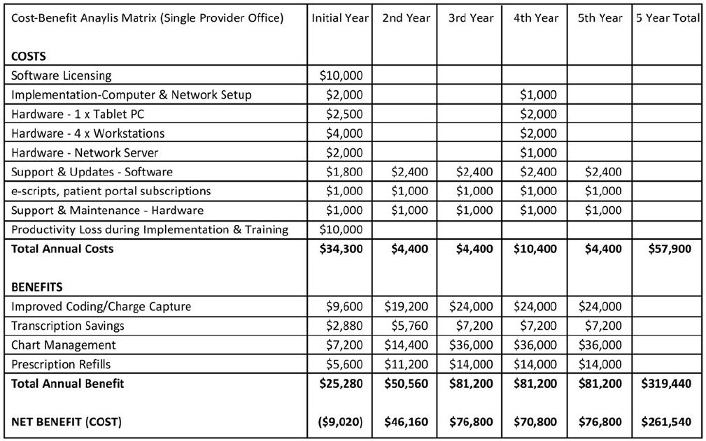
Cost Benefit Analysis (CBA)
Note: The CBA is only for example. For a data analytics project we may have data related costs too which is not
reflected

Slide 37
Model level Cost Benefit Analysis (CBA)
 |  |  |  |  |  | Cost Benefit Analysis for Churn
 | Registration fees (Rs) |  | 50
 | Cost of contacting potential churn customer(Rs) |  |  |  |  | 20
 |  | 1. Rs 5 for contacting
 |  | 2. Rs 15 discount In registration fees
 | 50% of potential churn customers accept offer
 |  |  |  |  |  |  | Confusion Matrix based revenue and cost analysis
 |  |  |  |  |  |  |  |  | Revenue | Cost | Net Revenue
1 | True Negative ( Customers not likely to churn and do not churn |  |  |  |  |  |  |  | 50 | 0 | 50 |  | Customers predicted to be loyal and they are
2 | Predicted Positive who churn (sent discount mailer ) |  |  |  |  |  |  |  | 0 | 20 | -20 |  | for 50% who do not accept the offer cost = 50 + 20
3 | Predictive Positives (do not churn) |  |  |  |  |  |  |  | 50 | 20 | 30 |  | 50% who take advantage of discount and do not churn
4 | False Negatives (predicted not to churn so no scheme offered but churn) |  |  |  |  |  |  |  | 0 | 50 | -50 |  | failed to identify and did not offer any scheme
 | Total cost benefit of a model
 |  |  |  | Class Metric |  | Count | Revenue |  |  | Description
 |  |  |  | True Negative |  | 2000 | 100000
 |  |  |  | PPC |  | 400 | -8000 |  |  | 50% of this class accept the offer and other 50% do not
 |  |  |  | PPDNC |  | 100 | 3000
 |  |  |  | False Negatives |  | 300 | -15000
 |  |  |  |  |  |  | 80000
 | Observations
 |  | 1. Greatest loss per unit is from 50% True Positive cases who do not accept the offer
 |  | 2. The maximum loss to total revenue comes from False Negative cases followed by True Positives who do not accept the offer
 | Suggestion
 |  | 1. Reduce False negatives by changing the threshold
 |  | 2. Reduction in False Negatives will increase True Positives but also False Positive cases and hence an increase in unnecessary expense in form of discounts where it is not required

Slide 38
Appendix - A

Slide 39
Stakeholder identification
Successful business requirement gathering and analysis / understanding starts with key stakeholder identification given the business problem
Stakeholders maybe within or outside the business organization, maybe spread across locations/geographies, maybe individuals or groups/departments
Compile list of stakeholders, their roles and responsibilities. Get the list whetted by the project owner

Slide 40
Stakeholder identification
Types of stakeholder (not an exhaustive list)
Project sponsors
Management
Employees
Suppliers
Customers/ consumers
Quality control
Security control
Internal external customers
Government / regulatory agencies
Competitors
Investors/ shareholders
Communities
Creditors
Media

Slide 41
Stakeholder identification
List the possible stakeholders for each of the following situations in which you are engaged by a -
Retail bank to help predict customer attritions
Community hospital to help predict demand for bed next quarter
Retail giant to optimize pricing strategy to increase business volume
Educational institute to assess demand for a new course

Slide 42
Gather stakeholder requirements
The objective here is to clearly understand your key stakeholders in terms of what they want, need, or expect from the project i.e., their requirements
Only on meeting these requirements (within the project constraints) will the project be considered successful
The requirements are usually expressed in business language
They have to be translated into analytics requirements / technical requirements

Slide 43
Data Analysis Tools
Data analytic tools are productivity enhancement tools that help in data analysis process in multiple ways such as
Collect data from various sources
Clean raw data
Structure data
Store data in optimal way
Data integration
Provide for descriptive, inferential, predictive analytics
Data modelling
Data transformation
Graphics for visualization
10. Reporting
https://crm.org/news/best-data-analytics-tools

Slide 44
Data Analysis Tools
One needs to evaluate the tools for suitability given the task at hand. Factors to consider to evaluate the tools include -
Cost of the tool
License cost
Cost of maintenance
Cost of upgradation
Tailoring
Fine tuning
Training cost
Manpower cost
Opportunity cost
Risk mitigation cost
Supporting hardware/software cost
https://crm.org/news/best-data-analytics-tools

Slide 45
Benefits of Analytics
Data analytics helps organizations extract rich information in form of valuable insights that can be integrated with business strategies to the advantage of the organization on the whole.
Increase efficiency – When the identified opportunities for improvement are leveraged, it can lead to overall increase in efficiency in functioning of the organization. The improvement can be measured periodically in various ways such as time taken to resolve customer ticket, frequency of stockout, optimal resource utilization etc.
Informed decisions – Strategic decisions are taken on the basis of objective evidence instead of emotions helping in reducing incorrect decisions. Taking informed decisions helps in optimal stock maintenance, optimal pricing etc. Effectiveness of informed decisions can be assessed using appropriate business metrics
Mitigate risks – Foresee risks and take steps to mitigate the same in advance. Identify cash cow customers likely to churn and take informed steps to prevent the churn. Degree of success can be easily measured using churn metrics

