Slide 1
A Resilient, AI-Powered SDLC Automation System
From Requirements to Pull Request: An Autonomous and Intelligent Workflow
The Challenge: Fragile Automation & Repetitive Work
Key Problems:
Writing boilerplate code for APIs
Managing project dependencies and versions.
Writing unit tests.
Diagnosing build failures
The Solution: A Multi-Agent System with a Quality Gate
AdkSdlcWorkflow:
An advanced multi-agent AI system that automates the software development lifecycle
Takes SRS input and produces a production-ready Spring Boot micro-service
Handles build failures intelligently.
Diagnosing build failures

Slide 2
Use Case
Rapid Microservice Prototyping
Scenario:
Developer provides an SRS file. (Future development: later it will take user stories from jira )
AdkSdlcWorkflow autonomously produces a microservice (src,test code , pom.xml, appliation.yml and ci.yml ) and creates a pull request on GitHub

Slide 3
Why ADK Stands Out for SDLC Automation
End-to-End SDLC automation: From planning to monitoring
Seamless integration with CI/CD tools (Jenkins, Git, Azure DevOps)
Modular, reusable components for faster delivery
Reduces manual effort, increases consistency
Proven improvements: 60% faster releases, 70% fewer errors
Key Benefits of ADK
Faster Time-to-Market: Automates repetitive tasks, reducing release cycles.
Modular Architecture: Easy to plug in or replace components per project needs.
Governance & Compliance: Built-in controls for audit, traceability, and policy adherence.
Continuous Feedback Loop: Supports shift-left and shift-right strategies for quality assurance.

Slide 4
Google ADK – Pros & Cons
✅ Props | ⚠ Cons
Modular Design: Clean architecture with clearly defined agent roles. | Niche Framework: Smaller community and fewer resources than LangChain
Simplified Orchestration: SequentialAgent automates state/context flow. | Rigid Orchestration: Conditional flows or retry loops need custom logic.
Focus on Business Logic: Abstracts away low-level API and retry handling. | Vendor Lock-in: Deeply tied to the Google ecosystem
Separation of Concerns: Each agent is independently testable and replaceable. | Debugging Complexity: Hard to trace issues across multiple dependent agents.

Slide 5
Google Gemini Model – Pros & Cons
✅ Props | ⚠ Cons
High-Quality Code Generation: Understands context and creates correct code and configs. | Inaccuracy / Hallucinations: May generate incorrect logic or imports.
Strong Instruction Following: Accurately executes complex, multi-step prompts. | Black Box Debugging: Root cause analysis often relies on trial-and-error.
Large Context Window: Handles entire codebases or large documents effectively. | Cost & Reliability: Frequent, large calls can be expensive and API failures happen.
Fast & Flexible: Gemini Flash offers speed without sacrificing too much quality. | Prompt Sensitivity: Small changes in wording can affect output drastically.

Slide 6
ACCEPTANCE CRITERIA
Happy Path:
Valid SRS file provided.
Generates complete Spring Boot project.
Passes tests and creates GitHub PR.
Failure Handling:
On build failure: generates analysis report.
Commits broken code and analysis, no PR created
Failure Handling:
On build failure: generates analysis report.
Commits broken code and analysis, no PR created
Graceful Exit:
Invalid config (e.g. missing GitHub URL): logs clear error and exits..
No changes in SRS

Slide 7
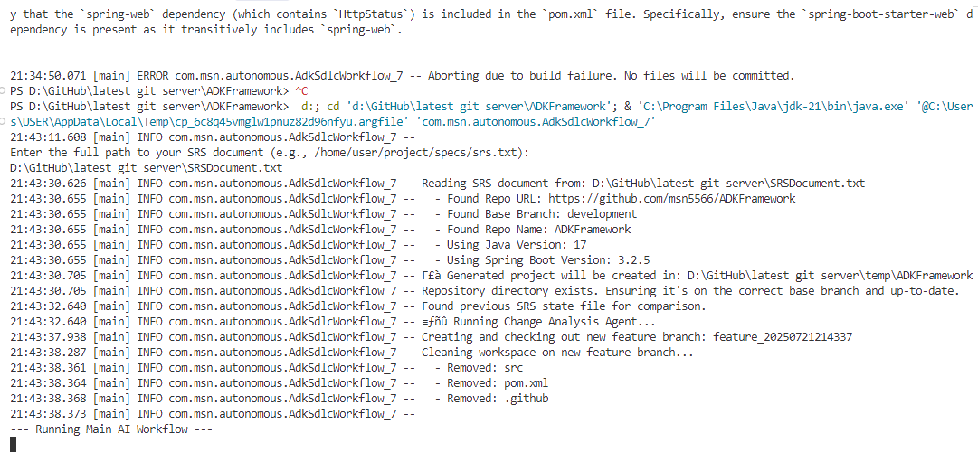

Slide 8
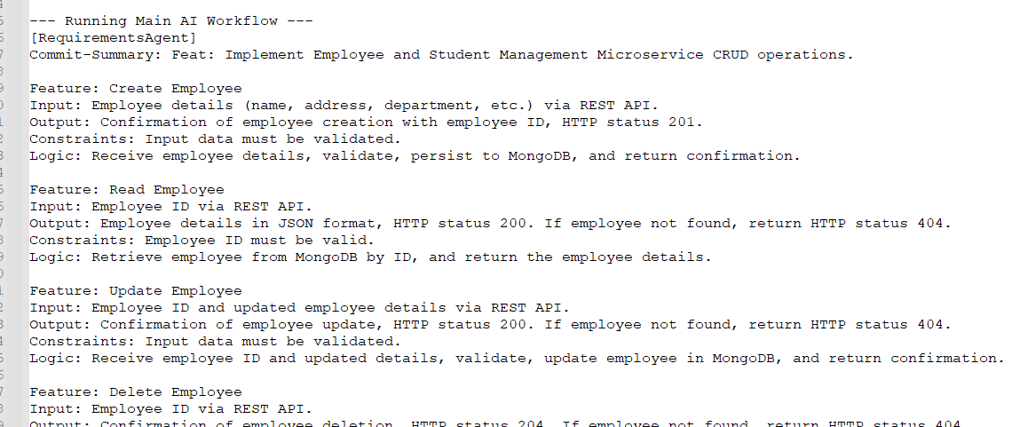

Slide 9
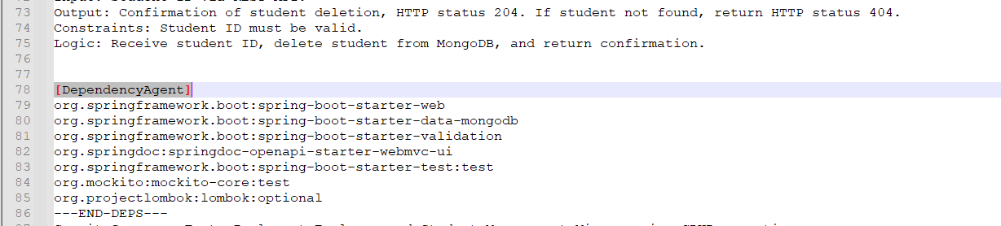

Slide 10
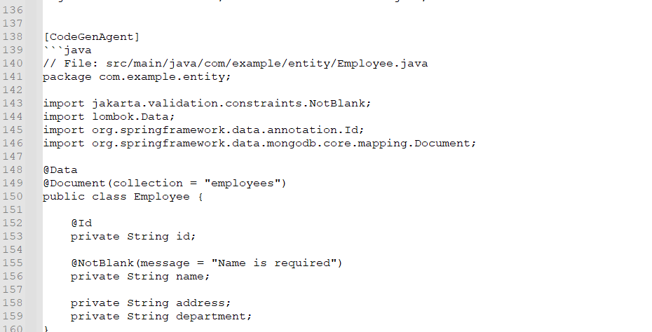

Slide 11
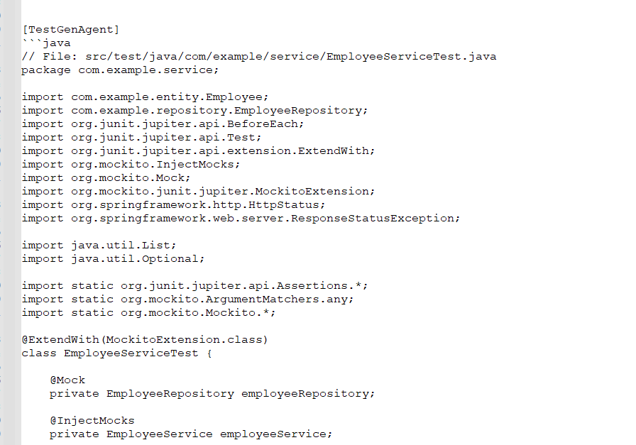

Slide 12
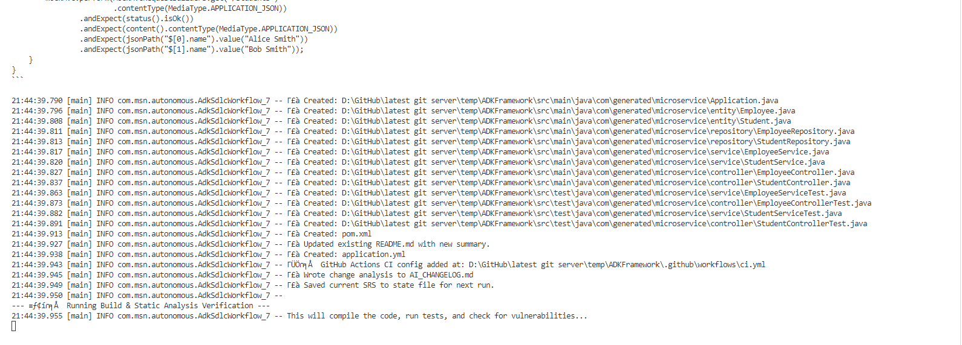

Slide 13
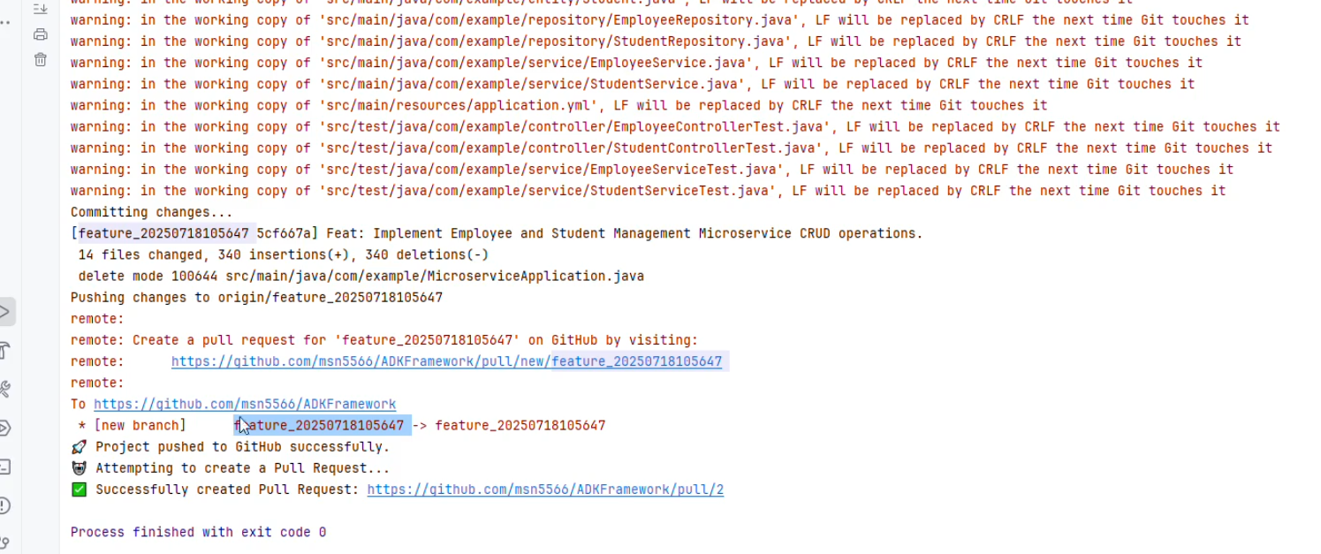

Slide 14
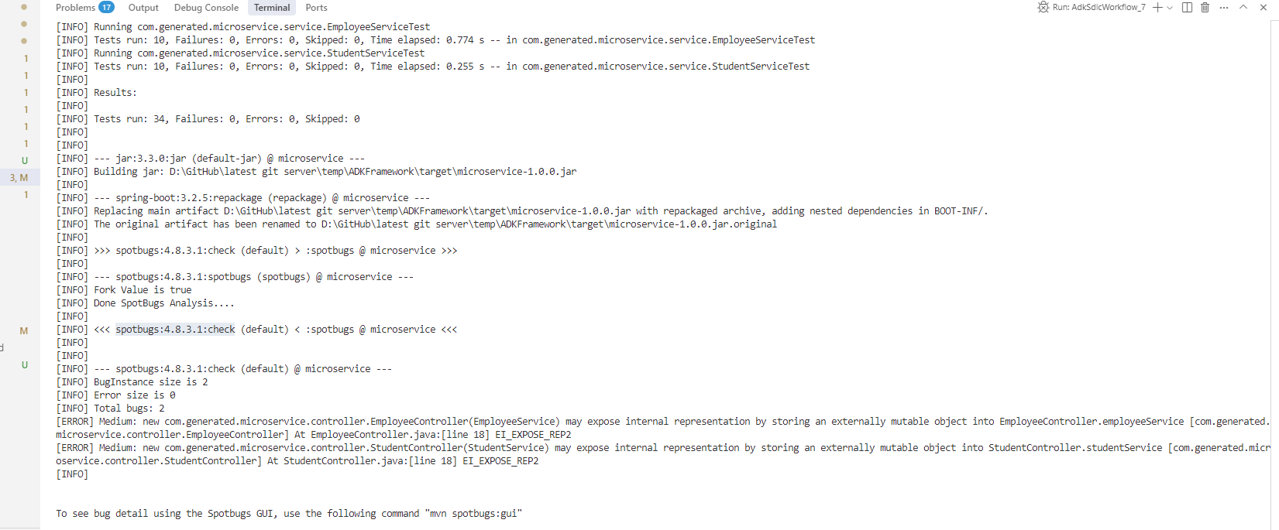

Slide 15
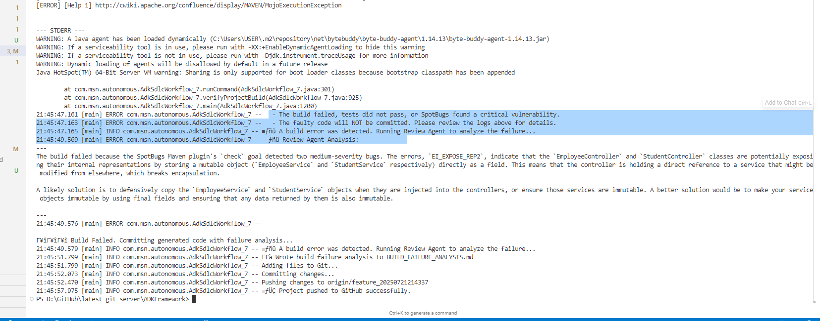

Slide 16
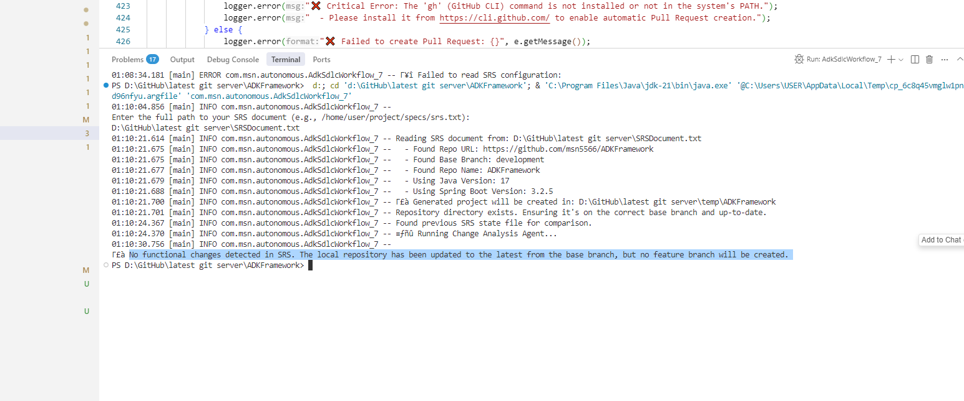

Slide 17
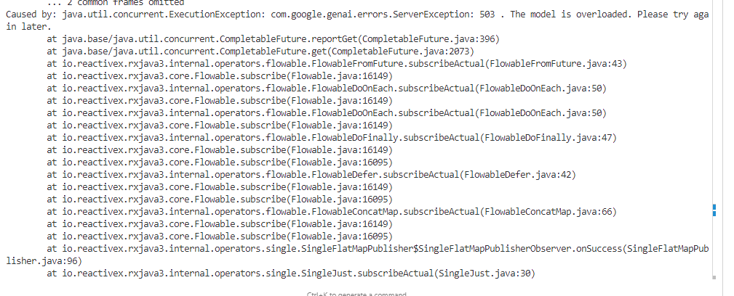

Slide 18
