Slide 1
Why ADK Stands Out for SDLC Automation
✅ End-to-End SDLC automation: From planning to monitoring
🔗 Seamless integration with CI/CD tools (Jenkins, Git, Azure DevOps)
⚙️ Modular, reusable components for faster delivery
📉 Reduces manual effort, increases consistency
📊 Proven improvements: 60% faster releases, 70% fewer errors

Slide 2
Key Benefits of ADK
✅ Faster Time-to-Market: Automates repetitive tasks, reducing release cycles.
🧩 Modular Architecture: Easy to plug in or replace components per project needs.
🔒 Governance & Compliance: Built-in controls for audit, traceability, and policy adherence.
🔁 Continuous Feedback Loop: Supports shift-left and shift-right strategies for quality assurance.

Slide 3
ADK vs Other Frameworks
Feature / Aspect | ✅ ADK | ⚠️ Other Frameworks
Scope of Automation | Full SDLC (Dev, Test, Deploy, Monitor) | Focused (e.g., only Test or Deploy)
Ease of Use | Low-code, simplified scripting | Requires skilled scripting
Reusability | Built-in components & templates | Manual script reuse
Integration Readiness | Plug & play with DevOps tools | Often needs setup/custom connectors
Maintenance Effort | Centralized management | Distributed & tool-specific

Slide 4
Google ADK – Pros & Cons
✅ Props | ⚠ Cons
Modular Design: Clean architecture with clearly defined agent roles. | Niche Framework: Smaller community and fewer resources than LangChain
Simplified Orchestration: SequentialAgent automates state/context flow. | Rigid Orchestration: Conditional flows or retry loops need custom logic.
Focus on Business Logic: Abstracts away low-level API and retry handling. | Vendor Lock-in: Deeply tied to the Google ecosystem
Separation of Concerns: Each agent is independently testable and replaceable. | Debugging Complexity: Hard to trace issues across multiple dependent agents.

Slide 5
Google Gemini Model – Pros & Cons
✅ Props | ⚠ Cons
High-Quality Code Generation: Understands context and creates correct code and configs. | Inaccuracy / Hallucinations: May generate incorrect logic or imports.
Strong Instruction Following: Accurately executes complex, multi-step prompts. | Black Box Debugging: Root cause analysis often relies on trial-and-error.
Large Context Window: Handles entire codebases or large documents effectively. | Cost & Reliability: Frequent, large calls can be expensive and API failures happen.
Fast & Flexible: Gemini Flash offers speed without sacrificing too much quality. | Prompt Sensitivity: Small changes in wording can affect output drastically.

Slide 6
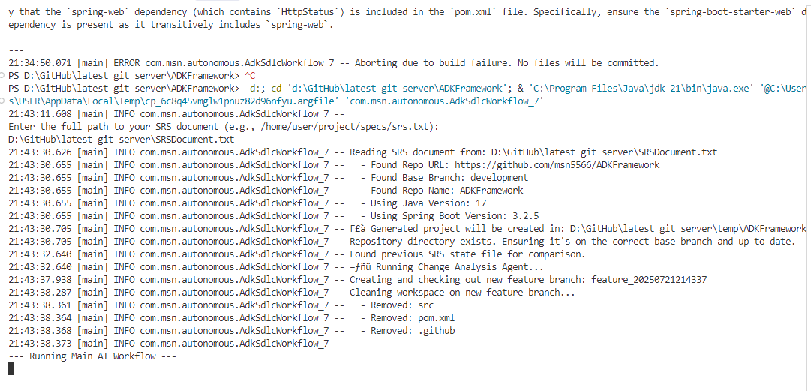

Slide 7
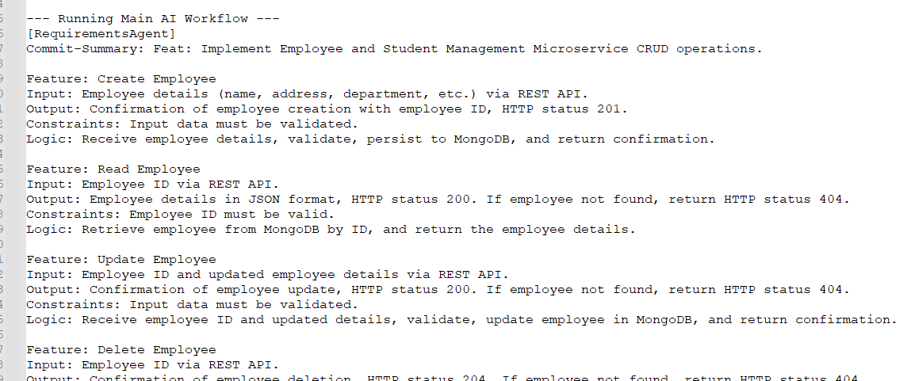

Slide 8
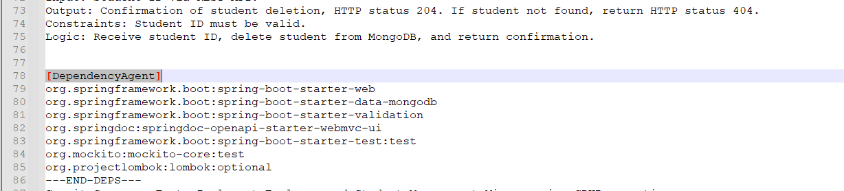

Slide 9
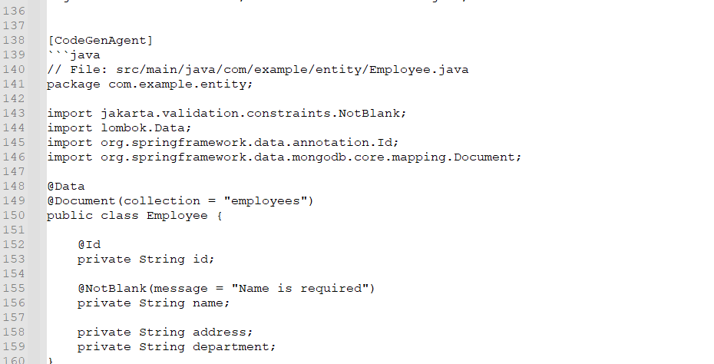

Slide 10
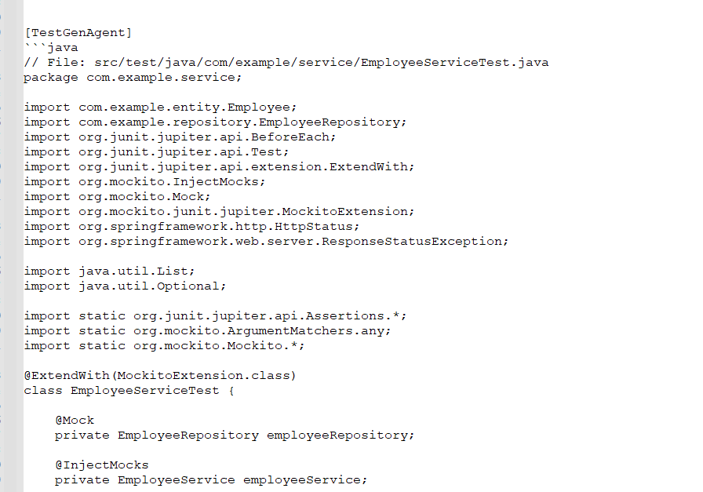

Slide 11
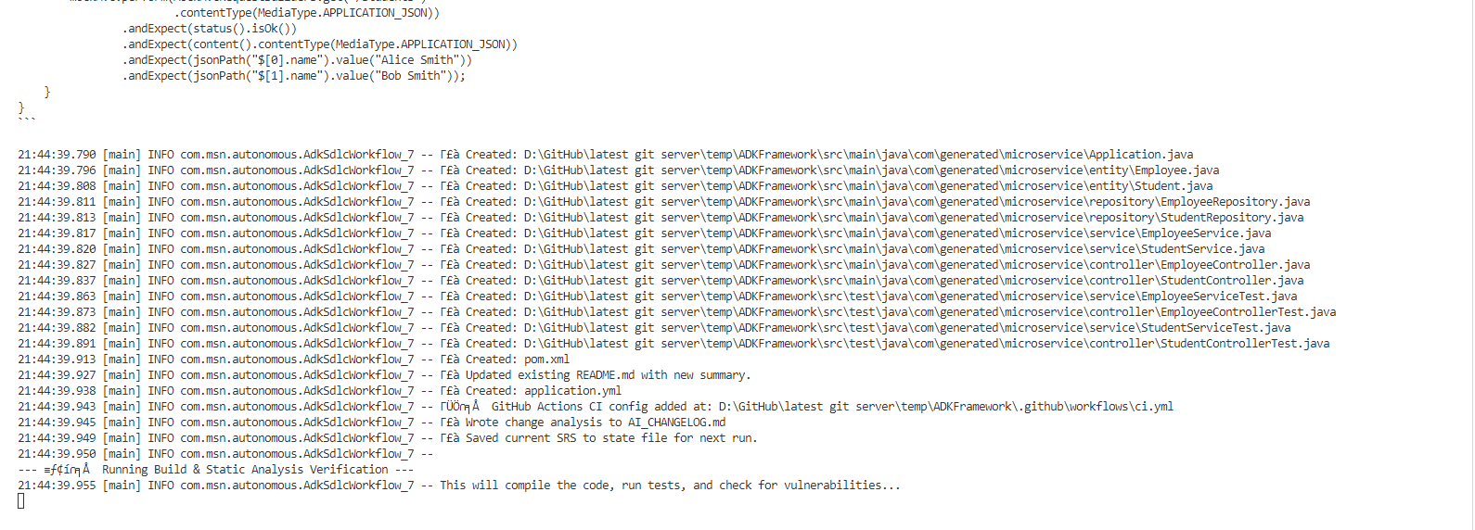

Slide 12
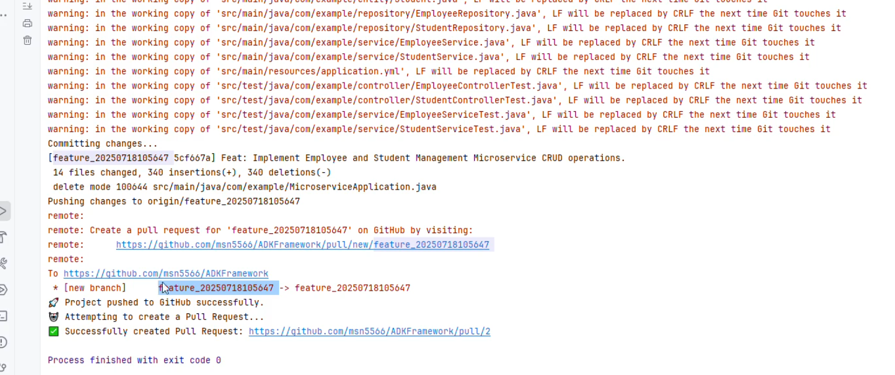

Slide 13
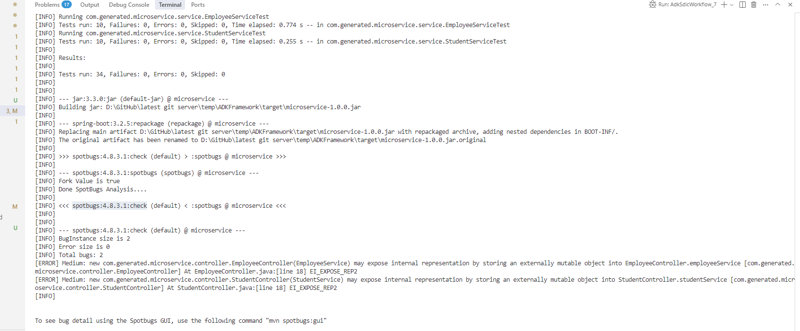

Slide 14
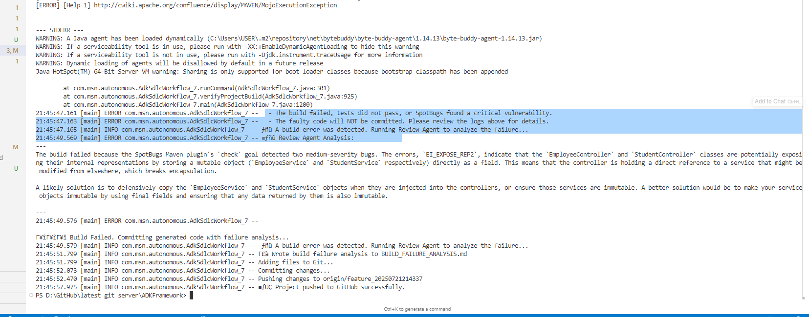

Slide 15
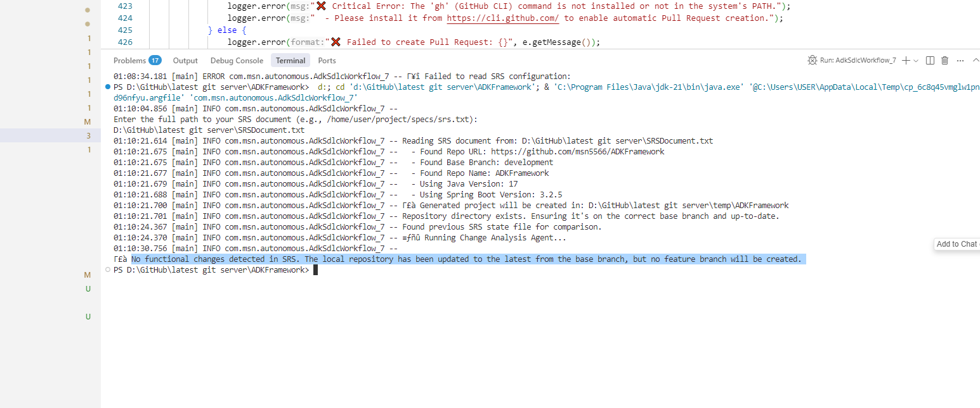

Slide 16
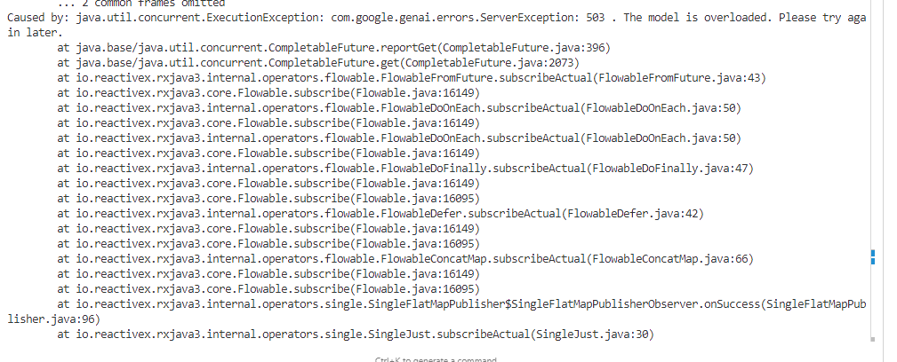

Slide 17
