Slide 1
KF
Mobile robot localization with gyroscope and constrained Kalman filter
Mohsen Mokhtari

Slide 2
Topics
How to estimate robot position?
What is Kalman Filter?
Kalman filter overview
Kalman filter equations
Kalman filter using gyroscope and odometry data
Result
Simulink
Refrences

Slide 3
How to estimate robot position?
GPS
Odometry
IMU
So on…

Slide 4
What is KF?
An optimal estimation algorithm

Slide 5




Kalman Filter
Named by
Kalman
Use in Apollo Project
Named
Apollo
Type
Estimate
Estimate Algorithm
Sensor Fusion

Slide 6
Kalman Filter
Named by
Kalman
Use in Apollo Project
Named
Apollo
Type
Estimate
Estimate Algorithm
Sensor Fusion

Slide 7
Kalman Filter
Named by
Kalman
Use in Apollo Project
Named
Apollo
Type
Estimate
Estimate Algorithm
Sensor Fusion

Slide 8
Kalman Filter
Named by
Kalman
Use in Apollo Project
Named
Apollo
Type
Estimate
Estimate Algorithm
Sensor Fusion

Slide 9
Kalman Filter
Named by
Kalman
Use in Apollo Project
Named
Apollo
Type
Estimate
Estimate Algorithm
Sensor Fusion

Slide 10
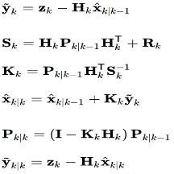
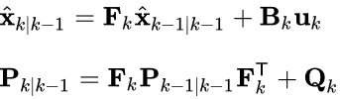


Kalman filter equations
Predict
Update
1
2

Slide 11
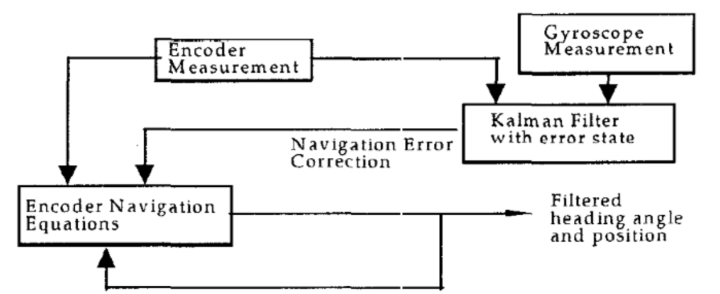
Kalman filter using gyroscope and odometry data

Slide 12
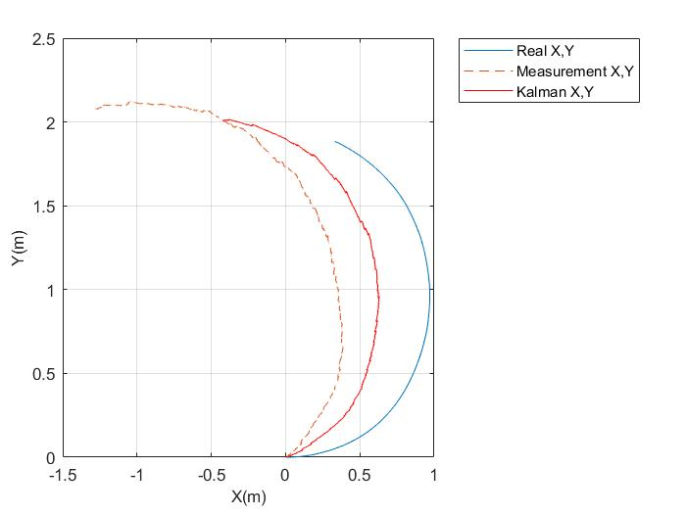
Result

Slide 13
Simulink

Slide 14
References
[1] KyuCheol Park, Dohyoung Chung ,1995,” Dead Reckoning Navigation of a Mobile Robot Using an Indirect Kalman Filter.”International Conference on Multisensor Fusion and Integration for Intelligent Systems’
[2] https://en.wikipedia.org/wiki/Kalman_filter
[3] “"نعریف فیلتر کالمن filter/https://behsanandish.com/learning/generalipmv/%D9%81%DB%8C%D9%84%D8%AA%D8%B1-%DA%A9%D8%A7%D9%84%D9%85%D9%86-kalman-filter/

Slide 15
Thanks For Your Attentions

