Slide 1

OpenAPI
Building APIs Without Code

Slide 2
What is OpenAPI
FKA Swagger (OpenAPI v2)
OpenAPI v3 Standard
Endpoints
Data Models
Response Codes
Authentication Schemes
Used for
Interface Driven API design
Request/Response Validation
Technical Documentation

Slide 3
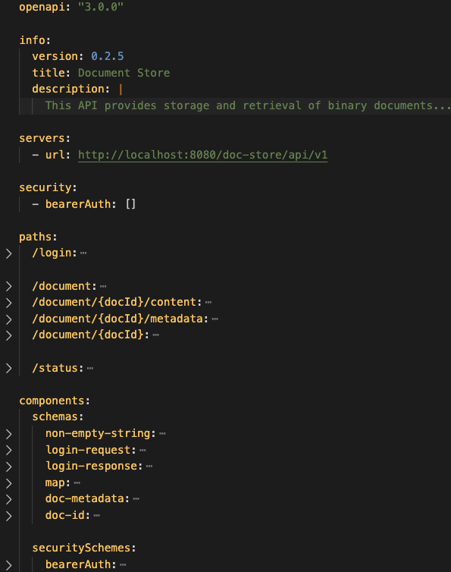
OpenAPI Specification
Simple YAML file
Easy to Parse
Ability to Provide Markdown Freeform Docs
JSON Schema to describe request/response data

Slide 4
Day Zero – Docs & Mocks

Slide 5
Day Zero + 1 – JSON Schemas

Slide 6
Day Zero + 2 – Generating Code

Slide 7
Day Zero + n – Dev Cycle
Update API Spec
Release Preview Docs & Mocks
Regenerate Base Code
Build functionality

Slide 8
Appendix – CI & Testing
Interface testing – PACT tests
Use Mocks from Day Zero
Rebuild Docs, Mocks and Schemas on merge

