Slide 1
Fix it where it fails: pronunciation learning by mining error correction from speech logs
Zhenzhen Kou, Daisy Stanton, Fuchun Peng, Franc¸oise Beaufays, Trevor Strohman
Google Inc., USA

Slide 3
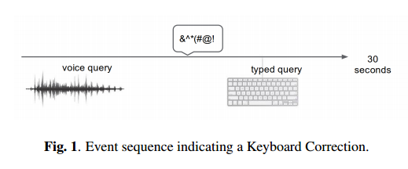
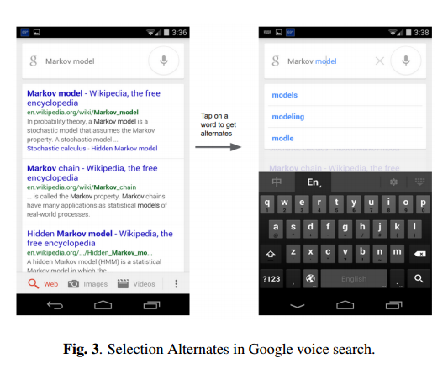

Slide 4
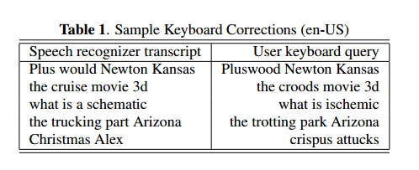
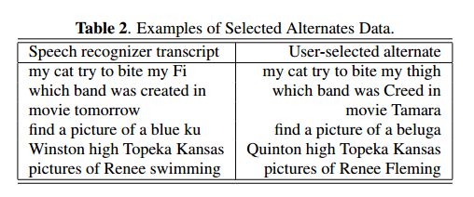
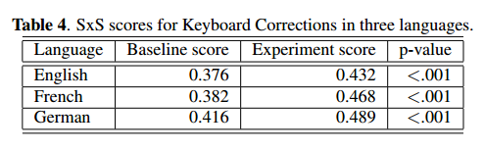
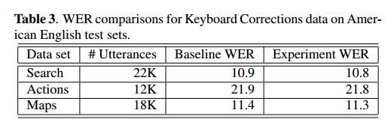

Slide 5
Thoughtful Questions

