Slide 1
Fix it where it fails: pronunciation learning by mining error correction from speech logs
Zhenzhen Kou, Daisy Stanton, Fuchun Peng, Franc¸oise Beaufays, Trevor Strohman
Google Inc., USA

Slide 2
Automatic speech recognition (ASR) system pronunciation dictionary (or lexicon)

Slide 3
Existing/related work
Research on machine learning for grapheme to phoneme conversion (G2P):
Decision tree classifier to learn pronunciation rules
Joint ngram model
Maximum entroy model
Active learning
Recurrent neural network
Studies on detection speech recognition errors:
Using acoustic and prosodic features to identify corrections
Prosodic features to detect recognition errors
Examining features related to the user’s speaking style to detect speech errors
Decision-tree based method to detect voice query retires
Co-occurence method for detecting and correcting misrecognition

Slide 4
Correction data focuses specifically on the areas of weaknesses of the system
Do not need to identify bad pronunciations ahead of time
Corrections are provided by the users who spoke them, who know how they want to pronounce the words
Using two different types of correction data:
Keyboard Correction
Selected Alternate

Slide 5
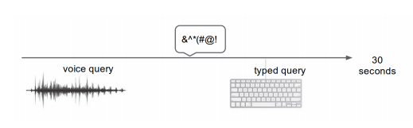
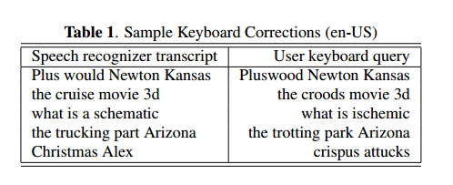
Keyboard correction data
User makes a voice query, then issues a typed query shortly after
Within 30 seconds
Analysis showed only 30-40% of these pairs are true corrections
Correction data classifier features
Word-based:
Unigram counts, number of word overlaps, and language model costs
Character-based:
Character counts, and edit distance between the recognized and typed queries
Phoneme:
Counts and edit distance between the phoneme sequences corresponding to the recognition results and typed query
Acoustic:
Forced phone alignment costs
Waveform-to-transcript length ratio

Slide 6
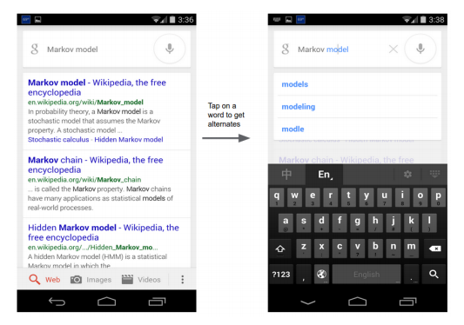
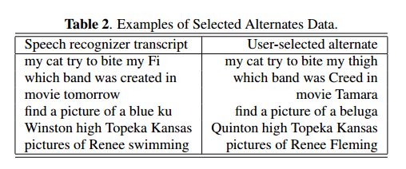
Selected alternate data
Google voice search user interface allows users to manually select from a list of alternative recognition results
User selection provides a high quality correction, so no extra classifier is needed

Slide 7
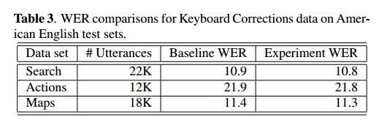
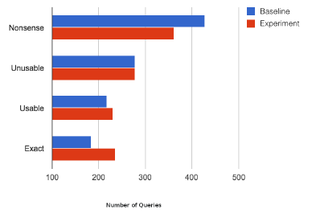
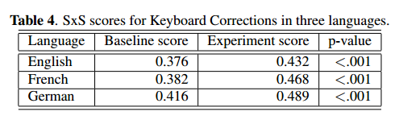
Results
Keyboard Correction Data
Alternate Selection Data

Slide 8
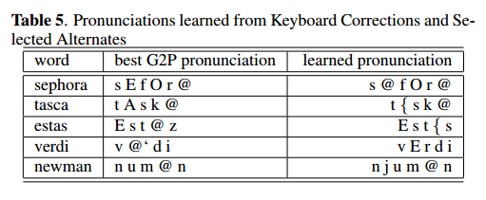
Results (cont.)

Slide 9
Thoughtful Questions

