Slide 1
Fix it where it fails: pronunciation learning by mining error corrections from speech logs
Zhenzhen Kou, Daisy Stanton, Fuchun Peng, Françoise Beaufays, Trevor Strohman
Google Inc., USA
Notes:
ICASSP (2015) – 2015 IEEE International Conference on Acoustics, Speech and Signal Processing (ICASSP)
Date of Conference: 19-24 April 2015
Page(s): 4619-4623
DOI: 10.1109/ICASSP.2015.7178846

Slide 2
Overview
Automatic speech recognition (ASR) systems include a pronunciation dictionary (or lexicon) and a grapheme to phoneme (G2P) engine
The lexicon consists of word-pronunciation pairs written by linguist
Hand-generated – cannot keep up with growing vocabulary
G2P has limited accuracy
Proper names – pronunciation can be influenced by historical or foreign-origin factors
Speech recognition task in general finds the word sequence that has the maximum posterior probability given the acoustic observations
Relies heavily on a lexicon
Uses a G2P for words not found in the lexicon
Notes:
A maximum a posteriori probability (MAP) estimate is a mode of the posterior distribution.
The posterior probability of a random event or an uncertain proposition is the conditional probability that is assigned after the relevant evidence or background is taken into account. Similarly, the posterior probability distribution is the probability distribution of an unknown quantity, treated as a random variable, conditional on the evidence obtained from an experiment or survey.
"Posterior", in this context, means after taking into account the relevant evidence related to the particular case being examined.

Slide 3
Existing/related work
Research on machine learning for G2P conversion:
Decision tree classifier to learn pronunciation rules
Joint ngram model
Maximum entroy model
Active learning
Recurrent neural network
Studies on detection speech recognition errors:
Using acoustic and prosodic features to identify corrections
Prosodic features to detect recognition errors
Examining features related to the user’s speaking style to detect speech errors
Decision-tree based method to detect voice query retires
Co-occurence method for detecting and correcting misrecognition

Slide 4
New Approach
Correction data focuses specifically on the areas of weaknesses of the system
Do not need to identify bad pronunciations ahead of time
Language-independent
Corrections are provided by the users who spoke them, who know how they want to pronounce the words
Using two different types of correction data:
Keyboard Correction
Selected Alternate

Slide 5
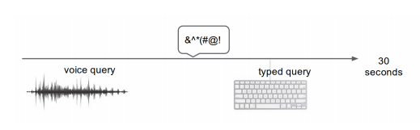
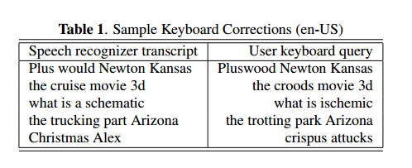
Keyboard correction data
User makes a voice query, then issues a typed query shortly after
Within 30 seconds
Analysis showed only 30-40% of these pairs are true corrections
Correction data classifier features
Word-based:
Unigram counts, number of word overlaps, and language model costs
Character-based:
Character counts, and edit distance between the recognized and typed queries
Phoneme:
Counts and edit distance between the phoneme sequences corresponding to the recognition results and typed query
Acoustic:
Forced phone alignment costs
Waveform-to-transcript length ratio

Slide 6
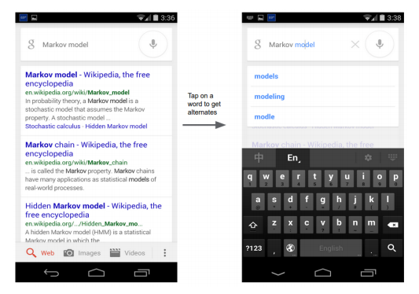
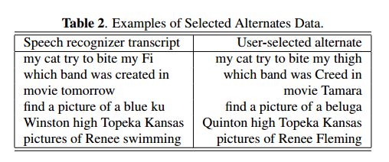
Selected alternate data
Google voice search user interface allows users to manually select from a list of alternative recognition results
User selection provides a high quality correction, so no extra classifier needed

Slide 7
Testing
Word error rate (WER) evaluation:
Anonymized speech queries randomly selected from traffic logs and human-transcribed
The most frequently used words already have a good pronunciation, but are still useful to ensure no learned “rogue” pronunciations
Side-by-side (SxS) tests:
Two ASR engines: one with the learned pronunciations and one without
Both engines are fed the exact same queries from anonymized voice search logs
Queries with differing recognition transcripts are evaluated by human raters and marked as one of four categories:
Nonsense: the transcript is nonsense
Unusable: the transcript does not correspond to the audio
Usable: the transcript contains only small errors
Exact: the transcript matches the spoken audio exactly
Notes:
WER: phone sequence for an infrequent word that matches the pronunciation of a different and more frequent word that would now be mirecognized
SxS: Acoustic model, language model, and vocabulary are the same in both engines. Only the lexicon changes.
SxS experiments have the advantage of focusing on cases where pronunciation changes do affect the recognition results. They typically show more “movement” than WER measurements on fixed test sets.

Slide 8
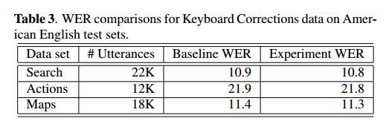
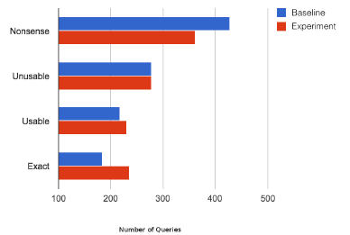
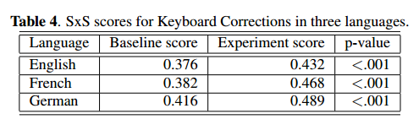
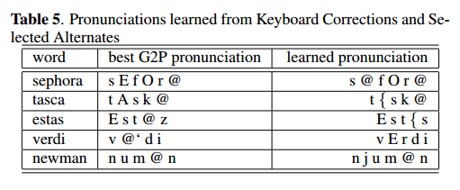
Results
Keyboard Correction
Alternate Selection
Together
Notes:
An experiment is considered positive if its SxS score is higher than that of the corresponding baseline. Generally this means it has fewer nonsense/unusable queries and more usable and exact queries.
Keyboard Correction:
We see a small reduction in word error rate on each test set.
SxS score improvements from adding new pronunciations to the baseline ASR engine
Alternate Selection:
The amount of data flowing through the Alternate Selection pipeline is smaller than that from Keyboard Corrections. As a result, the system learns fewer pronunciations, and our experiments showed no impact on standard test set word error rates. However, SxS evaluations showed significant improvements.
Side-by-side experiments demonstrate that the pronunciations learned via our methods significantly improve the quality of a production-quality speech recognition system.

Slide 9
Thoughts/Questions
Crowdsourcing – the authors originally looked at this technique
Ways to overcome shortcomings that may be used in conjunction with Keyboard Correction and Selected Alternate data
Can/is the data obtained from these tests used to also create better Selected Alternate data choices?
Homophones (same pronunciation, different spelling and/or meaning) and how they affect misrecognitions
Their, there, they’re

