Slide 1
Time Series Analysis & Forecasting for Stock Market
Prepared for: Quick Demo (Ticker=AAPL)\nDefaults: 2015-01-01 to 2024-12-31, Forecast 90 days

Slide 2
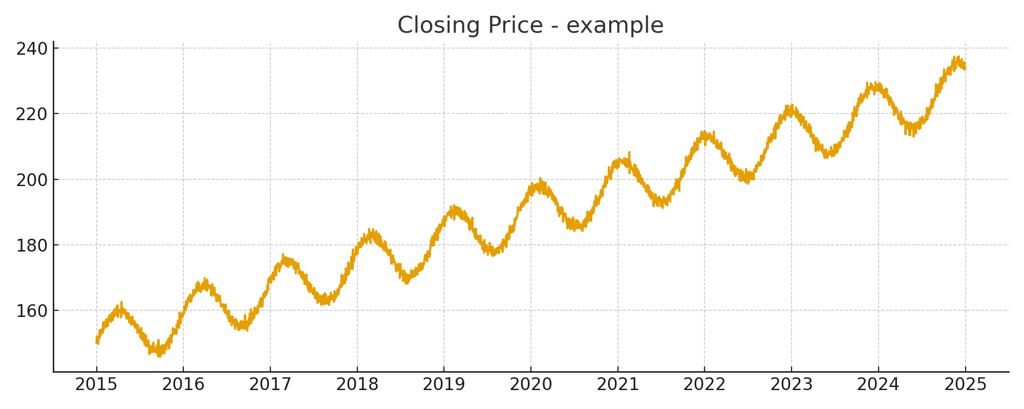
Closing Price Trend

Slide 3
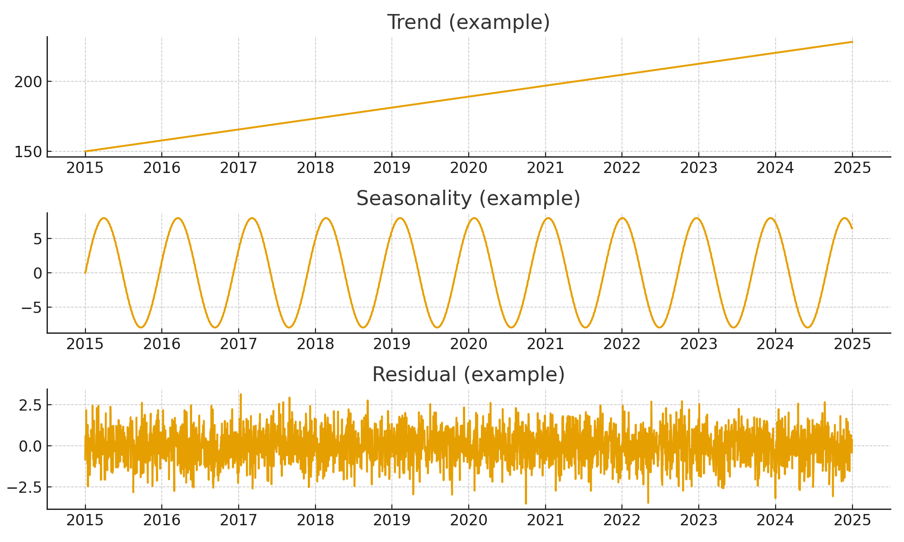
Seasonal Decomposition (Example)

Slide 4
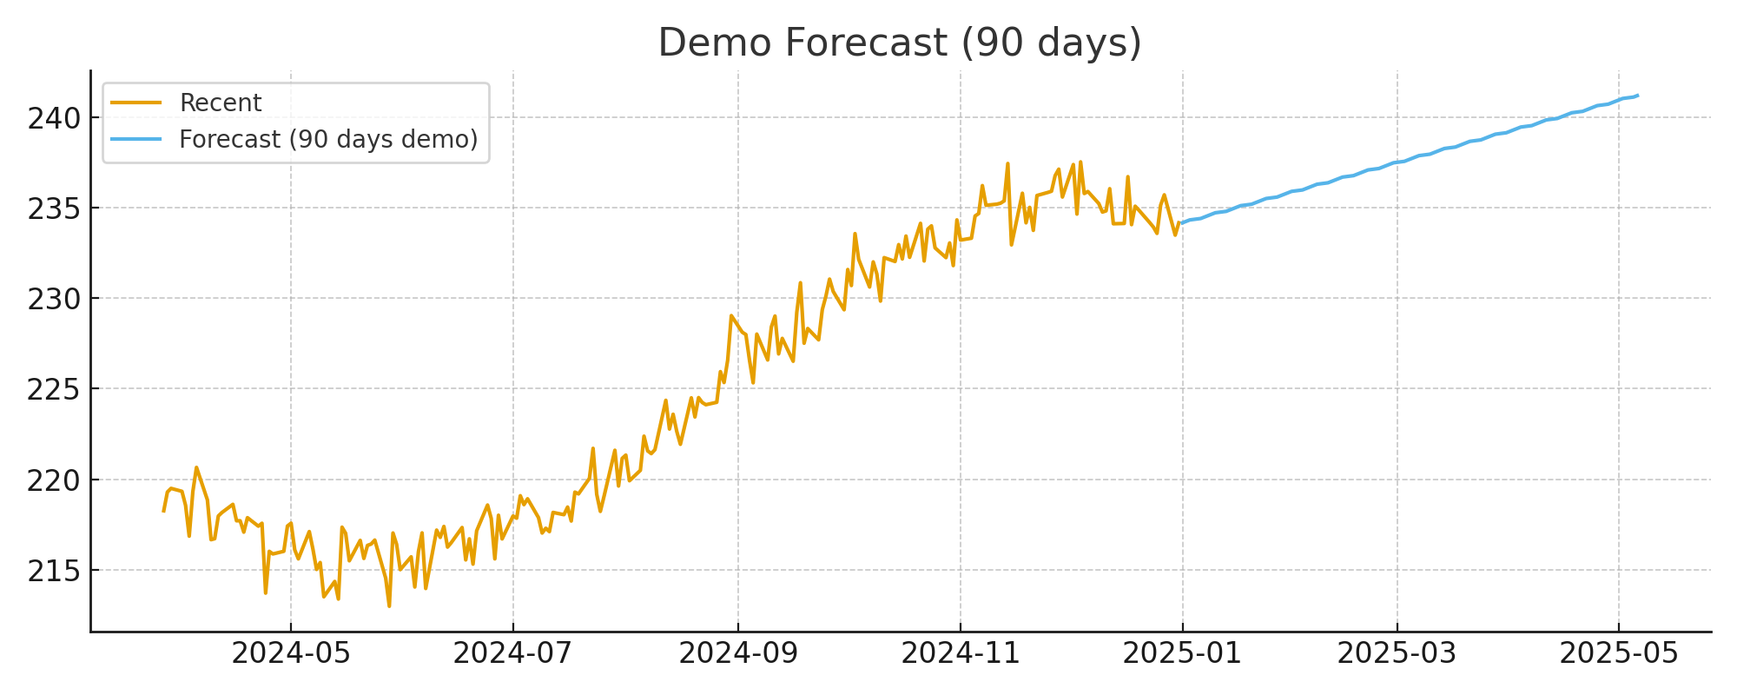
Forecast (90 days)

Slide 5
Model Comparison & Metrics
ARIMA MAE: --\nProphet MAE: --\nLSTM MAE: --\n\nRun the app to compute real metrics and replace these placeholders.

