Slide 1


CS860: Artificial Intelligence
Lecture # 4: Constraint Satisfaction Problems
Instructor: Dr. Soyiba Jawed
[These slides adapted from Dan Klein and Pieter Abbeel]

Slide 2


What is Search For?
▪
Assumptions about the world: a single agent, deterministic actions, fully observed state, discrete state space
▪
Planning: sequences of actions
▪
▪
▪
The path to the goal is the important thing Paths have various costs, depths Heuristics give problem-specific guidance
▪
Identification: assignments to variables
▪
▪
▪
The goal itself is important, not the path
All paths at the same depth (for some formulations) CSPs are specialized for identification problems

Slide 3

Constraint Satisfaction Problems

Slide 4


Constraint Satisfaction Problems
▪
Standard search problems:
▪
▪
▪
State is a “black box”: arbitrary data structure Goal test can be any function over states Successor function can also be anything
▪
Constraint satisfaction problems (CSPs):
▪
▪
A special subset of search problems
State is defined by variables X_{i} with values from a domain D (sometimes D depends on i)
Goal test is a set of constraints specifying allowable combinations of values for subsets of variables
▪
▪
Allows useful general-purpose algorithms with more power than standard search algorithms

Slide 5
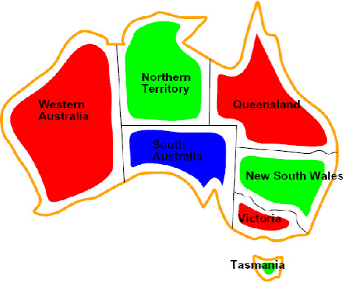
CSP Examples

Slide 6


Example: Map Coloring
▪
Variables:
▪
Domains:
Constraints: adjacent regions must have different colors
Implicit:
▪
Explicit:
▪
Solutions are assignments satisfying all constraints, e.g.:

Slide 7




Example: N-Queens
Formulation 1:
Variables:
Domains:
Constraints

Slide 8
Example: N-Queens
Formulation 2:
Variables:
Domains:
Constraints:
Implicit:
Explicit:

Slide 9
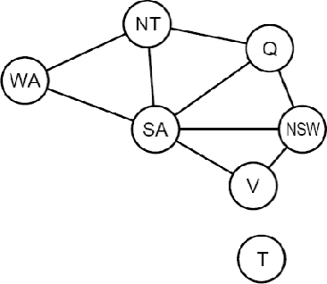
Constraint Graphs

Slide 10
Constraint Graphs
▪
Binary CSP: each constraint relates (at most) two variables
▪
Binary constraint graph: nodes are variables, arcs show constraints
▪
General-purpose CSP algorithms use the graph structure to speed up search. E.g., Tasmania is an independent subproblem!

Slide 11

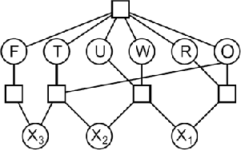
Example: Cryptarithmetic
Variables:
Domains:
Constraints:

Slide 12
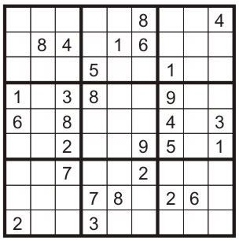
Example: Sudoku
▪
Variables:
Each (open) square Domains:
{1,2,…,9}
Constraints:
▪
▪
9-way alldiff for each column 9-way alldiff for each row
9-way alldiff for each region
(or can have a bunch of pairwise inequality constraints)

Slide 13


Varieties of CSPs
▪
Discrete Variables
Finite domains
Size d means O(d^{n}) complete assignments
E.g., Boolean CSPs, including Boolean satisfiability (NP- complete)
Infinite domains (integers, strings, etc.)
E.g., job scheduling, variables are start/end times for each job
Linear constraints solvable, nonlinear undecidable
▪
▪
Continuous variables
▪
▪
E.g., start/end times for Hubble Telescope observations Linear constraints solvable in polynomial time by LP methods

Slide 14
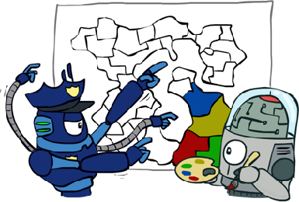
Varieties of Constraints
▪
Varieties of Constraints
Unary constraints involve a single variable (equivalent to reducing domains), e.g.:
▪
Binary constraints involve pairs of variables, e.g.:
▪
Higher-order constraints involve 3 or more variables: e.g., cryptarithmetic column constraints
▪
Preferences (soft constraints):
▪
▪
▪
▪
E.g., red is better than green
Often representable by a cost for each variable assignment Gives constrained optimization problems
(We’ll ignore these until we get to Bayes’ nets)

Slide 15
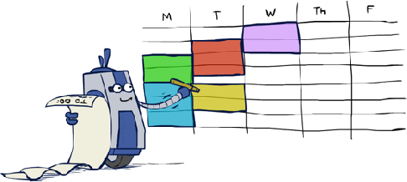
Real-World CSPs
▪
▪
▪
▪
▪
▪
▪
▪
Assignment problems: e.g., who teaches what class
Timetabling problems: e.g., which class is offered when and where? Hardware configuration
Transportation scheduling Factory scheduling
Circuit layout Fault diagnosis
… lots more!
▪
Many real-world problems involve real-valued variables…

Slide 16

Solving CSPs

Slide 17

Standard Search Formulation
Standard search formulation of CSPs
States defined by the values assigned so far (partial assignments)
Initial state: the empty assignment, {}
Successor function: assign a value to an unassigned variable
Goal test: the current assignment is complete and satisfies all constraints
We’ll start with the straightforward, naïve approach, then improve it

Slide 18
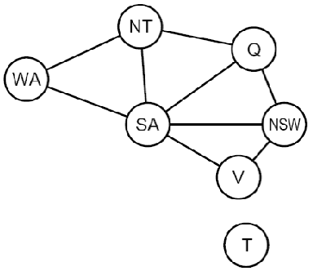
Search Methods
What would BFS do?
What would DFS do?

Slide 19
Search Methods
What would BFS do?
What would DFS do?
What problems does naïve search have?

Slide 20

Backtracking Search

Slide 21
Backtracking Search
▪
▪
Backtracking search is the basic uninformed algorithm for solving CSPs
Idea 1: One variable at a time
▪
▪
▪
Variable assignments are commutative, so fix ordering
I.e., [WA = red then NT = green] same as [NT = green then WA = red] Only need to consider assignments to a single variable at each step
▪
Idea 2: Check constraints as you go
▪
▪
▪
I.e. consider only values which do not conflict previous assignments Might have to do some computation to check the constraints “Incremental goal test”
▪
Depth-first search with these two improvements is called backtracking search (not the best name)
▪
Can solve n-queens for n ≈ 25

Slide 22
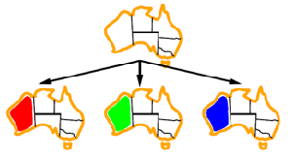
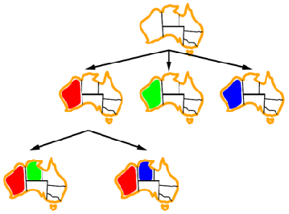
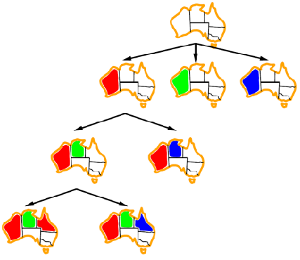


Backtracking Example

Slide 23
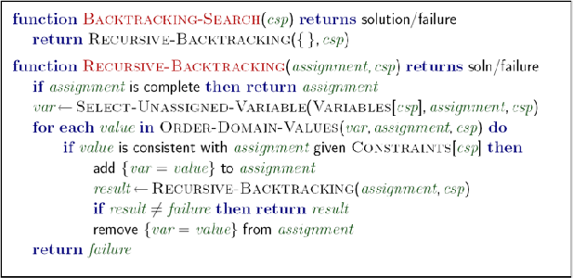
Backtracking Search
▪
Backtracking = DFS + variable-ordering + fail-on-violation

Slide 24

Improving Backtracking
General-purpose ideas give huge gains in speed
Ordering:
Which variable should be assigned next?
In what order should its values be tried?
Filtering: Can we detect inevitable failure early?
Structure: Can we exploit the problem structure?

Slide 25

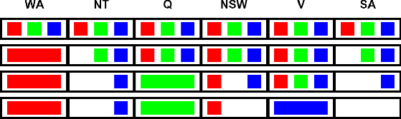
Filtering: Forward Checking
▪
▪
Filtering: Keep track of domains for unassigned variables and cross off bad options
Forward checking: Cross off values that violate a constraint when added to the existing assignment
NT SA
Q
NSW
V
WA

Slide 26

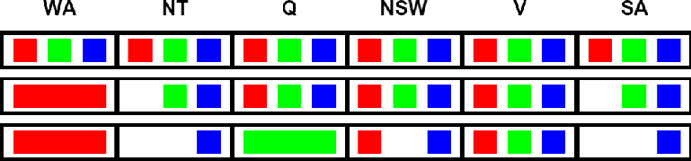
Filtering: Constraint Propagation
▪
Forward checking propagates information from assigned to unassigned variables, but doesn't provide early detection for all failures:
NT
SA
Q
WA
NSW
V
▪
▪
▪
NT and SA cannot both be blue! Why didn’t we detect this yet?
Constraint propagation: reason from constraint to constraint

Slide 27


Consistency of A Single Arc
▪
An arc X → Y is consistent iff for every x in the tail there is some y in the head which could be assigned without violating a constraint
NT
SA
Q
WA
NSW
V
Delete from the tail!
▪
Forward checking: Enforcing consistency of arcs pointing to each new assignment

Slide 28

Arc Consistency of an Entire CSP
▪
A simple form of propagation makes sure all arcs are consistent:
NT
SA
Q
WA
NSW
V
▪
▪
▪
▪
Important: If X loses a value, neighbors of X need to be rechecked! Arc consistency detects failure earlier than forward checking
Can be run as a preprocessor or after each assignment What’s the downside of enforcing arc consistency?
Remember: Delete from the tail!

Slide 29
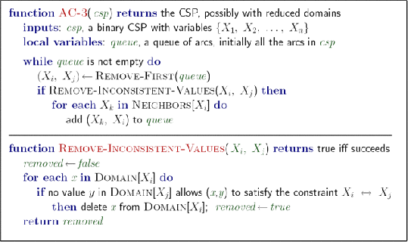
Enforcing Arc Consistency in a CSP
▪
▪
Runtime: O(n²d³), can be reduced to O(n²d²)
… but detecting all possible future problems is NP-hard – why?

Slide 30
Limitations of Arc Consistency
After enforcing arc consistency:
Can have one solution left
Can have multiple solutions left
Can have no solutions left (and not know it)
OK. Multiple solutions
Arc consistency still runs inside a backtracking search!
What went wrong here?

Slide 31

Ordering

Slide 32


Ordering: Minimum Remaining Values
Variable Ordering: Minimum remaining values (MRV):
Choose the variable with the fewest legal left values in its domain
Why min rather than max?
Also called “most constrained variable”
“Fail-fast” ordering

Slide 33
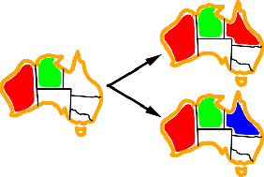

Ordering: Least Constraining Value
Value Ordering: Least Constraining Value
Given a choice of variable, choose the least constraining value
I.e., the one that rules out the fewest values in the remaining variables
Note that it may take some computation to determine this! (E.g., rerunning filtering)
Why least rather than most?
Combining these ordering ideas makes 1000 queens feasible

