Slide 1
Supernova and the Expanding Universe

Slide 2
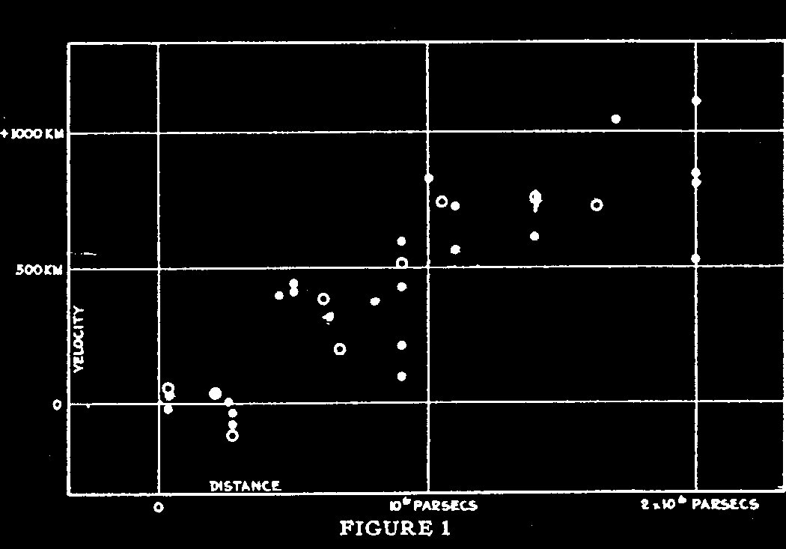
What is the future of our universe? ‽
Cosmologic Constant
Because why not?
1915: Einstein field equations
Lemaitre applied Einstein's theory of GR to cosmology
An expanding Universe is possible
1929: Hubble messured the velocity of galaxies
¿

Slide 3
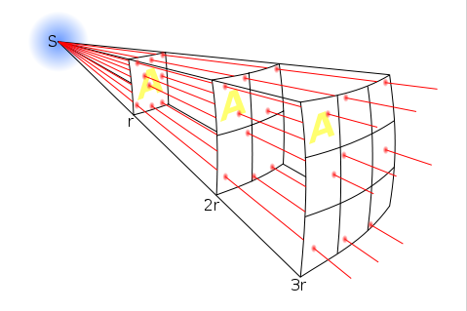
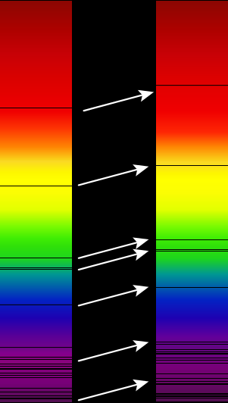
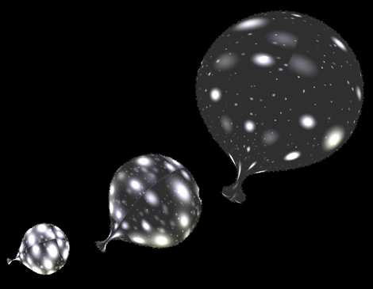
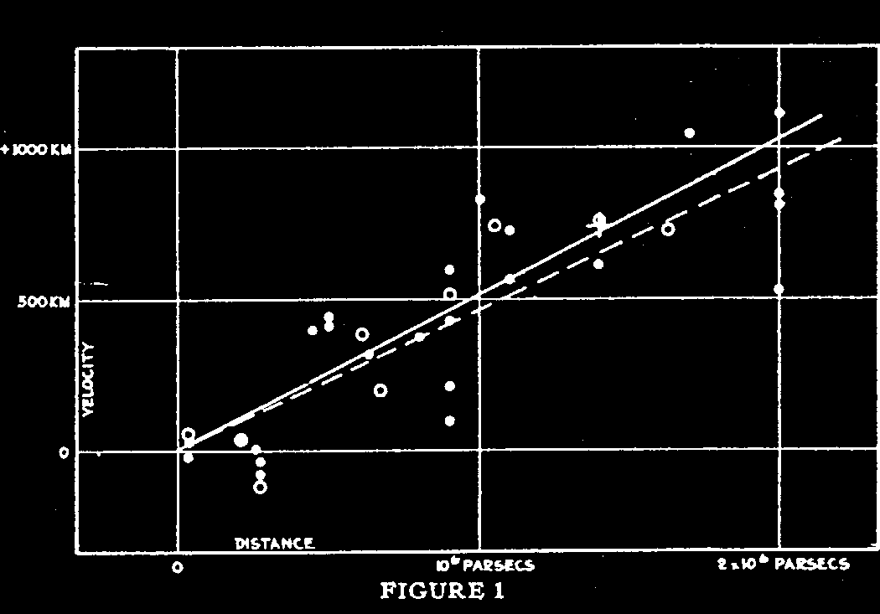
How did Hubble measured the velocity?
Used known brightness of Cepheids (Standard candle)
Noticed that the spectrum is almost always redshifted

Slide 4
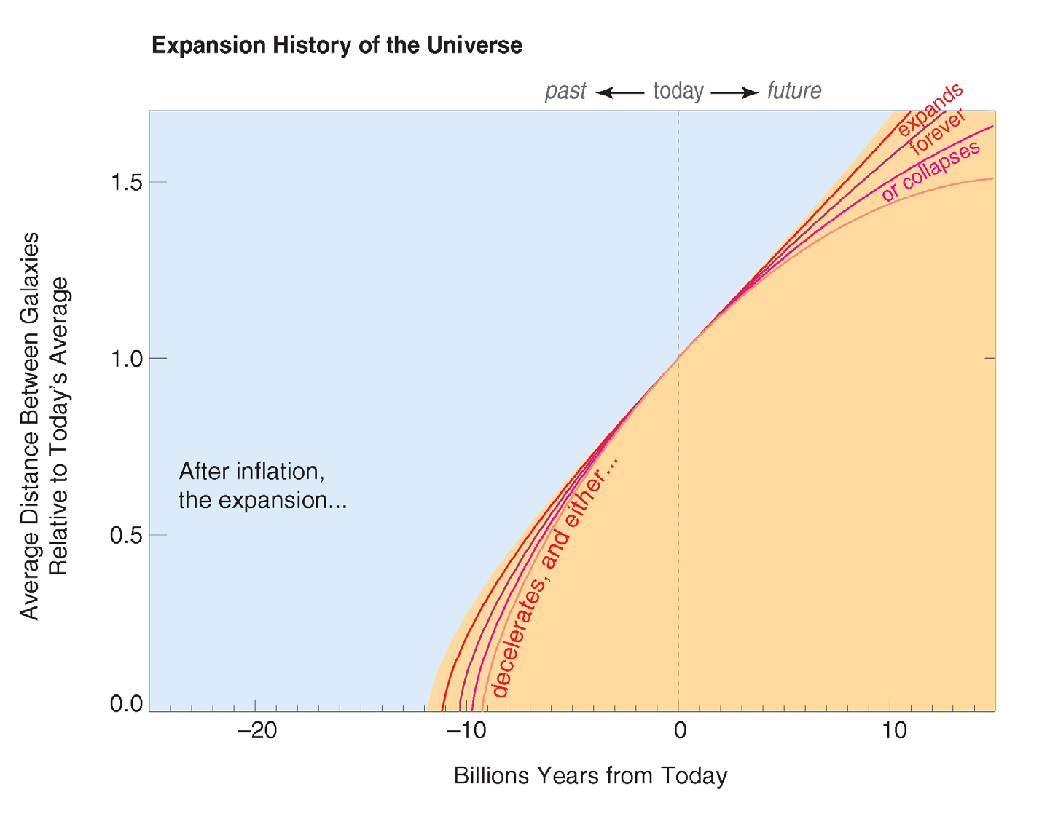
Where is it going where is it coming from?

Slide 5
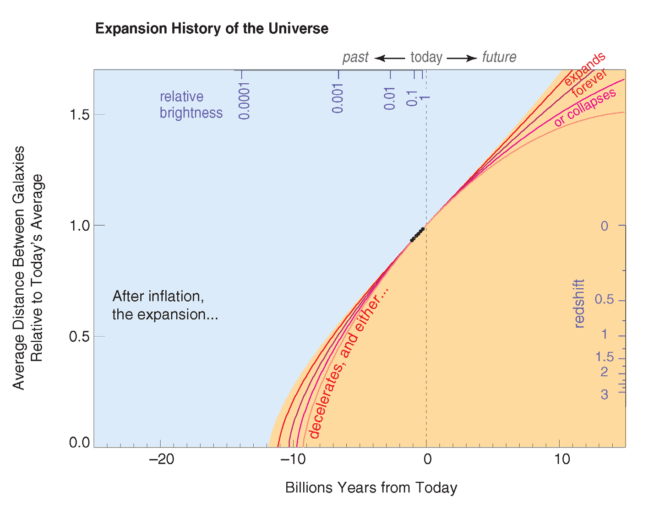
Where is it going where is it coming from?
To understand the fate of the universe
we have to understand its past

Slide 6
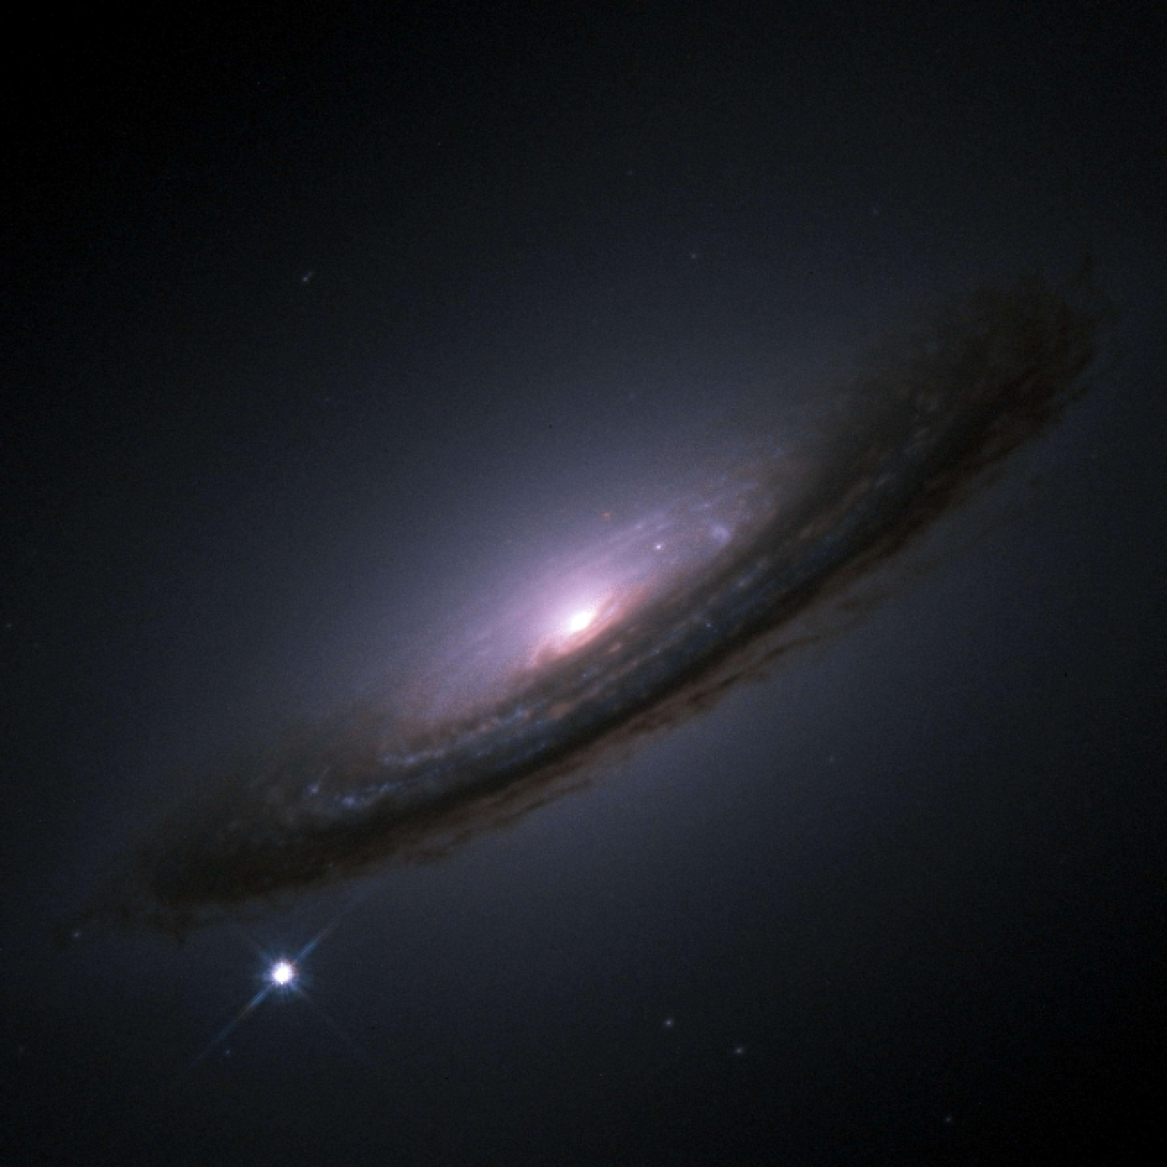
Looking for a new standard
Cepheiden are not bright (10000 Sun) enough to be observed at high distances (redshifts) few million light years
A new brighter standard candle is needed!
Final explosion of a star, its brightness increases billions of times
So they are brighter, but are they standard?
Supernova!?
Not necessarily: There are different types!

Slide 7
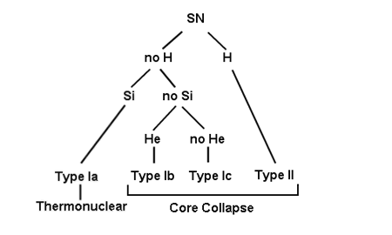
Types of Supernovae

Slide 8
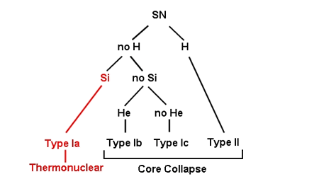
Types of Supernovae

Slide 9
Why not Core Collaps Supernova?
(Why can't we use Core Collaps SN as a standard candle)

Slide 10
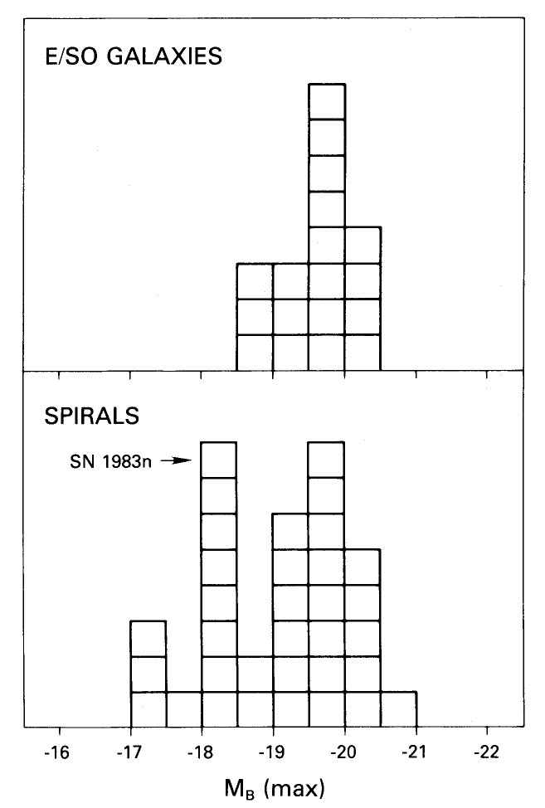
Supernova Type Ia
Neither H nor He Lines
→ either burned up or it disappeared somehow
Mostly in elliptical galaxies (older and low Starformationrate)
Most popular theory:
white dwarf in a binary star system

Slide 11
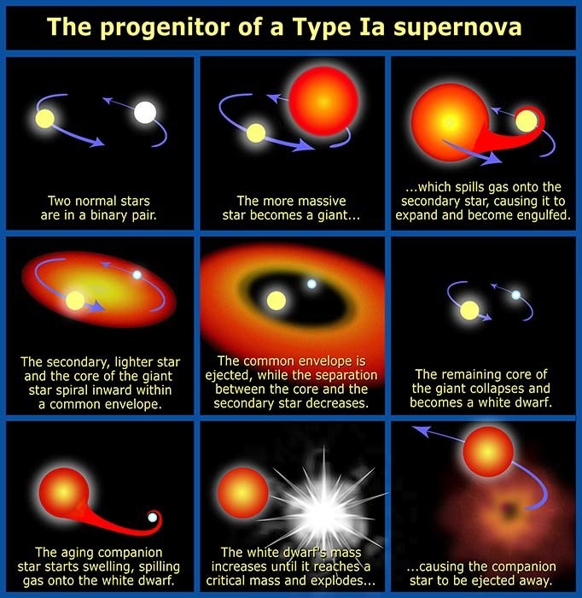
Sequence

Slide 12
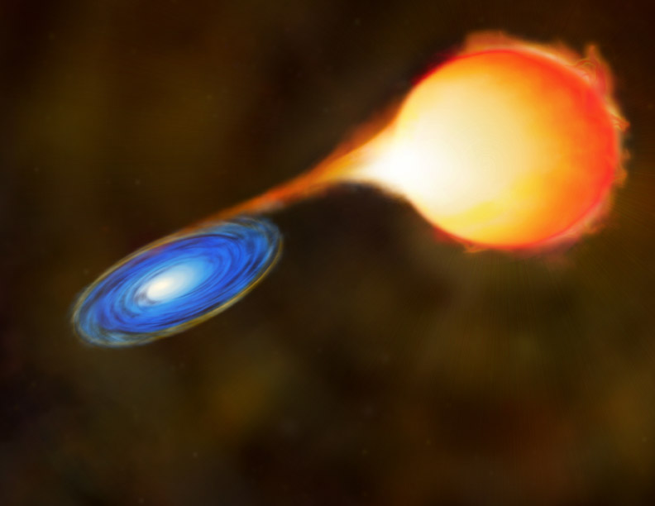
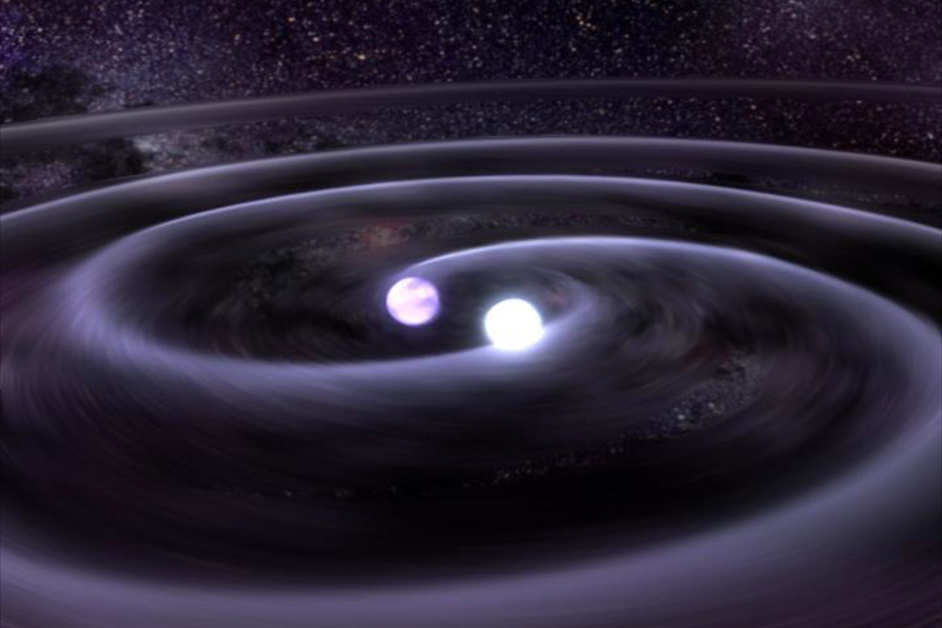
Sequence
Accretion of gas from the parnterstar or collusion of two white dwarfs
White Dwarf gains mass and reaches Chandrasekhar Limit (~1.45 M☉)
A White Dwarf above the mass is instable
→ Thermonuclear fusion starts

Slide 14
Thermonucleare Fusion
Temperature is high enough to fusion C
→ Temperature rises, but due to the degenerate state no cooling through expansion
→ A shock wave travels through the star to the surface
Two different scenarios are possible:
  Detonation: Released heat of reaction increases pressure in the ash (not degenerated)
  → The shock wave is pushed through the star
  Deflation: ash has a lower density → star expands
  BUT: Expansion is turbulent
  → Bigger Surface and more material is burned
  Shock wave is 100 times faster than laminare Wave

Slide 15
Reine Detonation: Mehr Elemente der Eisengruppe
kaum Silizium, ist charakteristisch für SN
Reine Deflation: zu wenig Ni
Most likely scenario is: verzögerte detonation
Erst deflation dann detonation

Slide 16
What is created in this explosion?
The shock wave travels through the star within seconds
→ the white dwarf expands, so in the outer layers only Ca, Ar, S and Si in the middle layers S, Si and Mg is created.
About 0.4 to 0.9 M☉ of ⁵⁶Ni is created in the inner core
The energy released by fusion is converted in kinetic energy → no compact remnant
⁵⁶Ni (t_{h}= 6.6d) decays via ⁵⁶Co (t_{h}= 77d) to ⁵⁶Fe (stable)
Radiation becomes visible due to the compton effect, ionisation and absorption

Slide 17
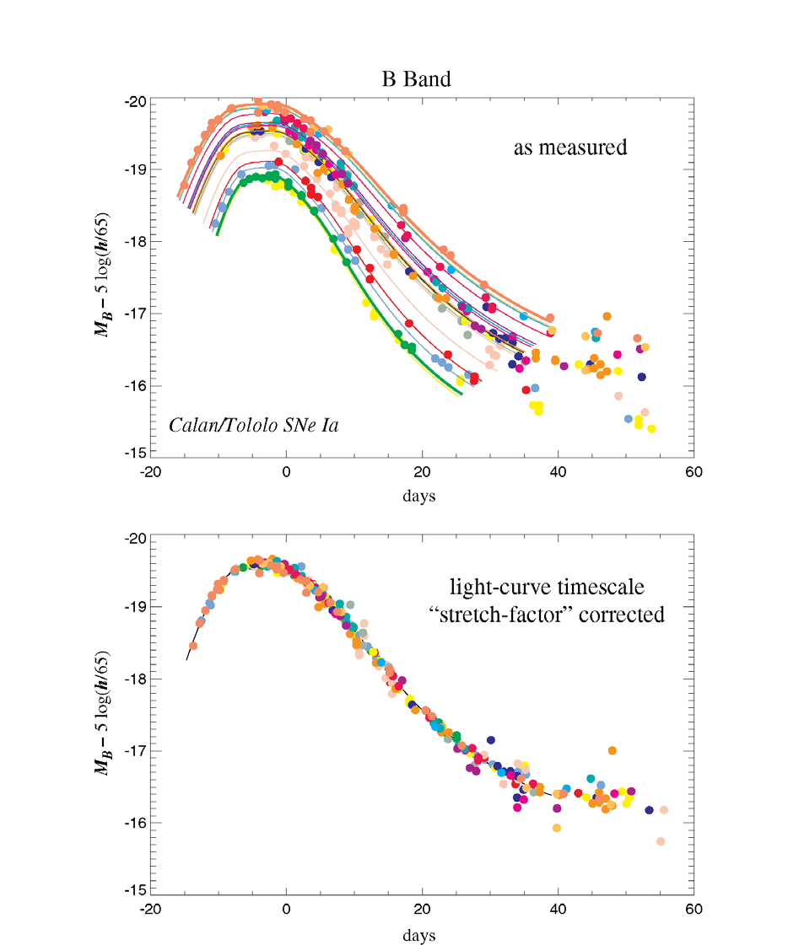
Funktion für die Streckung
!Aus sichtbarer Helligkeit einer Typ Ia SN kann die Entfernung berechnet werden

