Slide 1

Analyzing Data using Big Data System Techniques
By:
Ali Hussain Alaswad
Abdullah Khadem Aljame
Supervisor:
Dr.Eng.Mouhib Alnoukari
Eng.Anas Abdulaziz
2023/2024

Slide 2
Outlines
01
05
ABOUT THE PROJECT
System workflow Chart
02
06
Project Goals
Performed Works
03
07
Reference Study
About Data!
04
08
System Technologies
Unfinished Works

Slide 3
ABOUT THE PROJECT
Overview
Aim
What is Big Data?
Big data refers to the large, diverse sets of information that grow at ever-increasing rates. It encompasses the volume of information, the velocity at which it is created and collected, and the variety of the data points being covered
In this project, we are supposed to build a working environment for a big data system and perform data analysis using big data technology

Slide 4
Project Goals
1.
Build A Real Big Data system In SPU
2.
Analyzing Data using Big Data Techniques
3.
Make the environment ready to receive future big data projects

Slide 5

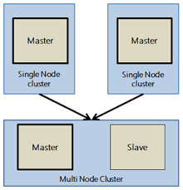
Reference Study
1.
Hadoop The Definitive Guide : Tom White
We worked using the reference to build the system and work on the best possible performance
2.
Hadoop Multinode Cluster Setup
We chose to work with Multinode Cluster In order to achieve the best performance with the available servers
https://www.projectpro.io/hadoop-tutorial/hadoop-multinode-cluster-setup

Slide 6







System Technologies
Apache Hadoop
Map Reduce
Apache Hive
Python
Apache Pig
Java

Slide 7
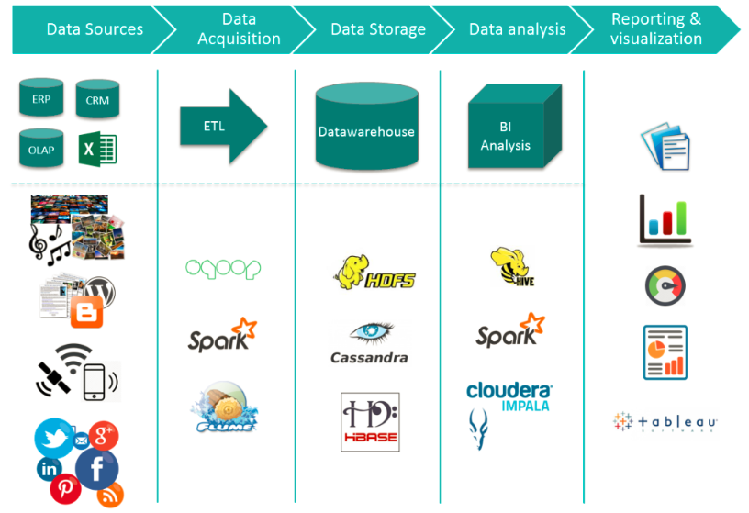
System workflow Chart

Slide 8
Performed works
1.
Get an overview of the available servers
2.
Start working on the servers and install the appropriate operating system
3.
Make a plan to build the system in more than one step within 4 weeks
4.
Find data to test on the system with metadata

Slide 9
About Data!
Forex tick data huge database since april 2020
Below, you’ll find the major currency pairs with tick-by-tick historical rates. This data is top-of-book, tick-by-tick market data, with fractional pip spreads in millisecond detail. All timestamps are based on GMT.
Source: https://www.kaggle.com/datasets/joseserrat/forex-april-2020-to-june-2021-tick-data?rvi=1

Slide 10
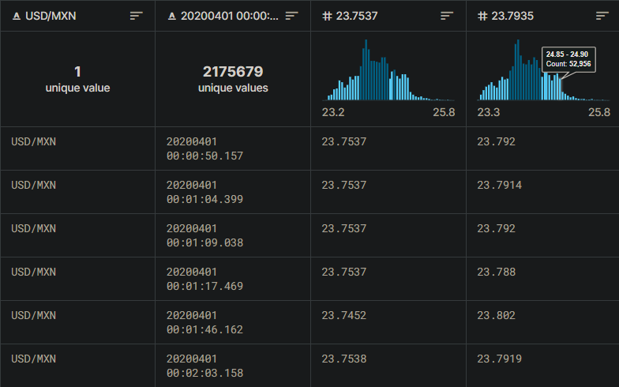
Part Of The Data Used
Currencies traded between two countries
Date and time of currency trading
Purchasing price
selling price

Slide 11
Unfinished Works
1.
Make a plan to analyze more than one step within 4 weeks
2.
Analyzing Data using Big Data Techniques
3.
Make the environment ready to receive future big data projects

Slide 12
THANK YOU
Do you have any questions?

