Slide 1

Analyzing Stock Market Data Using Big Data System Techniques
By:
Ali Hussain Alaswad
Abdullah Khadem Aljame
Supervisor:
Dr.Eng.Mouhib Alnoukari
Eng.Anas Abdulaziz
2023/2024

Slide 2
Outlines
01
05
ABOUT THE PROJECT
Hadoop Architecture & EcoSystem
02
06
Project Goals
Performed Works
03
07
Reference Study
About Data!
04
08
System Technologies
Unfinished Works

Slide 3
ABOUT THE PROJECT
Overview
Aim
What is Big Data?
Big data refers to the large, diverse sets of information that grow at ever-increasing rates. It encompasses the volume of information, the velocity at which it is created and collected, and the variety of the data points being covered
In this project, we are supposed to build a working environment for a big data system and perform data analysis using big data technology

Slide 4
Project Goals
1.
Build A Real Big Data system In SPU
2.
Analyzing Data using Big Data Techniques
3.
Make the environment ready to receive future big data projects
4.
Work on implementing financial analysis for financial companies

Slide 5
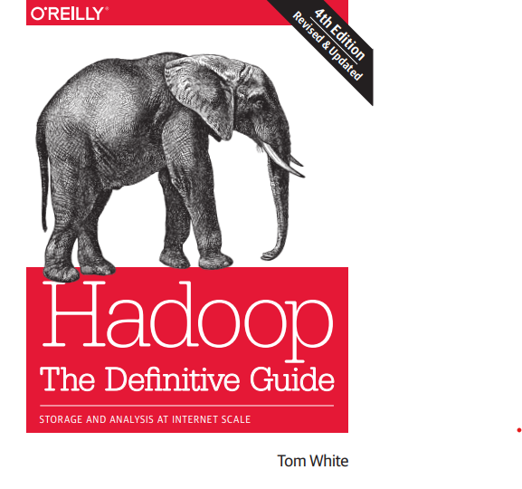


Reference Study
1.
Hadoop The Definitive Guide : Tom White
We worked using the reference to build the system and work on the best possible performance
2.
New Horizons for a Data-Driven Economy
A Roadmap for Usage and Exploitation of Big Data in Europe
3.
Dynamic Interaction Between Nifty 50 and Nifty Sectoral Indices: An Empirical Study on Indian Stock Indices
https://management-review.nmims.edu/

Slide 6






System Technologies
Apache Hadoop
Map Reduce
Apache Hive
Apache Mahout
Apache Pig
Python

Slide 7
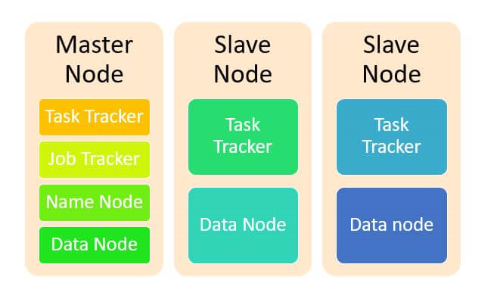
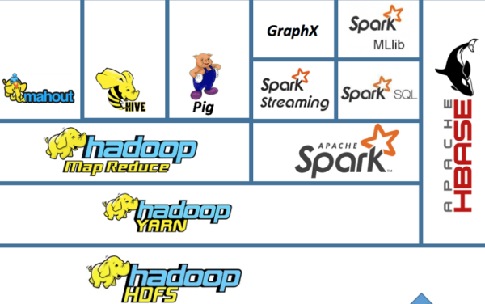
Hadoop Architecture & EcoSystem

Slide 8
Performed works
1.
Get an Overview of the available servers
2.
Start working on the servers and install the appropriate operating system With some system problems solved
3.
Work on installing the Hadoop environment and configuration files
4.
Find and extract data and start working on it
5.
Start Working on Descriptive and Predictive Analytics in Python

Slide 9
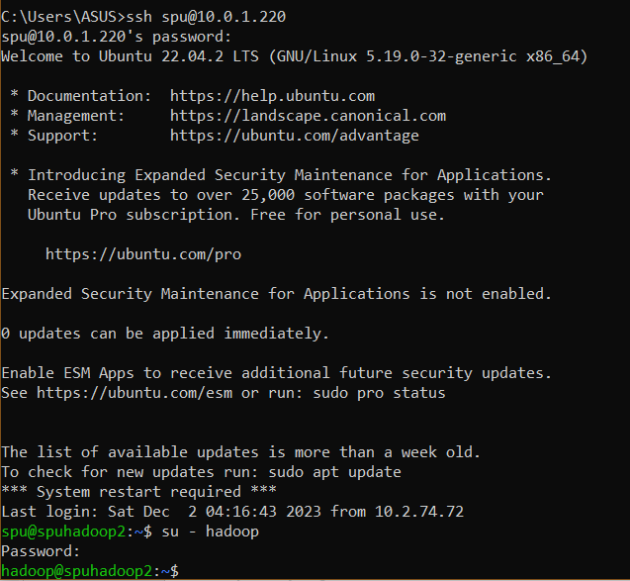
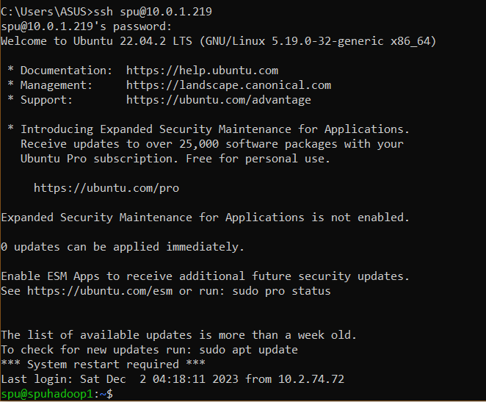
Performed works
2.
Start working on the servers and install the appropriate operating system With some system problems solved in ssh

Slide 10
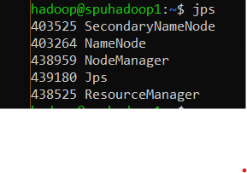

Performed works
3.
Work on installing the Hadoop environment and configuration files

Slide 11
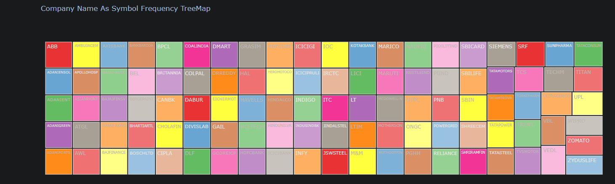
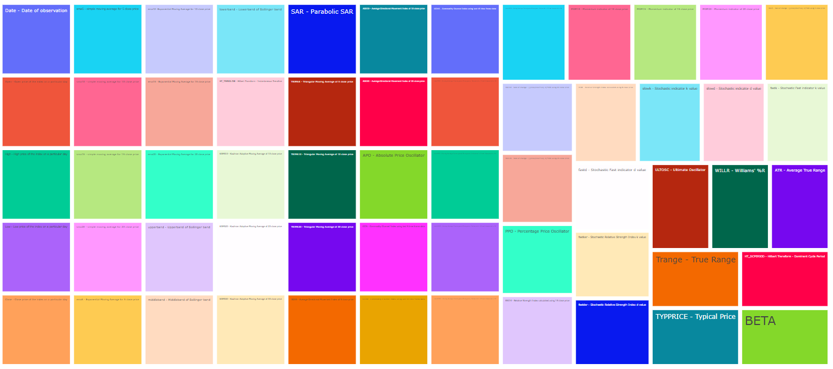
Performed works
4.
Find and extract data and start working on it
Stock Name in Nifty 100:
Technical indicator values:

Slide 12
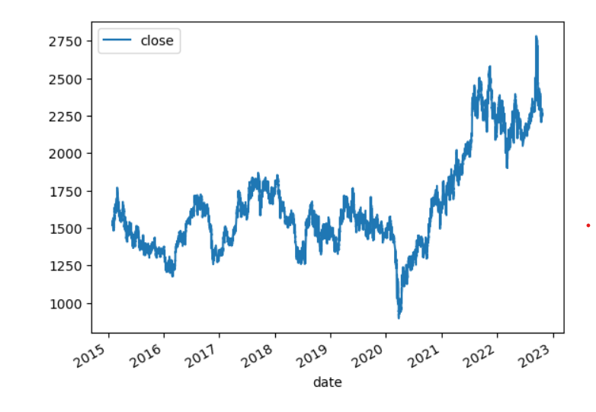
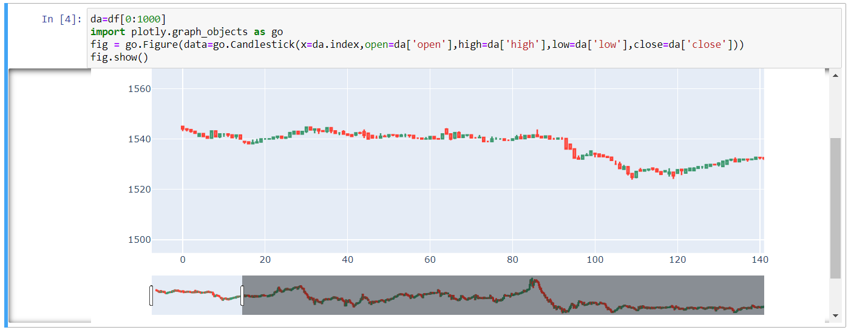
Performed works
5.
Start Working on Descriptive and Predictive Analytics in Python
Simple visualize:

Slide 13
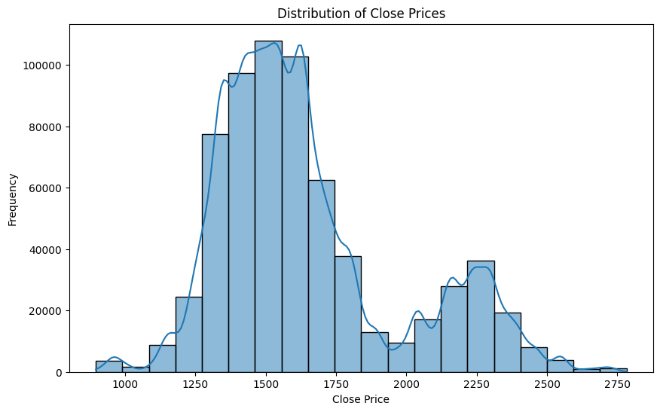
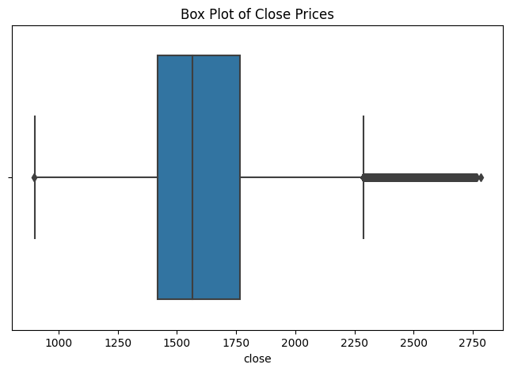
Performed works
Basic Descriptive Statistics

Slide 14
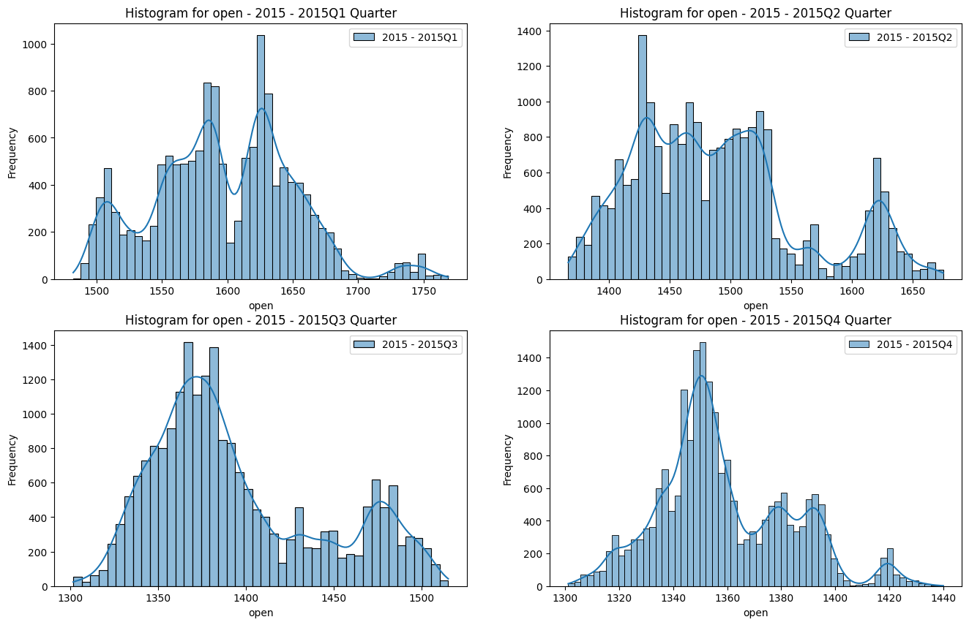
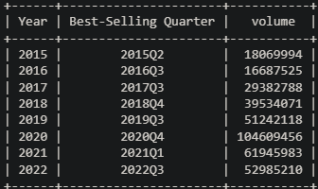
Performed works
Distribution for each quarter in 2015:
The best selling for each Quarter from 2015 to 2022:

Slide 15
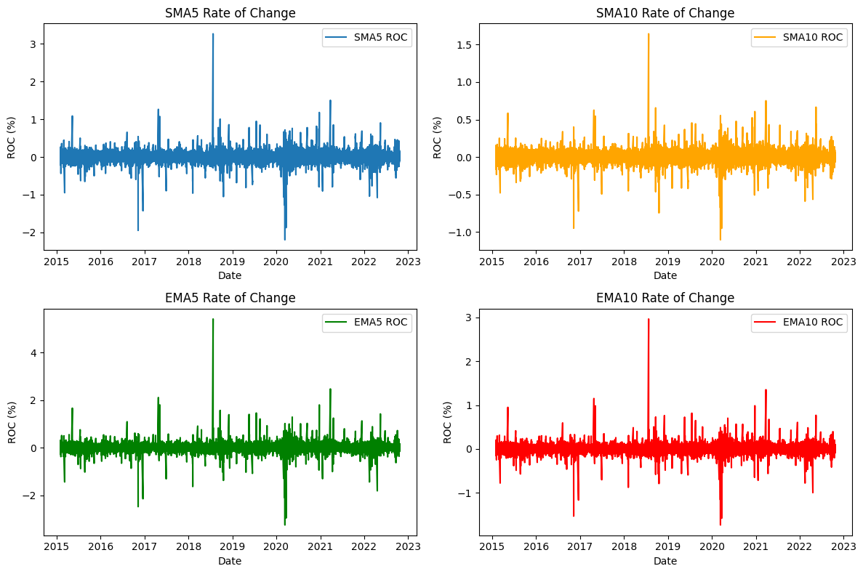
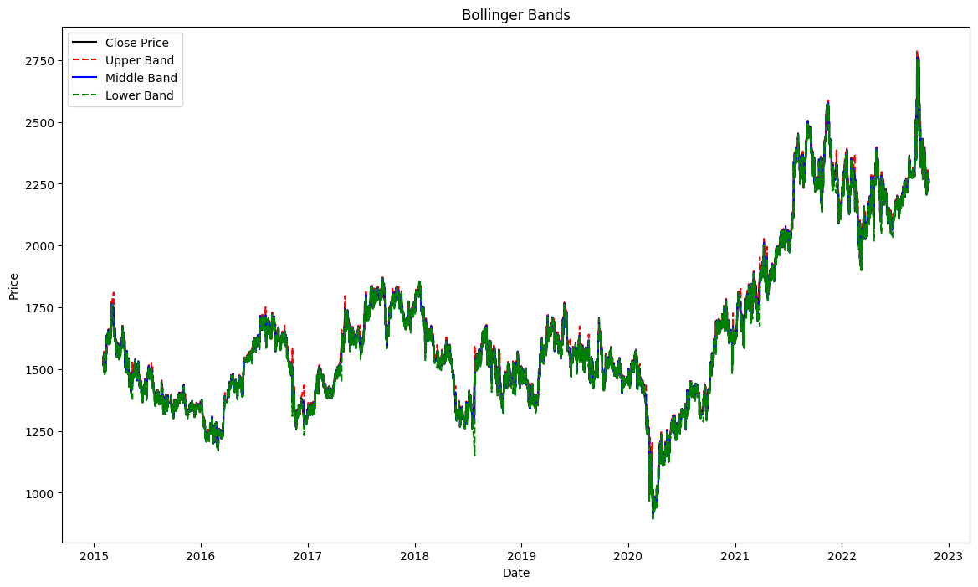
Performed works
Trend Indicators:
Bollinger Bands:

Slide 16
About Data!
Nifty 100: top 100 companies listed on the National Stock Exchange (NSE) of India.
Data samples are of 1-minute intervals and the availability of data is from Jan 2015 to Feb 2022.
Source: https://www.kaggle.com/datasets/debashis74017/stock-market-data-nifty-50-stocks-1-min-data

Slide 17
Data description
Stock Name in Nifty 100:
Technical indicator values:

Slide 18
Unfinished Works
1.
Complete Working on Descriptive and Predictive Analytics in Python
2.
Analyzing Data using Big Data Techniques
3.
Make the environment ready to receive future big data projects
4.
Modifying Hadoop's architecture to make it work for two data nodes

Slide 19
THANK YOU
Do you have any questions?

